Slide 1

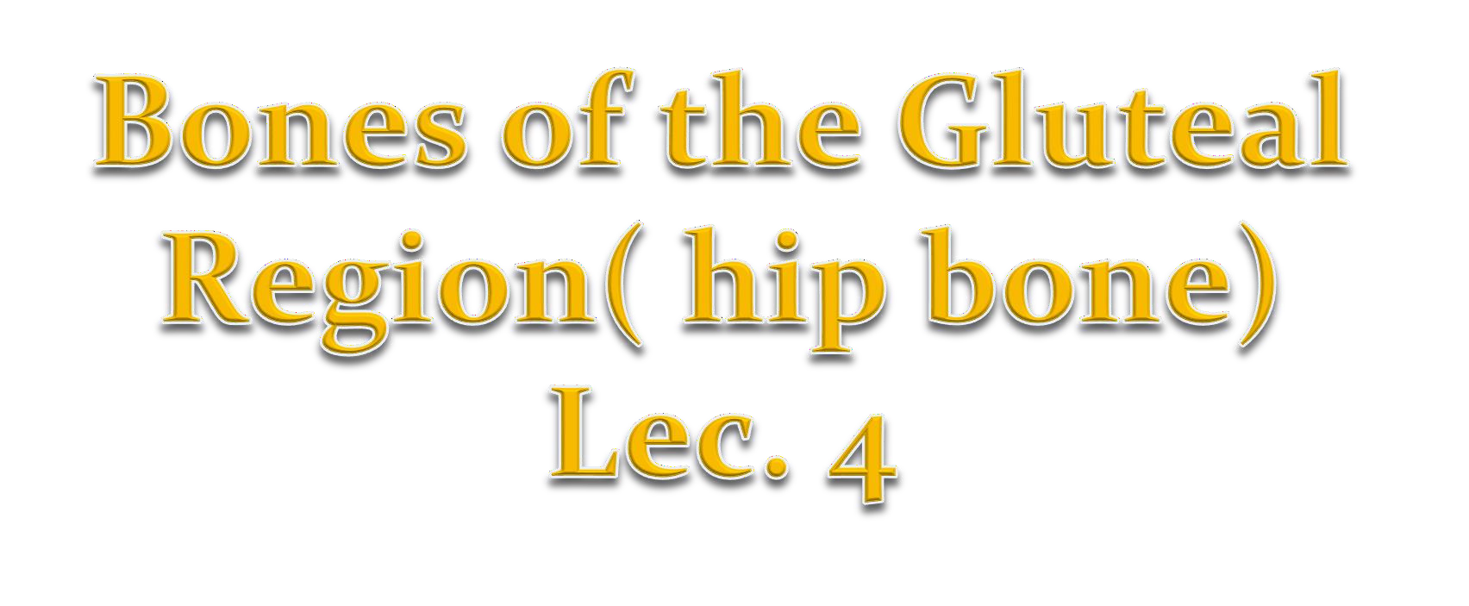
Presented by :Dr. Fadhil Sahib .

Slide 2
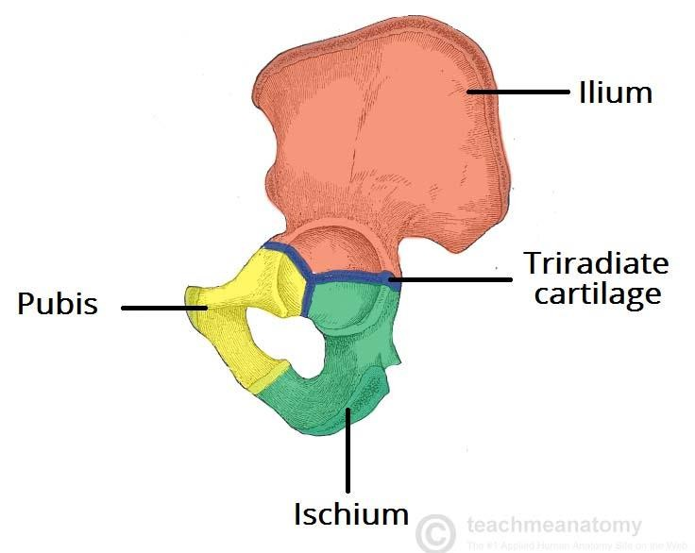
Bones of the Gluteal Region( hip bone):
The ilium, ischium, and pubis form the hip bone . They meet each other at the acetabulum. The
hip bones articulate with the sacrum at the sacroiliac joints and form the anterolateral walls of the pelvis; they also articulate with one another anteriorly at the symphysis pubis.
On the outer surface of the hip bone is a deep depression, called the acetabulum, which articulates with the almost spherical head of the femur to form the hip joint.

Slide 3
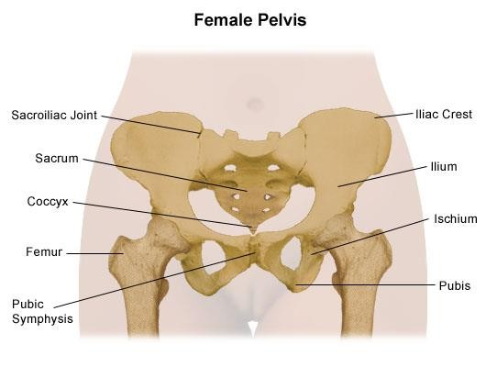
Bones of the pelvis:

Slide 4
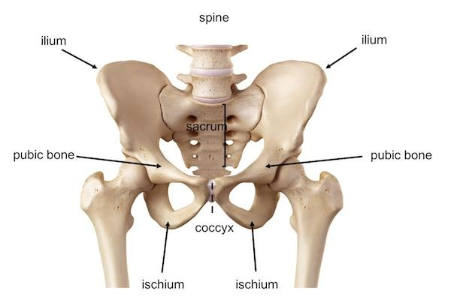

Slide 5
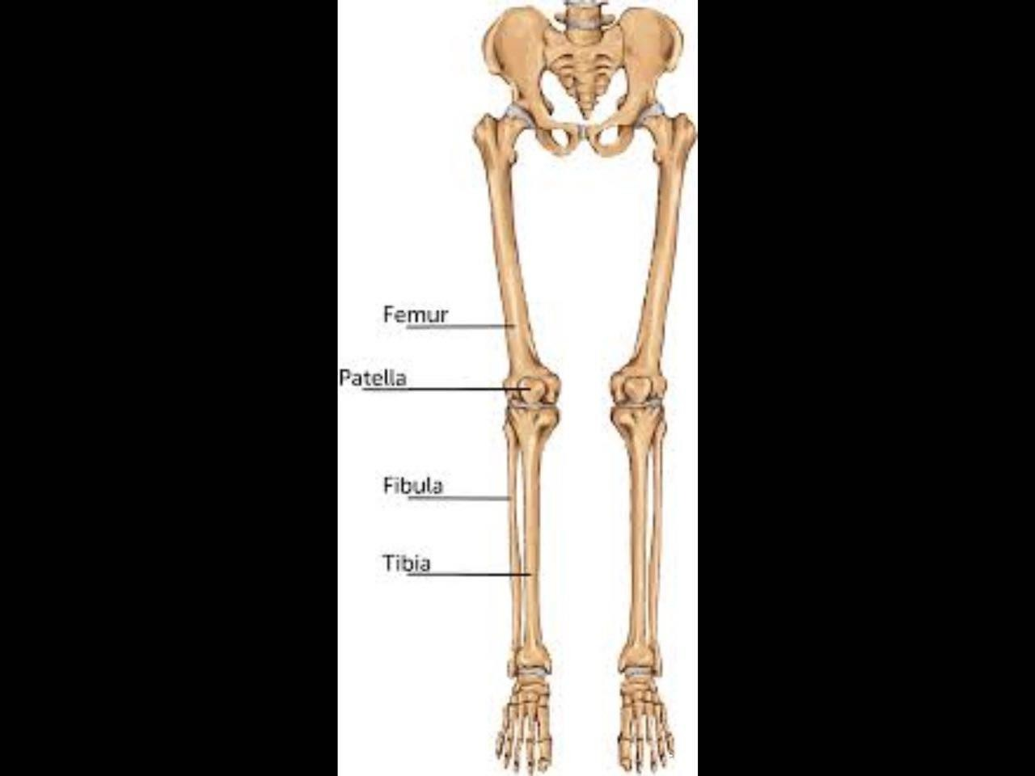
The pelvis and the lower limb:

Slide 6
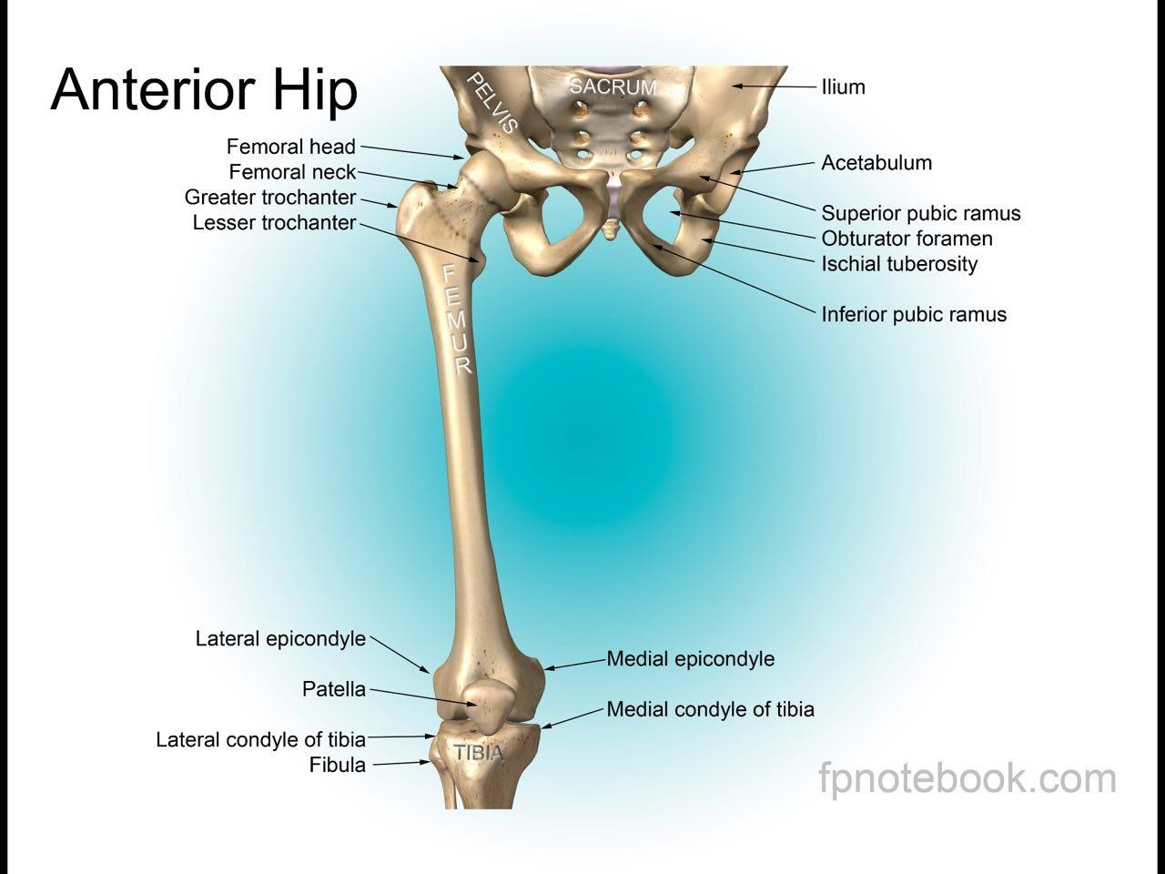

Slide 7
Femur:
The femur is the longest and the strongest bone of the body.
The femur articulates with the acetabulum to form the hip joint and below with the tibia and the patella to form the knee joint.
The upper end of the femur has : 1- head,
neck
greater and lesser trochanters.

Slide 8
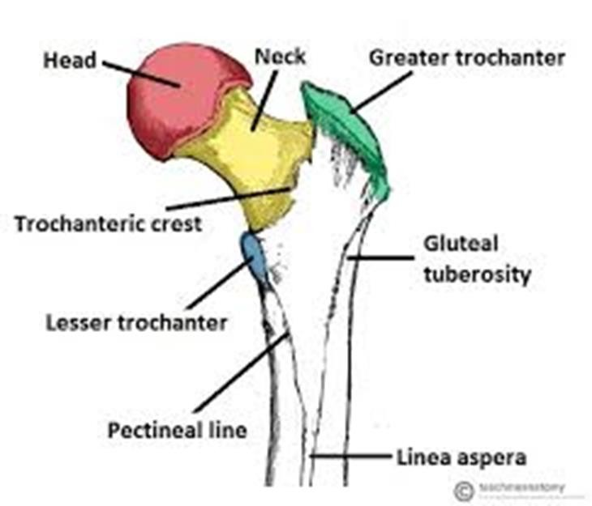
Femur:

Slide 9
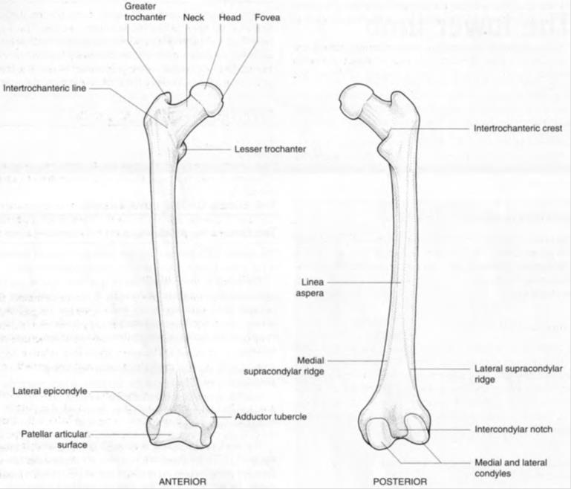

Slide 10
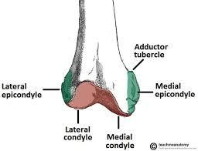
Lower femur:

Slide 11
The neck of the femur :
Makes an angle of about 125° degree .
It’s about 5 cm long.
The size of this angle can be altered by disease.
The greater and lesser trochanters are large eminences situated at the junction of the neck and the shaft Connecting the two trochanters are the intertrochanteric line anteriorly intertrochanteric crest posteriorly.
The lower end of the femur has :lateral and medial Condyles.
Above the condyles are the medial and lateral epicondyles.

Slide 12
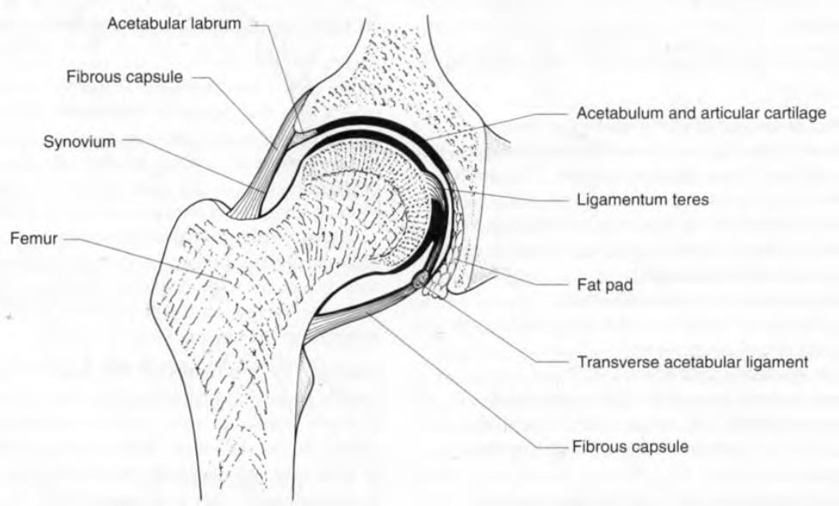
Hip Joint:

Slide 13
Articulation
The hip joint is the articulation between the hemispherical head of the femur and the cup-shaped of the acetabulum.
Type:
The hip joint is a synovial ball-and-socket joint.

Slide 14
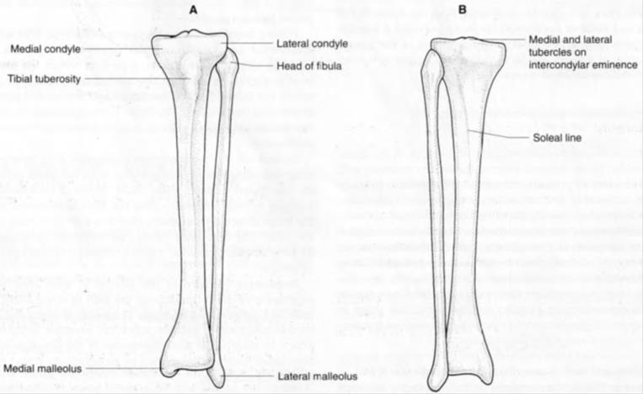
Bones of the Leg:

Slide 15
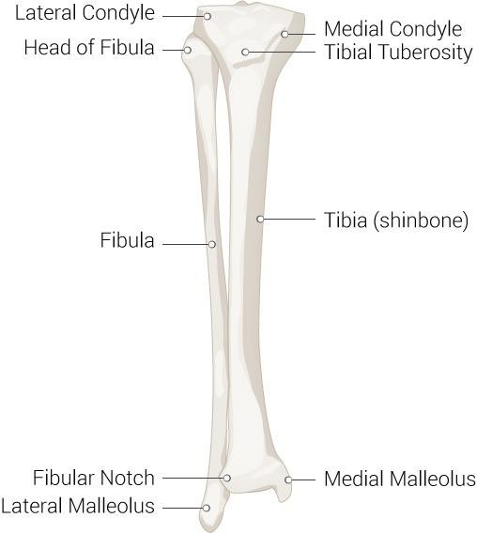
Tibia and Fibula:

Slide 16
The leg :
Is the part of the lower limb between the knee joint and the ankle joint.
Patella:
The patella is the largest sesamoid bone.
It is separated from the skin by subcutaneous bursa .
Tibia:
The tibia is the large weight-bearing medial bone of the leg .
The lower end is prolonged downward medially to form the medial malleolus
It articulates with1-: the condyles of the femur
2- head of the fibula above
3- talus and the distal end of the fibula below.

Slide 17
Fibula
The fibula is the slender lateral bone of the leg.
The lower end of the fibula forms the triangular lateral Malleolus.
It takes no part in the articulation at the knee joint, but below it forms the lateral malleolus of the ankle joint.

Slide 18
THE END

