Slide 1

AXIAL SKELETON
Lec. 6
Presented by : Prof. Dr. Fadhil Sahib .

Slide 2
AXIAL SKELETONE:
Sternum:
The sternum bone lies in the midline of the anterior chest wall.
It is a flat bone that can be divided into three parts:
manubrium sterni,
body of the sternum,
and xiphoid process.
The manubrium is the upper part of the sternum.

Slide 3
The body of the sternum articulates above with the manubrium at the manubriosternal joint and below with the xiphoid process at the xiphisternal joint.
The xiphoid process is a thin plate of cartilage that becomes ossified at its proximal end during adult
life.

Slide 4
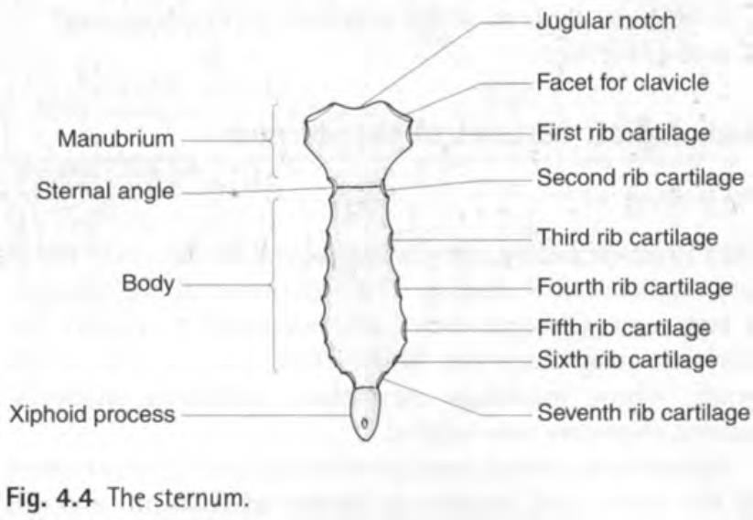
Sternum:

Slide 5
Ribs:
There are 12 pairs of ribs, all of which are attached posteriorly to the thoracic vertebrae .
The ribs are divided into three categories:
True ribs
False ribs
Floating ribs
True ribs: The upper seven pairs
False ribs: The 8th, 9th, and 10th pairs of ribs are attached Floating ribs: The 11th and 12th pairs

Slide 6
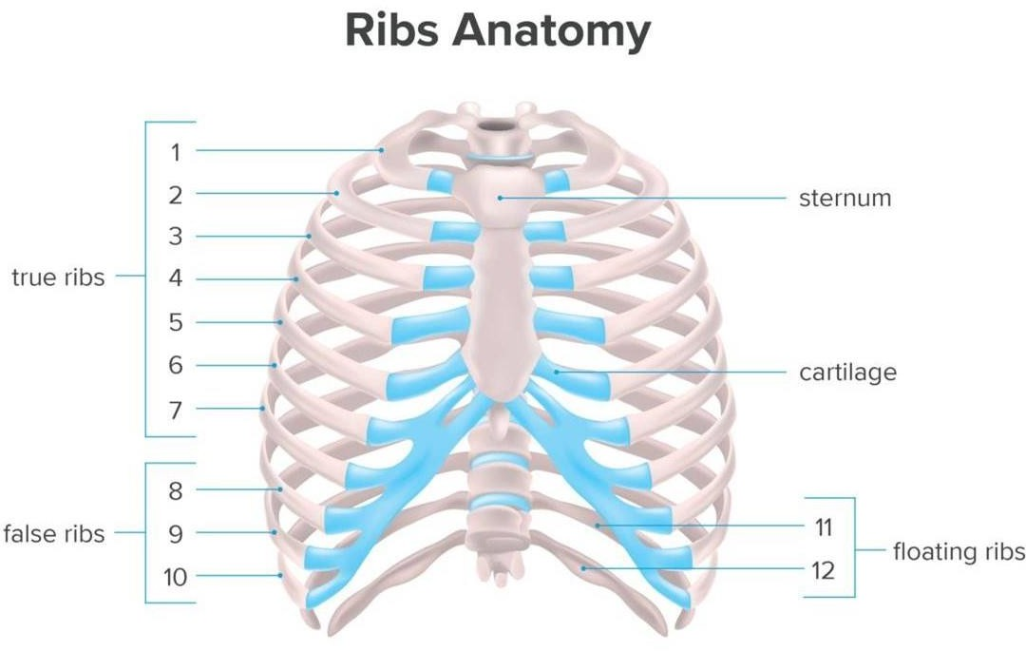

Slide 7
Typical rib:
A rib has a head, neck, tubercle, shaft, and angle.
Atypical rib: including:-
First rib
Second rib
Tenth rib
Eleventh rib

Slide 8
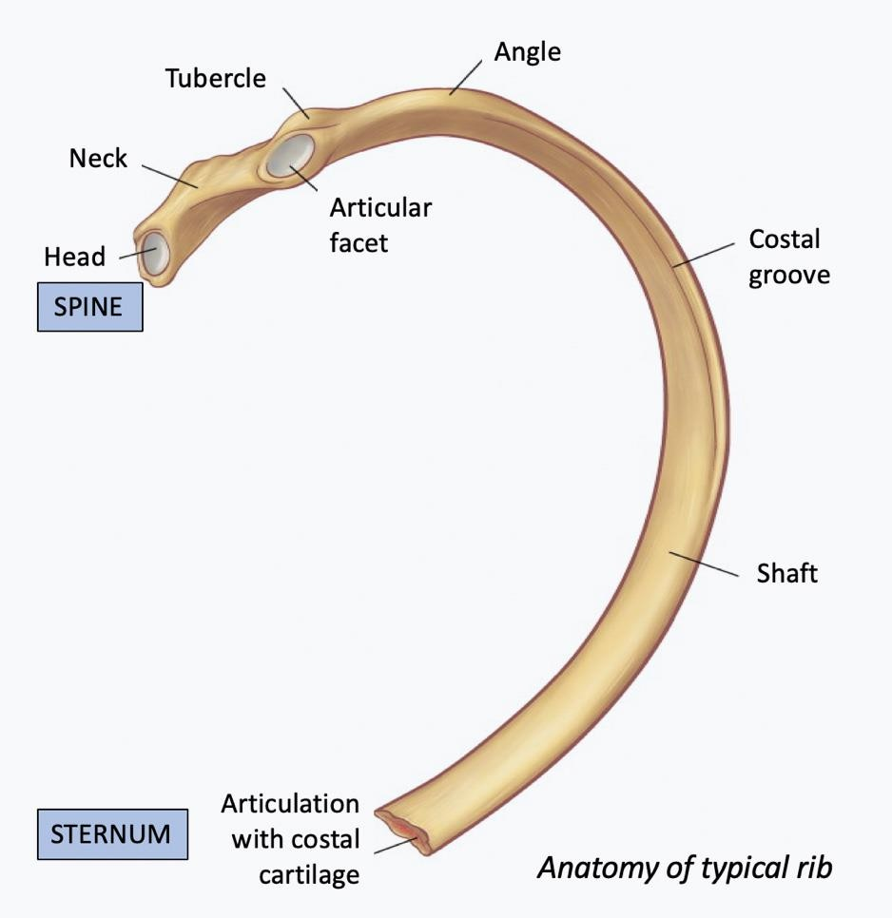

Slide 9
Costal Cartilages:
Costal cartilages: are bars of cartilage connecting the upper seven ribs to the lateral edge of the sternum and the 8th,9th, and 10th ribs to the cartilage immediately above.
The cartilages of the 11th and 12th ribs end in the abdominal musculature .

Slide 10
Joints of the Chest Wall:
Joints of the Sternum:
the manubrium + the body of the sternum =manibriosternal joint=cartilaginous joint
xiphoid process+ body sternum= xiphisternal joint=cartilaginous joint
Joints of the Ribs +Costal Cartilages= cartilaginous joints.

Slide 11
THE END

