Slide 1

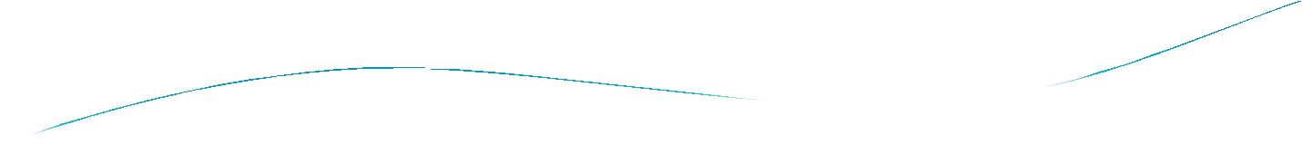



Lec 7

Slide 2
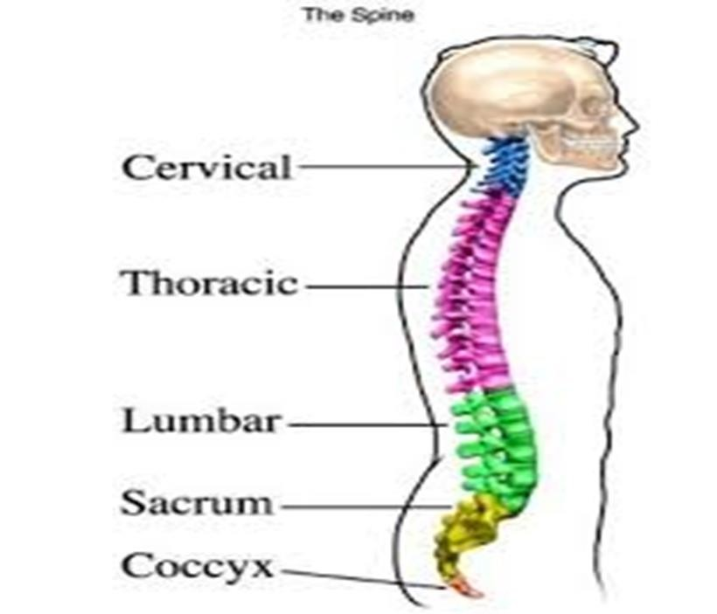
The Vertebral Column

Slide 3
The Vertebral Column:
The vertebral column is the central bony pillar of the body.
Function: It supports the skull, shoulder girdle, upper limbs, and thoracic cage and, by way of the pelvic girdle, transmits body weight to the lower limbs.
Within its cavity lie the spinal cord, the roots of the spinal nerves, and the covering meninges, to which the vertebral column gives great protection.

Slide 4
Composition of the Vertebral Column
The vertebral column is composed of 33 vertebrae—7 cervical, 12 thoracic, 5 lumbar, 5 sacral (fused to form the sacrum), and 4 coccygeal (the lower 3 are commonly fused).
** Because it is segmented and made up of vertebrae, joints, and pads of fibrocartilage called intervertebral discs, it is a flexible structure.
**The intervertebral discs form about one quarter the length of the column.

Slide 5
General Characteristics of a Vertebra:
Although vertebrae show regional differences, they all possess
a common pattern .
Typical vertebra consists of :
1-rounded body anteriorly. 2-vertebral arch posteriorly.
These enclose a space called the vertebral foramen, through which run the spinal cord and its coverings.

Slide 6
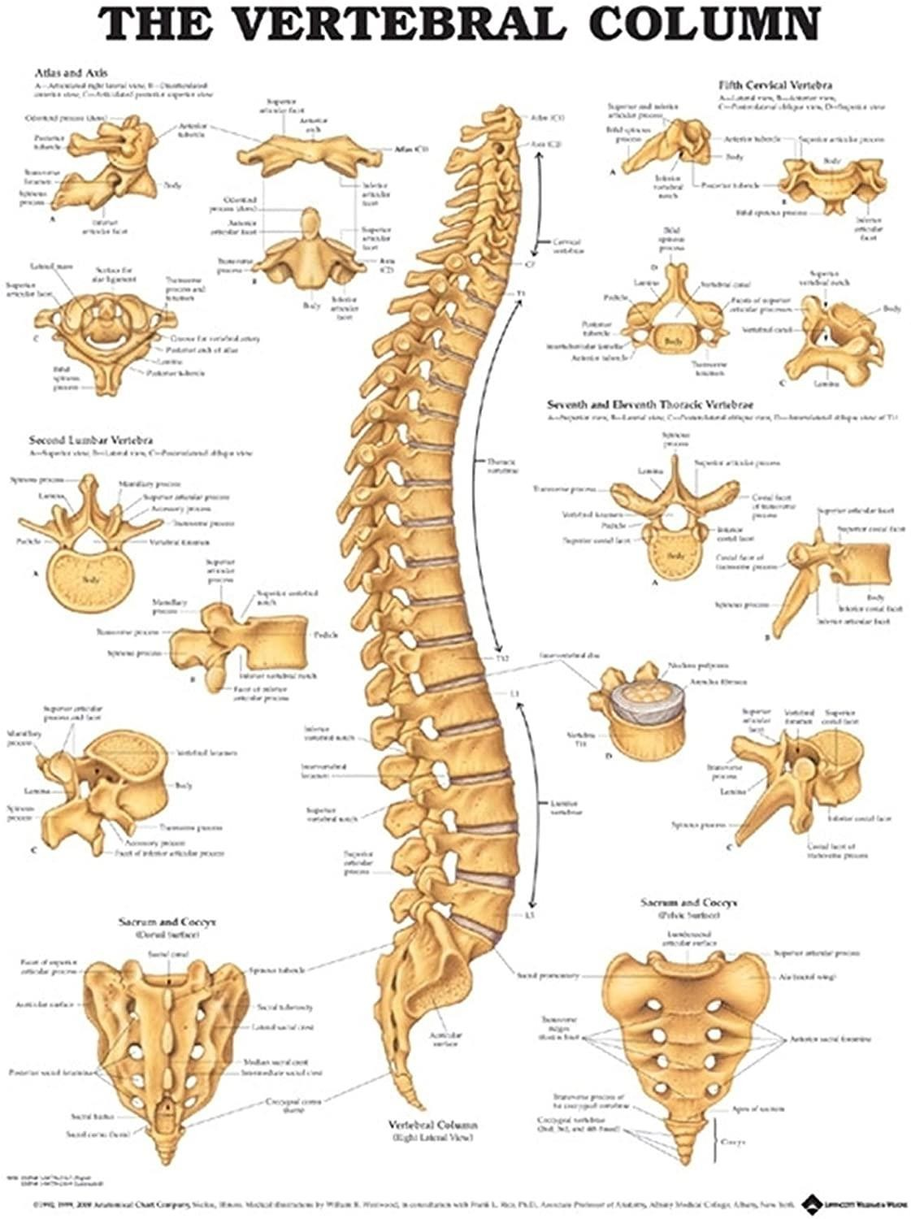

Slide 7
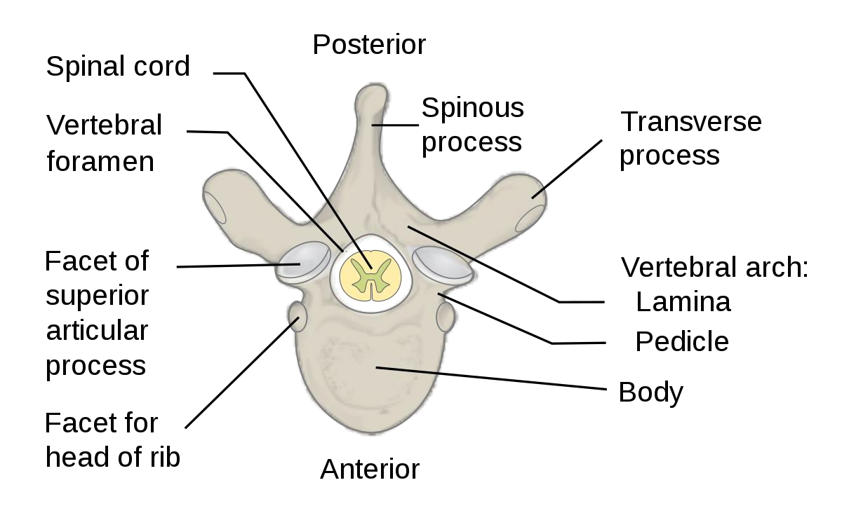

Slide 8
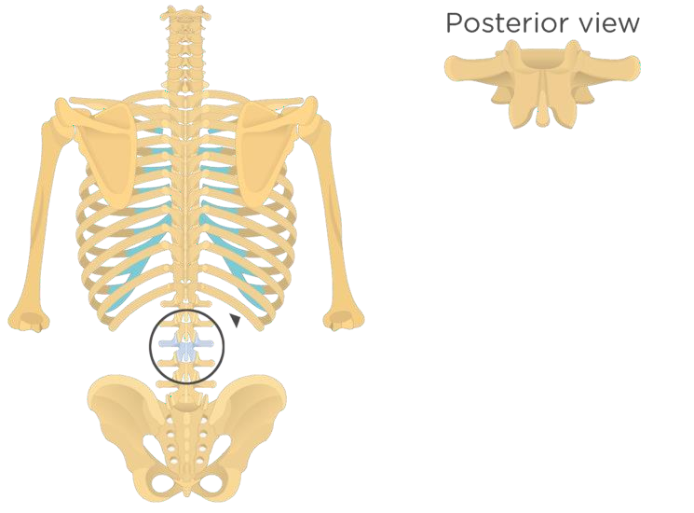

Slide 9
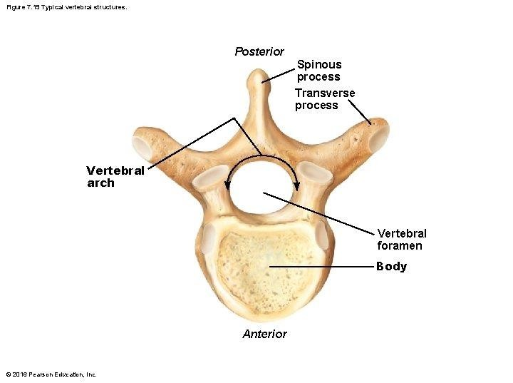
Typical vertebral structure:

Slide 10
The vertebral arch consists of :
1-a pair of cylindrical pedicles, which form the sides of the arch, and
2-a pair of flattened laminae, which complete the arch posteriorly.
The vertebral arch gives rise to seven processes:
1-onespinous, 2-two transverse, 3-and four articular .

Slide 11
The spinous process, or spine, is directed posteriorly
from the junction of the two laminae. The transverse processes are directed laterally from the junction of the laminae and the pedicles.
**Both the spinous and transverse processes serve as levers and receive attachments of muscles and ligaments.

Slide 12
**The articular processes are vertically arranged and
Consist of two superior and two inferior processes. They arise from the junction of the laminae and the pedicles, and
their articular surfaces are covered with hyaline cartilage.
**The two superior articular processes of one vertebral arch articulate with the two inferior articular processes of the arch above, forming two synovial joints.

Slide 13
The pedicles are notched on their superior and Inferior borders, forming the superior and inferior Vertebral notches. On each side, the superior notch of one vertebra and the inferior notch of an adjacent vertebra together form an intervertebral foramen.
These foramina, in an articulated skeleton, serve to transmit the spinal nerves and blood vessels. The anterior and posterior nerve roots of a spinal nerve unite within these foramina with their coverings of dura to form the segmental spinal nerves.

Slide 14
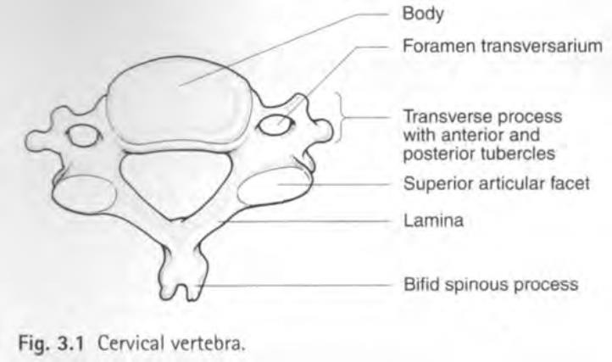
Characteristics of a Typical Cervical Vertebra:

Slide 15
Typical cervical vertebra has the following characteristics:
■■ The transverse processes possess a foramen transversarium for the passage of the vertebral artery and
veins (note that the vertebral artery passes through the transverse processes C1 to 6 and not through C7).
■■ The spines are small and bifid.
■■ The body is small and broad from side to side.
■■ The vertebral foramen is large and triangular

Slide 16
Non-typical Cervical Vertebrae:
The 1st, 2nd, and 7th cervical vertebrae are atypical.
The 1st cervical vertebra, or atlas
The 2nd cervical vertebra, or axis has apeg like odontoid process (dens) that projects from the superior surface of the body .
The 7th cervical vertebra, or vertebra prominens is so named because it has the longest spinous
process, and the process is not bifid.

Slide 17
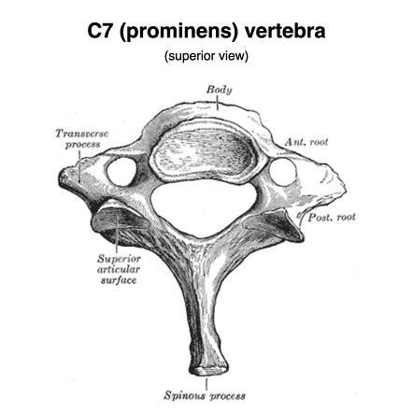

Slide 18
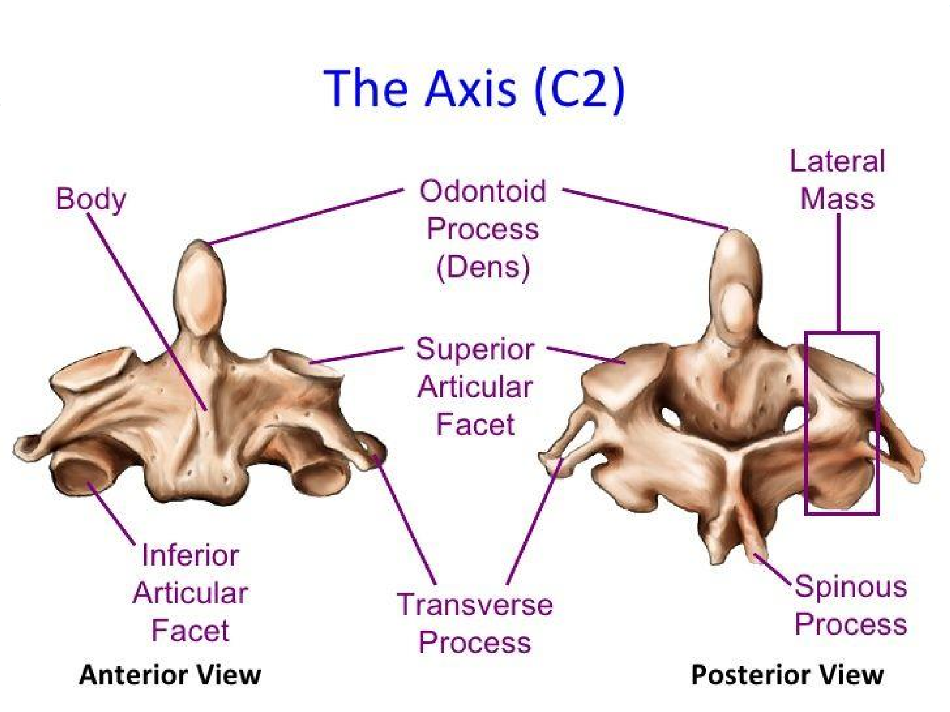


Slide 19
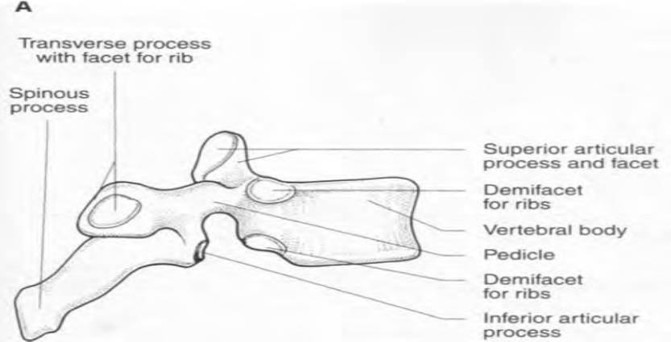
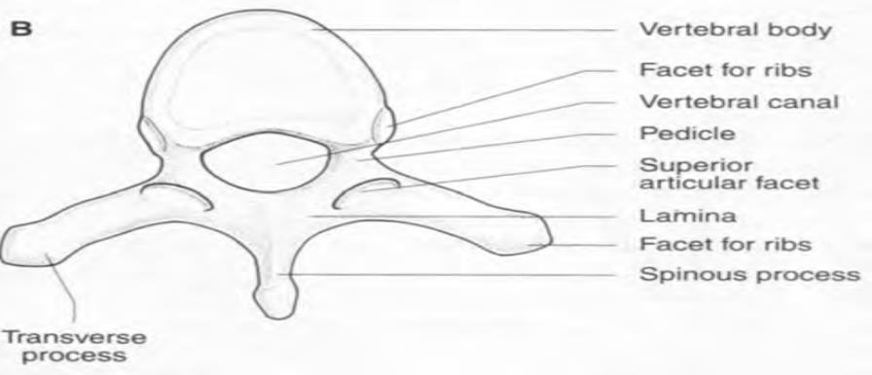
Characteristics of a Typical Thoracic Vertebra:

Slide 20
Typical thoracic vertebra has the following characteristics:
■■ The body is medium size and heart shaped.
■■ The vertebral foramen is small and circular.
■■ The spines are long and inclined downward.
■■ Costal facets are present on the sides of the bodies for articulation with the heads of the ribs.

Slide 21
■■ Costal facets are present on the transverse processes for articulation with the tubercles of the ribs (T11 and12 have no facets on the transverse processes).
■■ The superior articular processes bear facets that face posteriorly and laterally, whereas the facets on the inferior articular processes face anteriorly and medially. The inferior articular processes of the 12th vertebra face laterally,
as do those of the lumbar vertebrae.

Slide 22
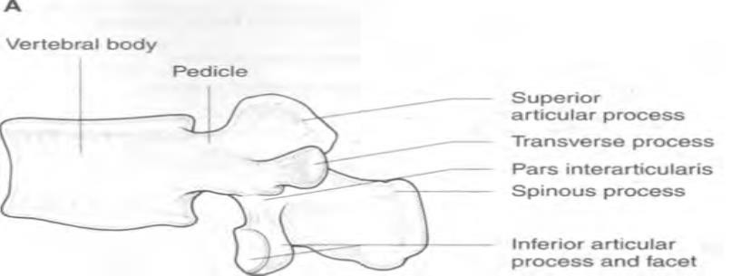
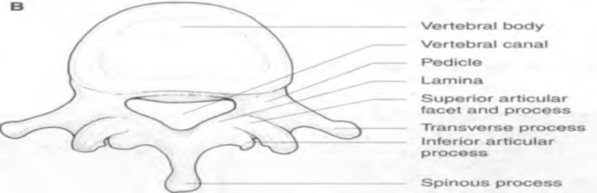
Characteristics of a Typical Lumbar Vertebra:

Slide 23
Typical lumbar vertebra has the following characteristics:
■■ The body is large and kidney shaped.
■■ The pedicles are strong and directed backward.
■■ The laminae are short in a vertical dimension
■■ The vertebral foramina are triangular.
■■ The transverse processes are long and slender.
■■ The spinous processes are short, flat, and quadrangular and
project posteriorly.
■■ The articular surfaces of the superior articular processes face medially, and those of the inferior articular processes face laterally.
Note that the lumbar vertebrae have no facets for articulation with ribs and no foramina in the transverse processes.

Slide 24


