Slide 1
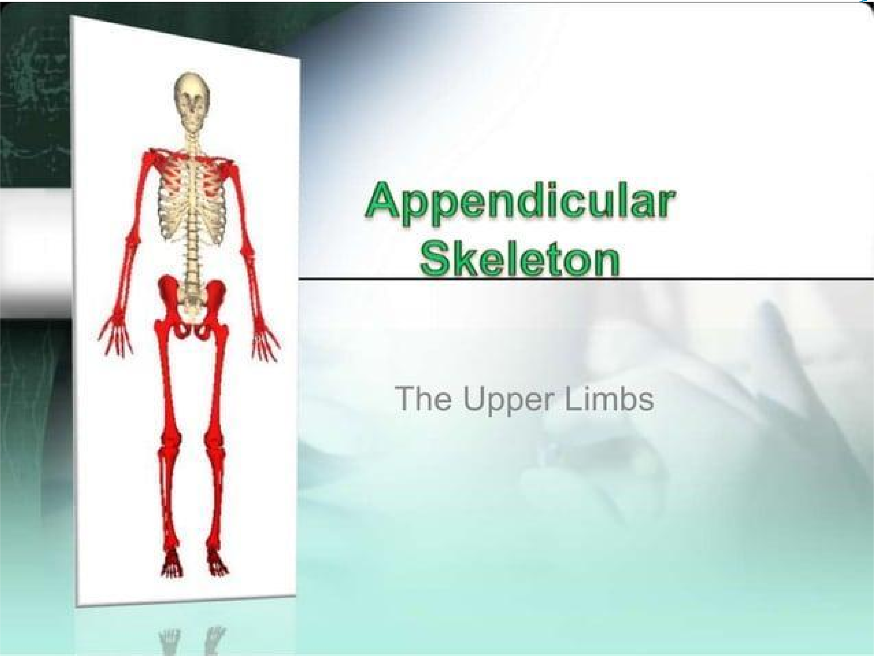
Presented by :Dr. Fadhil Sahib .

Slide 2
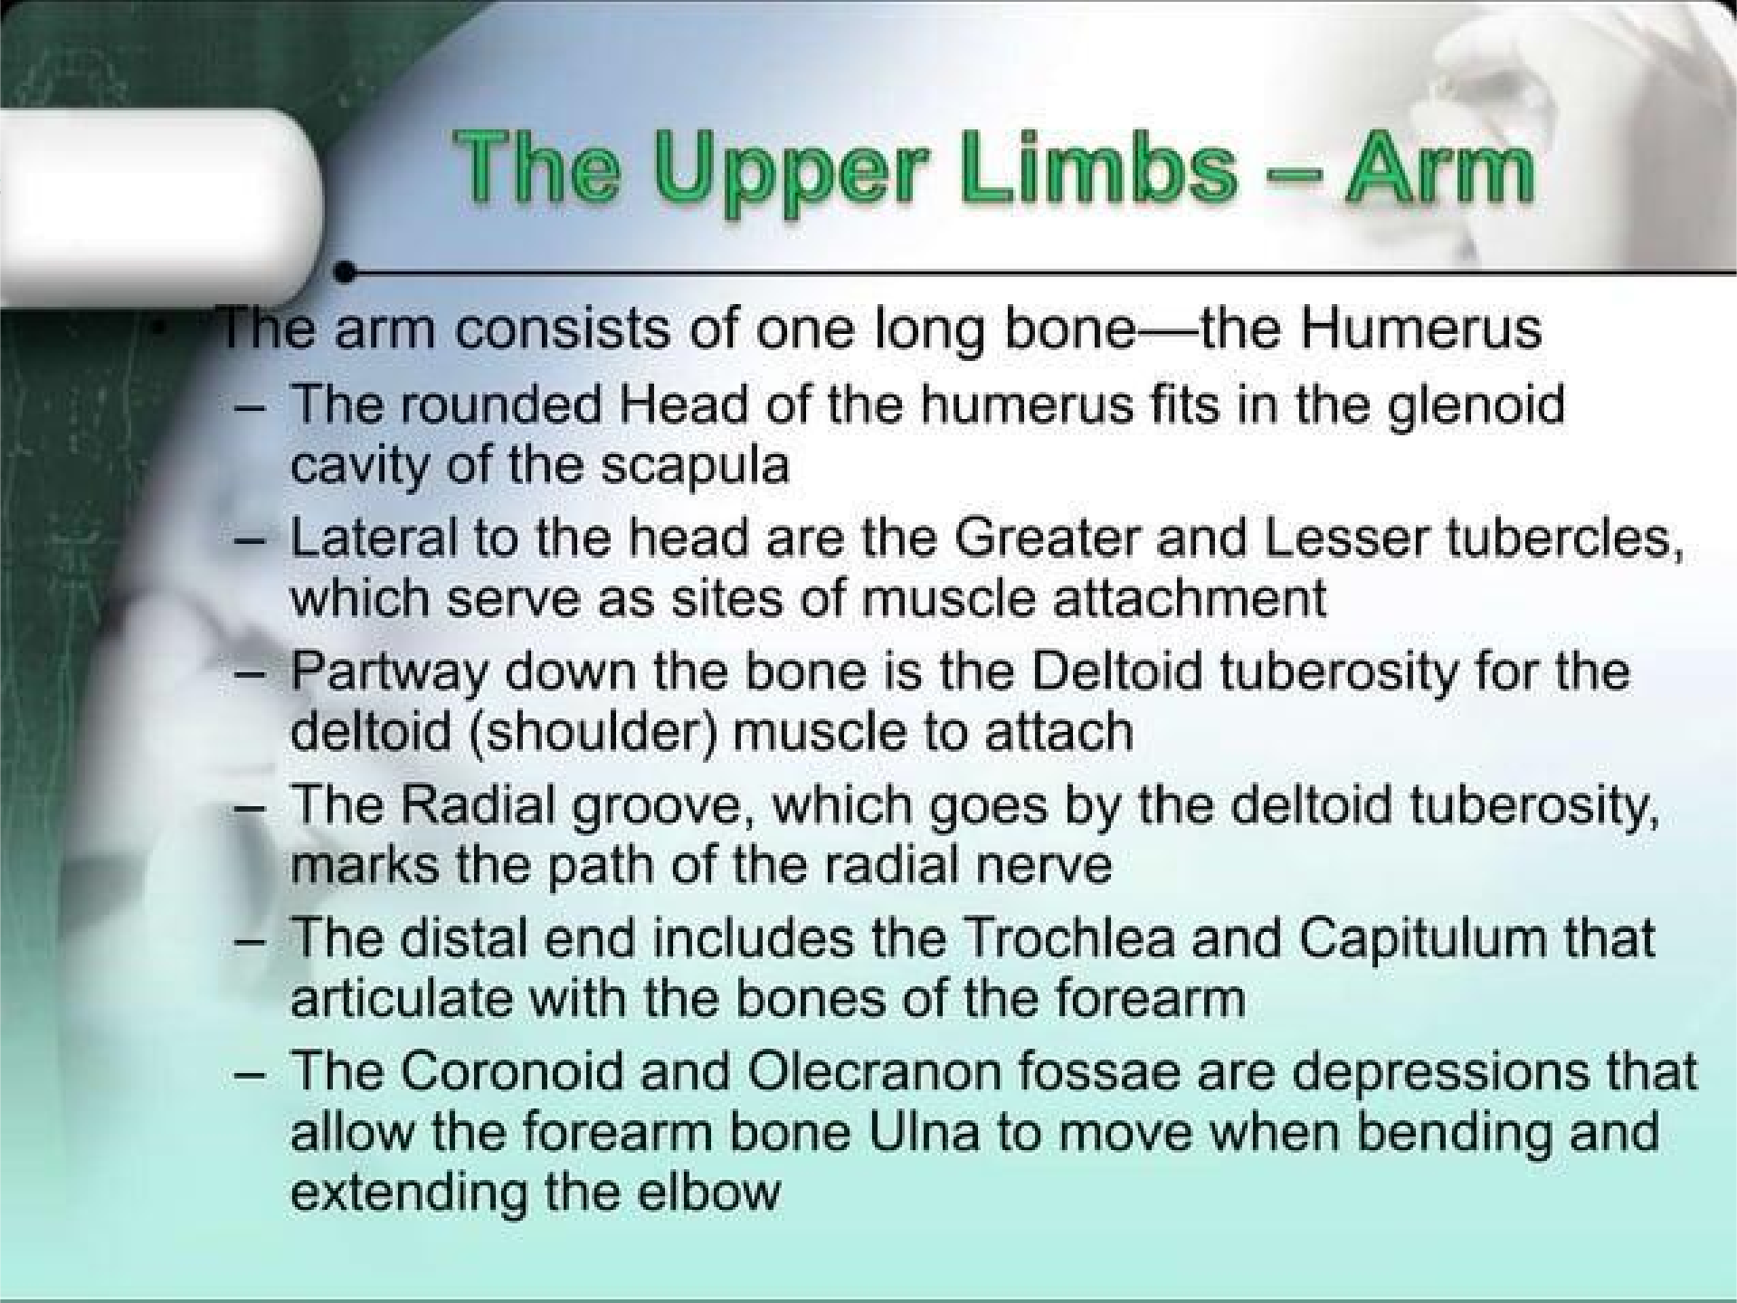

Slide 3
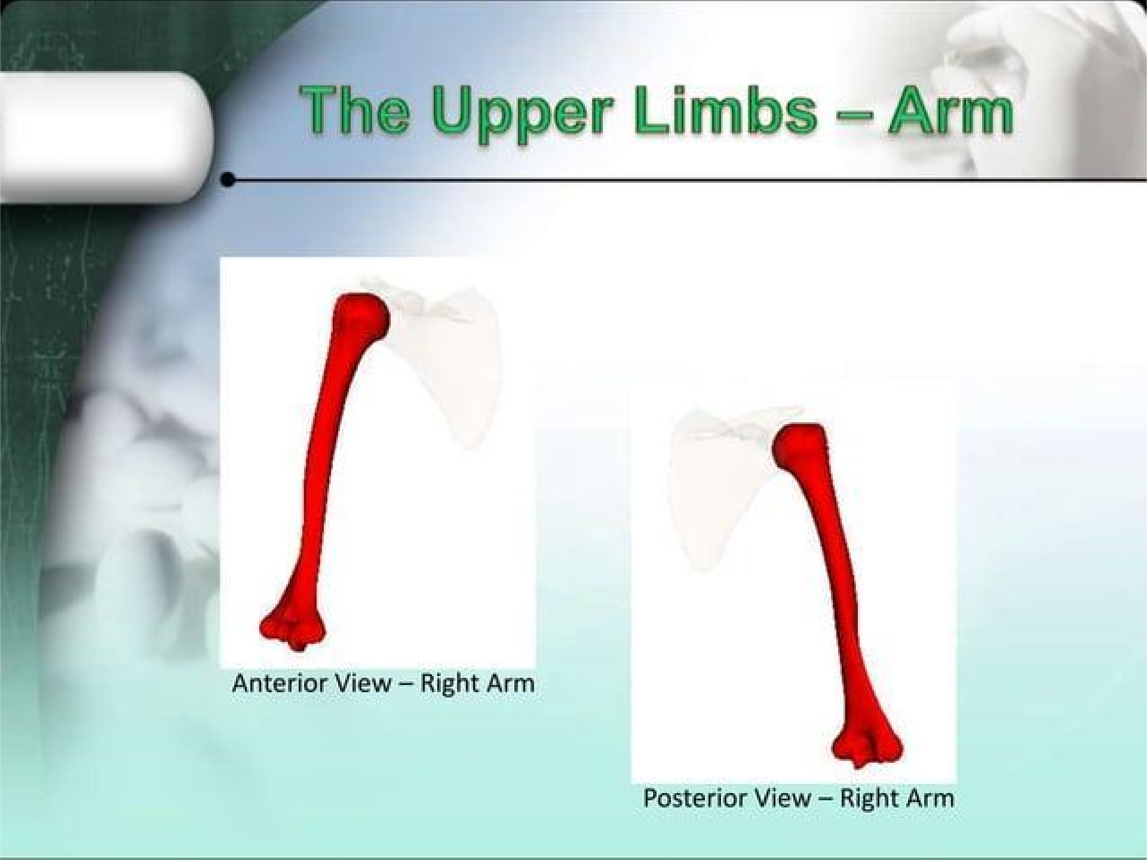

Slide 4
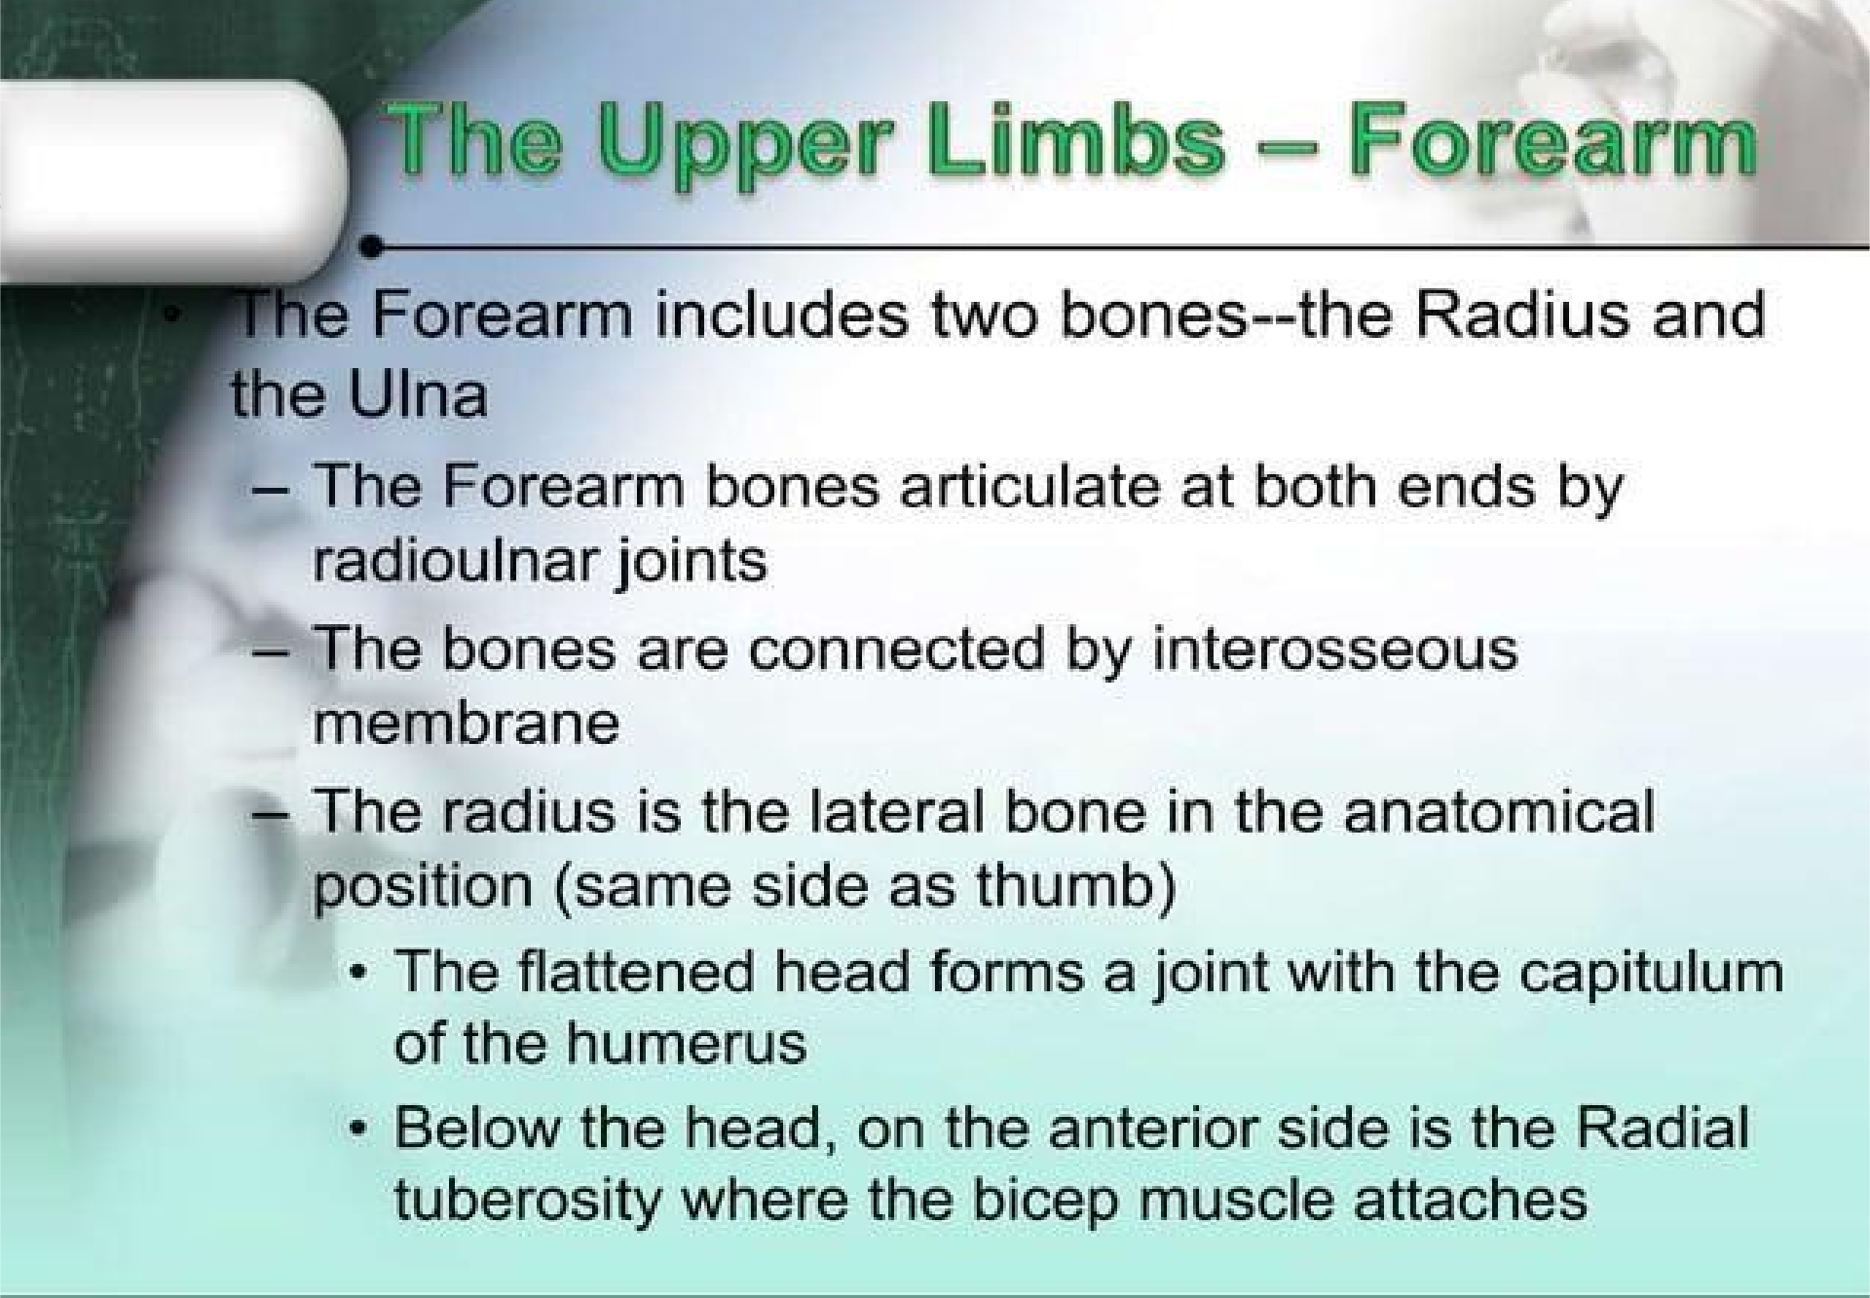

Slide 5
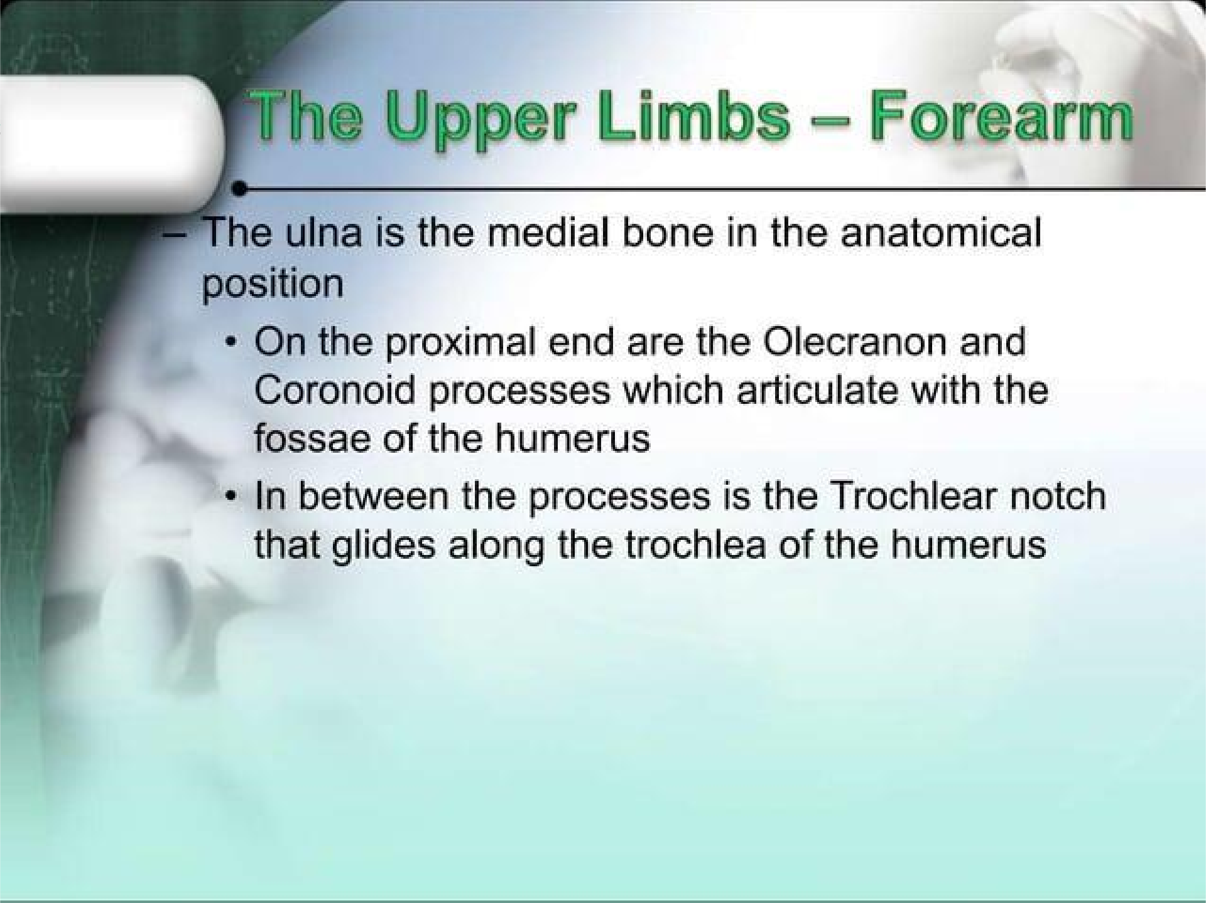

Slide 6
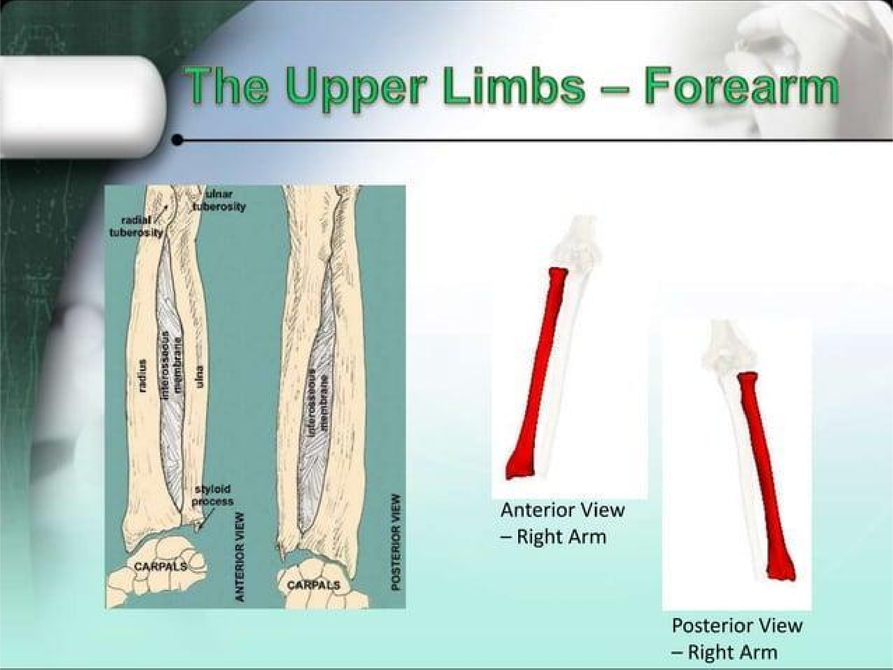

Slide 7
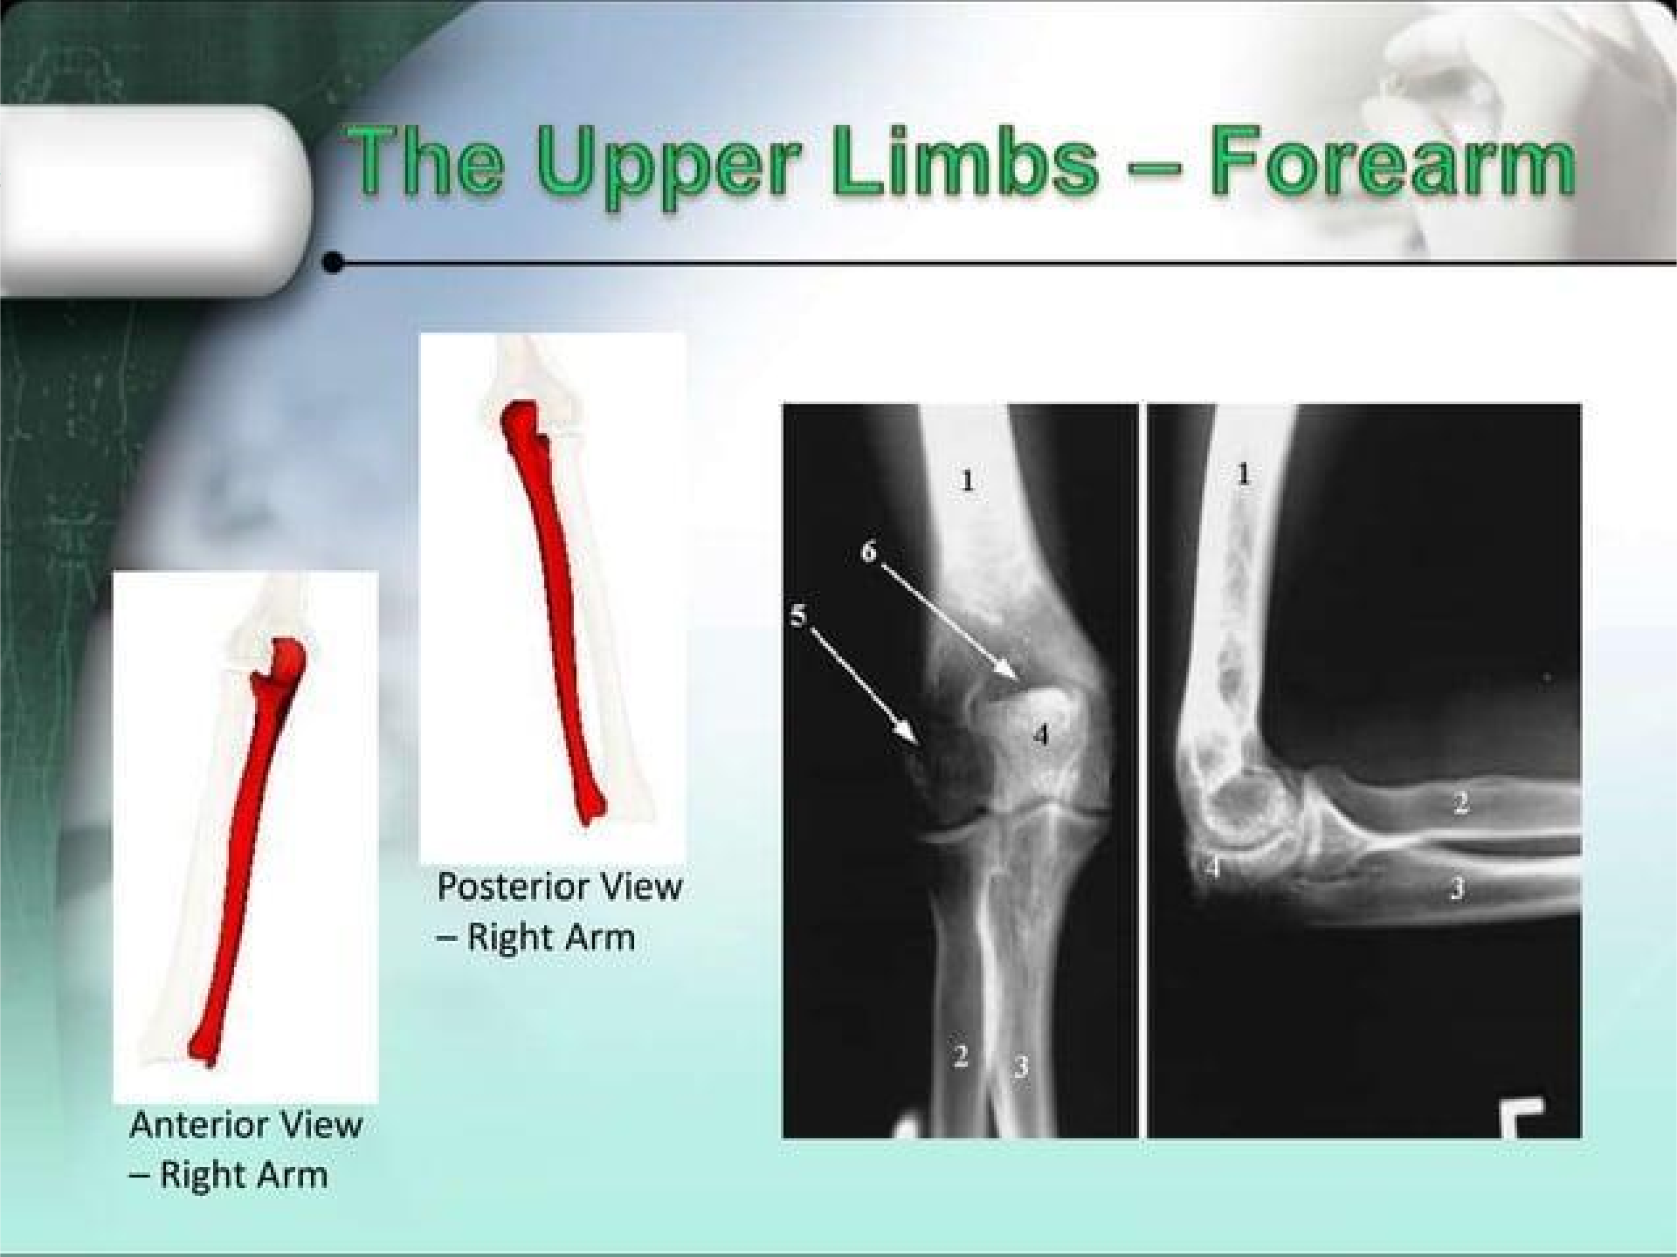

Slide 8
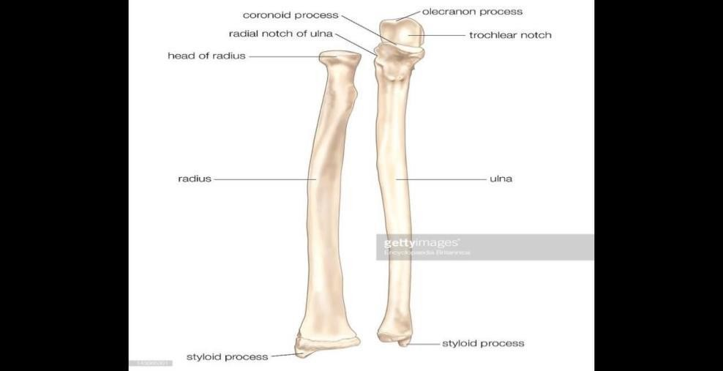
ULNA
*The proximal end of the ulna is large and is known as the olecranon
process, this forms the prominence of the elbow. *At the distal end of the ulna is the small rounded head, which has
projecting from its medial aspect the styloid process.

Slide 9
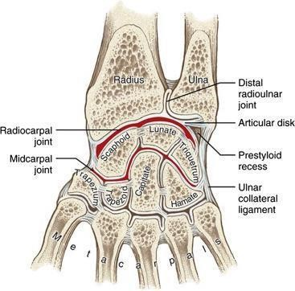
The wrist joint

Slide 10
Bones of the hand
There are eight carpal bones, made up of two rows of four
The proximal row consists of (from lateral to
medial) the scaphoid,
lunate, triquetral, and pisiform bones. The distal row consists of (from lateral to medial) the trapezium,
trapezoid, capitate, and hamate bones.Together, the bones of
the carpus present.

Slide 11
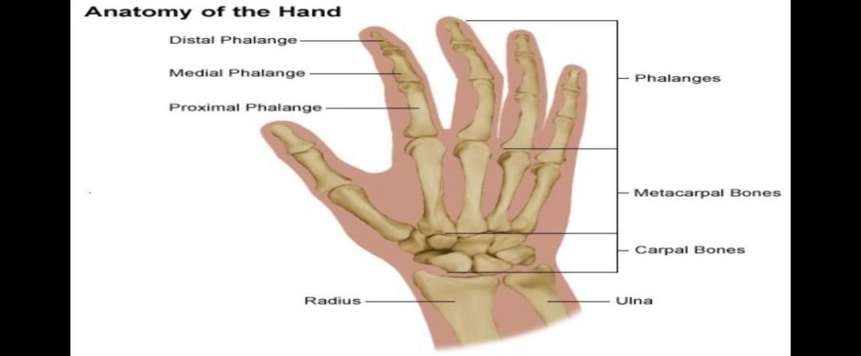
Anatomy of the hand

Slide 12
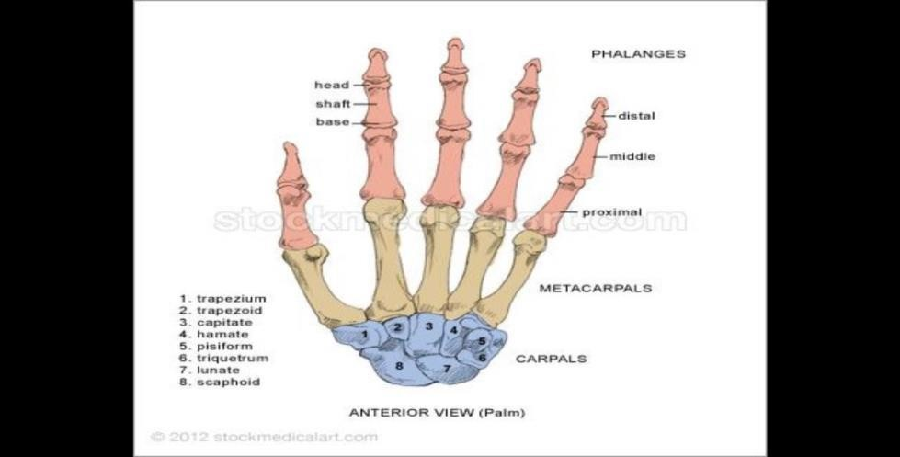
Bones of the hand

Slide 13

The Metacarpals and Phalanges: There are five metacarpal bones, each of which has a base, a shaft , and a
head
*The first metacarpal bone of the thumb, is the shortest and most mobile.
*There are three phalanges for each of the fingers but only two for the
thumb

Slide 14
Elbow Joint: Articulation: humerus, ulna and radius
Type: Synovial hinge joint.
Proximal Radioulnar Joint . Articulation: head of the radius and ulna Type: Synovial pivot joint.
Distal Radioulnar joint. Articulation: Between the rounded head of the ulna and radius
Type: Synovial pivot joint.

Slide 15
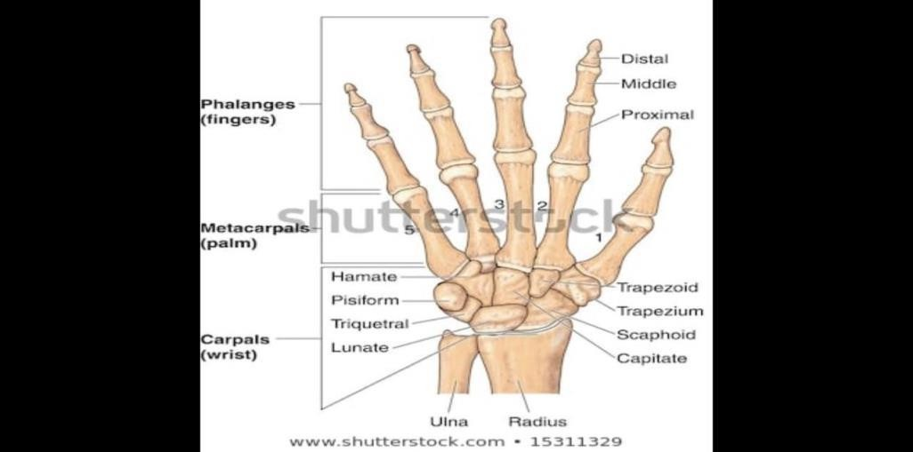
The hand

Slide 16
Wrist Joint (Radiocarpal Joint) Articulation: Between the distal end of the radius and the articular disc. above and the scaphoid, lunate, and triquetral bones below. Type: Synovial ellipsoid joint.

Slide 17
Joints of the Hand and Fingers
1.Intercarpal Joints: between the individual bones of the proximal row of the
carpus; between the individual bones of the distal row of the carpus; and finally, the midcarpal joint, between the proximal and distal rows of carpal bones. Type: Synovial plane joints.

Slide 18
Carpometacarpal and Intermetacarpal Joints: The carpometacarpal and intermetacarpal joints are synovial plane joints.
Metacarpophalangeal Joints:Articulation: Between the heads of the metacarpal bones and the bases of the
proximal phalanges.

Slide 19
Carpometacarpal Joint of the Thumb:
Articulation: Between the trapezium and the first metacarpal bone.
Type: Synovial saddle shaped joint
Interphalangeal Joints:
Interphalangeal joints are synovial hinge joints.

Slide 20
THE END

