Slide 1


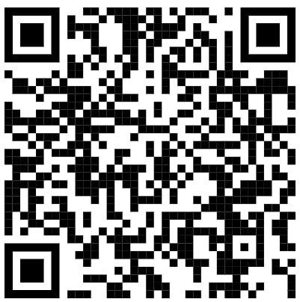
Subject Name: Biology
1st Class, First Semester
Academic Year: 2024-2025
Lecturer: Assist lect. Zainab Sattar Jabbar
Email: zainab.sattar.jabbar@uomus.edu.iq
Lecture No.:- 4
Lecture Title: [The Nucleus]

