Slide 1



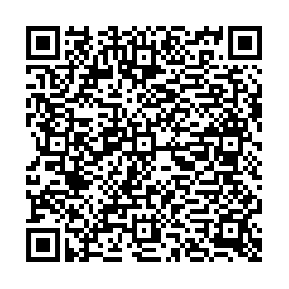

Al-Mustaqbal University
College of Arts and Humanities
Department of English Language
Subject : Grammar
First Stage
The First Lecture
Lecture by :
Past Simple Tense
M.Sc Rusul Niema Kamal
rusulbaiee@gmail.com
2024-2025

Slide 2
Lecture Description
Lecture Title: Past Simple Tense
Target Group : First-Stage students, English Language Department
Teaching Methods: Brainstorm, Group Work, and Hands-on Training Sessions.
Assessment and Feedback Strategy: Tests and Techniques, Oral References, Written Notes, Group Discussions, Personal Evaluation.
Lecture Attachments: Smart Screen, Whiteboard and Markers, Internet links such as Classroom and padlet .
Lecture Duration: 10 minutes.

Slide 3

Objectives of the lecture
General Objective : is for the student to provide the concept of the past simple tense in English language.
Behavioral Objectives : by the end of the lecture , students will be able to :-
Know the past simple tense.
Understand the rules of the past simple tense.
Construct meaningful sentences in the past simple tense.

Slide 4

Contents
Introduction.
What is the past simple tense?
Form affirmative sentence.
Form negative sentence.
Form Interrogative sentence.
Conclusion.

Slide 5
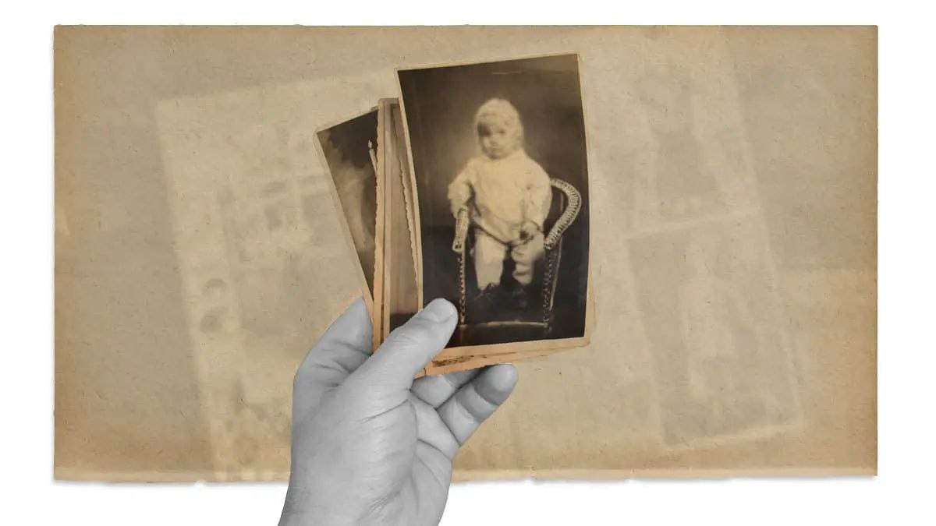
What does this picture mean ?

Slide 6

What is the Past Simple Tense?

Slide 7

What is the Past simple tense?
The past simple tense is used to describe completed actions or events that happened at a specific time in the past.
Ex. I was in the class yesterday.

Slide 8
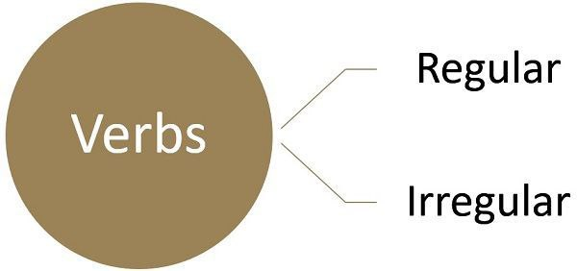
Types of Verbs
add -ed or –d after the verb.
For example : Play → played.
speical form.
For example : Go → went.

Slide 9
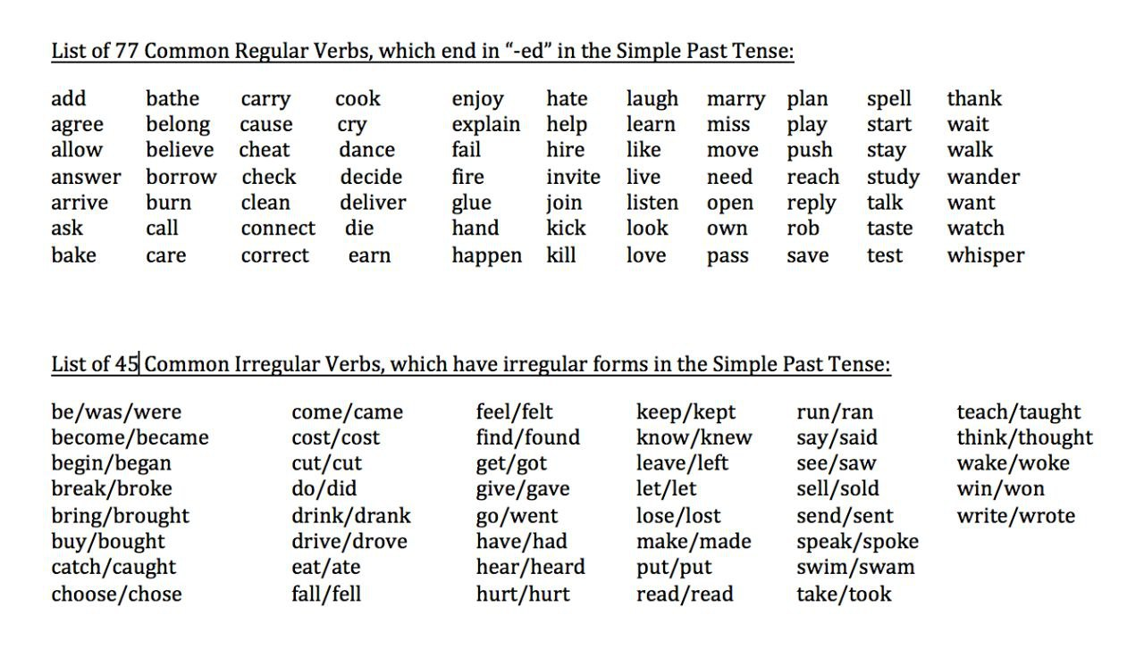

Slide 10
Past Time Expressions
1- Yesterday.
I went to the market yesterday.
2- Last week , last night , last year.
I played football last night.
3- Ago ( like two days ago ).
I broke my phone two days ago.

Slide 11

Form Affirmative
Subject + verb ( regular or irregular ) + com. …
Work ( regular verb ) Worked
Ex. He worked hard last week.
Have ( irregular verb ) Had
Ex. She had one pink dress.

Slide 12

Quiz Time
Individual activity ( use the paper ) ( 2 minutes)
Q\ Put the verb into the correct form positive.
1. The teacher _____________ (explain) the lesson yesterday.
2. She ______ (cook) dinner last night.
3. They ______ ( live ) in Hillah last year .

Slide 13
Form Negative
Subject + did not (didn't) + infinitive verb + com. ..
Ex. He worked hard last week. ( make negative)
He did not work hard last week.
Ex. She had one pink dress. ( make negative ).
She didn’t have one pink dress.
Did ( auxiliary verb )

Slide 14
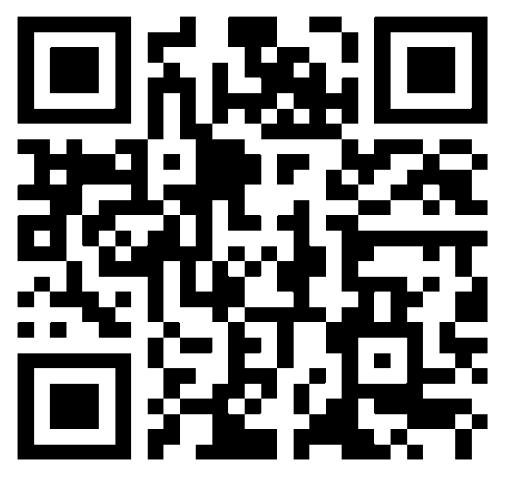
Quiz Time
Individual activity ( send the answer on the Padlet by using QR ).
Q\ which one is wrong and why ?
A) She didn’t let me to see him.
B) They loved to travel last year.
C) I didn’t met my friend three days ago.
( One minute only )

Slide 15
Form Interrogative
Did + Subject + infinitive verb + com. … + ?
Ex. He worked hard last week.
Did he work hard last week ?
Ex. She had one pink dress.
Did she have one pink dress ?

Slide 16
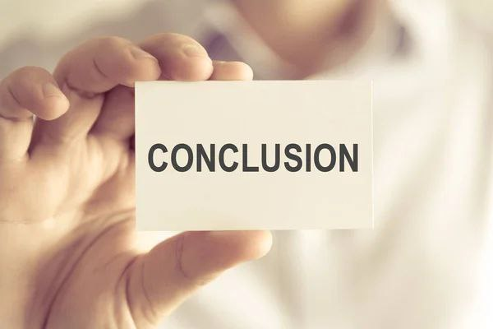
Conclusion
There are three cases to make sentences in the past simple tense ( positive , negative and question ) by using two types of verbs ( regular & irregular ).

Slide 17

HomeWork
Rewrite the sentences by using the past simple tense.
1. They ____ ( sent ) a message last night.( True or False).
2. She ______ (not cook) breakfast this morning.
_______ she _______ (pass) her driving test?
She ate breakfast at 8 a.m. ( True or False ).
Write 6 sentences using the past simple tense .
The answer will send tomorrow via the Google classroom. at 9:00 A.m
https://forms.gle/6mB1zfjLcPJWmeZq9

Slide 18
Thank You

