Slide 1


Slide 2
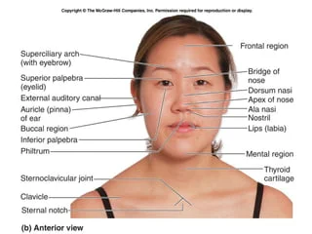
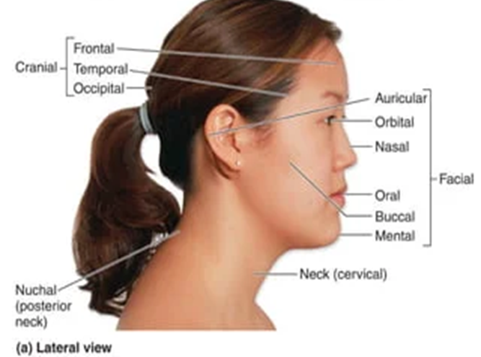
Surface anatomy
Surface anatomy (also known as superficial anatomy and visual anatomy) is the study of the external features of the body. It deals with anatomical features that can be studied by sight without dissection. There four techniques when examining surface anatomy in clinical medicine(inspection ,palpation , percussion and auscultation) .There fives regions of the body are(head, ,neck, chest ,abdomen , upper extremity and lower extremity).
The face is divided into fives mains parts(forehead ,nose ,eyes ,perioral area and
Cheek)
.

Slide 3
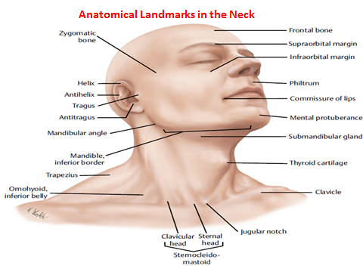
Neck:- is the anatomical region between the base of the skull superiorly and the clavicles inferiorly and it joins the head to the trunk, joining the head to the trunk and limbs, and serving as a major conduit for structures passing between them.
The neck is divided in two major
triangles anterior and posterior,
based mainly on the borders of
the sternocleidomastoid(SCM)
and trapezius muscles.
Anterior neck triangle:- is
region of the neck bounded
by the inferior border of
the mandible superiorly
, the anterior border of the
sternocleidomastoid laterally,
and the sagittal line down midline
Of the neck medially.

Slide 4
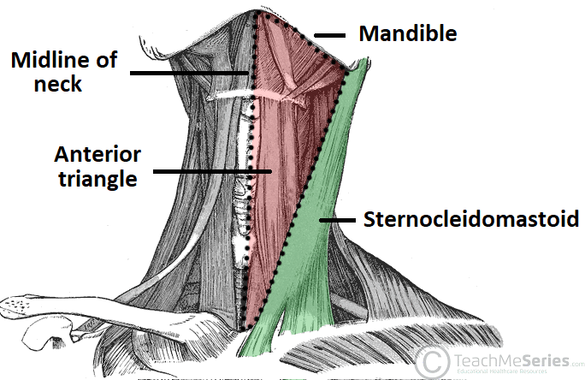
and inferiorly (apex)by the jugular and clavicular notch of the manubrium. This triangle has a superficial boundary or a roof formed by subcutaneous tissue containing the platysma, a deep boundary or a floor formed by the pharynx, larynx and thyroid gland
The anterior triangle is home to several muscles, nerves, arteries, veins, and lymph nodes. Muscles of this region are in two groups: the suprahyoid and infrahyoid muscle
Nerves anterior triangle contains
several cranial nerves, such as CN VII,
CN IX, CNX, CN XI, and CN XII.
Blood vessels passing through this
region include the common carotid artery,
which splits into the internal and the
external carotid artery supplying various
structures in the head. There is also
the internal jugular vein, which drains
venous blood from the head and neck.

Slide 5
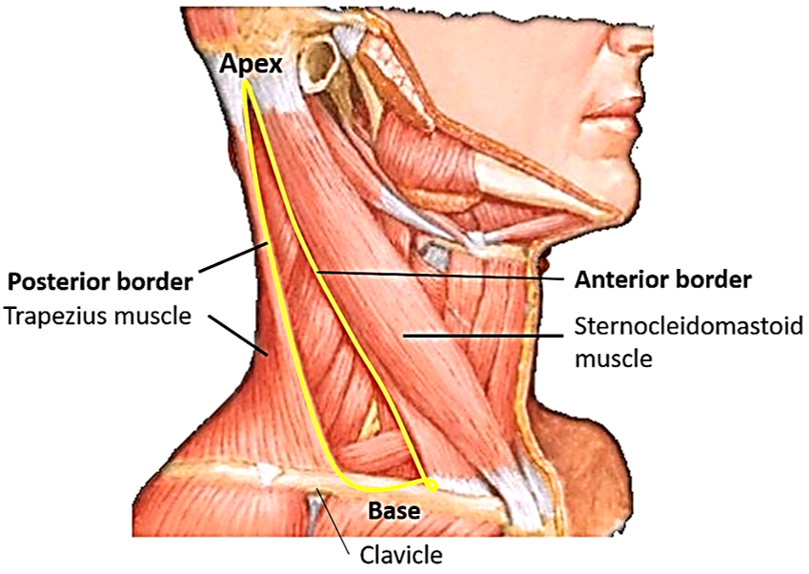
The posterior triangle is a triangular area found posteriorly to the sternocleidomastoid muscle. Anterior border is posterior margin of the sternocleidomastoid muscle .The posterior border is the anterior margin of the trapezius muscle, while the inferior border is the middle-third of the clavicle.
Apex: Union of the sternocleidomastoid and the trapezius muscles at the superior nuchal line of the occipital bone
The investing layer of deep cervical fascia forms the roof of the space , while the
floor is formed by paravertebral fascia
with its vertebral muscles ( splenius capitis
levator scapulae and anterior . Middle and
posterior scalenes
Content :-A) Nerves and plexuses:
Spinal accessory nerve (Cranial Nerve XI)
Branches of cervical plexus , Roots and
trunks of brachial plexus , Phrenic nerve
B- vessels:-subclavian(1/3) ,transverse
cervical and Suprascapular arteries
terminal part of external jugular vein
C- lymph nodes D- vertebral muscles, splenius
and inferior belly of omohyoid muscles

Slide 6

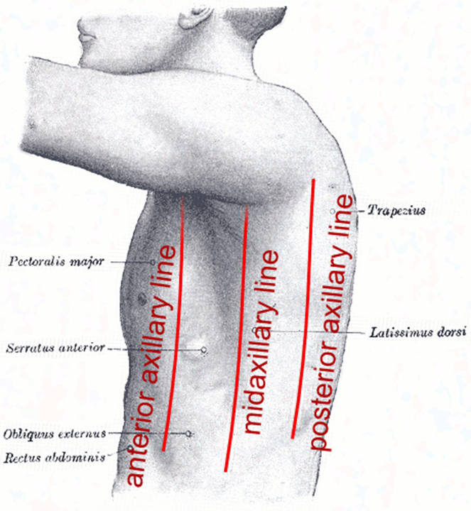
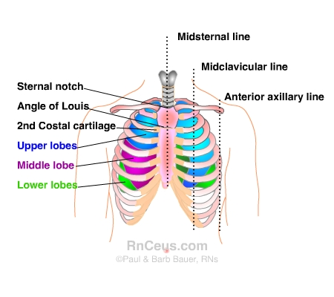
Anatomical Lines:- are imaginary lines drawn on the surface of the body and used to describe anatomical locations.
Anterior Axillary Line:- is a vertical line passing along anterior axillary fold
Mid axillary line:- is a line running vertically down the surface of the body, passing through the apex of the axilla (armpit).
Posterior axillary line:- is a line that passes through the posterior axillary skin fold..
Mid sternal Line is a vertical line passing down the middle of sternum.
Parasternal Line (mid clavicular) is a vertical line extends from the middle of the clavicle passing along lateral edge of sternum.
Scapular Line: is a vertical line passing over Inferior angle of scapula.
Vertebral line: passing over spinous processes of vertebra in the midline.

Slide 7
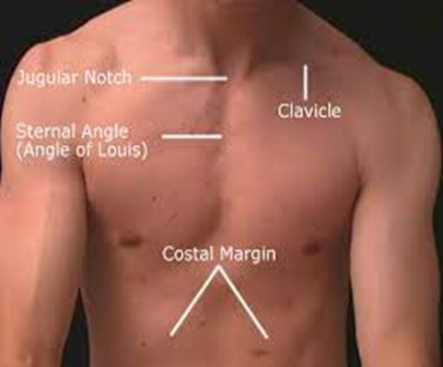
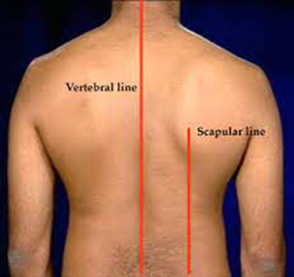
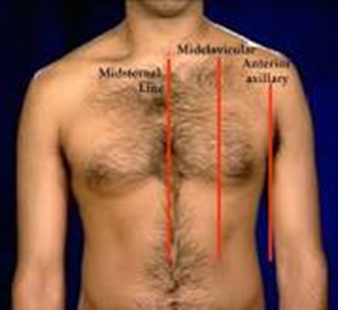
Surface Anatomy of the thorax
Anterior Chest Wall.
The suprasternal notch or the jugular notch is the superior margin of the manubrium sterni and is easily felt between the prominent medial ends of the clavicles in the midline.
The sternal angle (angle of Louis) is the angle made between the manubrium and the body of the sternum. The finger moved to the right or to the left onto the angle will pass directly onto the 2nd costal cartilage and then the 2nd rib. All ribs may be counted from this point
The subcostal angle. Is an angle situated at the inferior end of the sternum, between the sternal attachments of the 7th costal cartilages.
The costal margin is the lower boundary of the thorax and is formed by the cartilages of the 7th, 8th, 9th, and 10th ribs and the ends of the 11th and 12th cartilages.

Slide 8
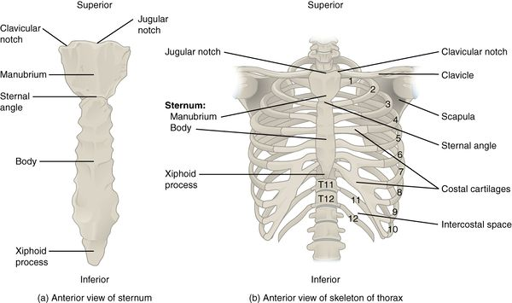
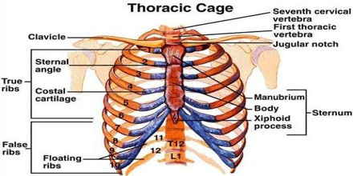
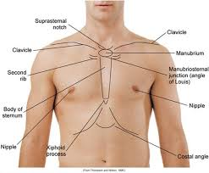
The thoracic cavity or the chest cavity:- lies between the neck and the abdomen. It is bounded by the thoracic wall and extends from the diaphragm (below) to the superior thoracic aperture (also called thoracic inlet or thoracic outlet). This is an opening at the base of the neck that connects the neck with the chest. The esophagus and trachea pass through this opening to enter the thoracic cavity. Many blood vessels, nerves and other structures also pass through it. This thoracic outlet comprises of the first thoracic vertebrae, upper border of manubrium sterni and the first ribs on either side. The five organs in the thoracic cavity are heart, lungs, esophagus, trachea and thymus , as well as blood vessels ,
nerves and connective tissues

Slide 9
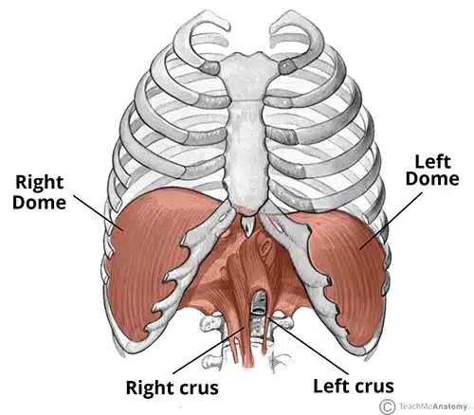
The diaphragm:-is a double-domed musculotendinous sheet, located at the inferior-most aspect of the rib cage. Its function separates the thoracic cavity from the abdominal cavity , Undergoes contraction and relaxation, altering the volume of the thoracic cavity and the lungs, producing inspiration and expirations ,so it is main muscle of respiration and also it sis passage for main structure between the chest and abdomen. The diaphragm is located at inferior most aspect rib cage
filling the inferior thoracic aperture. It acts as the floor of the thoracic cavity and the roof of the abdominal cavity. The attachments of diaphragm can be divided into peripheral and central attachments. It has three peripheral attachments:
1-Lumbar vertebrae and arcuate ligaments.
2-Costal cartilages of ribs 7-10 (attach directly to ribs 11-12).
3-Xiphoid process of the sternum.
The parts of the diaphragm that arise from the vertebrae
are tendinous in structure, and are known as the
right and left crura:
Right crus – Arises from L1-L3 and their intervertebral
discs. Some fibers from the right crus surround the
esophageal opening, acting as a physiological sphincter
to prevent reflux of gastric contents into the
esophagus.
left crus-Arises from L1-L2 and their intervertebral discs.

Slide 10
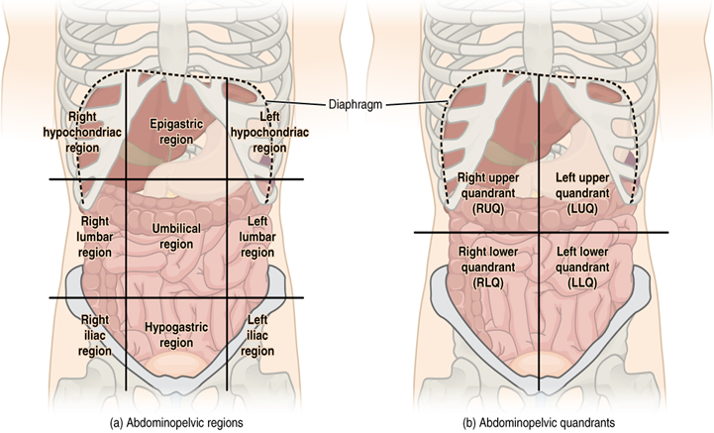
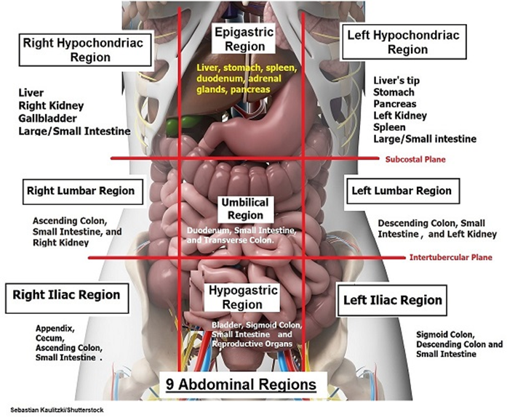
The anatomical regions of the abdomen. From superior to inferior, the abdomen is divided into nine regions: 1. Epigastric, 2. Umbilical, 3. Hypogastric, 4. Left hypochondriac,
5. Right hypochondriac, 6. Left lumbar, 7. Right lumbar, 8. Left iliac, 9. Right iliac. The abdomen is also divided into four main regions or quadrants: 1. the left upper quadrant, 2. the right upper quadrant, 3. the left lower quadrant and, 4. the right lower quadrant
It is important to know the anatomical regions and quadrants of the abdomen to correlate the pain to the organs contained in each area. For example, pain within the epigastric region should guide you to think about the stomach, liver, pancreas, duodenum, and adrenal glands. Pain in the suprapubic region should guide you to think about the bladder, sigmoid colon, rectum, and uterus

Slide 11
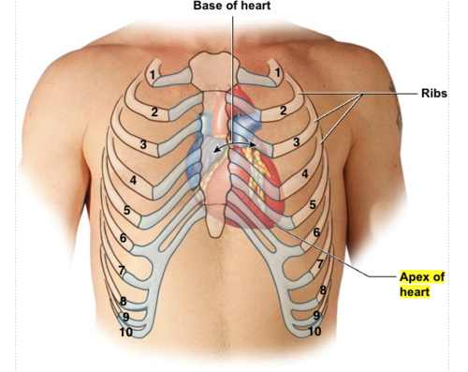
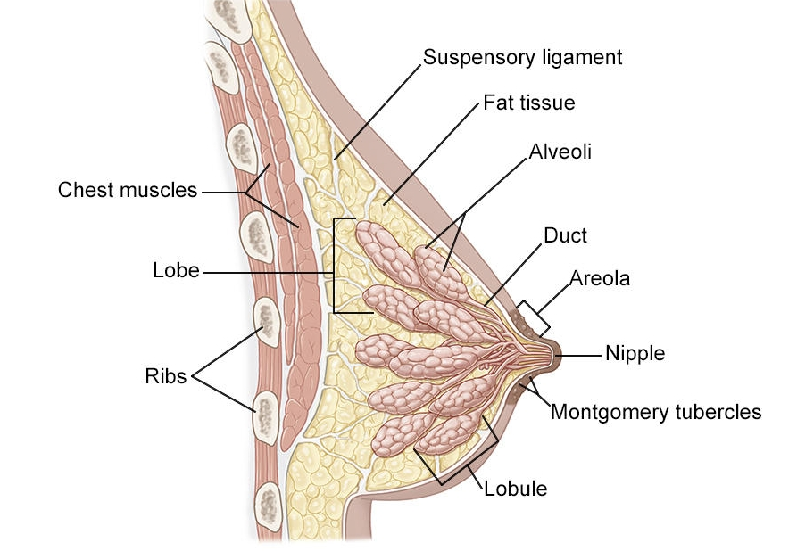
Apex Beat of the Heart
The apex of the heart is formed by the lower portion of the left ventricle. The apex beat is caused by the apex of the heart being thrust forward against the thoracic wall
as the heart contracts. The apex beat is normally found
in the fifth left intercostal space 9 cm from the midline.
Breasts are the most prominent superficial structure in the
Anterior thoracic wall Each breast has 15 to 20 lobes.
Each lobe has many smaller structures called
lobules. These end in dozens of tiny bulbs that
can produce milk. The lobes ,lobules and bulbs are
all linked by thin tubes called ducts. These ducts
These ducts lead to the nipple in the center of a
dark area of skin called the areola
The breast is located on the anterior thoracic wall.
It extends horizontally from the lateral border of
the sternum to the mid-axillary line. Vertically,
it spans between the 2nd and 6th costal cartilages.
It lies superficially to the pectoralis major and
serratus anterior muscles.
In the male, the nipple usually lies in the fourth
Intercostal space about 10 cm from the midline
In the female, its position is not constant

Slide 12


Thanks

