Slide 1
Physical Examination
of
Neoborn
Prepared by
Dr. Kareem G. Dhaidan

Slide 2
Vital signs :
Axillary temperature: 36.5- 36.6 . Avoid rectal in the
first day .
Respiration : 30- 60 bpm
Pulse : 120- 140 bpm
Blood pressure : 65/41 mmHg in the first 3 days.
Vital signs must be checked every 2 hours, then once every
8 hours until discharge.

Slide 3
General Appearance :
Skin
At birth, bright red, puffy, smooth
2nd-3rd day, pink, flaky, dry
Vernix caseosa
Lanugo
Edema around eyes, face, legs, dorsa of
hands, feet, and scrotum or labia
Acrocyanosis—Cyanosis of hands and feet

Slide 4
Head
Anterior fontanel—Diamond shaped;
size varies from barely palpable to
4-5 cm (0.5-2 inches)
Posterior fontanel—Triangular, 0.5-1 cm
(0.2-0.4 inches)

Slide 5
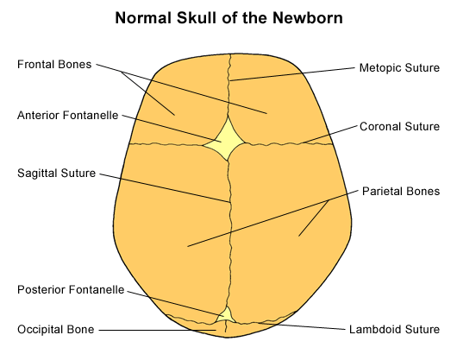
Main fontanels on the head of the newborn

Slide 6
Eyes
Lids usually edematous
Color—Slate gray, dark blue, brown
Absence of tears
Red reflex
Corneal reflex in response to touch
Pupillary reflex in response to light
Blink reflex in response to light or touch
Rudimentary fixation on objects and
ability to follow to midline

Slide 7
Ears
Position—Top of pinna on horizontal
line with outer canthus of eye
Startle (Moro) reflex elicited by loud,
sudden noise or stimulus
Pinna flexible, cartilage present
Nose
Nasal patency
Nasal discharge—Thin white mucus
Sneezing

Slide 8
Mouth and Throat
Intact, high-arched palate
Uvula in midline
Frenulum of tongue
Frenulum of upper lip
Sucking reflex—Strong and coordinated
Rooting reflex
Gag reflex
Extrusion reflex
Absent or minimum salivation
Vigorous cry

Slide 9
Neck
Short, thick, usually surrounded by
skinfolds
Tonic neck reflex
Chest
Anteroposterior and lateral diameters
equal
Slight sternal retractions evident during
inspiration
Xiphoid process evident
Breast enlargement

Slide 10
Lungs
Respirations chiefly abdominal
Cough reflex absent at birth, present by
1-2 days
Bilateral equal bronchial breath sounds

Slide 11
Abdomen
Cylindrical in shape
Liver—Palpable 2-3 cm (0.8-1.8 inches)
below right costal margin
Spleen—Tip palpable at end of 1st
week of age
Kidneys—Palpable 1-2 cm (0.4-0.8
inches) above umbilicus
Umbilical cord—Bluish white at birth
with 2 arteries and 1 vein
Femoral pulses—Equal bilaterally

Slide 12
Senses:
A - Touch: It is the most highly developed sense.
It is most acute at lips tongue, ears and forehead.
b - Vision:-
1 - Pupils react to light.
2 - Bright lights appear to be unpleasant to newborn infant.

Slide 13
c - Hearing.
1 - The newborn infant usually makes
some response to sound from birth.
2 - Ordinary sounds are heard well before 10
days of life. The newborn infant responds to sounds with a cry or eye movement, cessation of activity and / or startle reaction.

Slide 14
d - Taste:
well developed as bitter and sour fluids are
resisted while sweet fluids are accepted.
e - Smell:
Only evidence in newborn infant is his search for the nipple as he smells breast milk.

Slide 15
Development:
A. Motor Development:
1- His movements are random, diffuse and uncoordinated.
2 - Lack muscular strength to hold head steady and erect (his head sink down known as head lag).
3 - Bodily functions and responses to external stimuli are carried out by reflexes.
Reflexes: The reflexes such as: Moro-reflex, swallowing and gagging reflex. Sucking reflex, grasp reflex , tonic-neck reflex.

Slide 16
B- Cognitive Development:
The cognitive (intellectual) development of
newborn infant is difficult to understand or observe it.
C- Emotional Development:
Newborn infant expresses his emotion just through cry for hunger, pain or discomfort sensation.
D- Social Development:
Cry is his contact with environment; to communicate his physiological needs as hunger, throaty sounds show interest in human face.

Slide 17
References :
Wong’s nursing care of infants and children / [edited by] Marilyn J. Hockenberry, David Wilson.—10th edition.
https://nursekey.com/health-promotion-of-the-newborn-and-family.

Slide 18


