Slide 1

MINISTRY OF HIGHER EDUCATION & SCIENTIFIC RESEARCH
AL-MUSTAQBAL UNIVERSITY
COLLEGE OF ENGINEERING AND TECHNOLOGIES, DEPARTMENT OF BUILDING AND CONSTRUCTION TECHNIQUES ENGINEERING

Slide 2
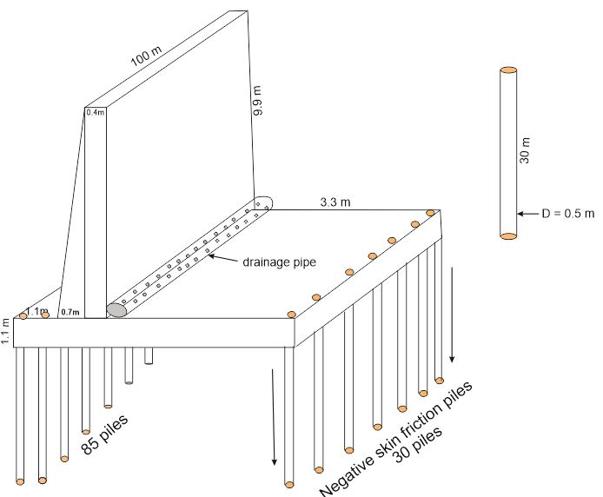
Eccentric Retaining Wall Design

Slide 3

ENGINEERING PROJECT
SUBMITTED TO THE DEPARTMENT OF BUILDING AND CONSTRUCTION TECHNIQUES ENGINEERING / COLLEGE OF ENGINEERING AND TECHNOLOGIES / AL-MUSTAQBAL UNIVERSITY IN PARTIAL FULFILLMENT OF THE REQUIREMENTS FOR THE DEGREE OF BACHELOR IN BUILDING AND CONSTRUCTION ENGINEERING
By:
Rulla Mahdi
Ahmed Fahdil
Muhammed Mahdi
Isra Salman
Saba Abdu Razak
Zainab Saad
Ibrahim Hasan
Supervised by:
Prof. Dr. Najah M. L. Al Maimuri

Slide 4
Case Study & Goals
A retaining wall is required for constructing an open tunnel in sandy clay soil.
The retaining wall type is a cantilever reinforced concrete with a depth of 11 m.
The soil properties were tested in the laboratory after conducting the site investigations and sampling. The results were indicated in Fig.1.
Groundwater was found at a depth of 3 m below ground level.
Since the area in which the tunnel is located is considered a crowded area by population, the following must be taken into account: -

Slide 5
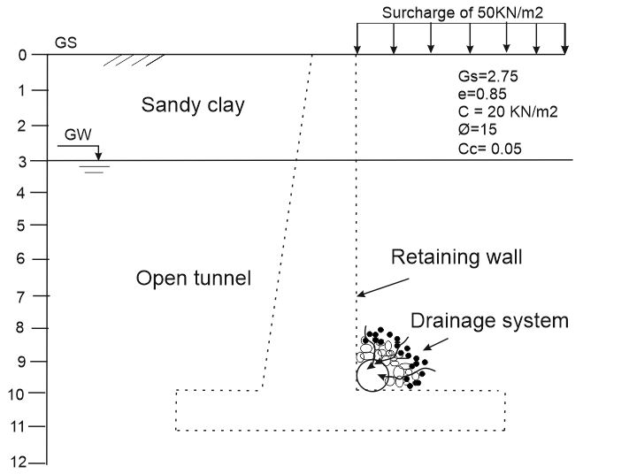
Fig.1 Location of the case study

Slide 6
Design Considerations
The retaining wall heel cannot be expanded horizontally due to the narrow spaces due to the presence of adjacent buildings.
The cost factor does not affect the choice of retaining wall type.
The sides of the tunnel represent a road for cars, so a constant surcharge of 50KN/m should be taken into consideration.
To secure the tunnel from groundwater problems, a closed drainage system must be designed, and therefore soil permeability was measured and found to be 2.5 m/day
The length of the retaining wall is 100m.

Slide 7
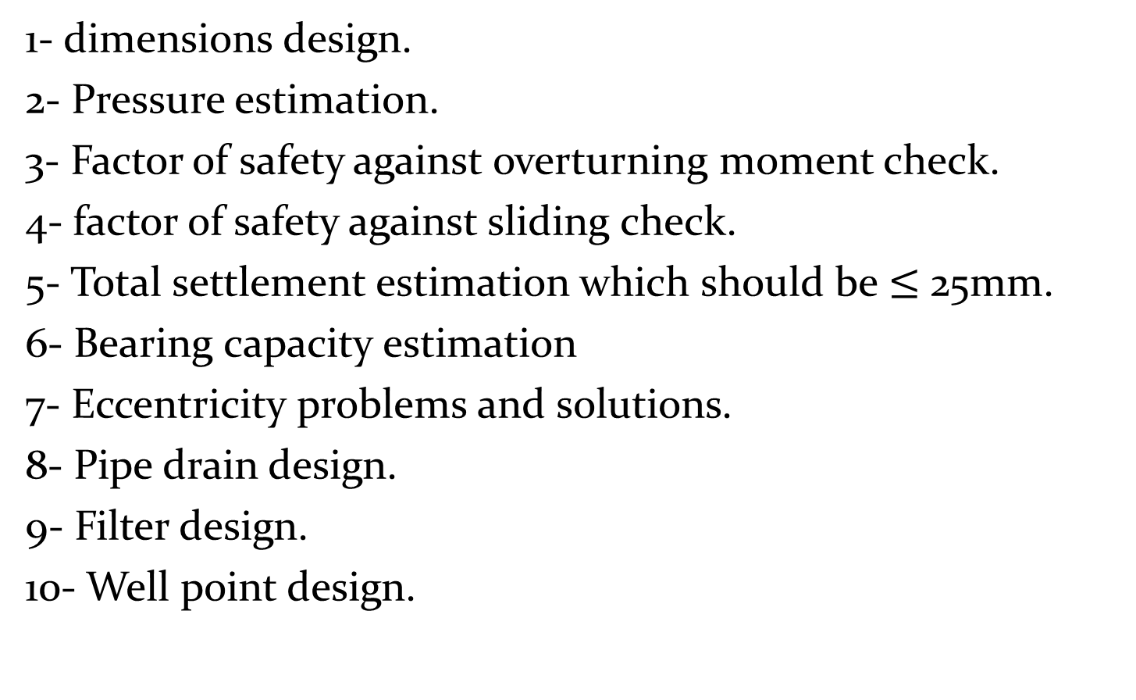
Techniques of Design
1- dimensions design.
2- Pressure estimation.
3- Factor of safety against overturning moment check.
4- factor of safety against sliding check.
5- Total settlement estimation which should be $≤$25mm.
6- Bearing capacity estimation
7- Eccentricity problems and solutions.
8- Pipe drain design.
9- Filter design.
10- Well point design.

Slide 8
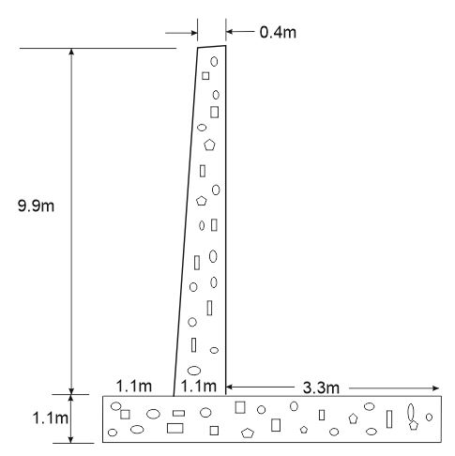
Design of Retaining wall geometry

Slide 9
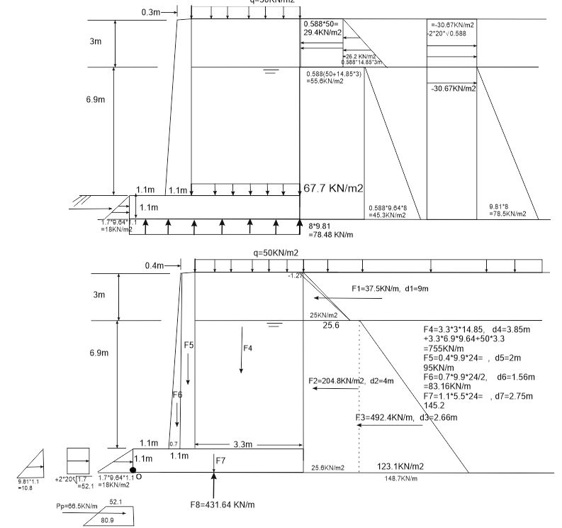
Pressures Estimations

Slide 10
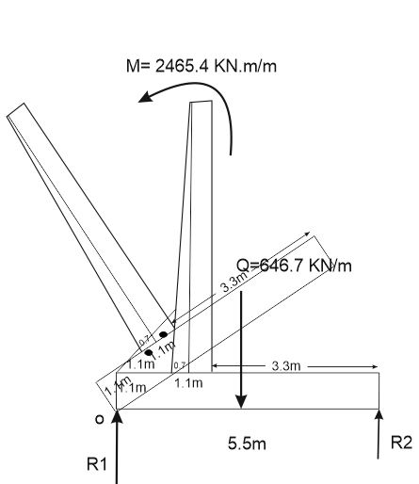
Fs against overturning moment

Slide 11

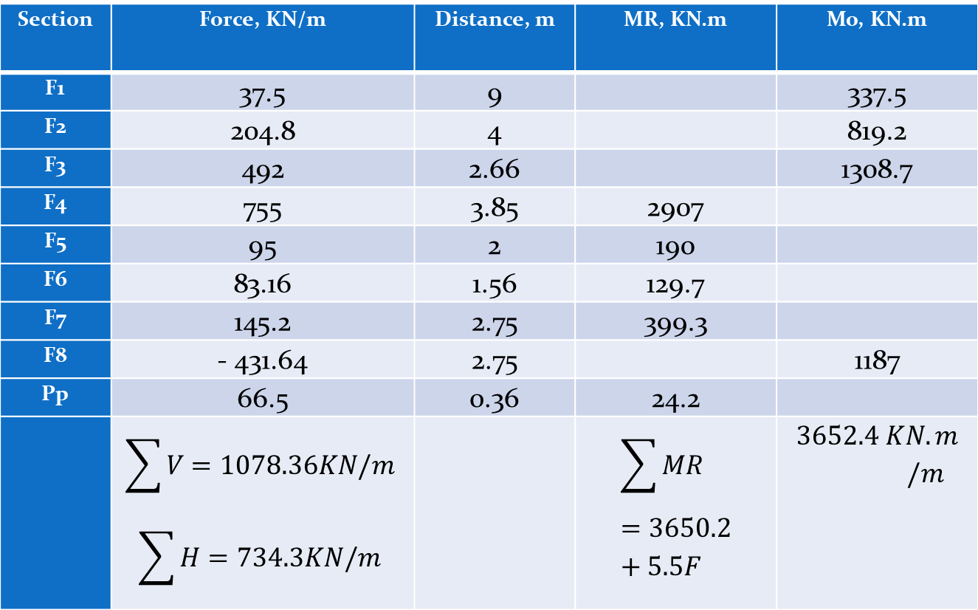
Table 1: System of forces and moments
Section | Force, KN/m | Distance, m | MR, KN.m | Mo, KN.m
F1 | 37.5 | 9 |  | 337.5
F2 | 204.8 | 4 |  | 819.2
F3 | 492 | 2.66 |  | 1308.7
F4 | 755 | 3.85 | 2907
F5 | 95 | 2 | 190
F6 | 83.16 | 1.56 | 129.7
F7 | 145.2 | 2.75 | 399.3
F8 | - 431.64 | 2.75 |  | 1187
Pp | 66.5 | 0.36 | 24.2
 | $$\sum{V=1078.36KN/m}$$ $$\sum{H=734.3KN/m}$$ |  | $$\sum{MR}=3650.2+5.5F$$ | $$3652.4 KN.m/m$$
$FS=\frac{3650+5.5F}{3652.4}=0.999<2$ Not good as desired

Slide 12
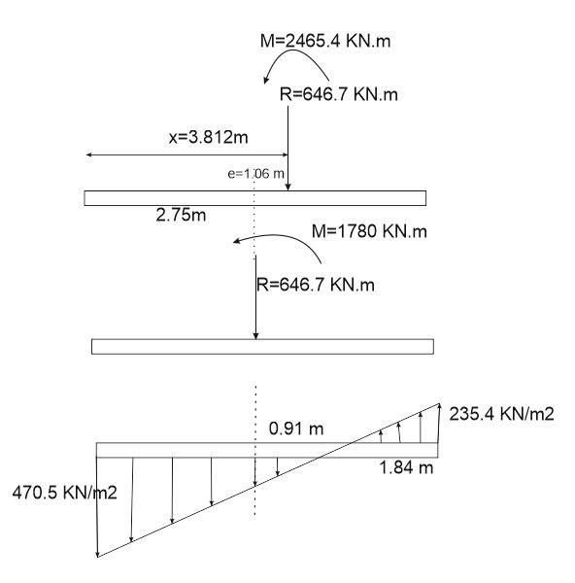
  Soil pressure

Slide 13
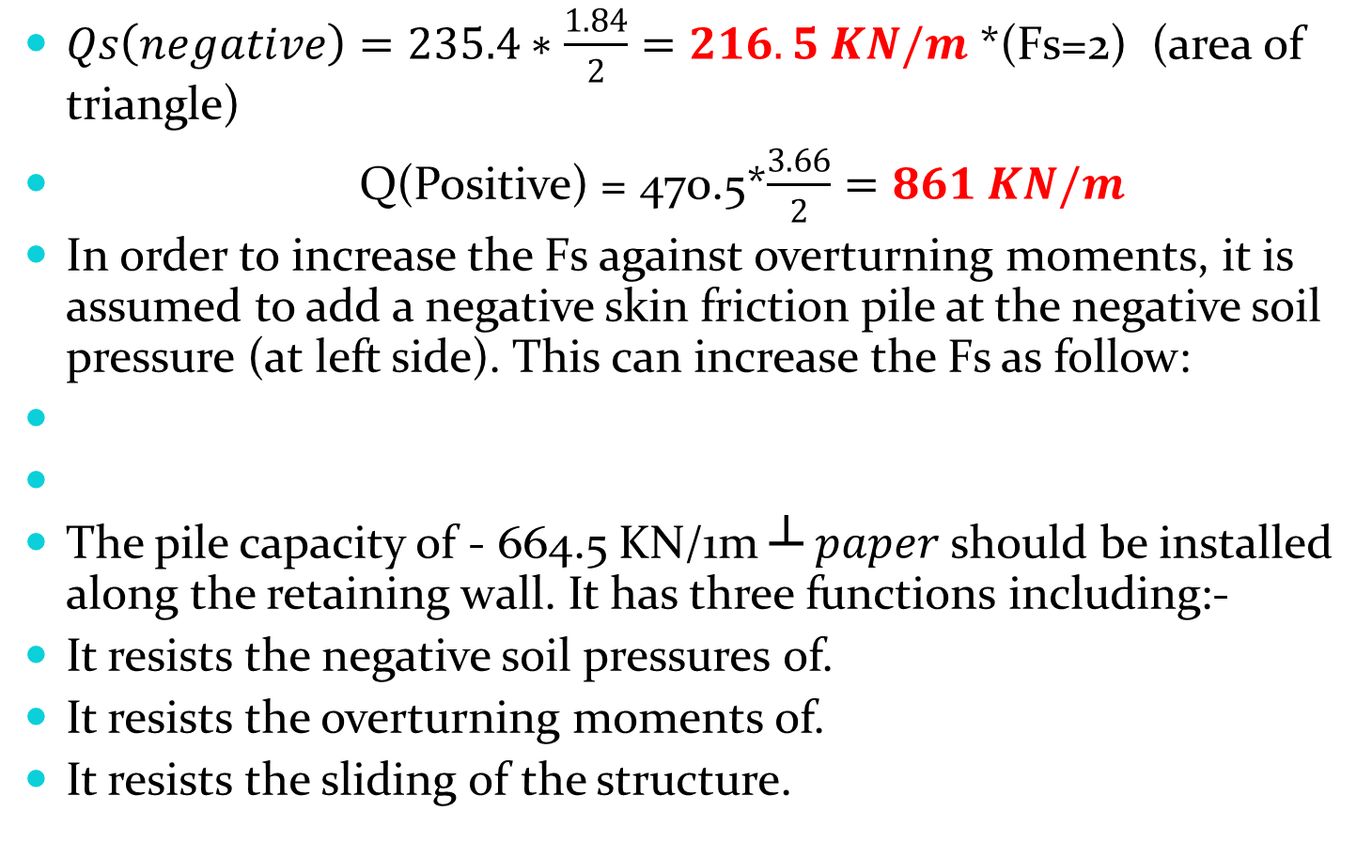
Total negative soil force
$Qs\left(negative\right)=235.4∗\frac{1.84}{2}=216.5 KN/m$ *(Fs=2) (area of triangle)
Q(Positive) = 470.5*$\frac{3.66}{2}=861 KN/m$
In order to increase the Fs against overturning moments, it is assumed to add a negative skin friction pile at the negative soil pressure (at left side). This can increase the Fs as follow:
The pile capacity of - 664.5 KN/1m ┴ $paper$ should be installed along the retaining wall. It has three functions including:-
It resists the negative soil pressures of.
It resists the overturning moments of.
It resists the sliding of the structure.

Slide 14
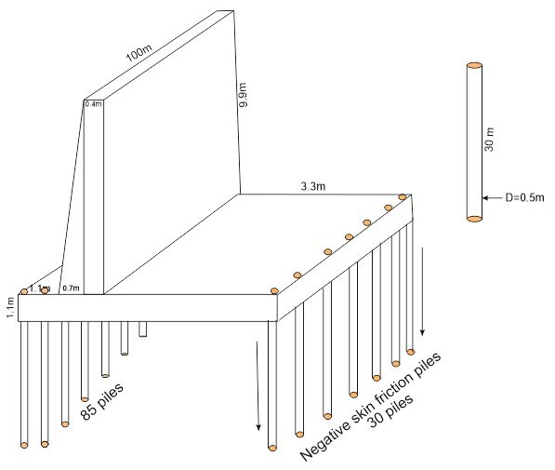
Retaining wall structure

