Slide 1

Collage of nursing
Lec:4 Part-1
Fundamental of Nursing
Instructor:
Dr. Mahdi Hamzah AL- Taee

Slide 2
Vital Signs
The taking of vital signs” refers to measurement of the client’s body temperature (T), pulse (P) and respiratory rates (R) , and blood pressure (BP). vital signs are taken whenever the patient is admitted to a health care facility or service, for example, home health care, clinic, or other ambulatory setting, and on a routine basis in the hospital.

Slide 3
Body Temperature (T)
Definition body Temperature:
Is controlled by balancing metabolic heat production with heat loss. Most heat production comes from the deep tissue organs (brain, liver, and heart) and the skeletal muscles.
Check temperature:
1-Thermometer: glass (client’s bedside).
2- Electronic and disposable protective sheath .
3-Lubricant (rectal, glass thermometer).

Slide 4
Physiology of body temperature
Hypothalamus is gland consider point of thermoregulatory center.
anterior hypothalamus = response to heat
posterior hypothalamus = response to cold

Slide 5
Physical process of heat loss
1.Radiation: the diffusion of heat by electromagnetic waves.
Ex. Body gives off waves of heat from uncovered surfaces.
2. Convection: the diffusion of heat by motion between areas of un equal density.
Ex. Fan of cool air across the surface of warm body.
3.Evaporation: conversion of the liquid to a vapor.
Ex. body fluid in form of in sensible loss it vaporize from skin.
4.Direct contact: transfer of heat to another object during direct contact.
Ex. Body transfer heat to ice pack and causing ice melt.

Slide 6
Factors can influence the normal temperature
1.Age
Newborn = Hypothermic stabilizing temperature within a small range, makes them susceptible to temperature variation especially hypothermia.
Children = have slightly higher normal temperature than adult 37C° until age 3 years.
Elderly = have decrease thermos regulation lower than normal 36C°.
2.Gender
Women have increase in body temperature more than men because hormonal changes

Slide 7
Cont.,…
3.Environment:
Cold environment can lead to hypothermia
Hot environment can lead to hyperthermia.
4.Circadian rhythm:
At morning, lower temperature than late afternoon and early evening.

Slide 8
Average normal temperature for adults at various site with advantage and dis advantage
Temperature route | Normal value | Advantage | Disadvantage
Oral | 37C° 98.6 F° | -Easy -Fast -Accurate | -Cannot use for patient -Unconscious -Confused -Prone to seizure -Recovering from surgery
Axillary | 37.5 C° 99.5 F° | - Safe - Good for children And new born | -measure skin surface can be variable
Rectal | 36.5 C° 97.7 F° | -More reflective of core temperature - Fast | -Cannot used for patient Rectal bleeding. Diarrhea. Hemorrhoid. Who are recovering from rectal surgery. Newborn

Slide 9
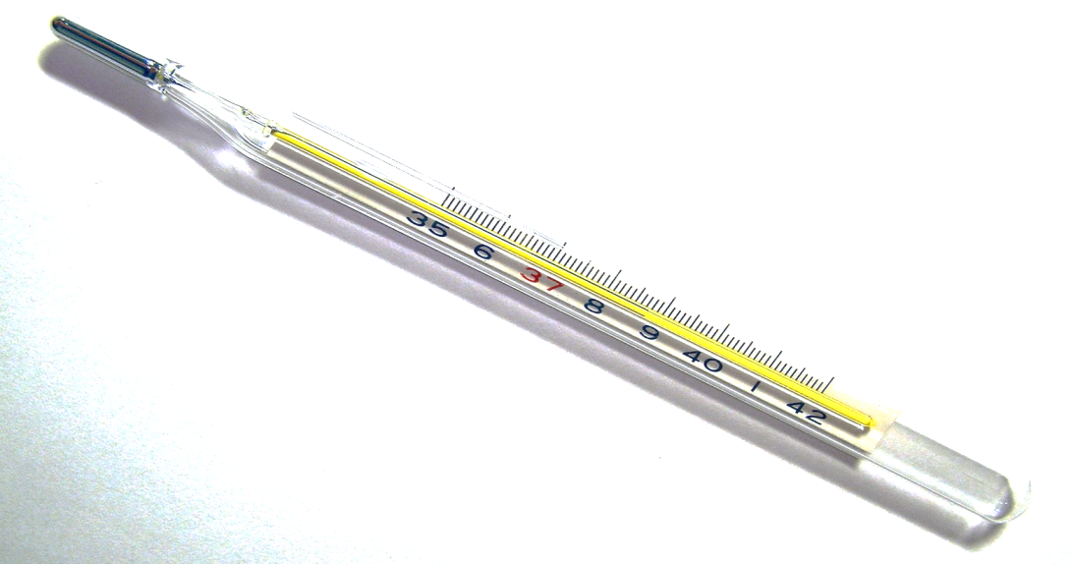
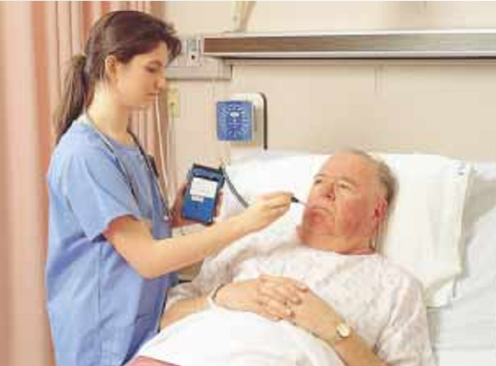
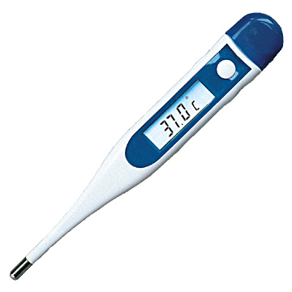
Thermometers

Slide 10
Shift between Fahrenheit and Celsius units
From Celsius to Fahrenheit:
F= 1.8 x C° +32
From Fahrenheit to Celsius:
C°= F - 32\ 1.8

Slide 11
Terms use to describe body temperature
Afebrile: a person with normal body temperature (without fever) 37C°.
Pyrexia=Fever
Arise of body temperature to any point above 37C° and to (40°C)
Hyperthermia = hyper pyrexia
Hypothermia: is a body below the lower limit of normal.
Excessive high body temperature above (41°C).

Slide 12
Fever
Definition of fever:
A fever is a temporary increase in your body temperature, often due to an illness. Having a fever is a sign that something out of the ordinary is going on in your body.
Causes:
1.Pyrogens (microorganisms).
2.Tissues injury: (myocardial infarction, Cancer, trauma, surgery).
3.Neurogenic fever.
4.Fever unknown origin (FUO)

Slide 13
Physical effects of fever (signs and symptoms)
1.Loss of appetite.
2.Headache.
3.Hot dray skin.
4.Flushed face.
5.Thirst.
6.Muscle aches.
7.Fatigue.
8.Increase respiratory and pulse rate.
9.Seizure in infant and confusion in elderly.
10.Blisters.

Slide 14
Nursing interventions for patient with fever:
Monitor vital signs.
Monitor intake and output.
Monitor seizure.
Administer antipyretic as order.
Administer IV fluid as order.
Apply cold compresses or ice pack covered with towel

Slide 15
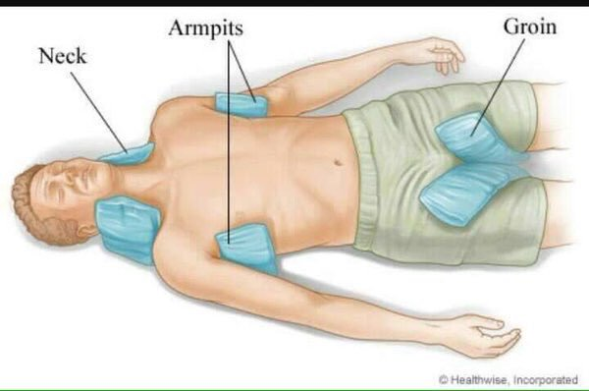
Sites of compresses:

Slide 16
Pulse (P)
Define the pulse:
Is the bounding of blood flow in an artery that is palpable at various points on the body.
Characteristics of pulse:
1.Rate (60- 100) beat per minute b\m
2.Quality (absent, thready, weak, normal, rapid)
3.Rhythm (regular, irregular) .

Slide 17
Physiology of the pulse
Stroke volume : quantity of blood forced out of the left ventricle with each contraction
Sv = 70 ml\min.
Heart rate range = (60- 100 ) b\m
Cardiac output (CO): amount of blood pumped per minute.
Cardiac output CO= Stroke volume (SV) X Heart rate (HR)
Normal CO = 3.5 to 8 L\m

Slide 18
Factors affecting of pulse.
1-Age: Normally Pulse Rates at Varies Ages.
2-Sex: After puberty, the average male pulse rate is slightly lower than the female.
3-Exercise
4-Temperature: Fever; Hypothermia
5-Emotions: Acute pain ,anxiety -- pulse rate Unrelieved severe pain-- pulse rate
6-Drugs: atropine digitalis
7-Postural changes: Standing or sitting , Lying down
8-Hemorrhage:
9-Pulmonary conditions: poor oxygenation

Slide 19
Terms describe pulse
Tachycardia: increase pulse rate more than normal range (100-180 b\m)
Bradycardia: decrease pulse rate less than normal range (less 60 b\m).
Absent pulse : no pulse is felt despite extreme pressure.
Thready pulse: pulse is not easily felt but slight pressure causes it to disappear.
Weak pulse: stronger than thread appear with light pressure
Bounding pulse: strong pulse felt with moderate pressure.
Pulse deficit: differences between apical and radial pulse rate.

Slide 20
Sites of pulse points:
1.Temporal.
2.Carotid.
3.Apical.
4.Brachial.
5.Radial.
6.Femoral.
7.Popliteal.
8.Posterior tepia
9.Dorsalis Pedi's.

Slide 21
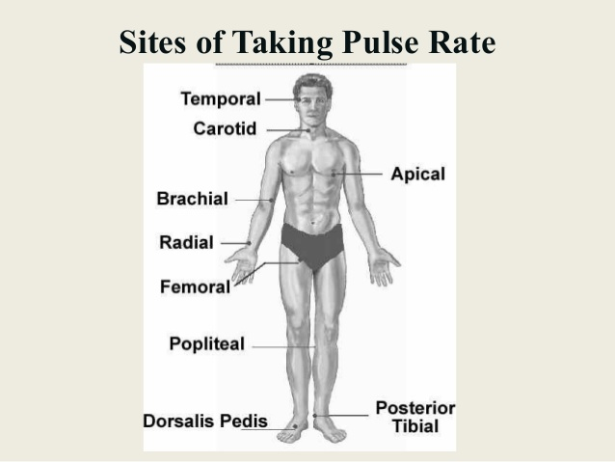
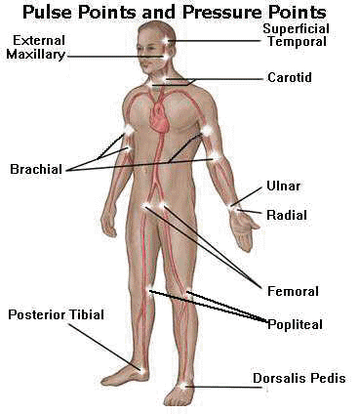
Site of Taking Pulse

Slide 22
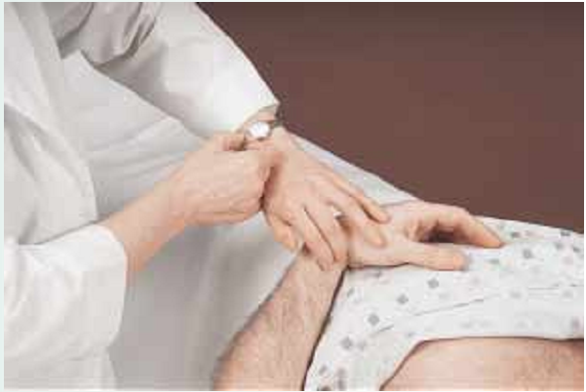
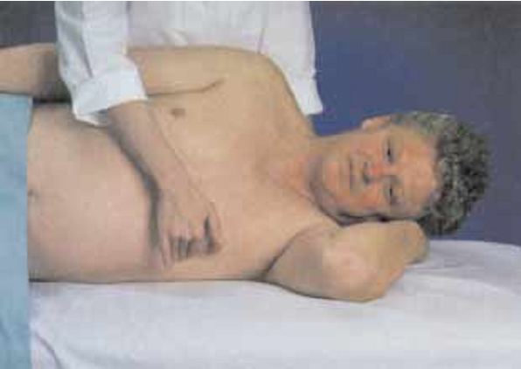
Place index and middle finger on inner aspect of client’s wrist over the radial artery.
Palpating the Apical Pulse.

Slide 23
Normal age-related variations in resting pulse
Age | Normal Range | Average Rate/Minute
Newborn | 100–170 | 140
1 yr | 80–170 | 120
3 yr | 80–130 | 110
6 yr | 75–120 | 100
10 yr | 70–110 | 90
14 yr | 60–110 | 90
Adult | 60–100 | 80

Slide 24

Thank You

