Slide 1
Collage of nursing
Lec:5
Fundamental of Nursing
Medication Administration
Instructor:
Dr. Mahdi Hamzah AL- Taee

Slide 2
Medication-Related Terms
Medication :substances administered for Dx, Rx ,cure ,relieve and prevention of diseases.
Generic name (scientific name): drug name describe the chemical structures of the drug.
Trade name (brand name): name given by the manufacturer.
Prescription:
written direction for the preparation and administration of medication

Slide 3
Medication-Related Terms
Therapeutic effect : the reason the drug prescribed.
Side effect (adverse effect): the secondary effect of the drug that is unintended.
Drug allergy: immunologic reaction to drug.
Anaphylactic reaction: severe allergic reaction usually occur immediately after drug administration.
Drug toxicity: deleterious effects of a drug on an organism or tissue, results from over dosage, buildup of the drug in the blood because of impaired metabolism or excretion.
Drug interaction: occurs when the administration of one drug before, at the same time, or after another drug alter the effect of one or both drug.

Slide 4
Actions of Drugs on the Bodies
Onset of action: the time after administration when the body initially responds to drug.

Slide 5
Factors Affecting Medication Actions
Developmental factors
  Pregnancy, and the effect of medication on the fetus.
  Physical changes due to aging.
  Gender: hormonal actions
Diet
  Ex. Vitamin K and Warfarin
Environment:
  Temperature
Psychological factor
Illness and disease

Slide 6

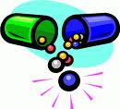
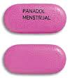

Types of Drug Preparation
Tablets
Pills
Capsule
Lozenge
Syrup
Aqueous suspension
Cream
Jells or jelly
Lotion
Ointment
Paste
suppositories

Slide 7
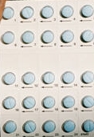
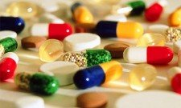
Route of administration

Slide 8
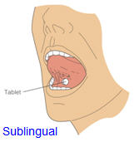
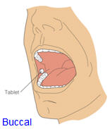
1. Oral medication
1.1 swallowing
1.2 Sublingual
  Under tongue
  Used for general or local effect
  Under tongue
  Dissolved
  Largely absorbed in to blood stream
1.3 Buccal (cheeks)
  keep until Dissolved
  Same as oral
  under cheeks

Slide 9
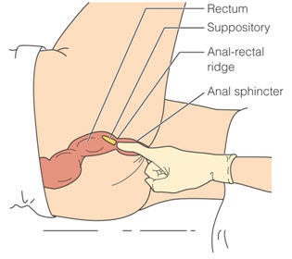
2. Rectal route
Used when oral drug has objectionable taste or odor
Release at slow steady rate
Pt on the left lateral position with upper leg flexed
Use lubricant
Wear gloves insert suppositories beyond internal sphincter 10 cm

Slide 10


3. Topical route
(Dermatological Preparation, Instillation and irrigation, and Inhalation).
3.1 Dermatological preparation
3.2 Eye (Ophthalmic) instillation
Eye Drops, Eye Ointment

Slide 11
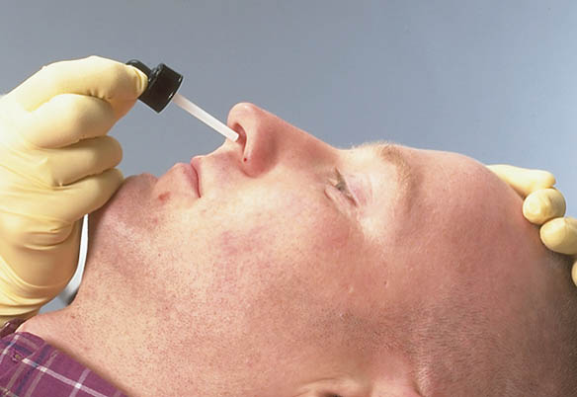
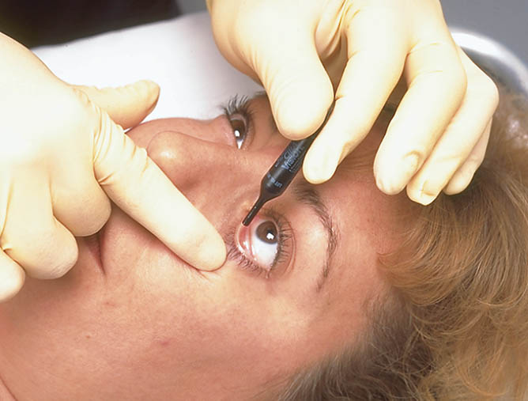

Slide 12
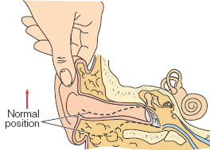
3.3 Ear (otic) drops
Assist patient in side-lying position
Clean the ear
For children (under three years old) gently pull the pinna down and back
For the adult pull the pinna upward and back ward to straighten the auditory canal.

Slide 13
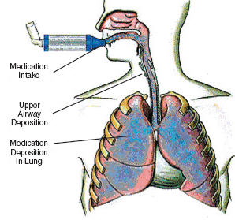
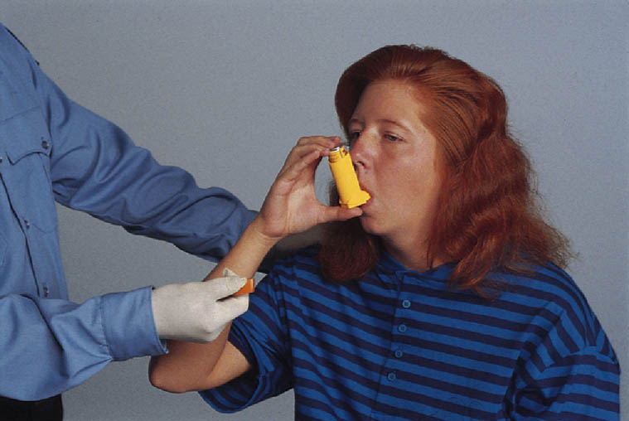
3.4 Respiratory inhalation
Introduce drug through out respiratory tract
Rapid localized relief
Use only for respiratory system

Slide 14
4. Parenteral routes(injections)
1. Intradermal (ID)
2. Subcutaneous (SQ or SC)
3. Intramuscular (IM)
4. Intravenous (IV)

Slide 15
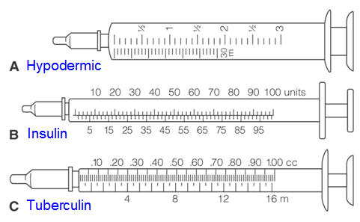
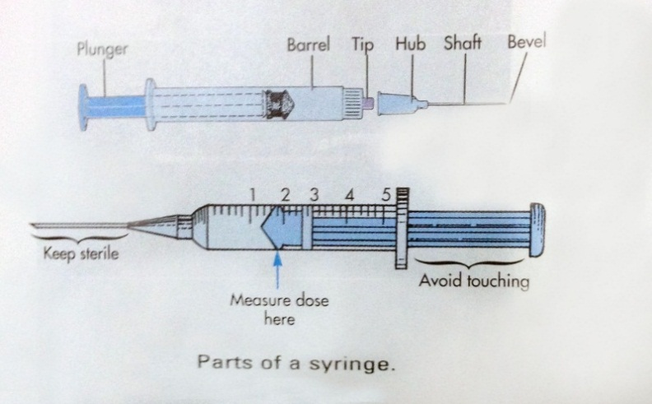
Equipment's
Syringes
Types
  Hypodermic syringe
  Insulin syringe (100 unit/ 1ml)
  Tuberculin syringe (1 ml)
  Regular syringe (5, 10, 20, and 50 ml)
Prefilled unit-dose system

Slide 16
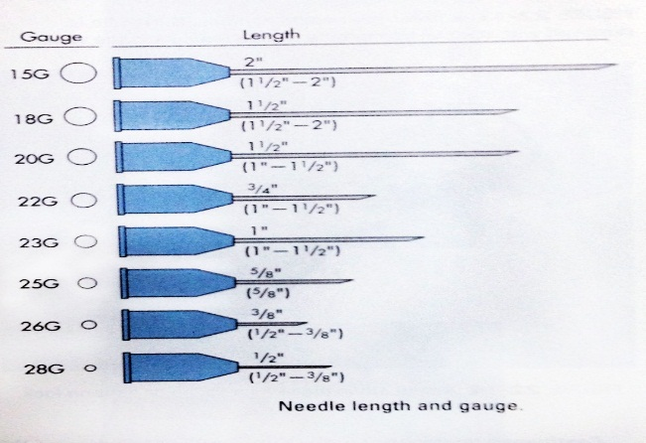
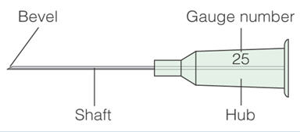
Equipment's needles
Needle characteristics
Bevel (short/ long)
Shaft (1/2- 2 inches)
Gauge (diameter) = 18- 28

Slide 17

4. 1 Intradermal injections
ID in to the dermal layer of the skin
Small doses 0.1 ml
Used for diagnostic purposes
15 degrees angle insertion of the needle
The drug produce a bleb (wheal)
Common site :inner aspect of the arm. upper chest, under scapula
Do not massage the site of the injection
Need time to interpret

Slide 18
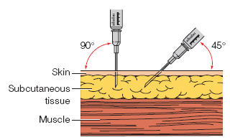

4. 2 Subcutaneous injections(SQ)
Just under the skin
usage
  Vaccination
  Insulin
  Heparin
Only small doses(0.5-1ml)
Needle size and length based on the patient body mass
45 degree angle of insertion

Slide 19
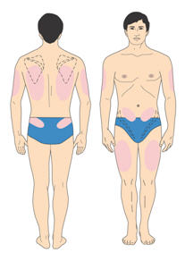
4. 2 Subcutaneous injections (SQ) cont.
SQ injection sites need to be rotated to minimize tissue damage
Common sites: outer aspect of the upper arm, anterior aspect of the thigh, abdomen ,scapular area the ventrogluteal, dorsogluteal area

Slide 20
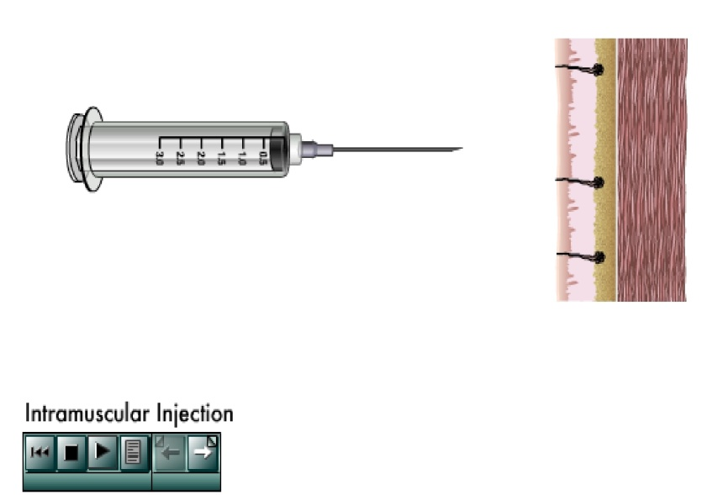
4. 3 Intramuscular injections (IM)
Absorbed more quickly than SQ
1-2 ml used for less developed adult muscle
Use safe site located away from large blood vessels, nerves and bone.
0.5-1 ml in the deltoid muscle
Adult with well developed muscle 4 ml in the gluteal medius and gluteal maximus muscle

Slide 21
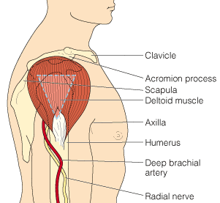
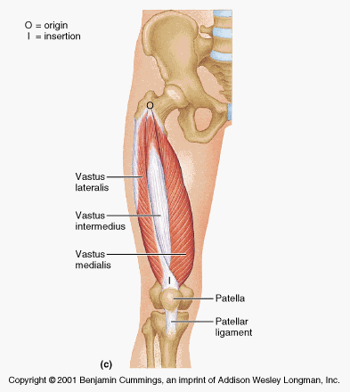
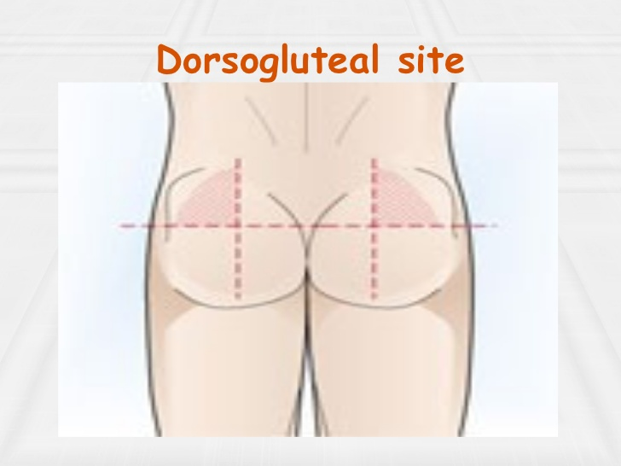
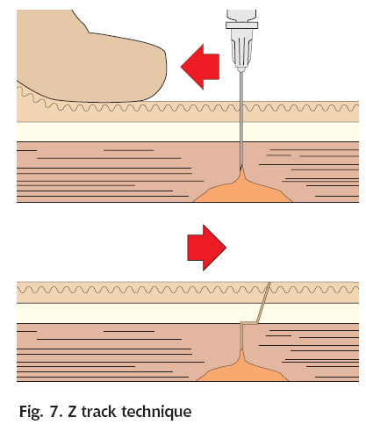
Sites of IM injection
1. Deltoid Muscle
2. Vastus lateralis Muscle
3. Gluteal Muscle
Z-track technique

Slide 22


4. 4 Intravenous injections
Drug enter the blood stream directly
  For rapid effect is required
  Used when medication irritate the tissues
  Large volume of IV fluid
Observe patient closely for signs of adverse reactions
Intravenous push
Hazards effect is volume overload.

Slide 23
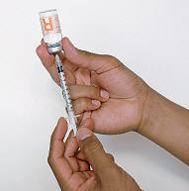
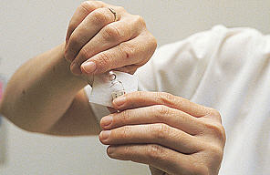
Preparing injectable medication
Ampules
Vials
  Single dose vial
  Multi dose vials
Assignment
Calculation

Slide 24
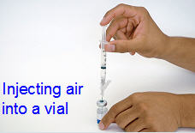
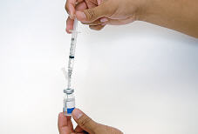
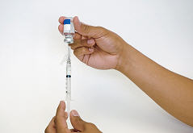
Preparing Medications From Vials
Withdrawing a
medication from
a vial that is held
with the base down
Withdrawing a
medication from
an inverted vial

Slide 25

Drug Calculation
Quantity in hand
Dose in hand
Desired quantity
Desired dose

Slide 26
Safe medication administration
Be acknowledge about the medication you administer.
Take the medication history
Inform patient, explain action, give the side effect.
Question the physician about any unclear order, high doses.
Record the administration.
Evaluate the patient response to the drug.
Use only medication that are clearly labeled.
Do not use liquid drug that are cloudy, change in color.
Do not leave the medication at the bed side.

Slide 27
Rights of the Drug
Right medication
Right dose
Right time (frequency)
Right route
Right patient
Right documentation

Slide 28
Thank you for listening

