Slide 1


Al-Mustaqbal University
College of Science
Qualitative Analytical Chemistry
First Year Students / 1st Lecture
2024-2025
By
Prof. Dr. Naser Abdulhasan Naser

Slide 2
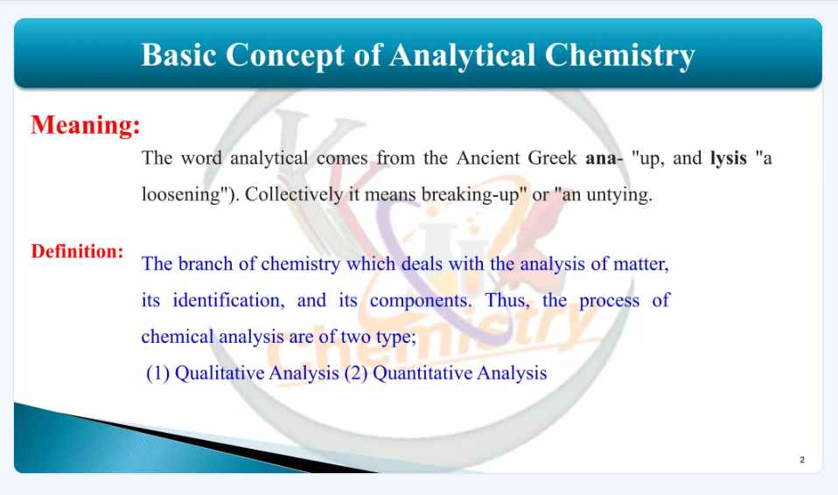

Slide 3
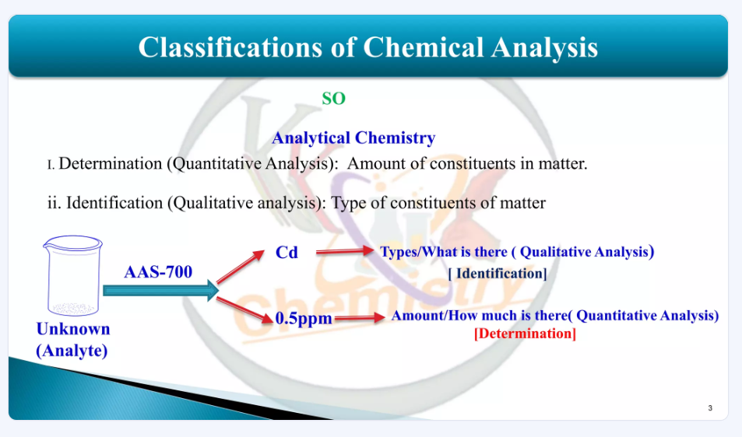

Slide 4
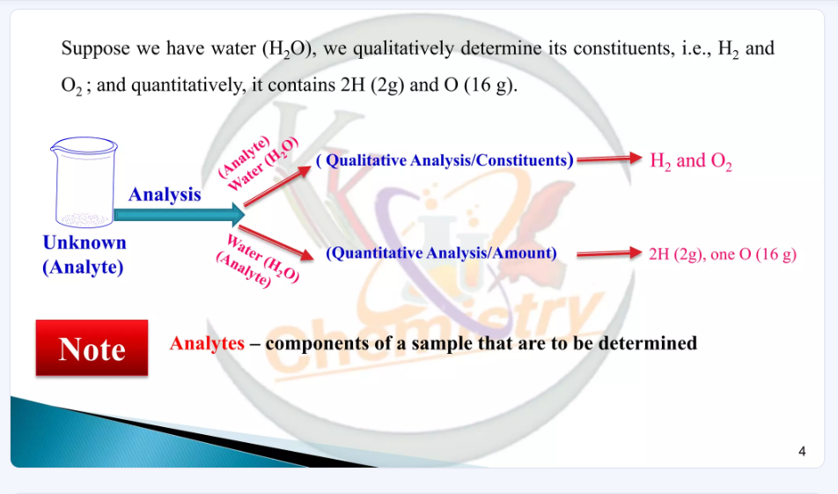

Slide 5
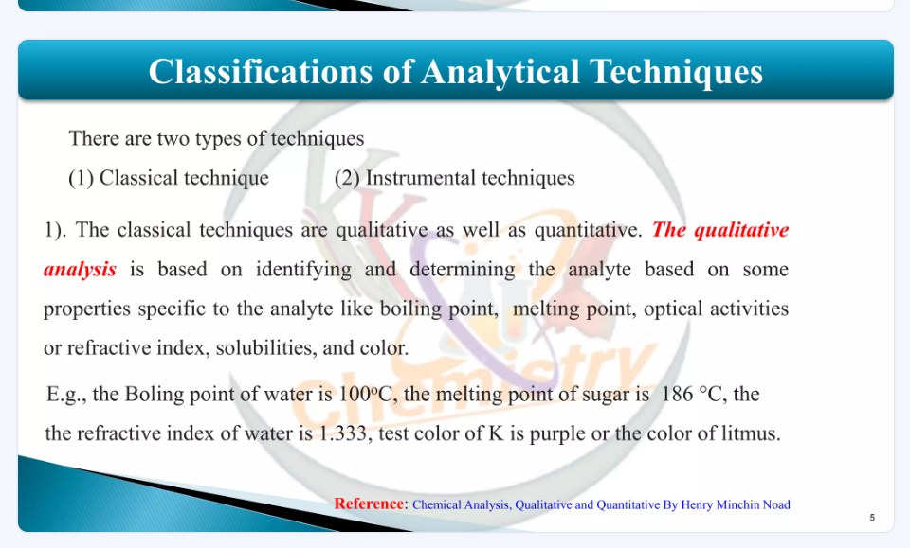

Slide 6
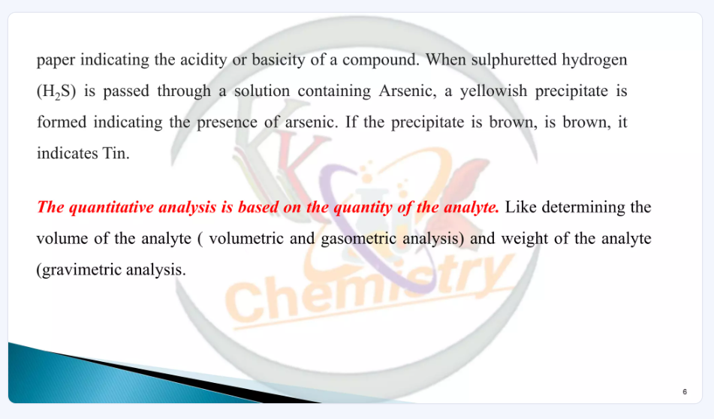

Slide 7
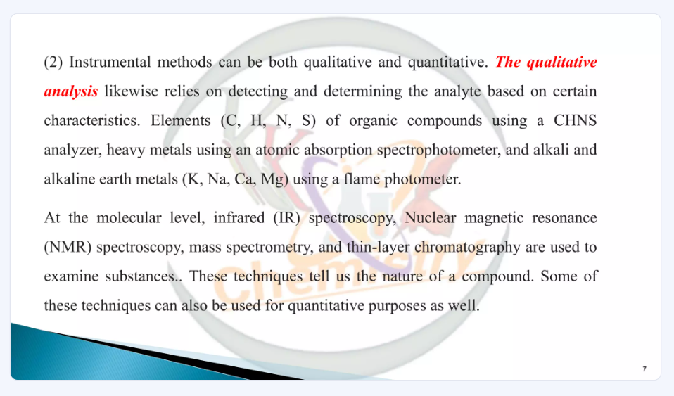

Slide 8
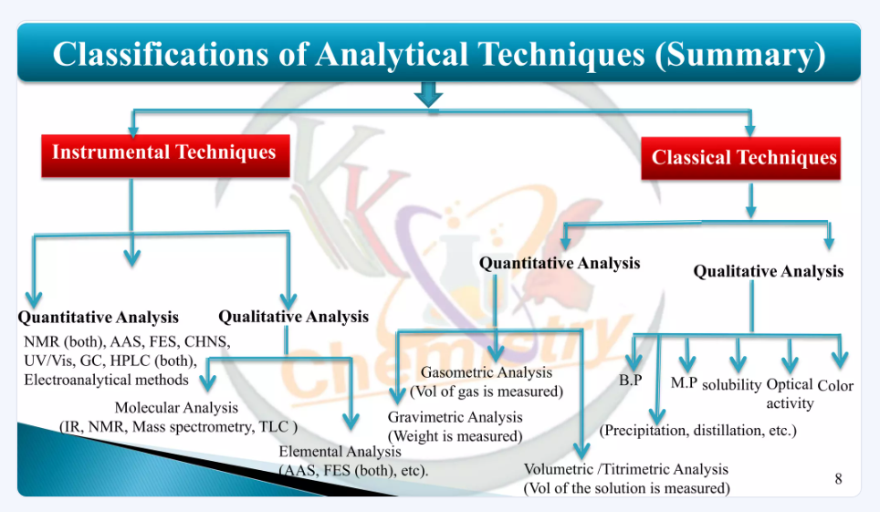

Slide 9
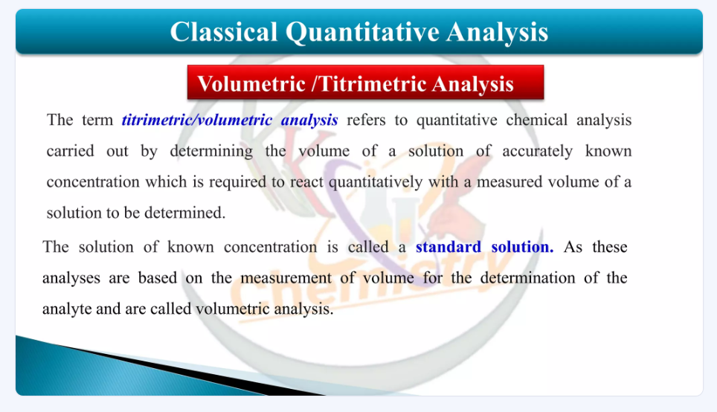

Slide 10
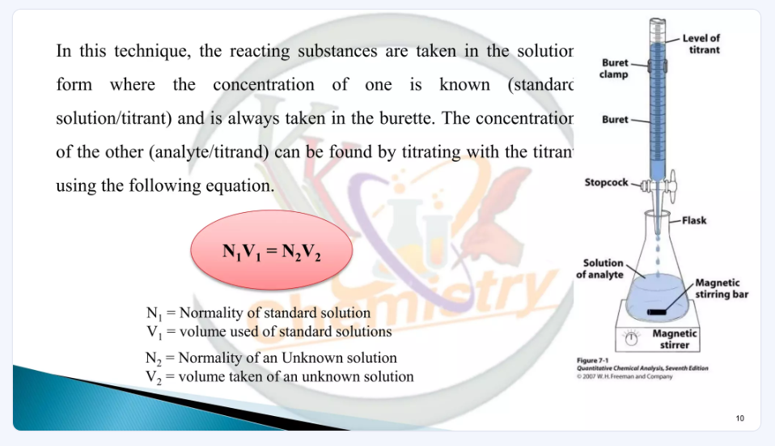

Slide 11
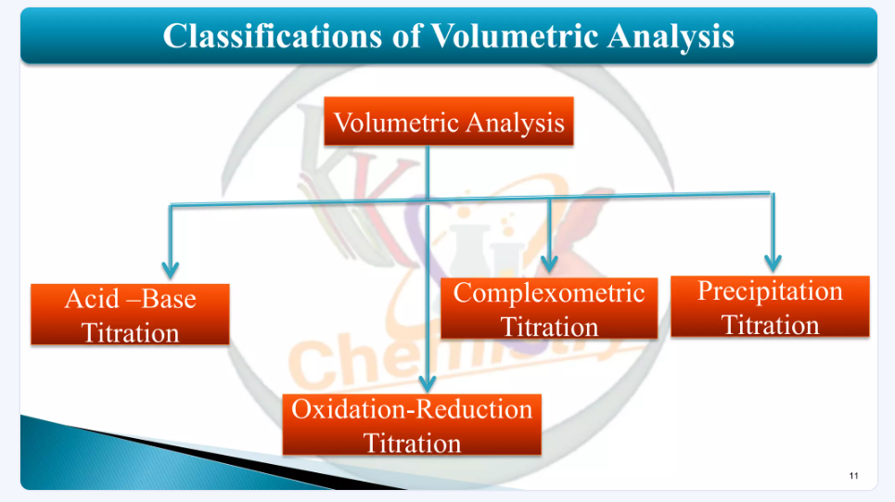

Slide 12
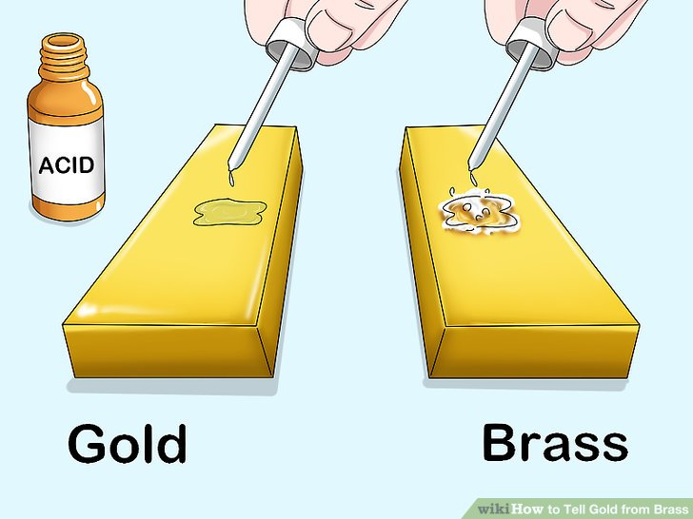
1. Classical Methods
There exist many classical methods of checking for the presence or absence of a particular compound in a given analyte.
These examples are of classical method of qualitative analysis:
The acid test for gold:
The mark is tested by applying
nitric acid, which dissolves
the mark of any item
that is not gold

Slide 13
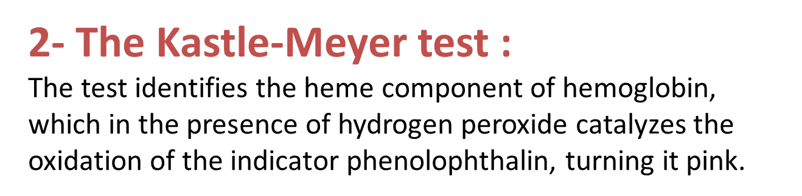
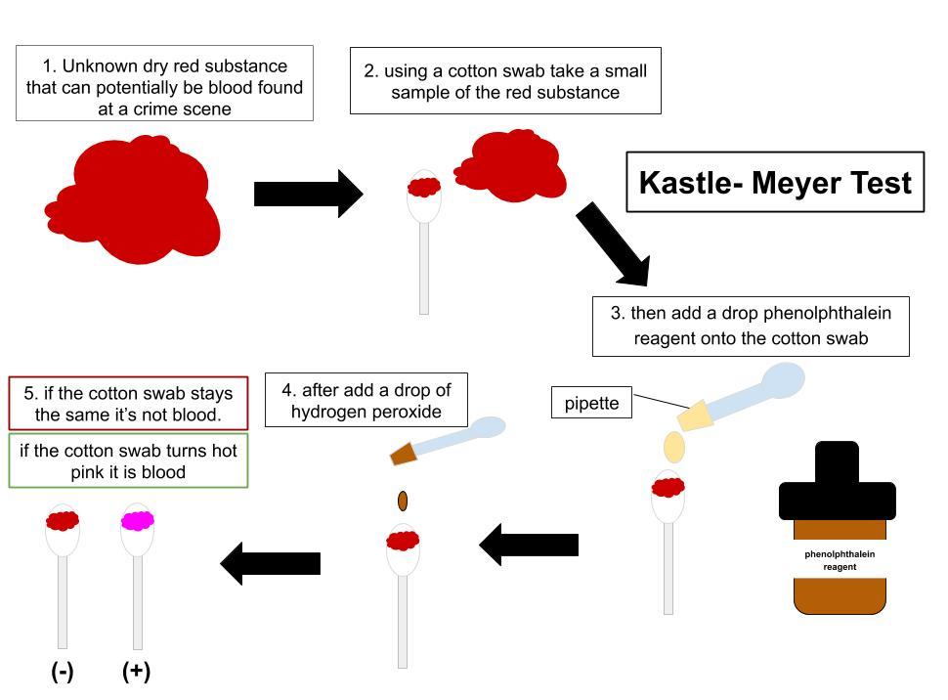

Slide 14
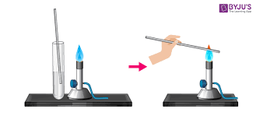
3-Flame tests:
These can be used to check for the presence of specific elements in an analyte by exposing it to a flame and observing the change in the color of the flame.
A flame test is a qualitative analysis used by the chemist to identify the metal and metalloid ion in the sample. Not all metal ions emit color when heated in the gas burner.

Slide 15
