Slide 1
Qualitative Functional Group Analysis

Slide 2
Functional group class
ether
aldehyde
ketone
alcohol
ester
carboxylic acid

Slide 3
Acid (acyl) chloride
amide
alkene
Aromatic=arene
amine
thiol

Slide 4
Name that condensed form
RCOOR’
ROR’
RCOR’
ester
ether
ketone
RCOCl
RCHO
RCOOH
Acyl chloride
aldehyde
carboxylic acid

Slide 5
Do it backwards condensed → name
RCONH₂
RR’C=CRR’
RCl
amide
alkene
Alkyl halide
ROH
RSR’
RNH₂
alcohol
sulfide
Primary
amine

Slide 6
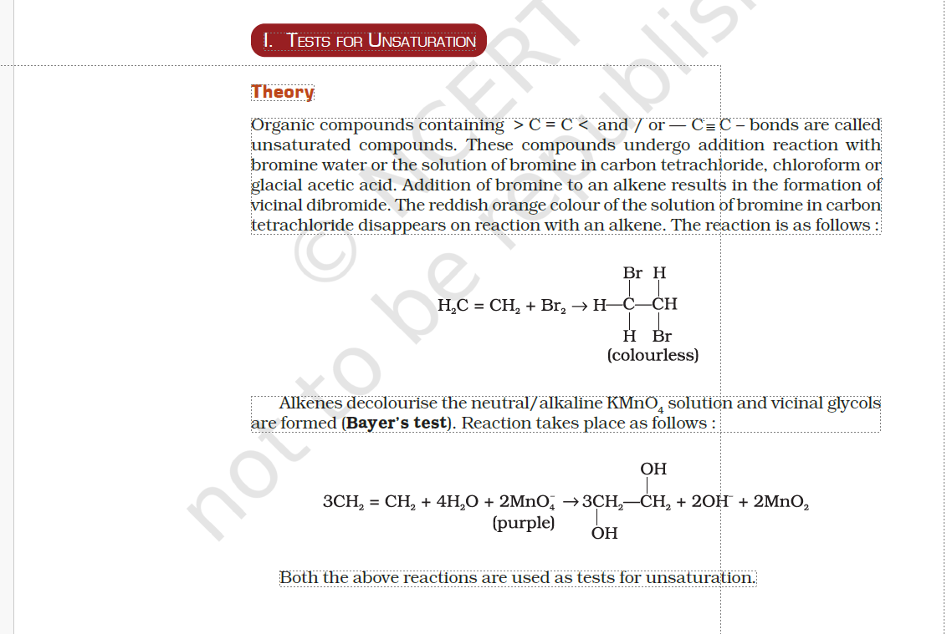
Tests for Functional Groups
https://www.youtube.com/watch?v=mxvB1xLmPI4

Slide 7
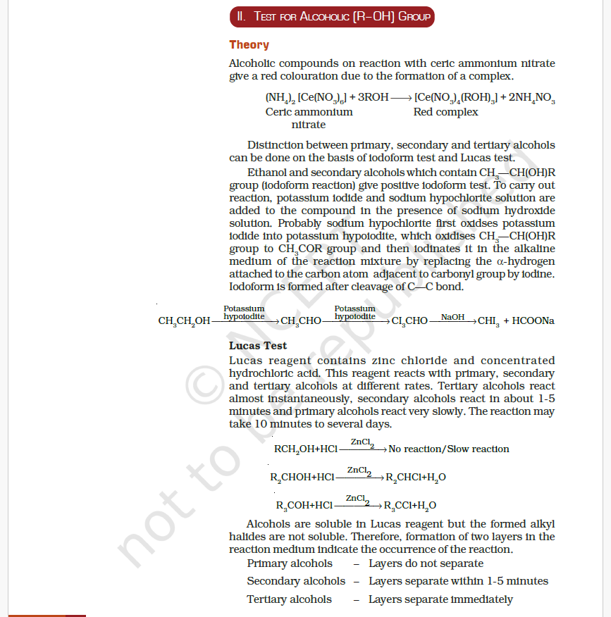
https://www.youtube.com/watch?v=ZuAKxcxdDF8

Slide 8
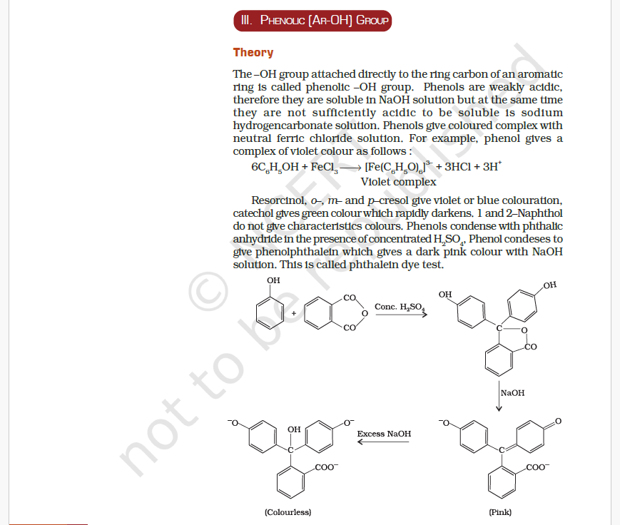
Stop it Doc !
https://www.youtube.com/watch?v=HSGlfbV7W84&t=140s

Slide 9
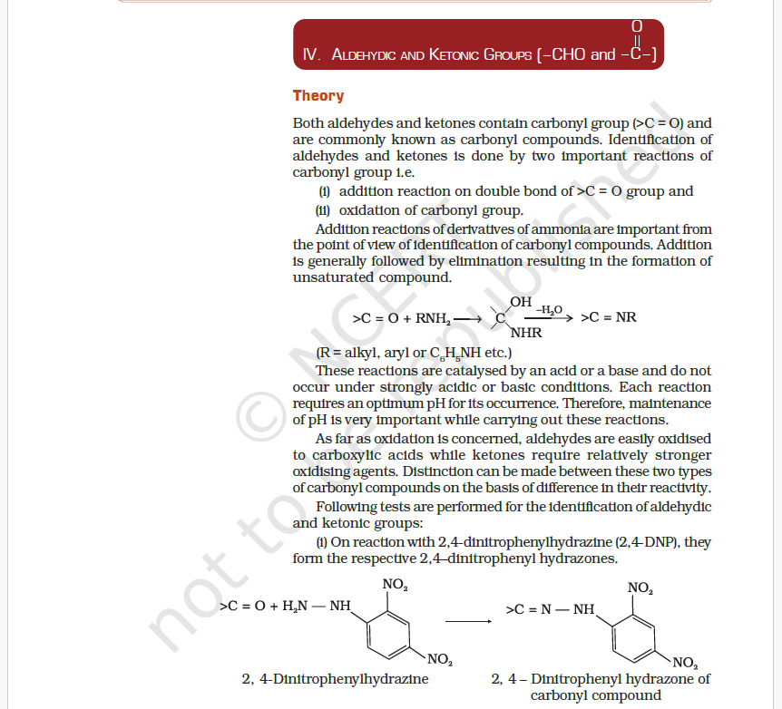
https://www.youtube.com/watch?v=HSGlfbV7W84

Slide 10
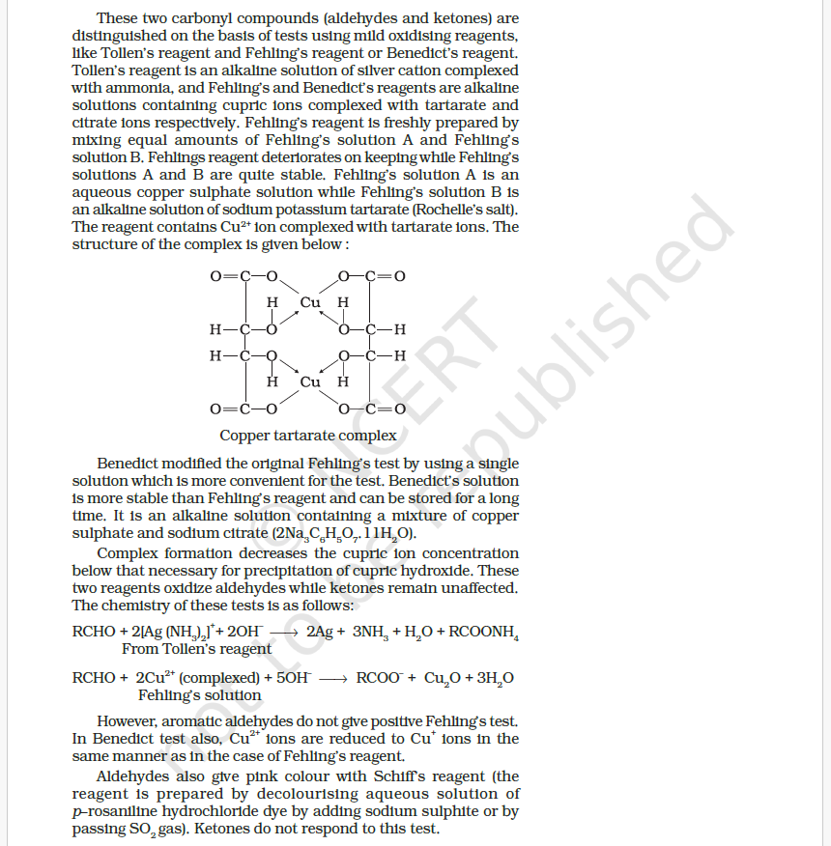
https://www.youtube.com/watch?v=pehXI484Cwc

Slide 11
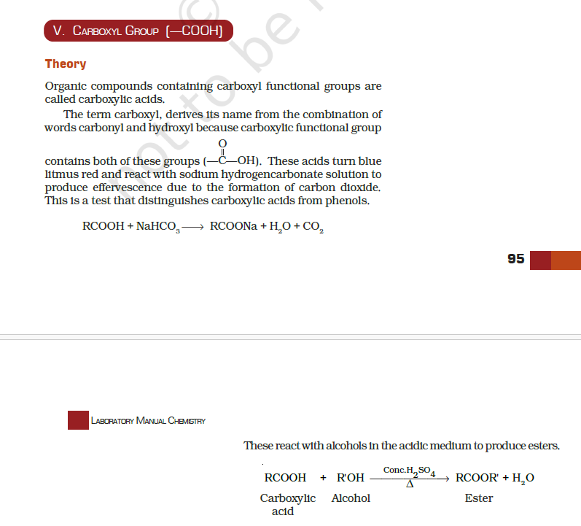
https://www.youtube.com/watch?v=E2xNpSj_A4U

Slide 12
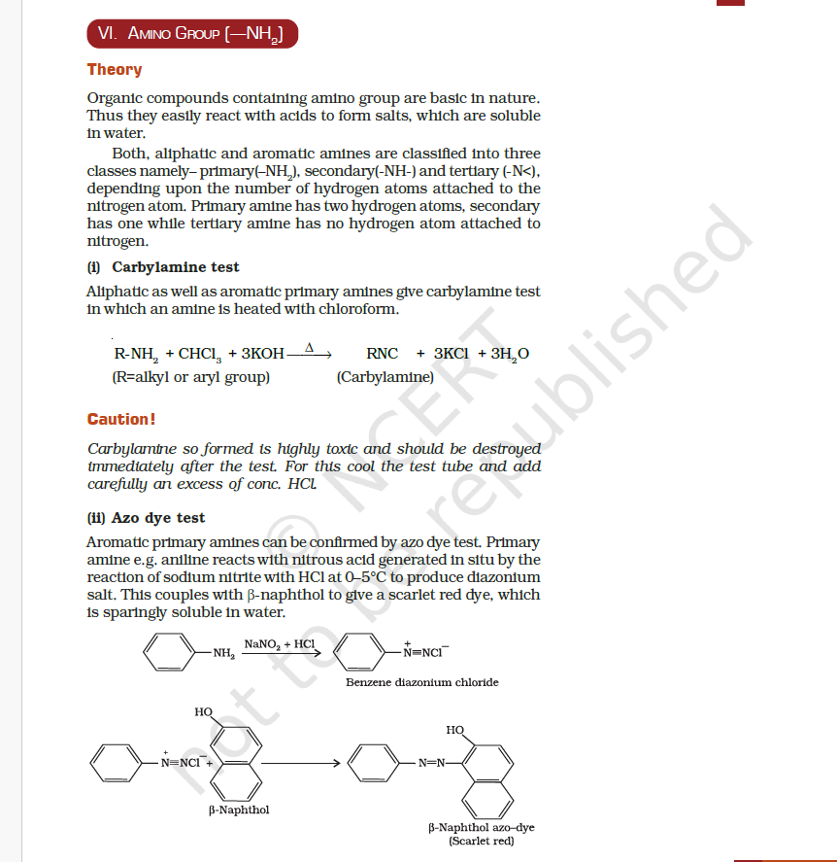
https://www.youtube.com/watch?v=XopvgYTP_AI

