Slide 1


Al-Mustaqbal University
College of Engineering and Engineering Technologies
Biomedical Engineering Department
Subject: Systemic Physiology I
Introduction to Human Physiology
Class : 3th
Lecture: 1
By Assistant Lecturer : Zainab Sattar Jabbar
BME

Slide 2
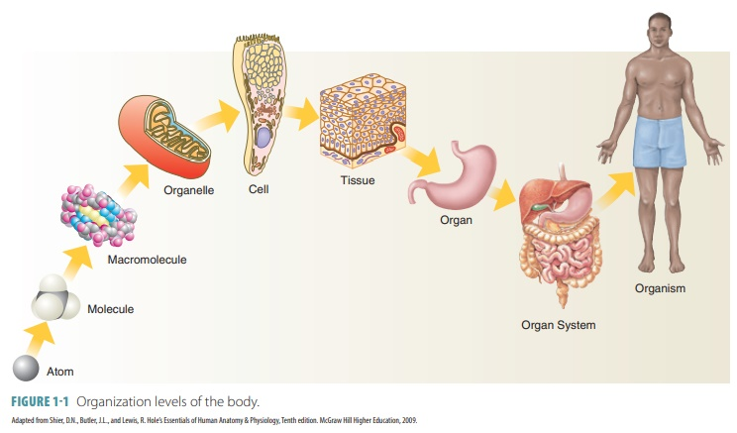
Introduction
Physiology?
Physiology tells us how the bodies of living organisms work. Physiology is based on the gross and microstructure. Both structure and function must be studied at all levels from the cellular to the molecular to the intact organism.
Physiology is the study of the functions of living things.

Slide 3
Levels of structural organization
From single cell to organ system cells are the basic units of living organisms. The number of cells is very large. For example, an adult person contains approximately 100 trillion cells.
Humans have several levels of structural organizations that are associated with each other. The chemical level includes all chemicals substances essential for sustaining life. These chemicals are made up of atoms joined together in various ways. The diverse chemicals, in turn, are put together to form the next higher level of organization, the cellular level.
Cells are the basic structural and functional units of life and organization. Each cell has a different structure and each performs a different function.

Slide 4
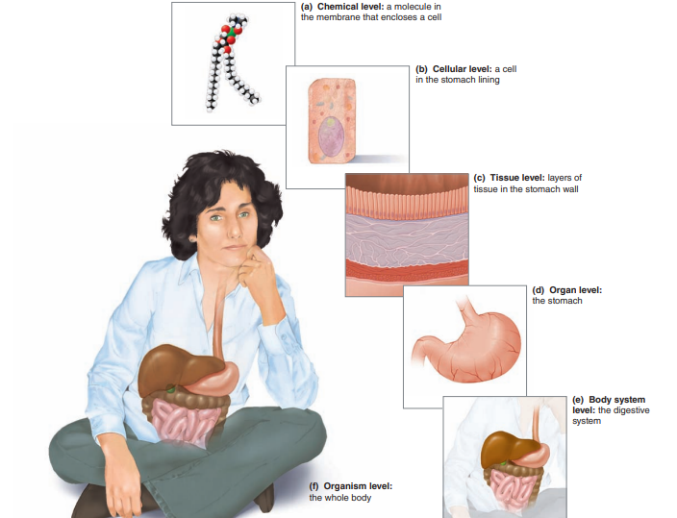
Levels of structural organization

Slide 5
Levels of structural organization
Higher levels of organization are built from lower levels. Therefore, molecules combine to form cells, cells combine to form tissues, tissues combine to form organs, organs combine to form organ systems, and organ systems combine to form organisms.
Cells are the basic structural and functional units of life and organization.
Tissues are formed when cells with similar or related features and functions join together.
Organs are made up of different types of tissues that work together. They perform specific and specialized functions within the body. Organ Systems are made up of different organs that perform coordinated functions

Slide 6
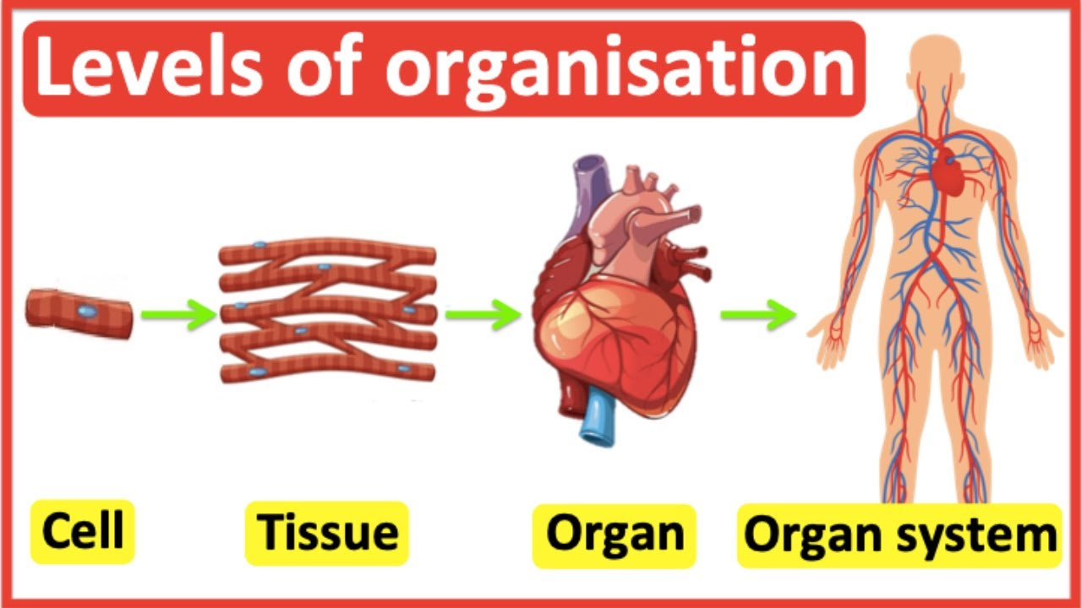

Slide 7
Muscle tissue
Muscle tissue is specialized for contraction and generation of tension. The different types of muscle tissue are functional adaptation of the basic contractile system of actin and myosin.
Skeletal muscles : are responsible for movement of the skeleton, cardiac muscle for the contraction of the heart that causes blood circulation.
Smooth muscle: is responsible for propelling contents within soft hollow organs, such as the stomach, intestine, and blood vessels. Smooth muscle is not under voluntary control and has no striations.
Cardiac muscle fibers branch but are separated into individual cell by continuity of the plasma membrane, the intercalated discs.

Slide 8
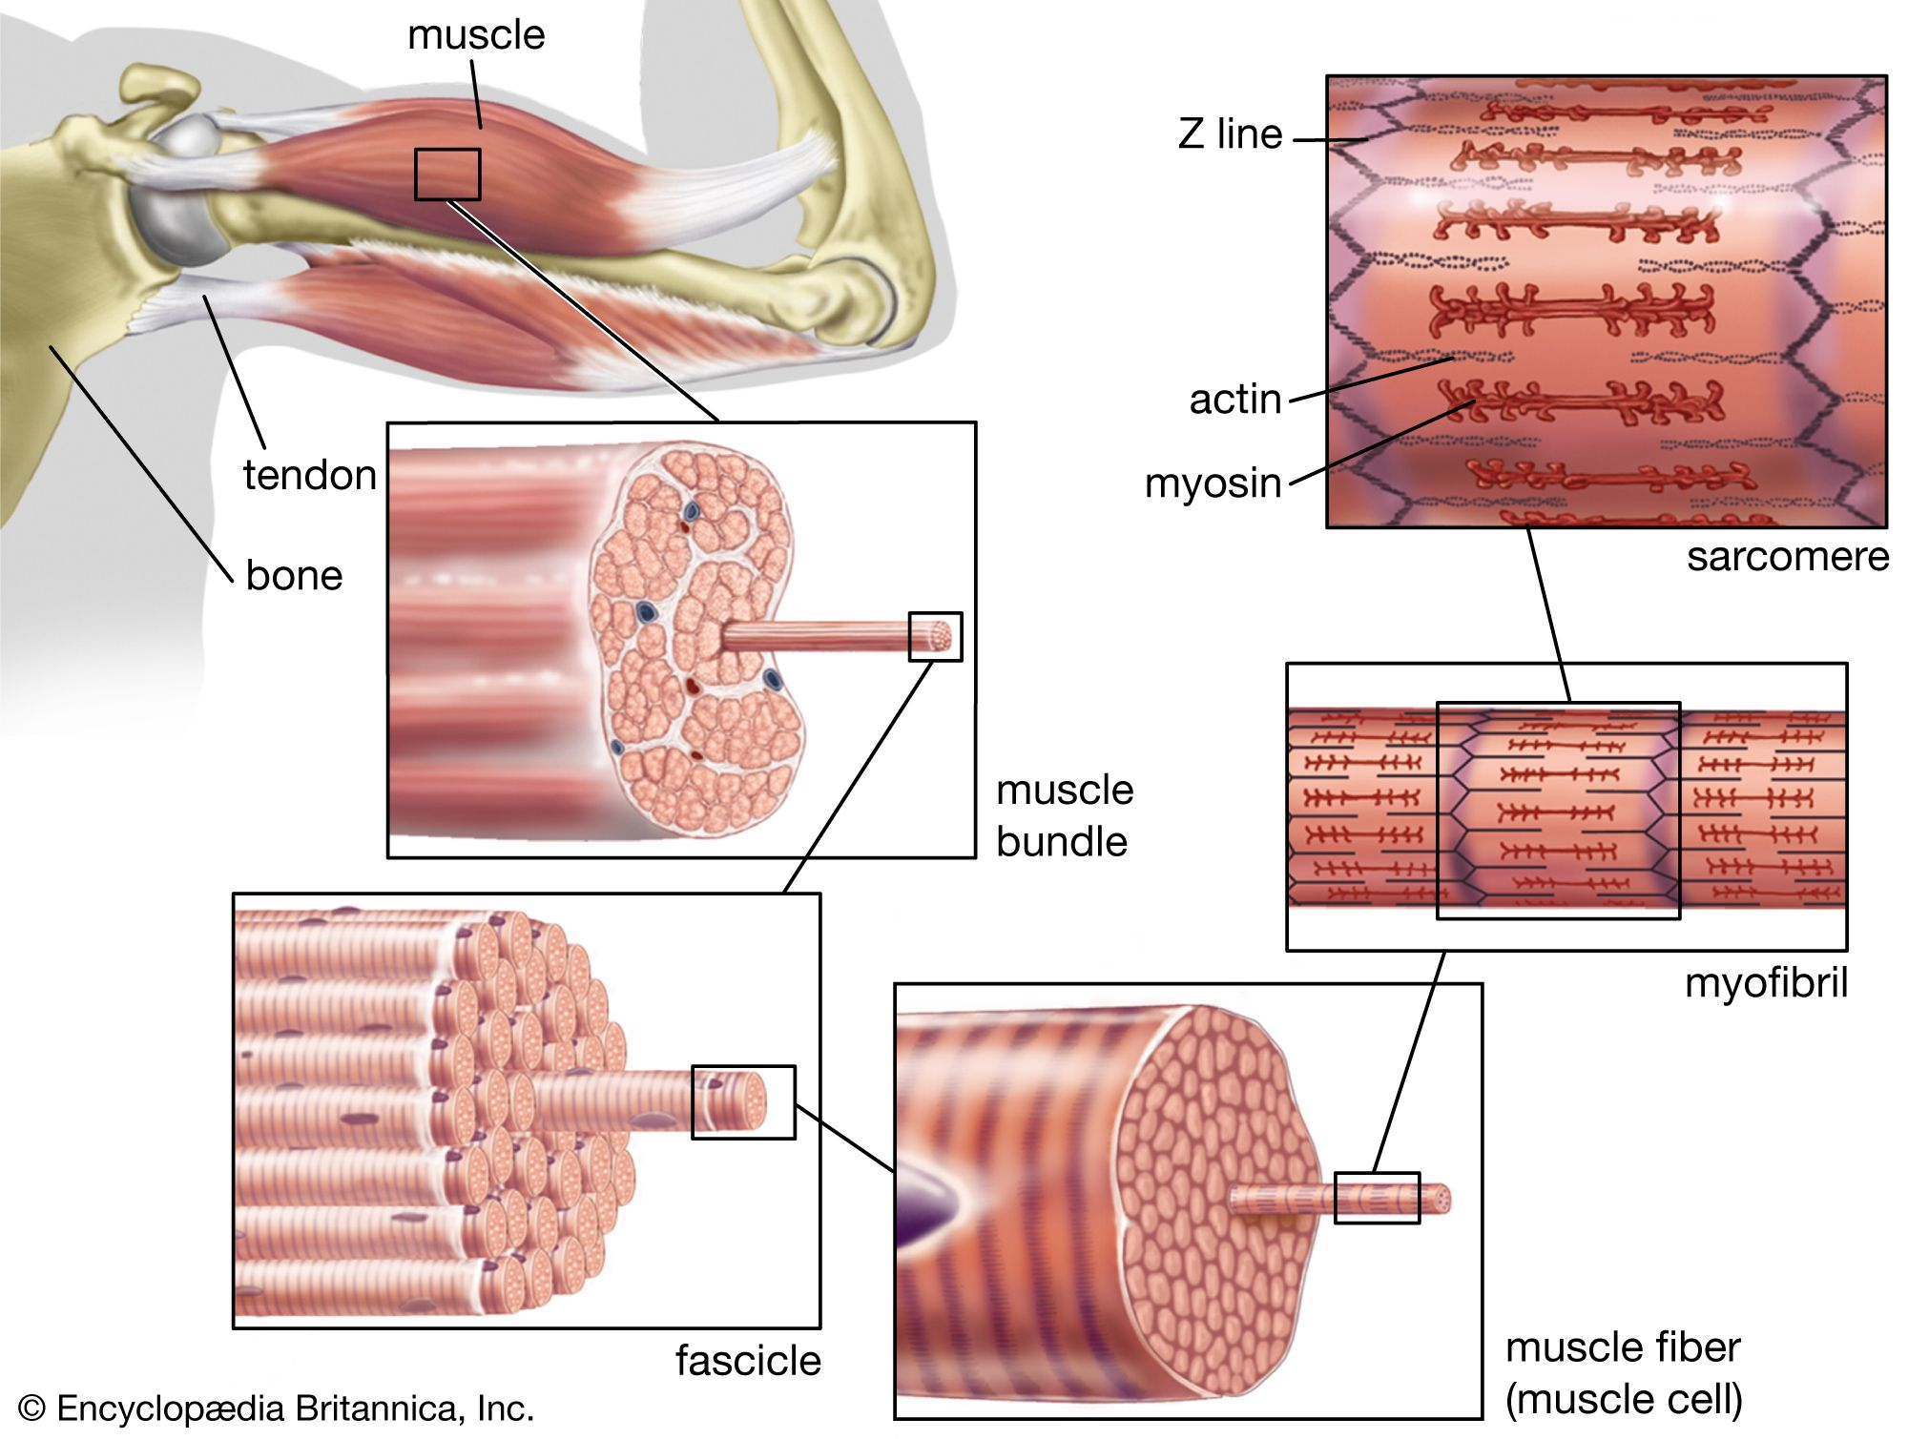
Muscle tissue

Slide 9
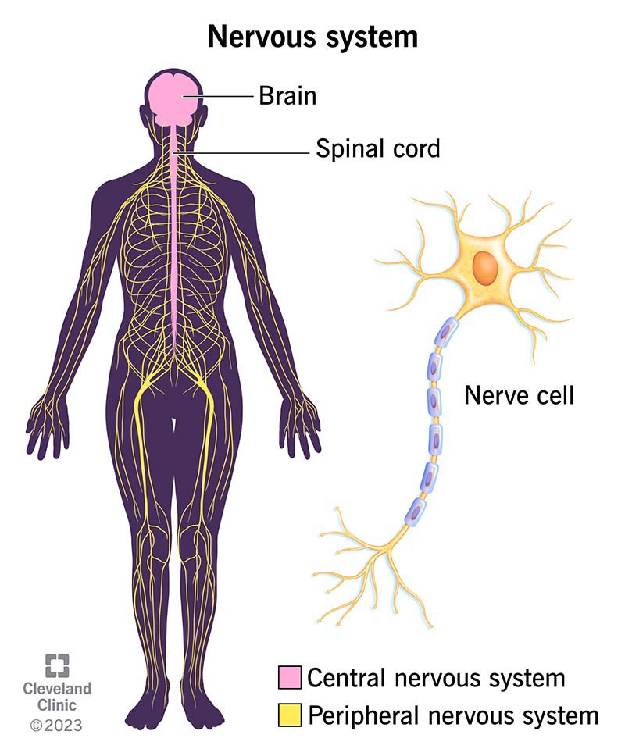
Nervous System- Conducting signals
This tissue is specialized for conduction and transmission of electrical impulses and the organization of these nerve cells or neurons is the most complex of any of the tissue.
The neuron has a cell body that contains the nucleus and the other organelles with very high metabolic activity (e.g., ribosomes and mitochondria).
The neuron is further specialized for having processes, which contact it through the synapses to other neurons, making a long chain of conducting tissue linking the various parts of the body.

Slide 10
Epithelial tissue
It is functionally very diverse. It includes the membranes that cover body surfaces and line hollow viscera internal organs, forming barrier between the interior of the body and the environments.
Epithelial cells may be modified to function as sensory receptor, detecting specific stimuli from the environment. Epithelial cells also form the endocrine glands (pituitary, parathyroids, thyroid, adrenals, ovary, and testis), which secrete 4 hormones directly into the blood and the exocrine glands secrete substances via ducts (e.g., salivary glands, pancreas and liver).

Slide 11
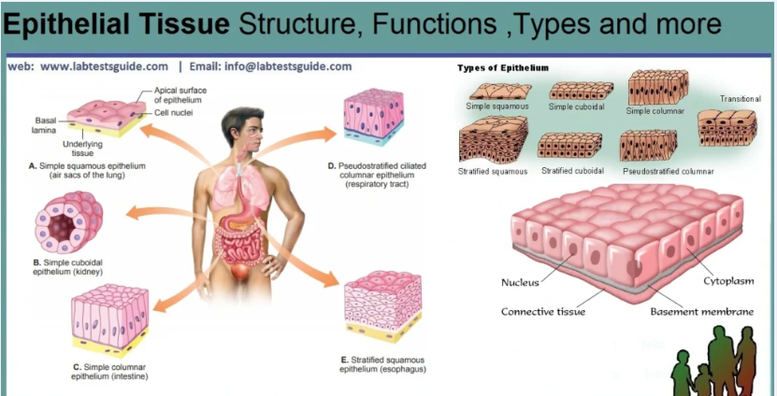
Epithelial tissue structure

Slide 12
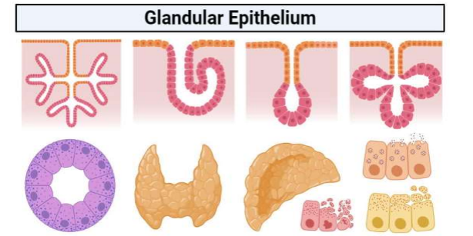
Glandular epithelial tissue

Slide 13
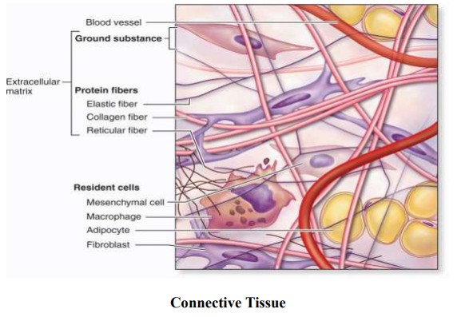
Connective Tissue
It is mesodermal in origin and functions in supporting, connecting and transporting.
It covers wide variety of tissues, but having more intercellular materials or matrix, than cells. It also contains extracellular fibers, which may be tough collagenous fibers or the resilient elastic fibers.

Slide 14
Life processes
The following are the important life processes of humans:
- Metabolism: includes catabolism and anabolism that provides energy and body’s structural and functional components.
- Excitability: Ability to sense changes in and around us.
- Conductivity: ability to carry the effects of stimulus from part of a cell to another.
- Contractility: ability to contract in response to stimulus.
- Growth.
- Differentiation.
- Reproduction.

Slide 15
Composition of the Body
At an average, 60% of the body weight of young adult male is water. The remaining is composed of minerals, fat and proteins.
The human body contains organic compounds such as lipids, proteins, carbohydrates and nucleic acids.
The lipids are important forms of storage fuel in addition to providing insulation of the body as a whole or essential component in the structure of plasma membranes, myelin and other membranes. Carbohydrates serve as a lesser form of fuel storage (400-500 gms).
Proteins serve as the structural basis for all enzymes, contractile muscle proteins, connective tissue, such as collagen and elastin and in addition as a fuel (about 15%), or precursor for carbohydrate in the process of gluconeogenesis. Ingested glucose is converted to glycogen and stored in the liver, muscle and adipose tissue.

Slide 16
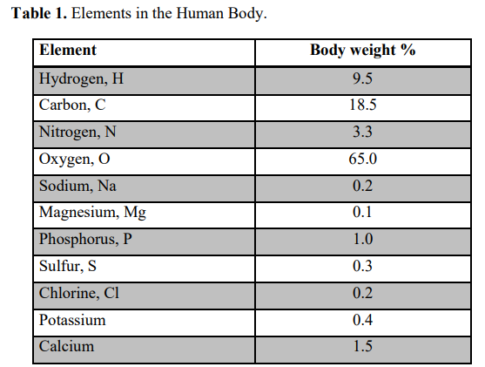
Elements in the Human Body

Slide 17
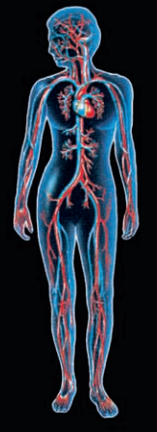
Components of Body System
Circulation : Heart, blood vessels, blood.
Transport materials from one part to another, defends against disease.
Circulation system

Slide 18
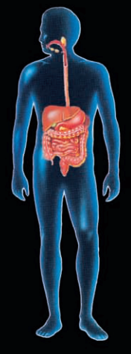
Components of Body System
Digestive system: Mouth, pharynx, esophagus, stomach, small and large intestine, salivary glands, pancreas liver, and gallbladder.
Ingests and digests food, absorbs nutrients into blood.
Digestive system

Slide 19
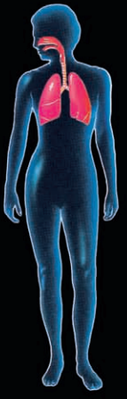
Components of Body System
Respiratory system: Nose, pharynx, larynx, trachea, bronchi, lungs.
Exchanges gases between blood and external environment.
Respiratory system

Slide 20
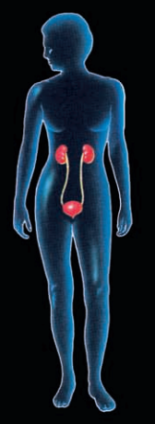
Components of Body System
Urinary system: Kidneys, ureters, urinary bladder, urethra.
Excretes metabolic wastes , regulates fluid balance and acid base balance.
Urinary system

Slide 21
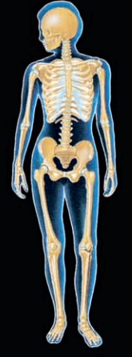
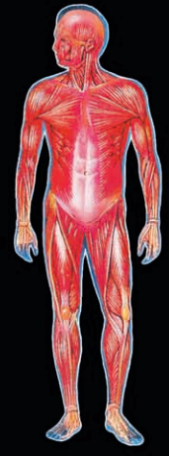
Components of Body System
Skeletal system: Bones, cartilage, joints
Muscle system : Skeletal muscle
Skeletal system
Muscle system

Slide 22
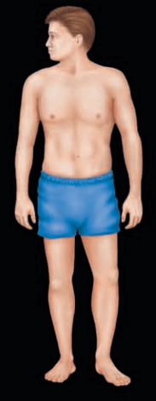
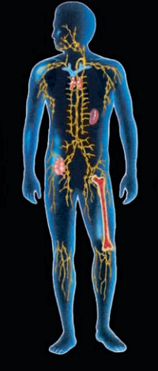
Components of Body System
Integumentary system : Skin, hair, nails
Immune system : Leukocytes, thymus, bone marrow, tonsils, adenoids, lymph nodes, spleen, appendix, gut-associated lymphoid tissue, skin-associated lymphoid tissue muscosa associated lymphoid tissue
Integumentary system
Immune system

Slide 23
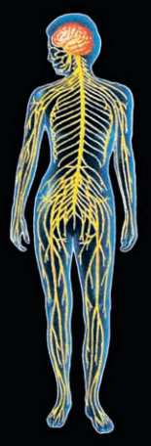
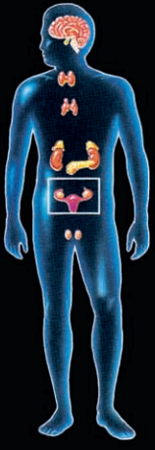
Components of Body System
Nervous system: Brain, spinal cord, peripheral nervous system Special sense organs
Endocrine system: All hormone-secreting tissues including hypothalamus, pituitary, thyroid, parathyroids, adrenals, endocrine pancreas, kidney, intestine, heart, thymus, pineal
Nervous system
Endocrine system

Slide 24
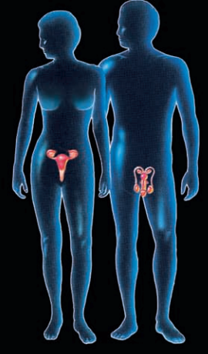
Components of Body System
Reproductive system :
Male: testis, prostate, seminal vesicles, bulbourethral glands, associated ducts.
Female: ovary, oviduct, uterus, vagina, breast.

Slide 25
THANK YOU

