Slide 1







Shipping of hazard materials
M.Sc. Amna Shaker
College of Science
Medical Biotechnology Department
Al-Mustaqbal University

Slide 2
Introduction for Shipping of hazard materials
Hazardous Materials : are solids, liquids, or gases that can harm people, other living organisms, property, or the environment if improperly shipped, stored, or handled.

Slide 3
Hazardous Materials like explosives, gases, toxic materials, and radioactive materials to more seemingly minor products like hair spray that still pose a shipping and handling risk. Each of these classes has a specific sub class that also provides more details on the classification.

Slide 4
Hazardous Materials Divided to :
Class 1: Explosives
Class 2: Gases
Class 3: Flammable liquids
Class 4: Flammable solids
Class 5: Oxidizers/organic peroxides
Class 6: Toxic and infectious substances
Class 7: Radioactive materials
Class 8: Corrosives
Class 9: Miscellaneous hazardous materials

Slide 5
Miscellaneous hazardous materials
Category | Properties
M1 | Substances which, on inhalation as fine dust, may endanger health
M2 | Substances and articles which, in the event of fire, may form dioxins
M3 | Substances evolving flammable vapors
M4 | Lithium batteries
M5 | Life-saving appliances
M6 - M8 | Environmentally hazardous substances: M6: Pollutant to the aquatic environment, liquid M7: Pollutant to the aquatic environment, solid M8: Genetically modified microorganisms and organisms
M9 - M10 | Elevated temperature substances: M9: Liquid M10: Solid
M11 | Other substances and articles presenting a danger during carriage, but not meeting the definitions of another class.

Slide 6
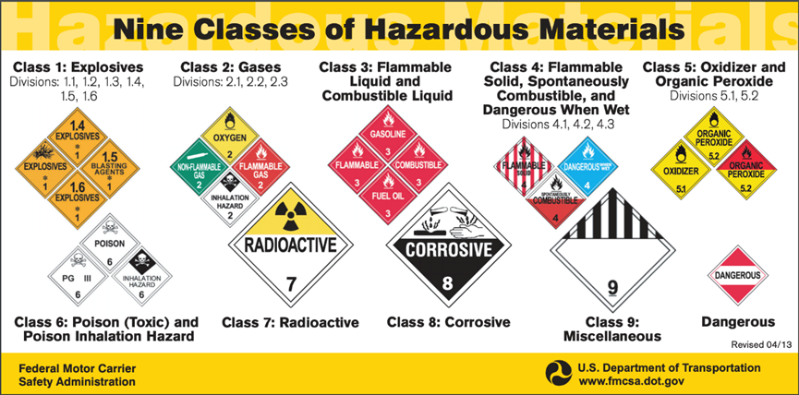

Slide 7
How To Ship Hazardous Materials?
Shipping hazardous materials can be a complicated process, as there are serious implications for getting it wrong. In order to ship hazardous materials, you need to follow a few key steps:
1-Classify the material
2-Contact top carriers
3-Select appropriate packaging
4-Mark and label your package
5-Prepare shipping papers
6-Identify additional carrier requirement.

Slide 8
Shipping hazardous materials considered a complex and expensive process?
- Because there are so many rules and regulations required.

Slide 9
تذكر...
السلامة أولاً!

