Slide 1
Medical Terminology
Musculoskeletal System lec. 7
Dr. Lamees Abd ALRaheem
M.B.CH.B F.I.C.M.S

Slide 2
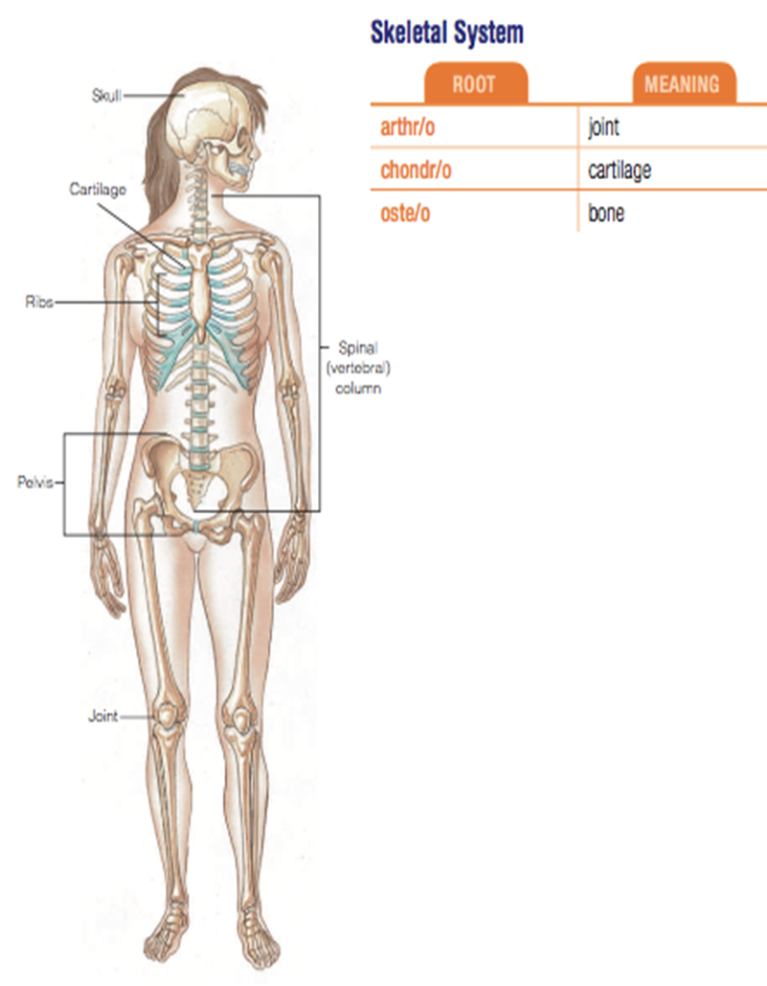
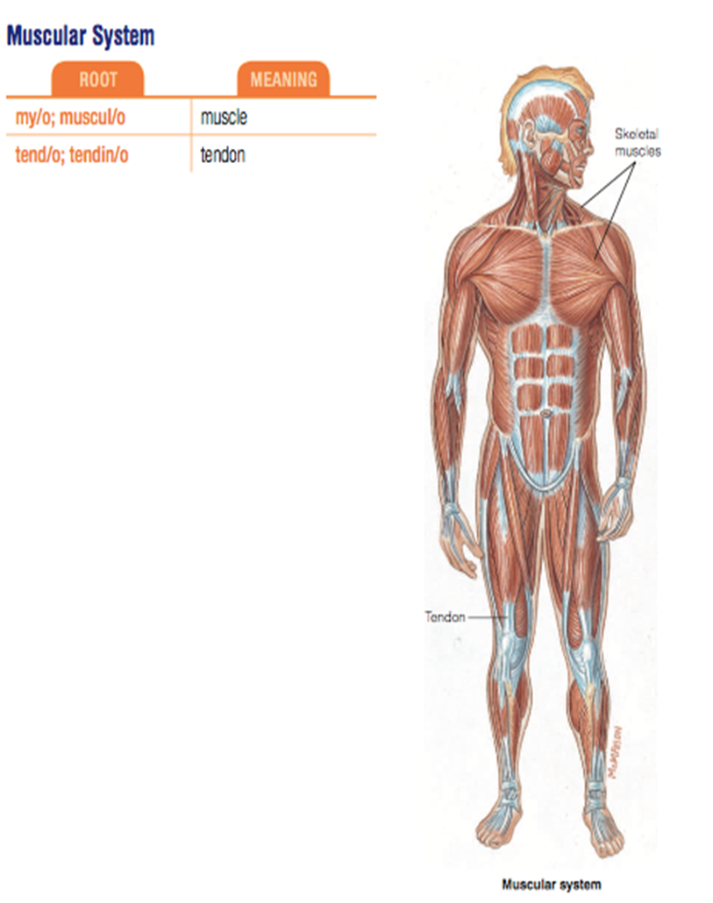

Slide 3
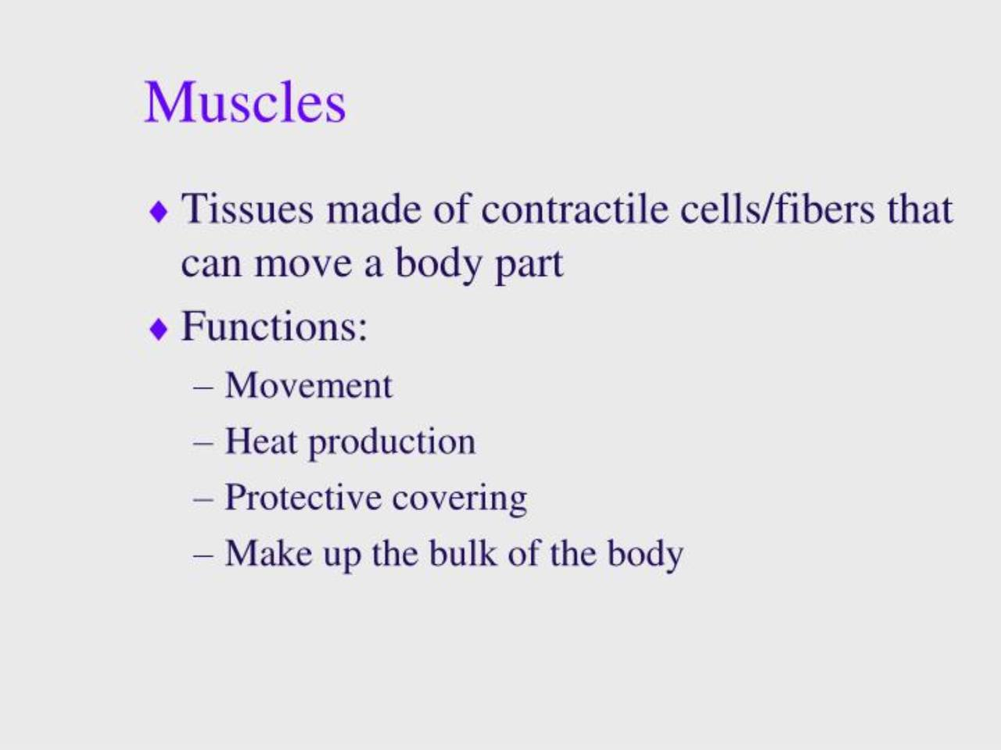

Slide 4
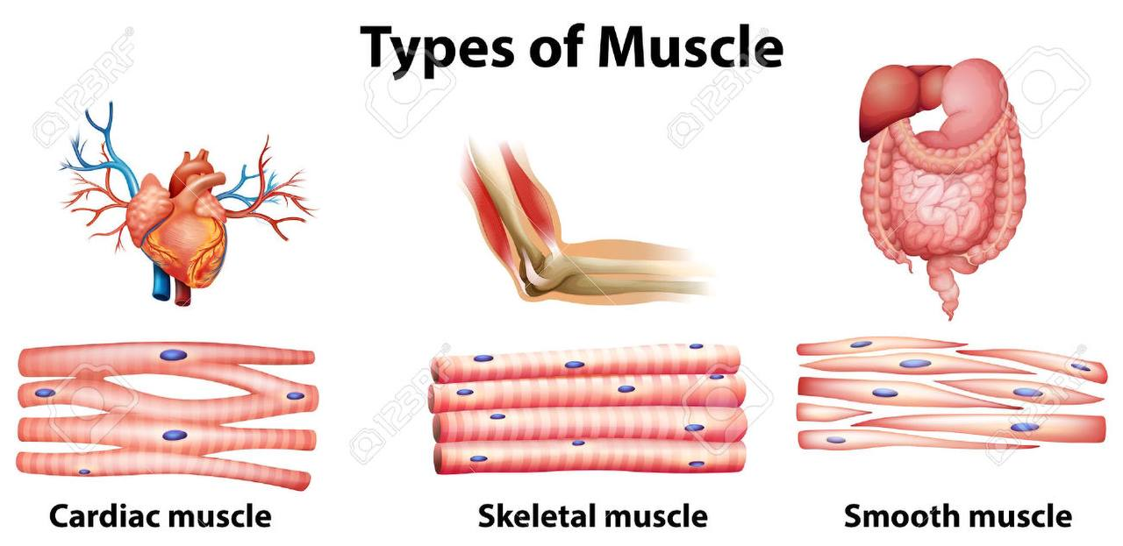


Slide 5
NEW ROOTS :
Root | Meaning | Word analysis
leiomy/o | Smooth muscle | Leiomy/oma : tumor of smooth muscle
muscul/o | muscle | Muscul/ar : pertaining to muscles .
my/o | muscle | My/oma : tumor contaning muscle tissue.
Rhabdmy/o | Striated muscle | Rhabdmy/o/lysis : breakdown of striated muscle.
Tend/o | tendon | Tend/o/plasty : surgical repair of a tendon.

Slide 6
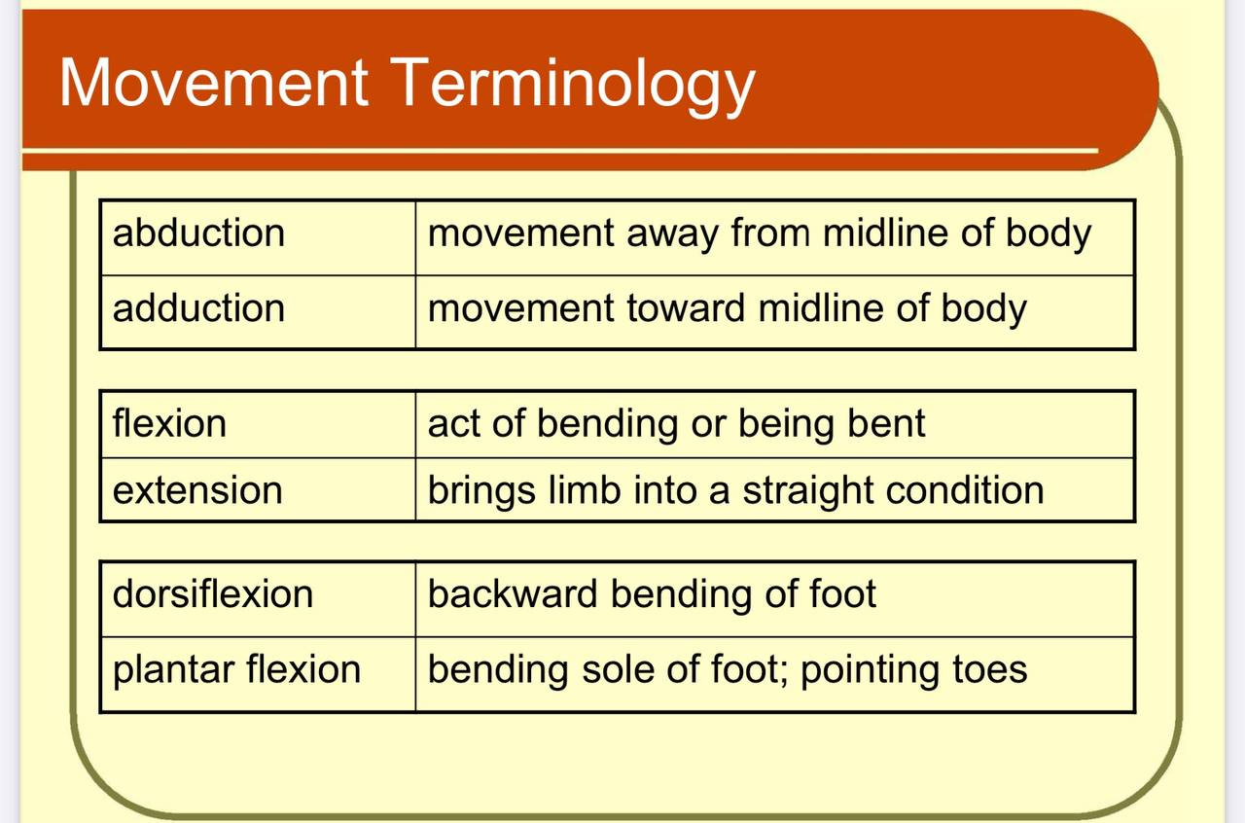

Slide 7
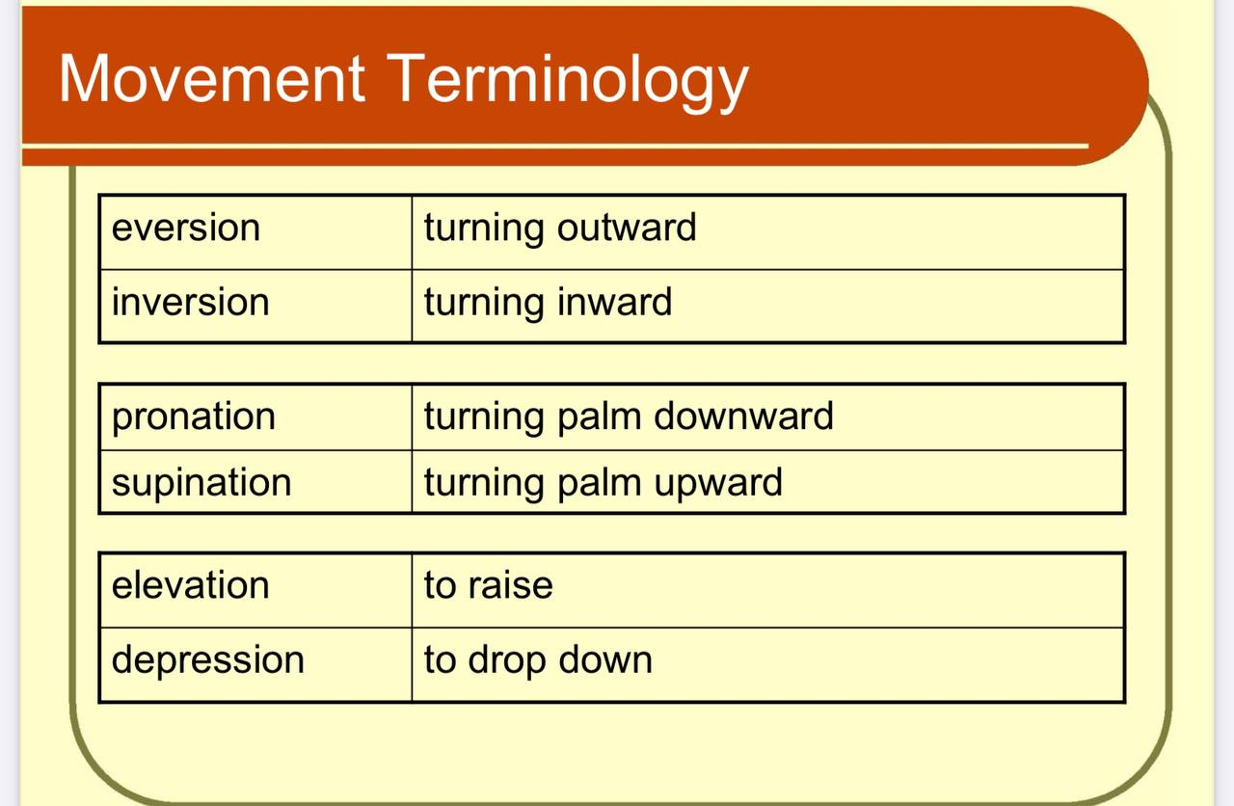

Slide 8
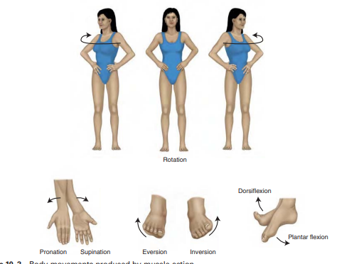
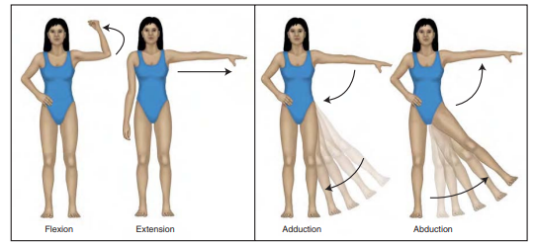

Slide 9
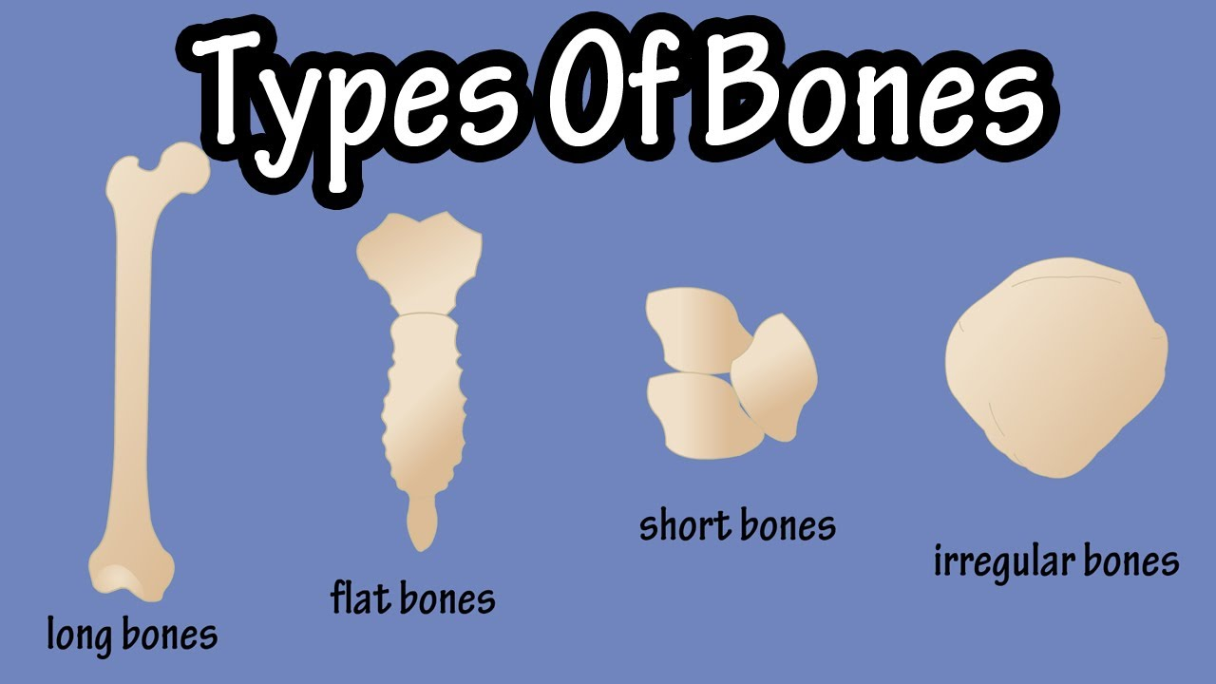

Slide 10
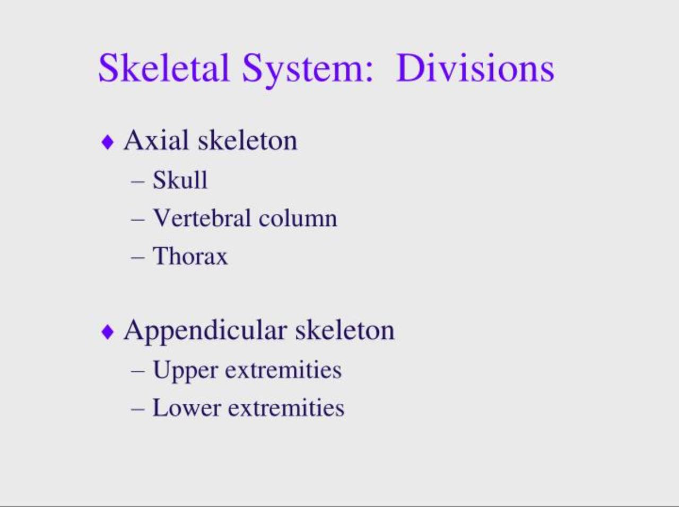

Slide 11
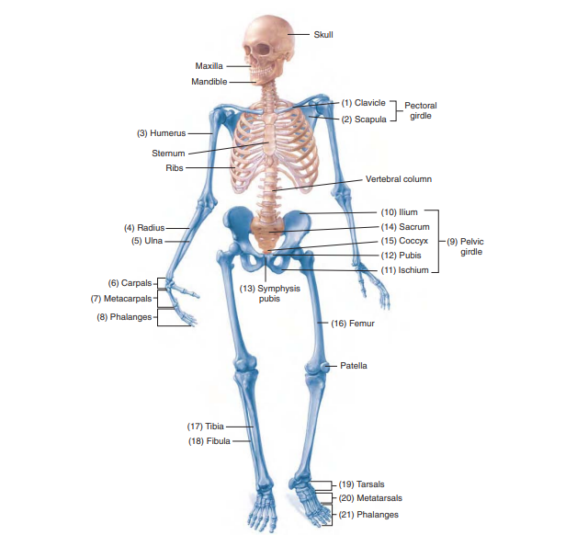

Slide 12
NEW ROOTS RELATED TO SPECIFIC BONE:
Element | Meaning | Word analysis
dactyl/o | Fingers, toes | Dactyl/o/megaly : abnormally large size of fingers & toes
clavicul/o | clavicle | clavicul/ar : pertaining to clavicle.
Cost/o | ribs | Cost/ectomy : excision of ribs.
patell/o | Patella (knee cap) | Patell/ectomy : removal of the patella.

Slide 13
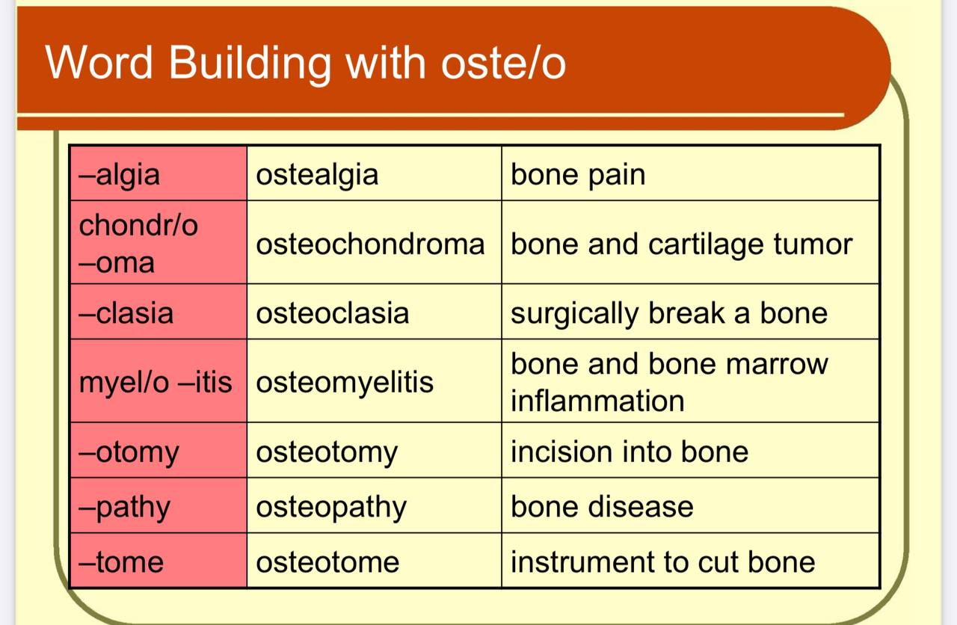

Slide 14
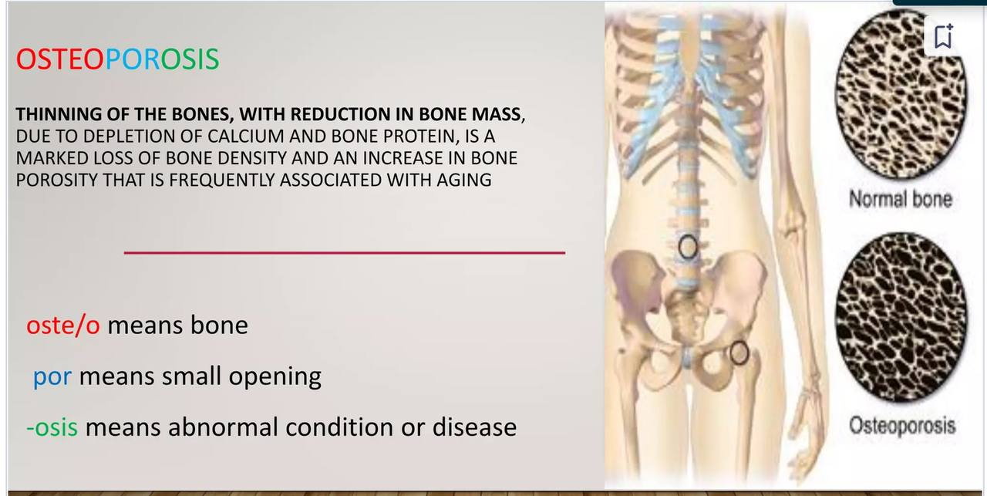

Slide 15
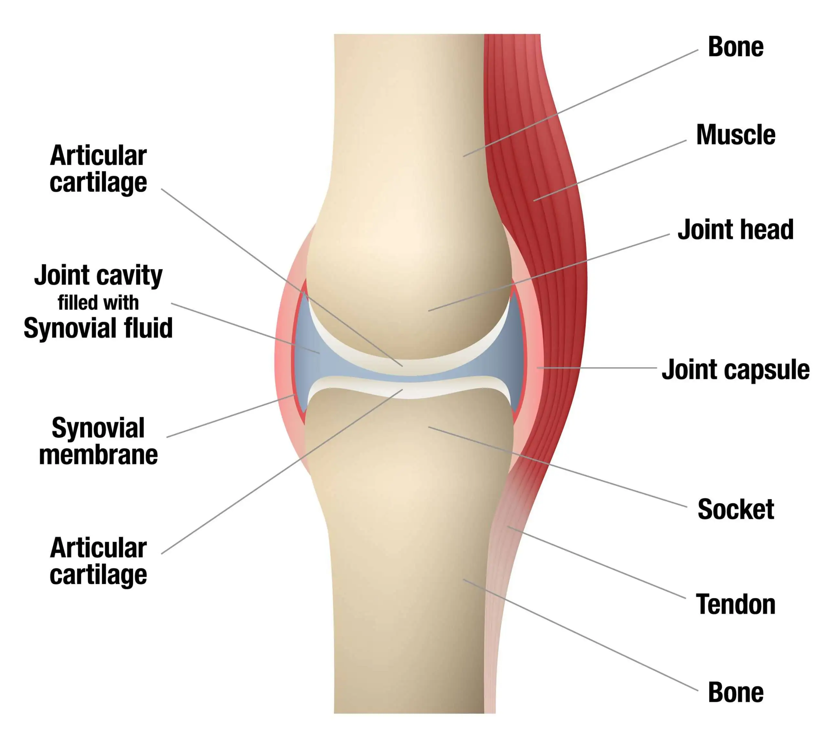
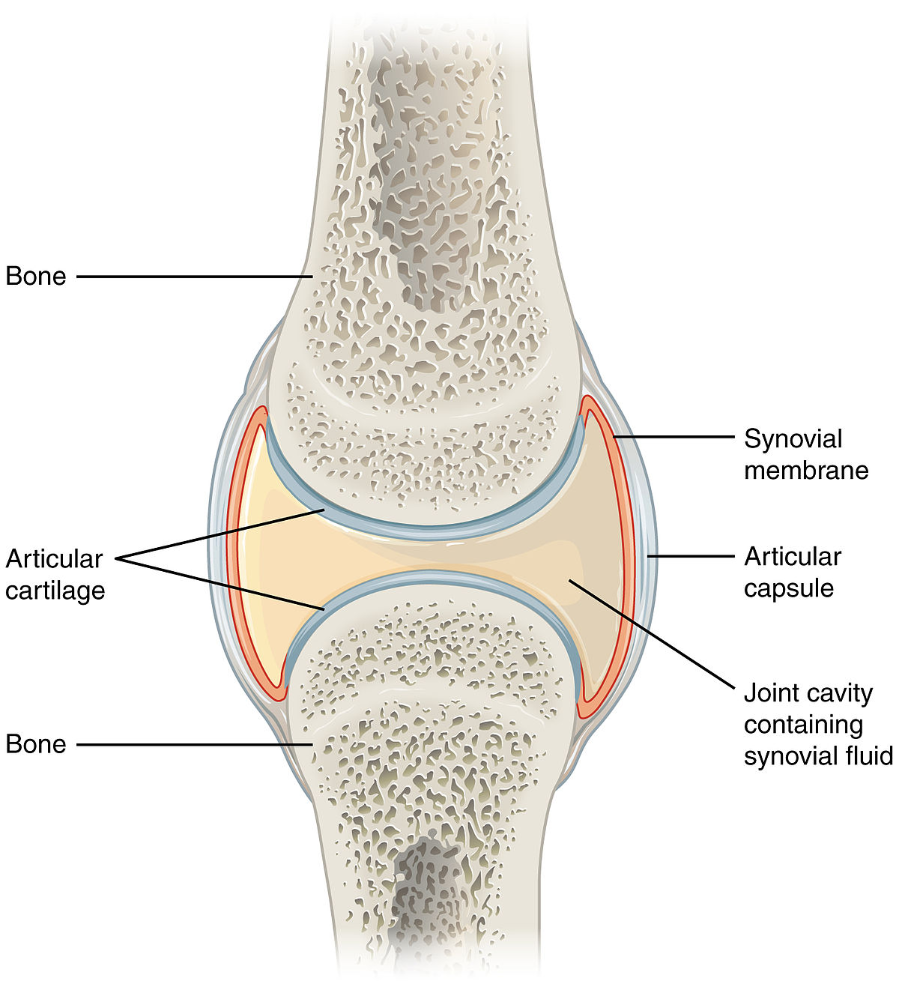
Joints:
The part of the body where two or more bones meet to allow movement.

Slide 16
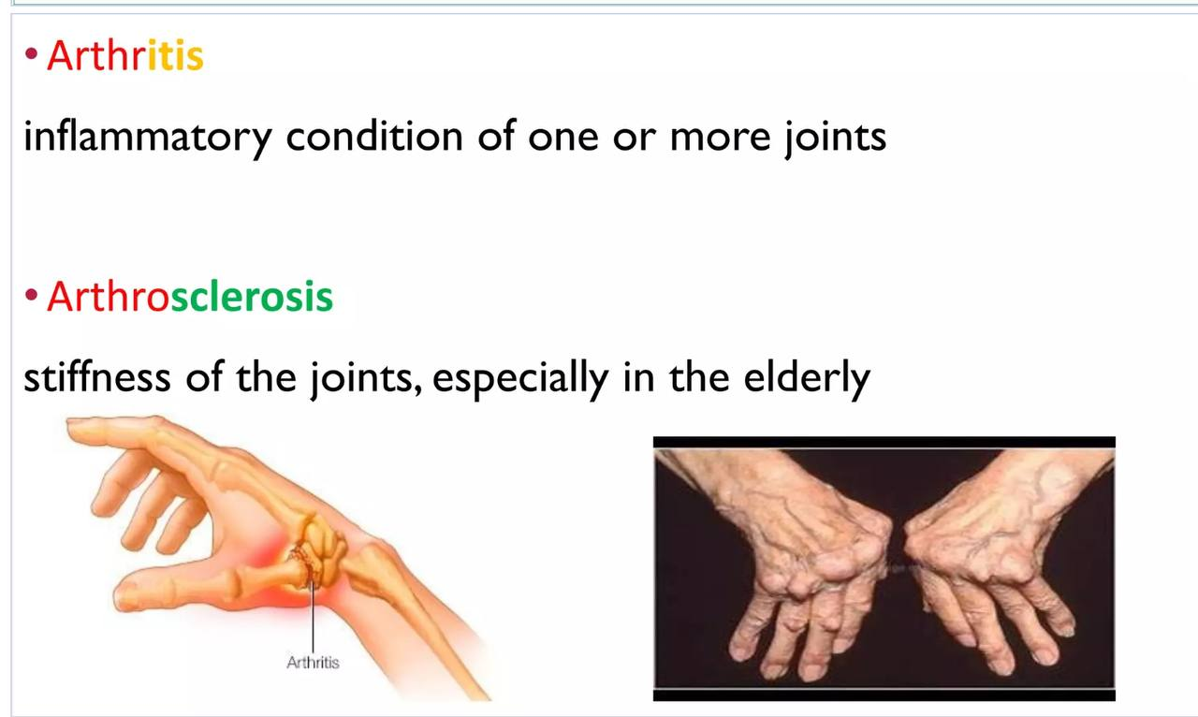

Slide 17
New Roots :
Element | Meaning | Word analysis
Ankyl/o | stiffness | ankyl/osis : immobility and stiffness of a joint
Arthr/o | Joint | arthr/itis : inflammation of a joint
Oste /o | bone | Oste/oma : bone tumor
spondyl/o | vertebrae | spondyl/itis :inflammation of vertebrae.

Slide 18
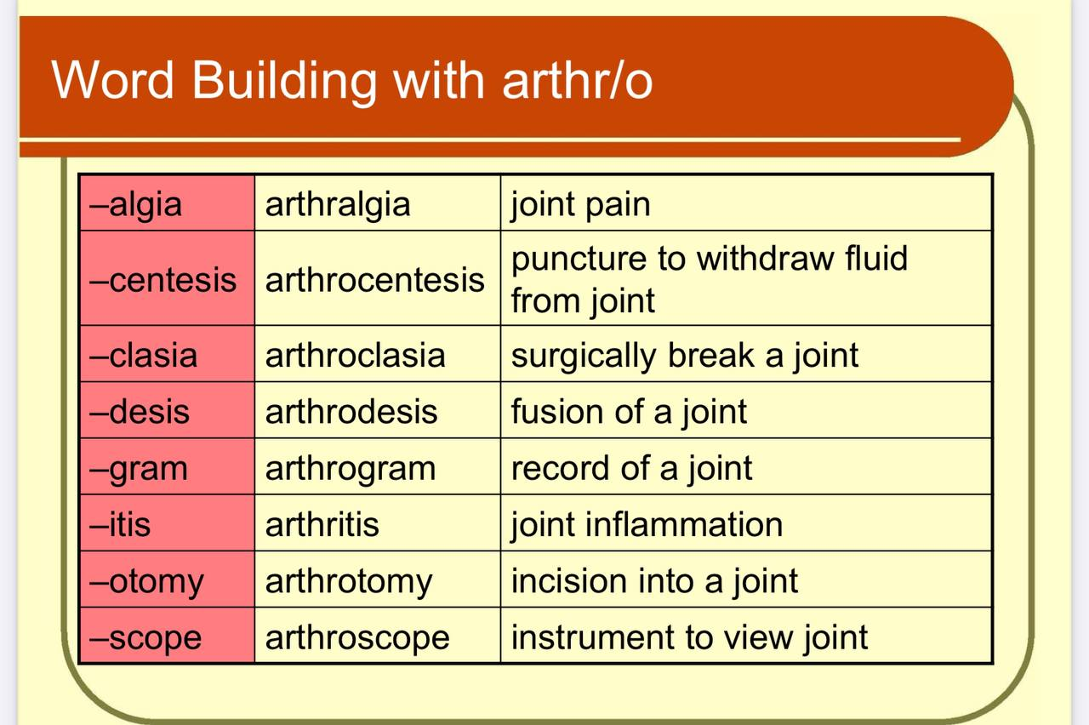

Slide 19
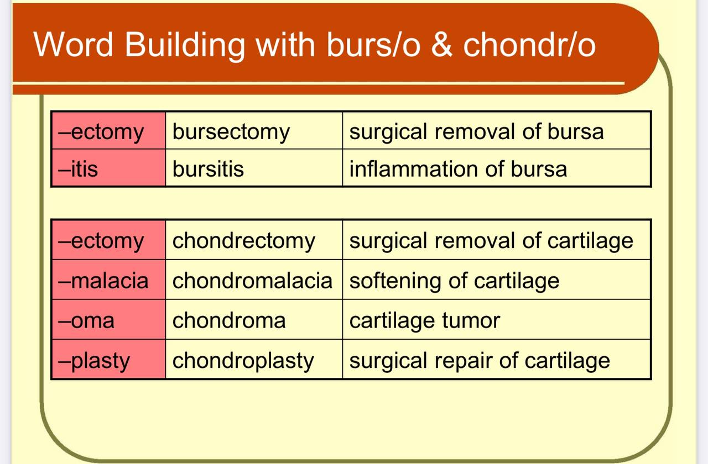

Slide 20
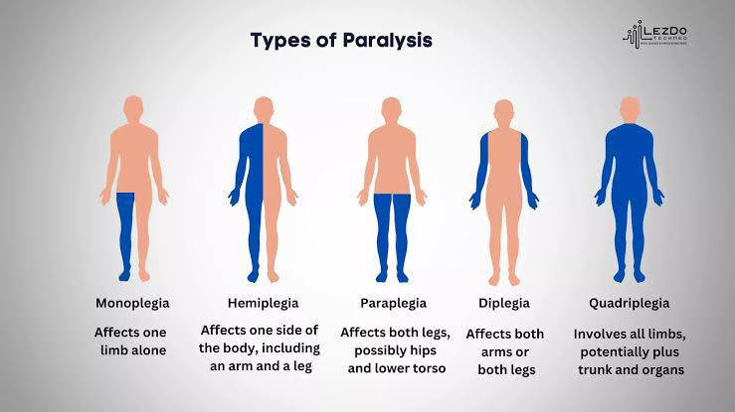

Slide 21


