Slide 1

Chapter 3
General Human Anatomy & Physiology
Skin and Body Membranes
Dr.Rasha Hussain Aouda
M.B.Ch.B. C.A.B.M.s
1st Semester 2023-2024

Slide 2
Skin and Body Membranes
Function of body membranes
  Line or cover body surfaces
  Protect body surfaces
  Lubricate body surfaces
Copyright © 2003 Pearson Education, Inc. publishing as Benjamin Cummings

Slide 3
Classification of Body Membranes
Epithelial membranes
  Cutaneous membrane
  Mucous membrane
  Serous membrane
Connective tissue membranes
Copyright © 2003 Pearson Education, Inc. publishing as Benjamin Cummings

Slide 4
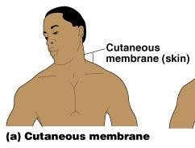
Cutaneous Membrane
Cutaneous membrane = skin
  A dry membrane
  Outermost protective boundary
Superficial epidermis
  Keratinized stratified squamous epithelium
Underlying dermis
  Mostly dense connective tissue
Figure 4.1a
Copyright © 2003 Pearson Education, Inc. publishing as Benjamin Cummings

Slide 5
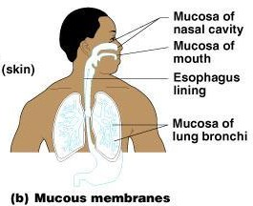
Mucous Membranes
Surface epithelium
  Type depends on site
Underlying loose connective tissue (lamina propria)
Lines all body cavities that open to the exterior body surface
Often adapted for absorption or secretion
Figure 4.1b
Copyright © 2003 Pearson Education, Inc. publishing as Benjamin Cummings

Slide 6
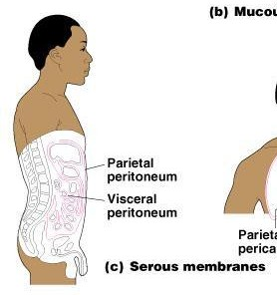
Serous Membranes
Surface simple squamous epithelium
Underlying areolar connective tissue
Lines open body cavities that are closed to the exterior of the body
Serous layers separated by serous fluid
Figure 4.1c
Copyright © 2003 Pearson Education, Inc. publishing as Benjamin Cummings

Slide 7

Serous Membranes
Specific serous membranes
  Peritoneum
    Abdominal cavity
  Pleura
    Around the lungs
Pericardium
  Around the heart
Figure 4.1d
Copyright © 2003 Pearson Education, Inc. publishing as Benjamin Cummings

Slide 8
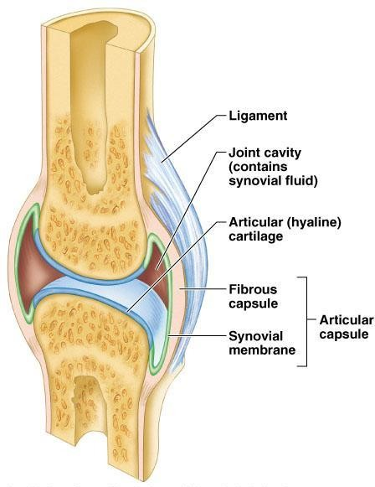
Connective Tissue Membrane
Synovial membrane
  Connective tissue only
  Lines fibrous capsules surrounding joints
Figure 4.2
Copyright © 2003 Pearson Education, Inc. publishing as Benjamin Cummings

Slide 9
Integumentary System
Skin (cutaneous membrane)
Skin derivatives
  Sweat glands
  Oil glands
  Hairs
  Nails
Copyright © 2003 Pearson Education, Inc. publishing as Benjamin Cummings

Slide 10
Skin Functions
Protects deeper tissues from:
  Mechanical damage
  Chemical damage
  Bacterial damage
  Thermal damage
  Ultraviolet radiation
  Desiccation
Copyright © 2003 Pearson Education, Inc. publishing as Benjamin Cummings

Slide 11
Skin Functions
Aids in heat regulation
Aids in excretion of urea and uric acid
Synthesizes vitamin D
Copyright © 2003 Pearson Education, Inc. publishing as Benjamin Cummings

Slide 12
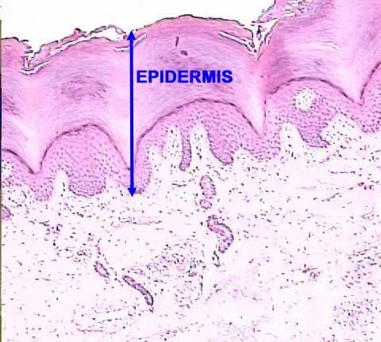
Skin Structure
Epidermis – outer layer
  Stratified squamous epithelium
  Often keratinized (hardened by keratin)
Slide 4.10a

Slide 13
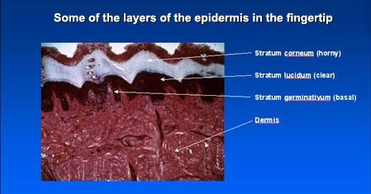
Layer of Epidermis
Slide 4.11b

Slide 14
Melanin
Pigment (melanin) produced by melanocytes
Color is yellow to brown to black
Melanocytes are mostly in the stratum basale
Amount of melanin produced depends upon genetic and exposure to sunlight
Copyright © 2003 Pearson Education, Inc. publishing as Benjamin Cummings

Slide 15
Skin Color Determinants
Melanin
  Yellow, brown or black pigments
Carotene
  Orange-yellow pigment from some vegetables
Hemoglobin
  Red coloring from blood cells in dermis capillaries
  Oxygen content determines the extent of red coloring
  Cyanosis - Low oxygen content creates a bluish appearance

Slide 16
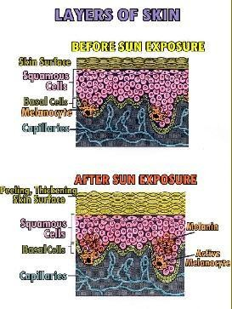
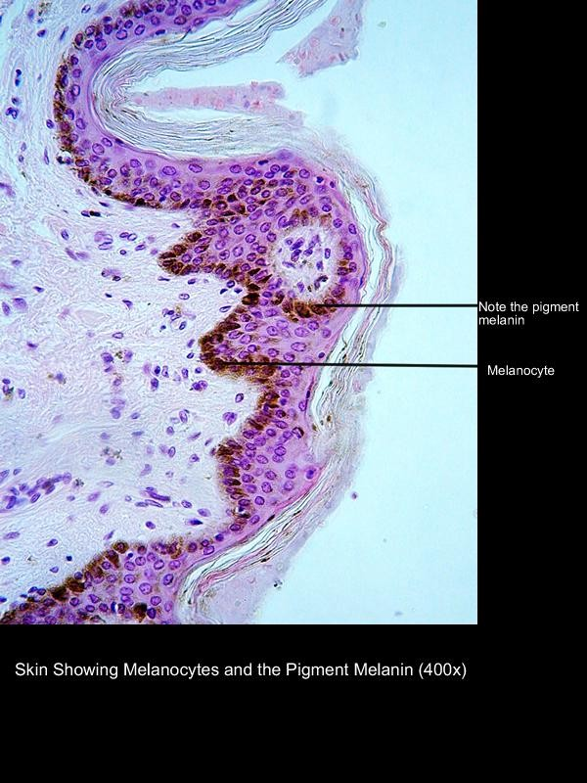
MELANIN
How Sun Effects Melanin

Slide 17
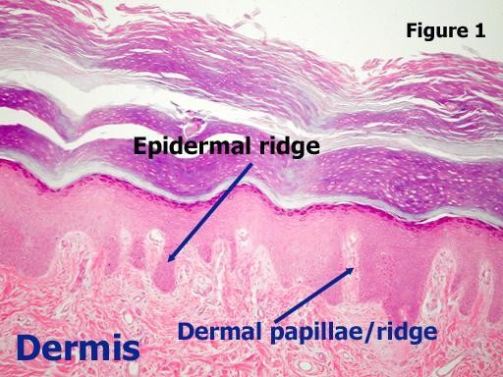
Dermis
  Dense connective tissue

Slide 18
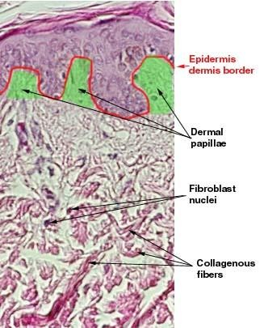
Dermis
Two layers
  Papillary layer
  Reticular layer
Copyright © 2003 Pearson Education, Inc. publishing as Benjamin Cummings
Slide 4.13a

Slide 19
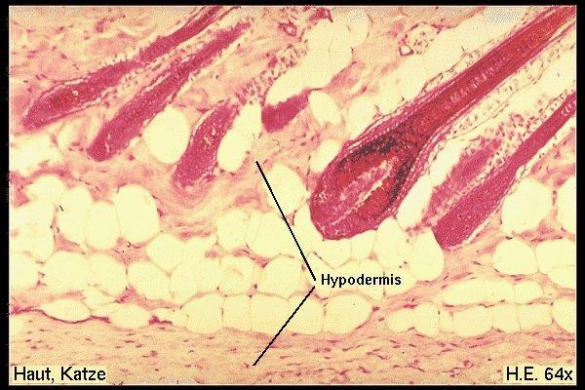
Skin Structure
Deep to dermis is the hypodermis
  Not part of the skin
  Anchors skin to underlying organs
  Composed mostly
of adipose tissue
Slide 4.10b

Slide 20
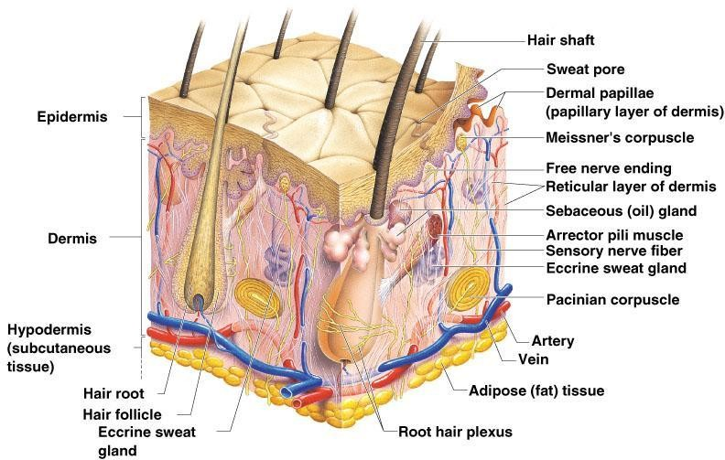
Skin Structure
Figure 4.4
Copyright © 2003 Pearson Education, Inc. publishing as Benjamin Cummings

Slide 21
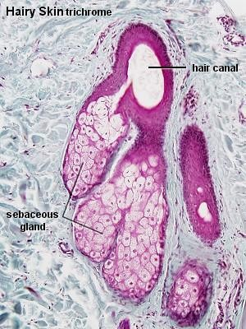
Appendages of the Skin
Sebaceous glands
  Produce oil
    Lubricant for skin
    Kills bacteria
  Most with ducts that empty into hair follicles
  Glands are activated at puberty

Slide 22
Appendages of the Skin
Sweat glands
  Widely distributed in skin
  Two types
    Eccrine
    Apocrine
Copyright © 2003 Pearson Education, Inc. publishing as Benjamin Cummings

Slide 23
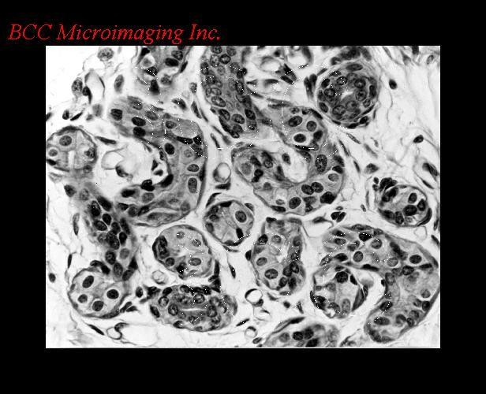
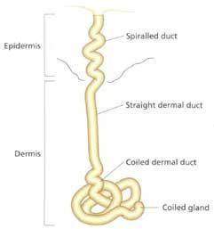
Eccrine sweat gland
  Open via duct to pore on skin surface

Slide 24
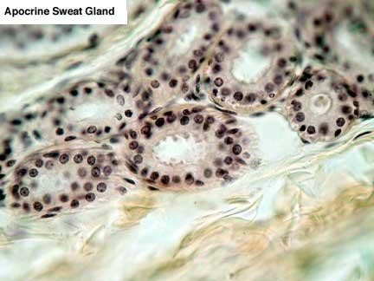
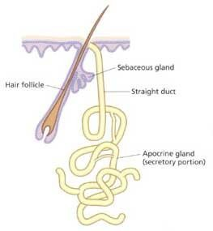
Apocrine sweat gland
  Ducts empty into hair follicles

Slide 25
Sweat and Its Function
Composition
  Mostly water
  Some metabolic waste
  Fatty acids and proteins (apocrine only)
Function
  Helps dissipate excess heat
  Excretes waste products
  Acidic nature inhibits bacteria growth
Odor is from associated bacteria
Copyright © 2003 Pearson Education, Inc. publishing as Benjamin Cummings

Slide 26
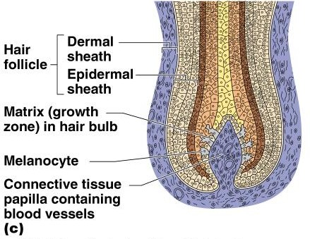
Appendages of the Skin
Hair
  Produced by hair bulb
  Consists of hard keratinized epithelial cells
  Melanocytes provide pigment for hair color
Figure 4.7c
Copyright © 2003 Pearson Education, Inc. publishing as Benjamin Cummings

Slide 27
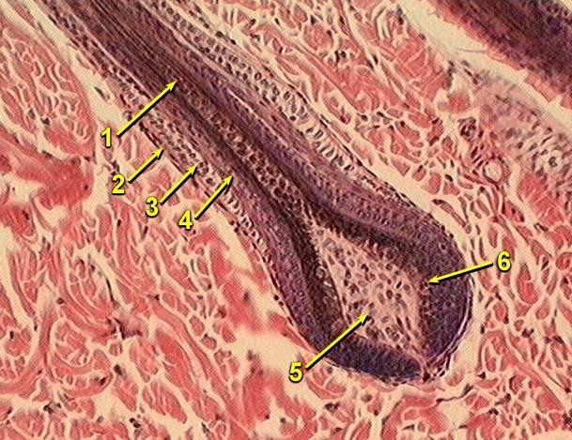
HAIR FOLLICLE

Slide 28
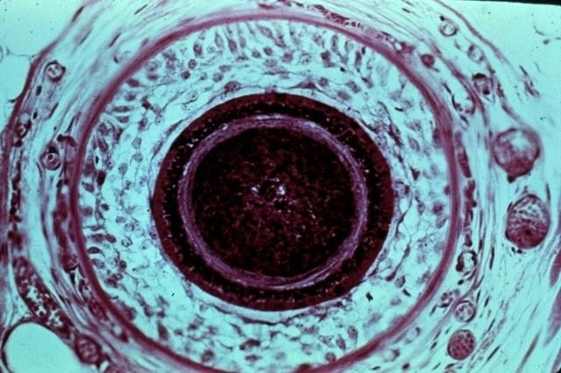
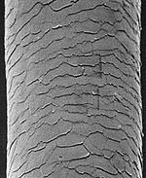
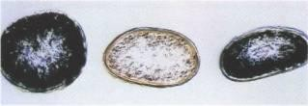
In this cross-section of a hair root, the dark cortex and medulla are surrounded by the interlocked cuticles, Huxley's and Henle's layers, the outer epithelial root sheath, a deeply stained basement membrane and, finally, the
well-vascularized connective tissue sheath.
Asian, Caucasian, African

Slide 29
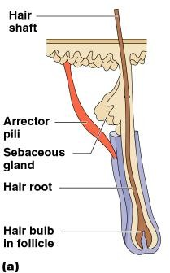
Associated Hair Structures
Hair follicle
  Dermal and epidermal sheath surround hair root
Arrector pilli
  Smooth muscle
Sebaceous gland
Sweat gland
Figure 4.7a
Copyright © 2003 Pearson Education, Inc. publishing as Benjamin Cummings

Slide 30
Appendages of the Skin
Nails
  Scale-like modifications of the epidermis
    Heavily keratinized
  Stratum basale extends beneath the nail bed
    Responsible for growth
  Lack of pigment makes them colorless
Copyright © 2003 Pearson Education, Inc. publishing as Benjamin Cummings

