Slide 1
2nd Semester, 1st Lec.
Alkanes and Cycloalkanes

Slide 2
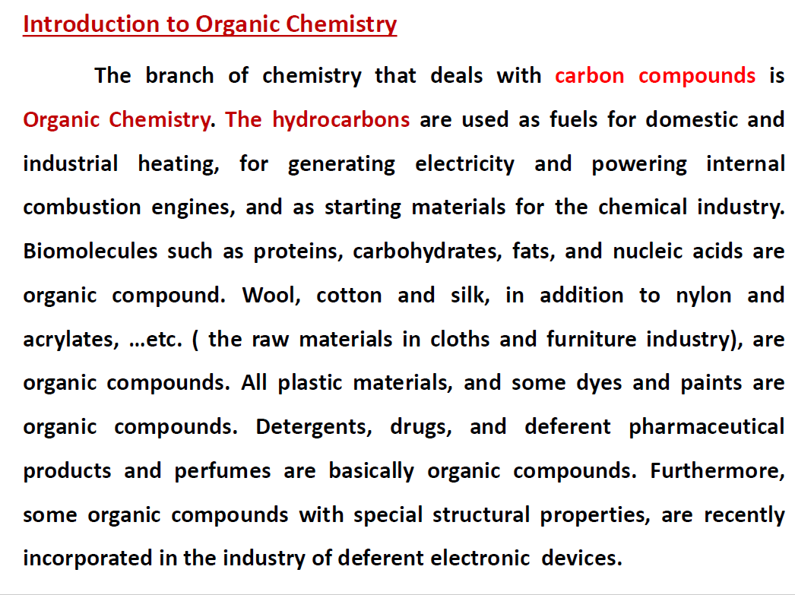

Slide 3
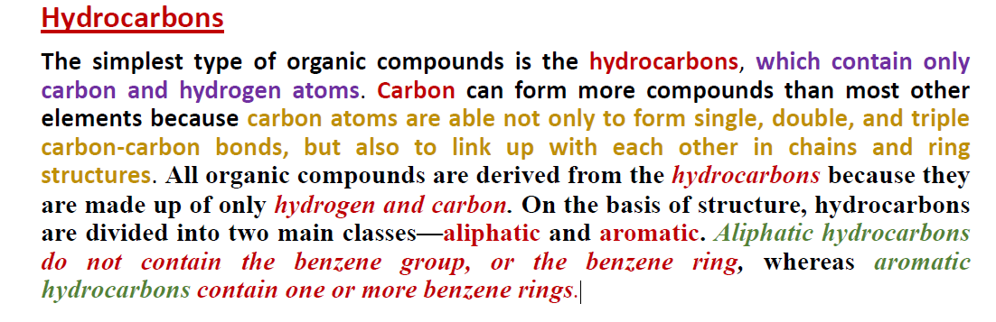

Slide 4
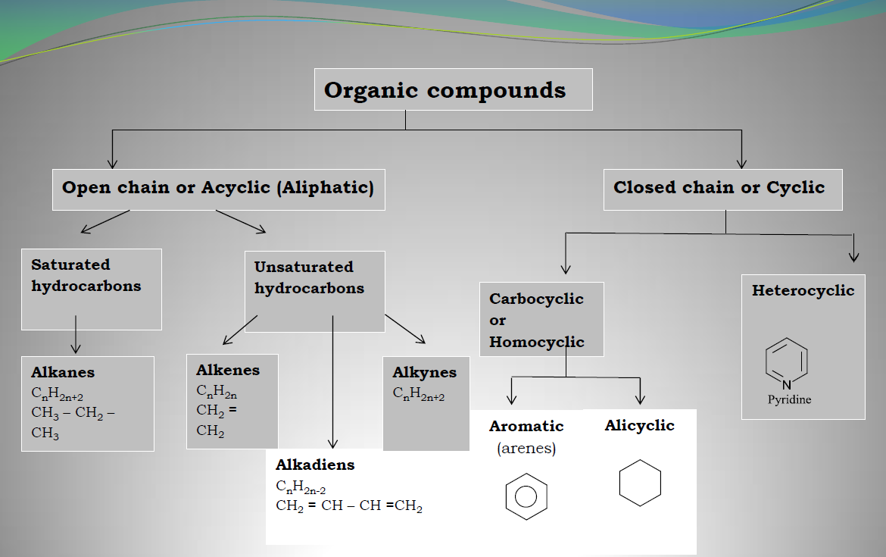

Slide 5
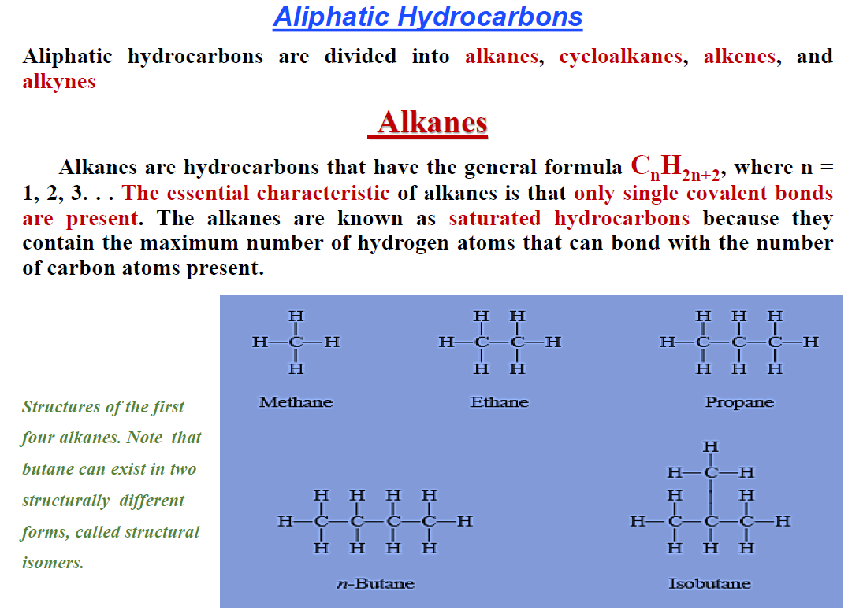

Slide 6
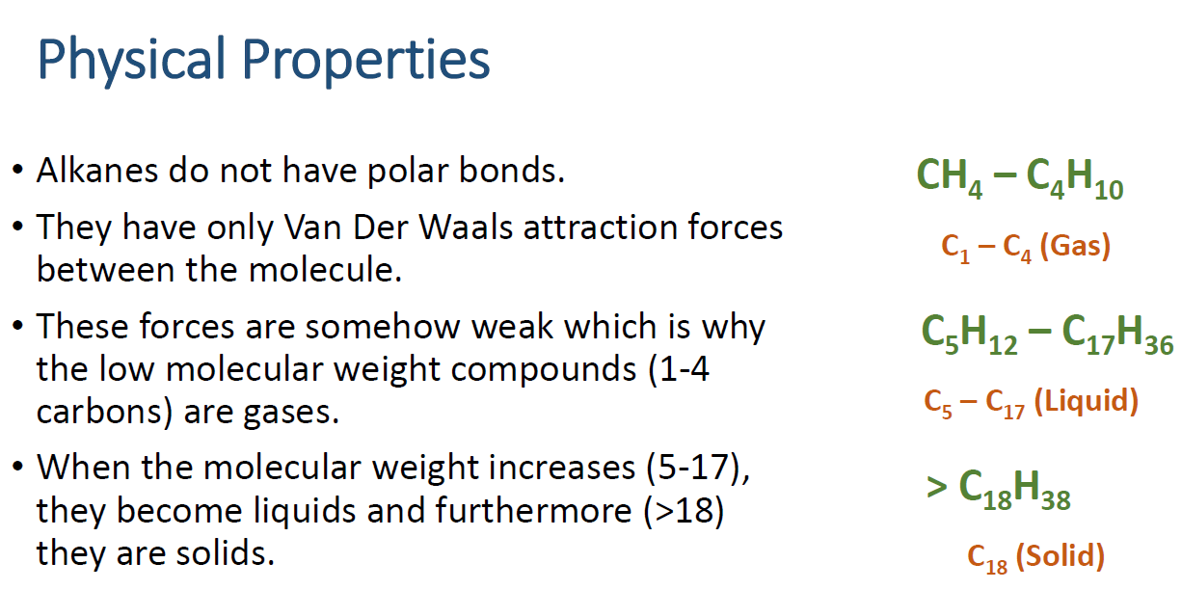

Slide 7
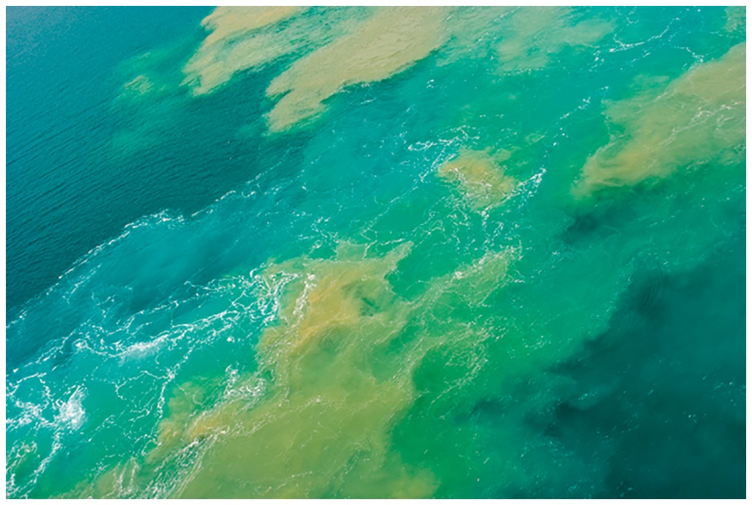
Physical properties
Alkanes are
nonpolar.
insoluble in water.
less dense than water.
flammable in air.
found in crude oil.
have the lowest melting and
boiling points of organic compounds.
contain only the nonpolar bonds of C — C and C — H.
exhibit only weak dispersion forces in the solid and liquid states.
If there is an oil spill in the ocean, the alkanes in the crude oil do not mix with the water but float on top, forming a thin layer on the surface.

Slide 8
Alkanes
aliphatic hydrocarbons having C—C and C—H σ bonds.
Acyclic alkanes
  molecular formula C_{n}H_{2n+2}
  contain only linear and branched chains of carbon atoms.
  Saturated hydrocarbons -- have the maximum number of hydrogen atoms per carbon.
Cycloalkanes
  carbons joined in one or more rings.
  molecular formula C_{n}H_{2n}
    have two fewer H atoms than an acyclic alkane with the same number of carbons.

Slide 9
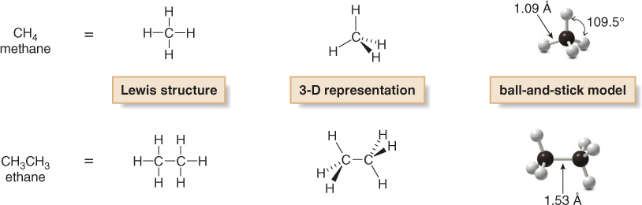
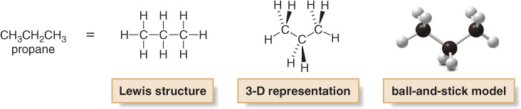
All C atoms in an alkane are surrounded by four groups
sp³ hybridized
Tetrahedral (all bond angles are 109.5⁰)

Slide 10
Representing Alkanes
  Line-angle formula
    Each line represents a single bond.
    Each line ending represents a CH₃ group.
    Each vertex (angle) represents a carbon atom.

Slide 11
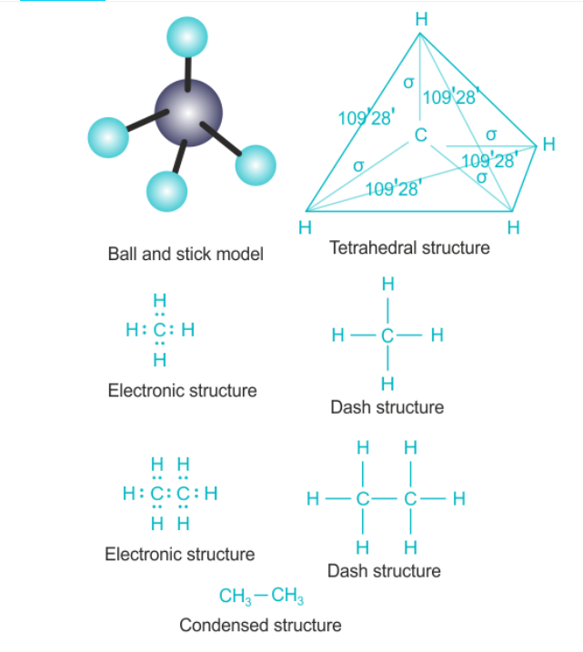
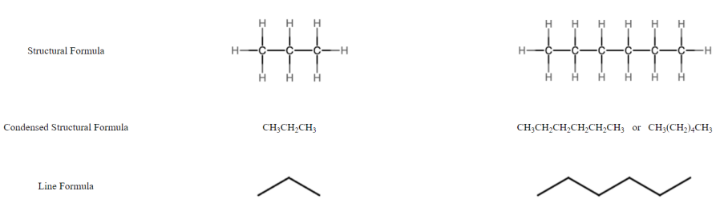

Slide 12
Alkanes
Alkanes have the general formula C_{n}H_{2n+2}
  Names of unbranched alkanes with 1 to 20 carbon atoms.

Slide 13
Constitutional Isomers
Constitutional isomers: Compounds with the same molecular formula but a different connectivity of their atoms.
  There are two constitutional isomers with molecular formula C₄H₁₀.

Slide 14
  The potential for constitutional isomerism is enormous.
World population
is about
6,000,000,000

Slide 15
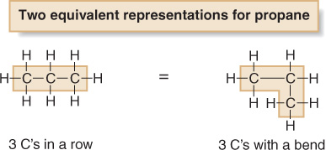
In propane and higher molecular weight alkanes, the carbon skeleton can be drawn in a variety of ways and still represent the same molecule.
In a Lewis structure, the bends in a carbon chain don’t matter.

Slide 16
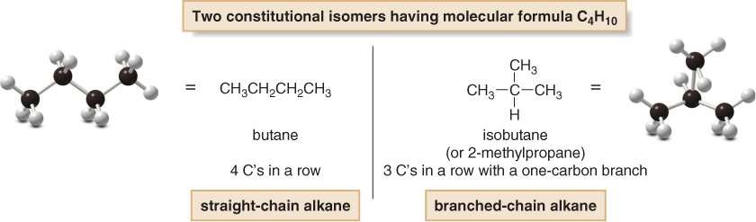
There are two different ways to arrange four carbons, giving two compounds with molecular formula C₄H_{10.}
Butane and isobutane are constitutional isomers (different compounds with the same molecular formula. )
Constitutional isomers differ in the way the atoms are connected to each other.

Slide 17
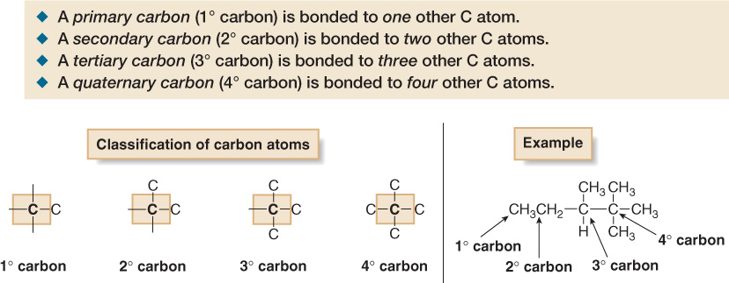
Classification of Carbons
Carbon atoms in alkanes and other organic compounds are classified by the number of other carbons directly bonded to them.

Slide 18
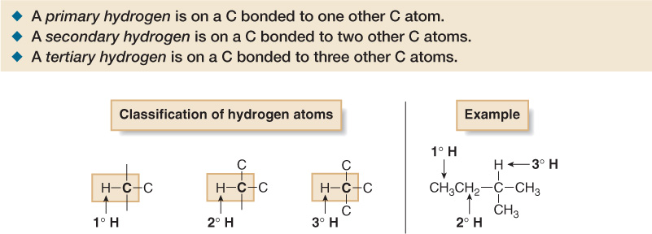
Hydrogen atoms are classified as primary (1⁰), secondary (2⁰), or tertiary (3⁰) depending on the type of carbon atom to which they are bonded.

Slide 19
The maximum number of possible constitutional isomers increases dramatically as the number of carbon atoms in the alkane increases.
  75 possible isomers for 10 carbons
  366,319 possible isomers for 20 carbons.
The suffix “ane” identifies a molecule as an alkane.
By increasing the number of carbons in an alkane by a CH₂ group (“methylene”) , one obtains a “homologous series” of alkanes.

Slide 20
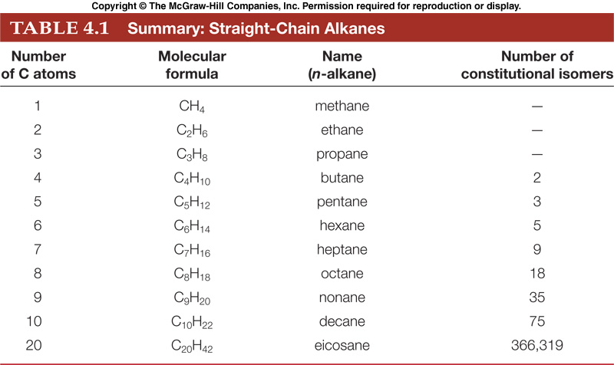

Slide 21
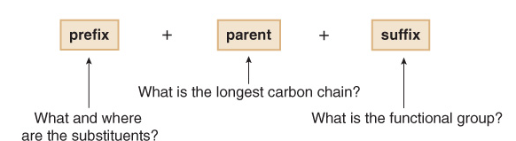
Nomenclature
The name of every organic molecule has 3 parts:
The parent name indicates the number of carbons in the longest continuous chain
The suffix indicates what functional group is present
The prefix tells us the identity, location, and number of substituents attached to the carbon chain

Slide 22
Nomenclature
Carbon substituents bonded to a long carbon chain are called alkyl groups.
An alkyl group is formed by removing one H atom from an alkane.
To name an alkyl group, change the –ane ending of the parent alkane to –yl.
  methane (CH₄) becomes methyl (CH₃-)
  ethane (CH₃CH₃) becomes ethyl (CH₃CH₂-).

Slide 23
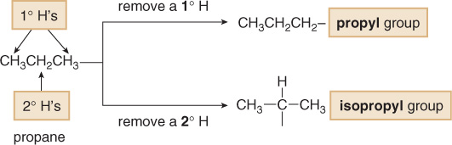
Naming three- or four-carbon alkyl groups is more complicated because the parent hydrocarbons have more than one type of hydrogen atom.
Propane has both 1⁰ and 2⁰ H atoms, and removal of each of these H atoms forms a different alkyl group with a different name.

Slide 24
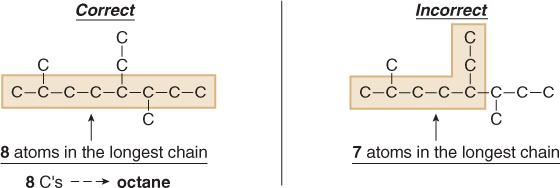
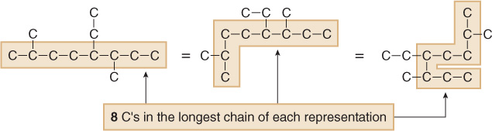
Rules for Naming Alkanes
1. Find the parent carbon chain and add the suffix.
It does not matter if the chain is straight or it bends.

Slide 25
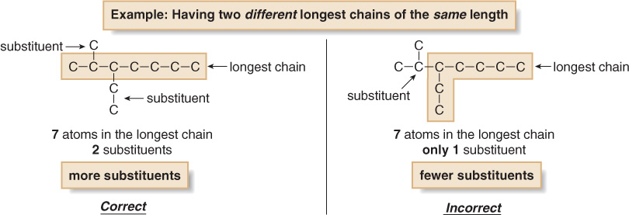
If there are two chains of equal length, pick the chain with greater number of substituents.

Slide 26
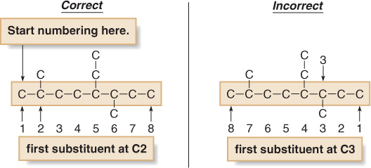
2. Number the atoms in the carbon chain to give the first substituent the lowest number.

Slide 27
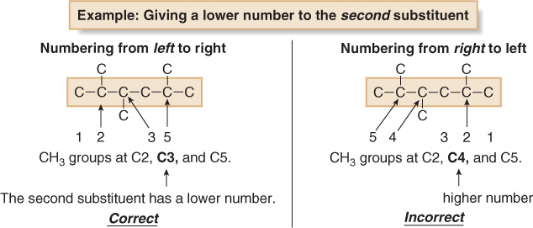
If the first substituent is the same distance from both ends, number the chain to give the second substituent the lower number.

Slide 28
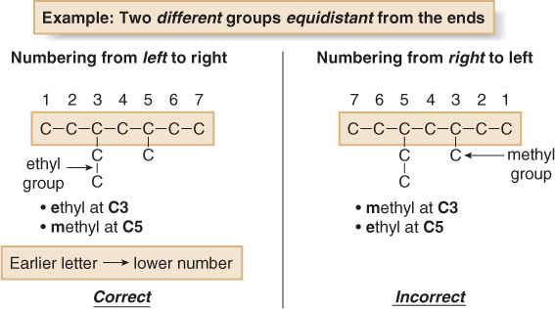
When numbering a carbon chain results in the same numbers from either end of the chain, assign the lower number alphabetically to the first substituent.

Slide 29
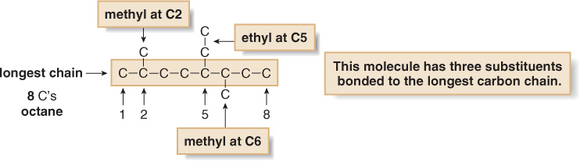
3. Name and number the substituents.
Name the substituents as alkyl groups.
Every carbon belongs to either the longest chain or a substituent, not both.
Each substituent needs its own number
If two or more identical substituents are bonded to the longest chain, use prefixes to indicate how many: di- for two groups, tri- for three groups, tetra- for four groups, and so forth.

Slide 30
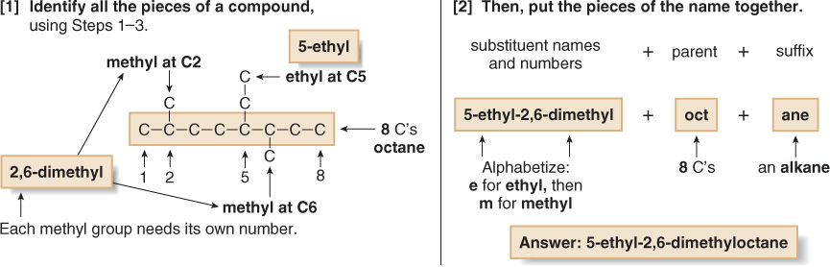
4. Combine substituent names and numbers + parent and suffix.
Precede the name of the parent by the names of the substituents.
Alphabetize the names of the substituents, ignoring all prefixes except iso, as in isopropyl and isobutyl.
Precede the name of each substituent by the number that indicates its location.
Separate numbers by commas and separate numbers from letters by hyphens. The name of an alkane is a single word, with no spaces after hyphens and commas.

Slide 31
Branched Alkyl Groups
Can Name as Simple Alkane w/ “yl” Ending Replacing “ane”

Slide 32
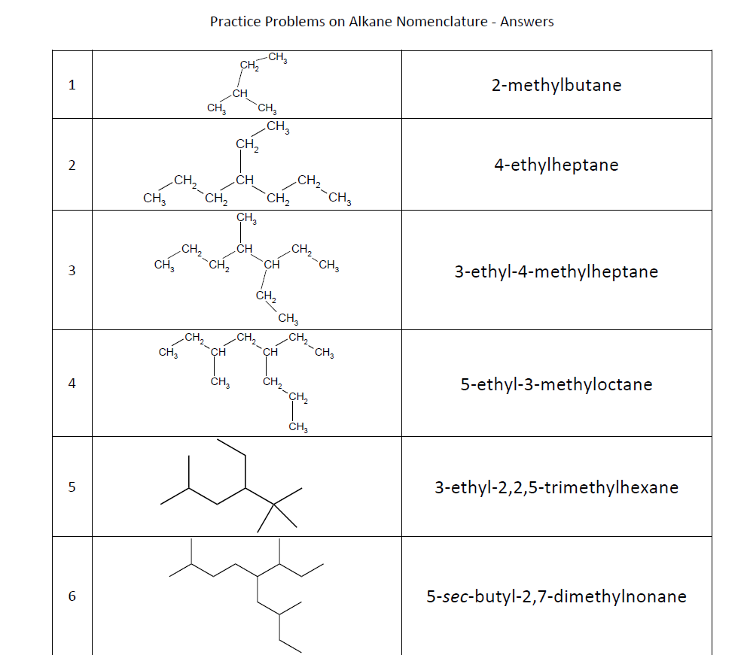

Slide 33
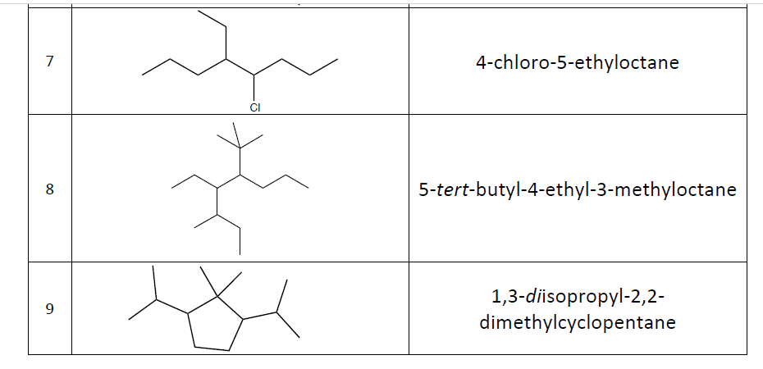

Slide 34
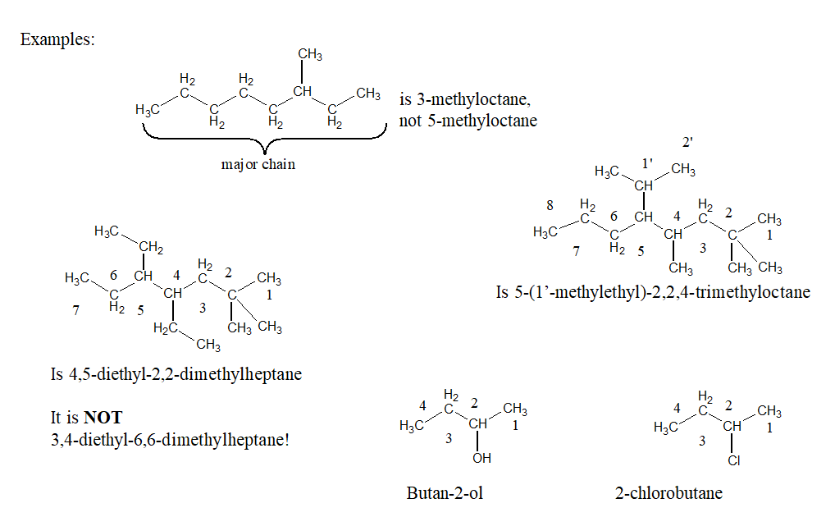

Slide 35
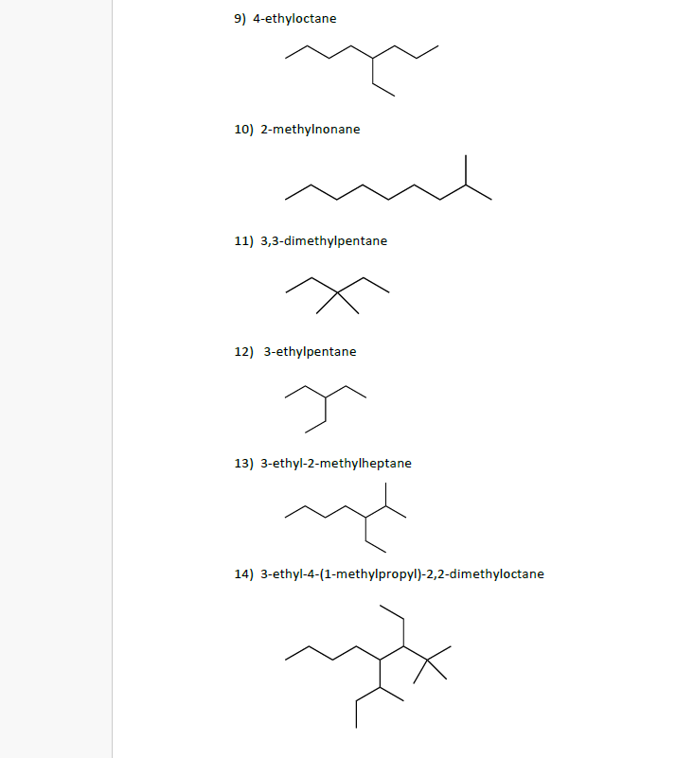

Slide 36
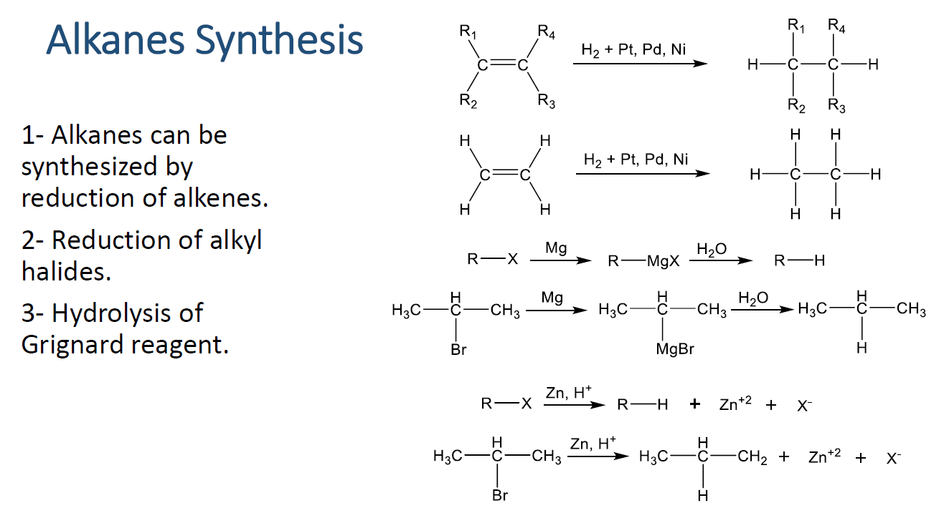

Slide 37
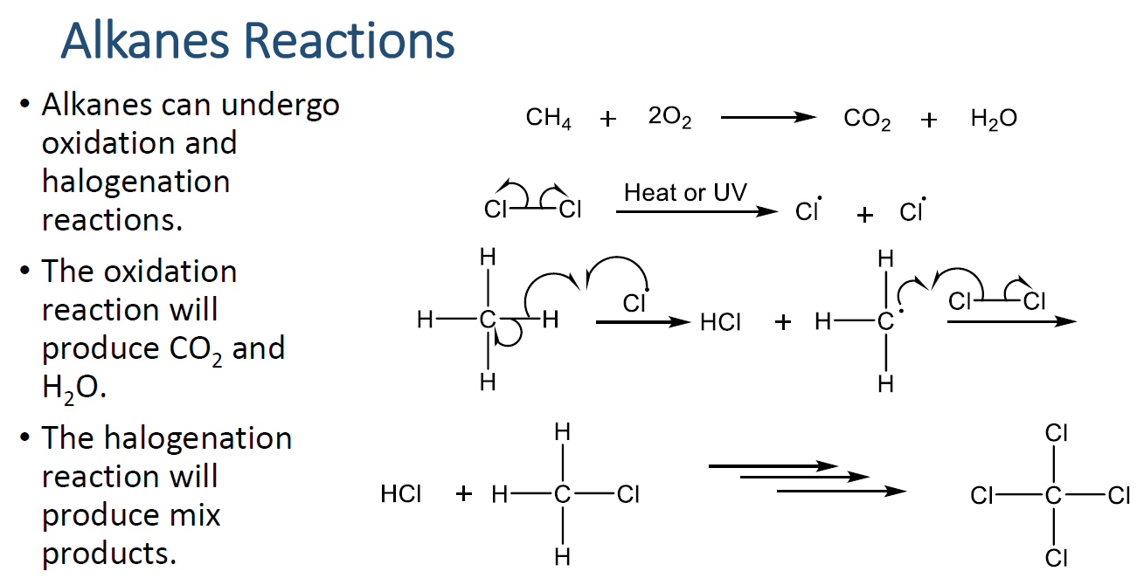

Slide 38
Cycloalkanes
General formula C_{n}H_{2n}
  Five- and six-membered rings are the most common.
Structure and nomenclature
  To name, prefix the name of the corresponding open-chain alkane with cyclo-, and name each substituent on the ring.
  If there is only one substituent, no need to give it a number.
  If there are two substituents, number from the substituent of lower alphabetical order.
  If there are three or more substituents, number to give them the lowest set of numbers, and then list substituents in alphabetical order.

Slide 39
Cycloalkanes
Commonly written as line-angle formulas
  examples:

Slide 40
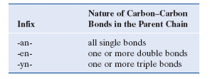
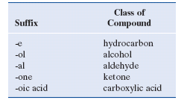
A General System
prefix-infix-suffix
  Prefix tells what and where are the substituents.
  Infix tells the nature of the carbon-carbon bonds.
  Suffix tells the class of compound.

Slide 41
A general system
  prop-en-e = propene
  eth-an-ol = ethanol
  but-an-one = butanone
  but-an-al = butanal
  pent-an-oic acid = pentanoic acid
  cyclohex-an-ol = cyclohexanol
  eth-yn-e = ethyne
  eth-an-amine = ethanamine

Slide 42
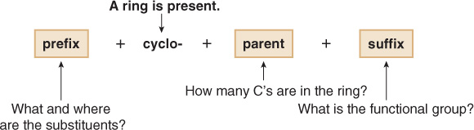
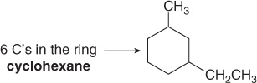
Cycloalkanes are named by using similar rules, but the prefix cyclo- immediately precedes the name of the parent.
1. Find the parent cycloalkane.

Slide 43

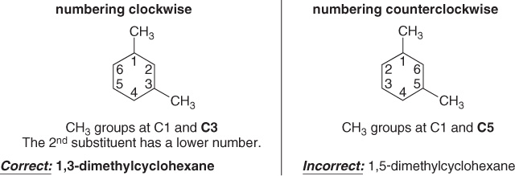
2. Name and number the substituents. No number is needed to indicate the location of a single substituent.
For rings with more than one substituent, begin numbering at one substituent and proceed around the ring to give the second substituent the lowest number.

Slide 44
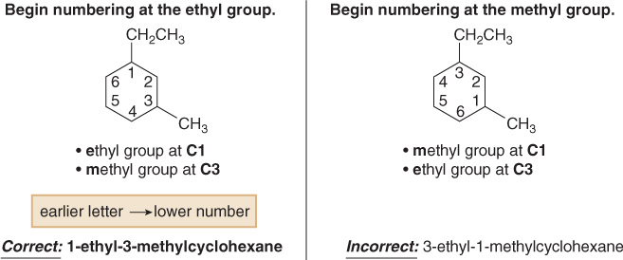
With two different substituents, number the ring to assign the lower number to the substituents alphabetically.
In the case of an alkane composed of both a ring and a long chain. If the number of carbons in the ring is greater than or equal to the number of carbons in the longest chain, the compound is named as a cycloalkane.

Slide 45
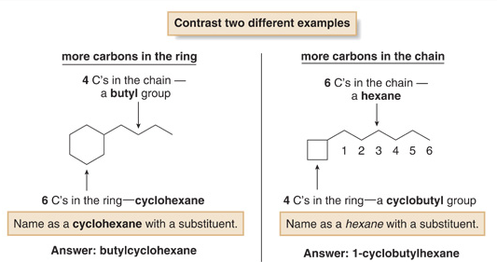

Slide 46
