Slide 1
Lecture 2 Medical Terminology
Dr.Zainab Ali hussein
MBCHB , F.I.C.M.S Path

Slide 2
Medical Terms
Medical Terms Sound-like Terms and Word Parts Examples : Arteri = artery ,Ather = plaque or fatty substance ,Arthr = joint
Ileum = part of small intestine, Ilium = part of the hip bone Mucous=specialized mucous membranes that line the body cavities. Mucus = a noun and the name of the substance secreted by the mucous membranes.

Slide 3
Medical Terms
The essentials for medical terms include the following :
Pronunciation
Spelling and Writing & Definition
Proper uses of Root Words , Suffixes and Prefixes
Singular and Plural uses for ending of medical terms.

Slide 4
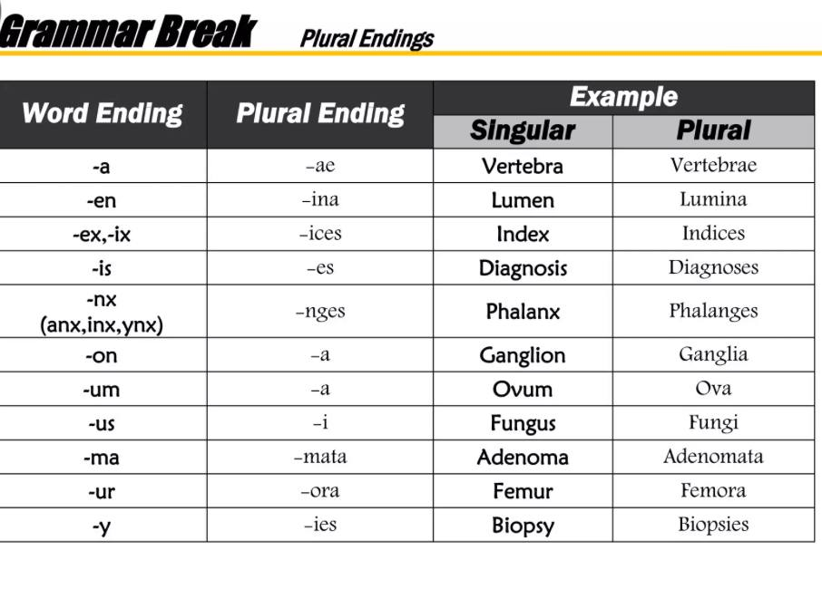
Suffix: Singular vs. Plural
Singular Suffixes
-a
  Vertebra, conjunctiva
-us
  Bacillus, bronchus
-um
  Bacterium, ilium
-is
  Testis
Plural Suffixes
-ae
  Vertebrae, conjunctivae
-i
  Bacilli, bronchi
-a
  Bacteria, ilia
-es
  Testes

Slide 5
Suffix: Singular vs. Plural
Singular
-on
Spermatozoon, ganglion
-ma
  Carcinoma, lipoma
-sis
  Crisis, prognosis
-nx
  Larynx, pharynx
Plural Suffixes -a Spermatozoa, ganglia
-mata
  Carcinomata, lipomata
-ses
  Crises, prognoses
-ges
  Larynges, pharynges

Slide 6
Suffix: Singular vs. Plural
Singular Suffixes
-ex
  cortex
-ix
  Appendix
-ax
  thorax
Plural Suffixes
-ices cortices
-ices
  appendices
-aces
  thoraces

Slide 7
Practice…
Singular:
Sarcoma
Diagnosis
Phalanx
Coccus
Calcaneum
Vertex
Cervix
thorax
Plural:
Sarcomata
Diagnoses
Phalanges
Cocci
Calcanea
Vertices
Cervices
thoraces

Slide 8
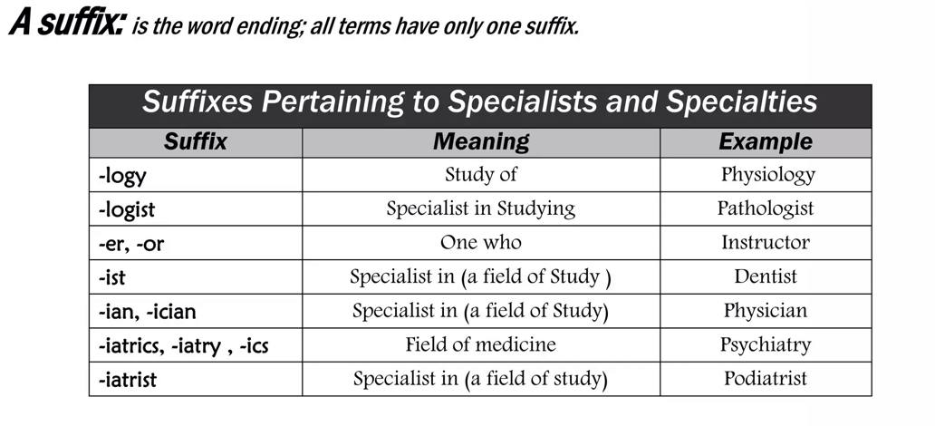

Slide 9
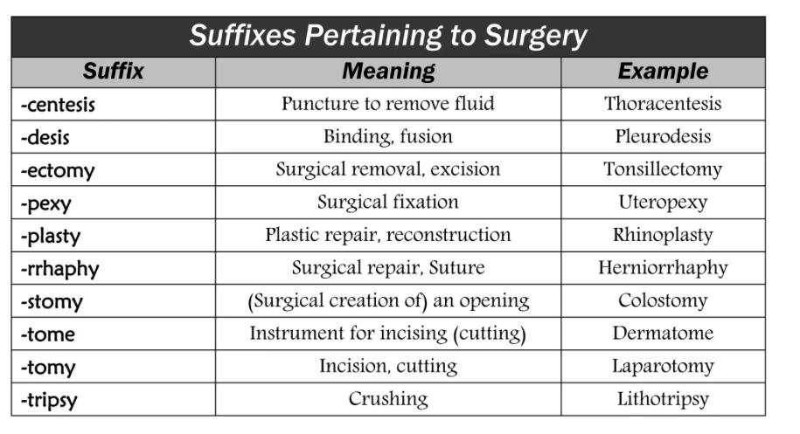

Slide 10
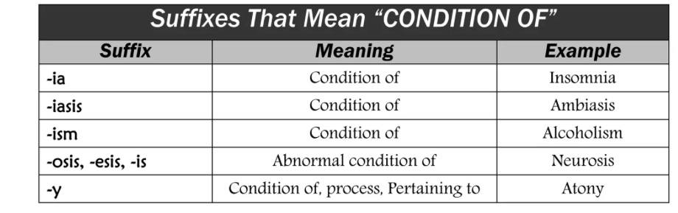

Slide 11
Megal/o = Enlarged, Large
-megaly = Suffix for “enlarged”
Acr/o/megaly: Enlargement of the extremities
Acromegalic Gigantism = A specific disorder of the body with enlargement of the bones of the hands, feet, and head.

Slide 12
Dermat/o = Skin
-logy = Study of
-logist = One who studies
-logos = Greek for study
Dermat/o/logist: The person who specializes in diseases of the skin
Dermat/o/logy: The study of skin
Eti/o/logy: Study of the origin of disease

Slide 13
-itis = Inflammation
Dermat/itis: Inflammation of the skin
Acr/o/dermat/itis: Inflammation of the skin of the extremities

Slide 14
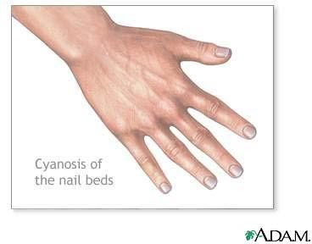
-osis = Condition, Status, Process
Dermat/osis: Any skin condition. (abnormal condition)
Cyan/osis: Condition of blueness

Slide 15
Prefix
Prefix is a word part that goes in front of a word root, changing the meaning of the word.

Slide 16
Prefix
Ex- + tension
Ex- + press
= Extension
= Express
Dis-
Dis-
+ please
+ ease
= Displease
= Disease
Im- + plant =
Implant
Trans-
+ plant
=Transplant

Slide 17
Acr/o = Extremities
Acr/o = extremities (arms and legs)
  Acr = word root
  O = vowel
  Acr/o = combining form
Acr/o/paralysis: Paralysis of extremities
Acr/o/cyan/osis: Condition of blue extremities
Acr/o/dermat/itis: Inflammation of skin of the extremities, like red inflamed hands

Slide 18
Cyan/o = Blue, Blueness
Cyan/osis: (noun) Condition of blueness
Cyan/otic: (adj.) a condition of blueness
– -tic = adjective suffix
Acr/o/cyan/osis: Blueness of the extremities
Cyan/o/derma: Bluish discoloration of the skin

Slide 19
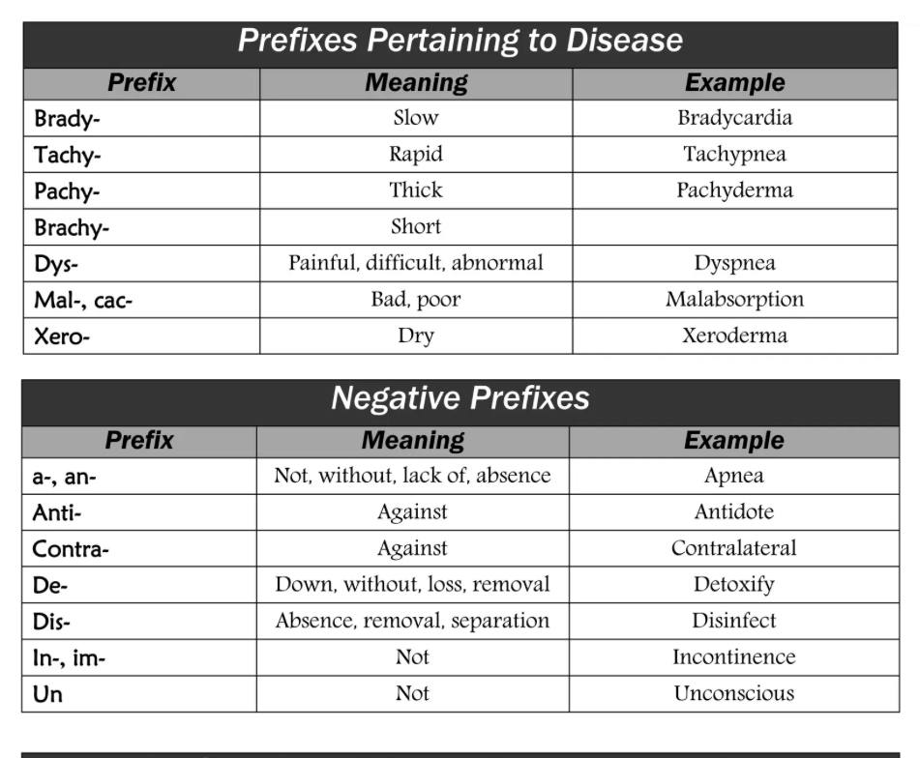

Slide 20
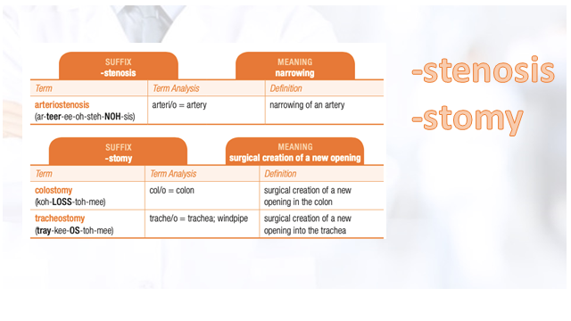

Slide 21

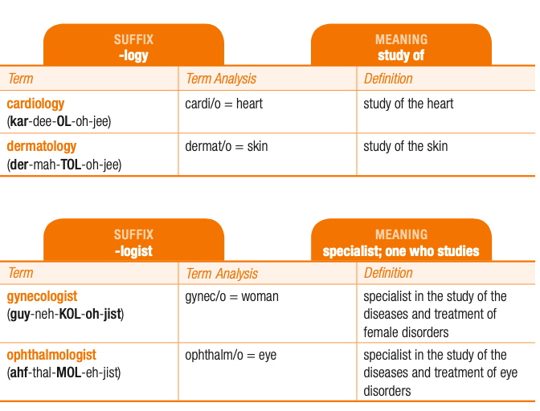
-logy
-logist

Slide 22

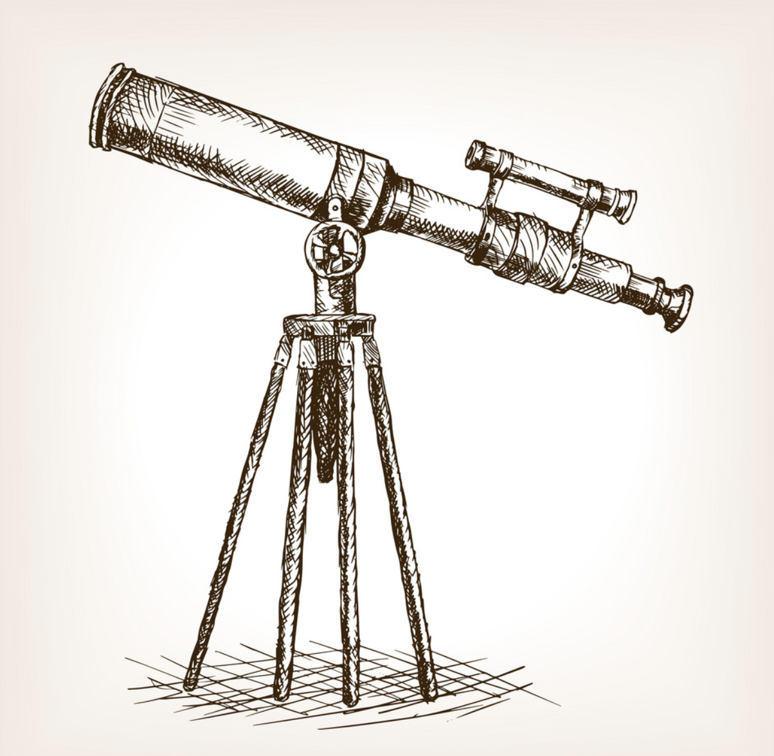


Slide 23
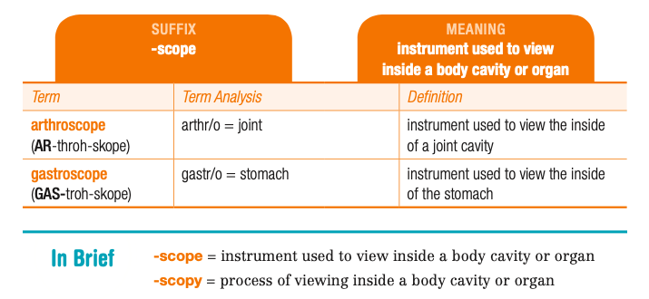
-scope
-scopy

Slide 24
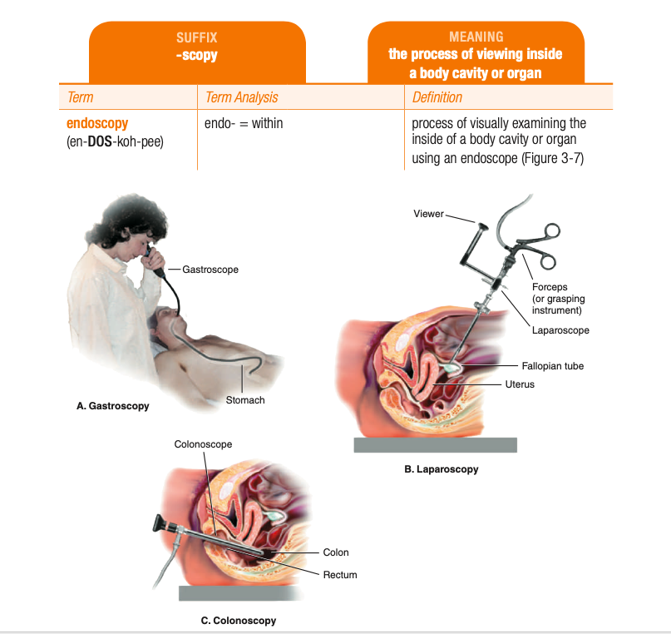
-scopy

Slide 25

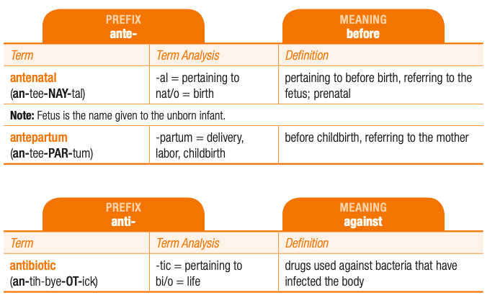
Anti-
Ante-
The prefix anti- means “against.” Note that both the prefix and its meaning contain the letter “i.”
The prefix ante- means “before.” Both the prefix and its meaning contain the letter “e.”

Slide 26
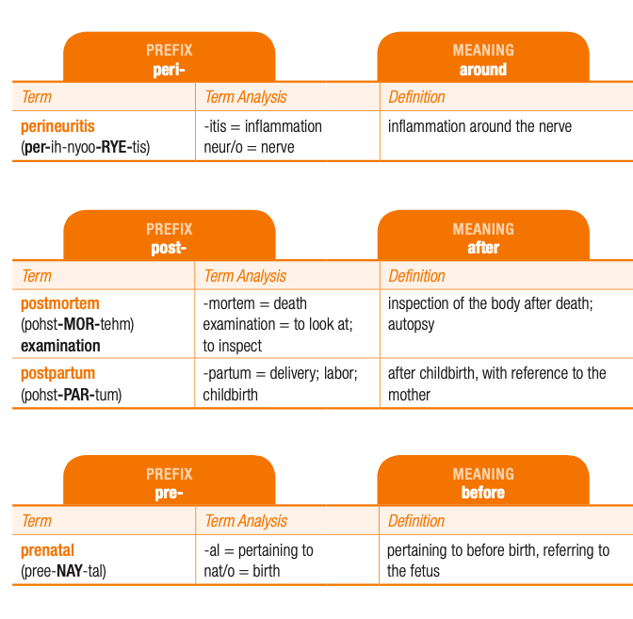
Peri-=around
Post-=after
Pre-=befor
pan- = all
Para-=beside,
near
Per-=through
Peri-=around
Post-=after.
pre- = before.

Slide 27
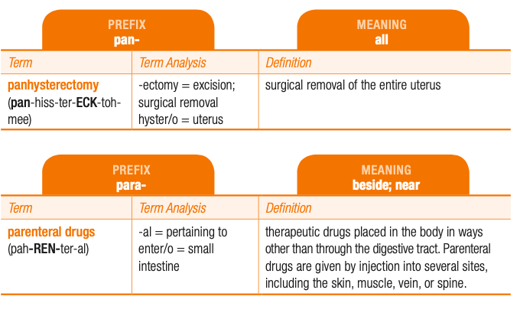
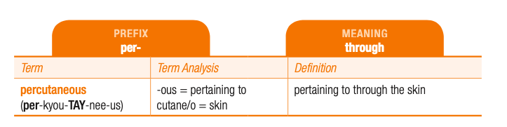
pan=all
Para=
beside,near
Per throuhg
Peri =around
Post= after.
pre= before

Slide 28
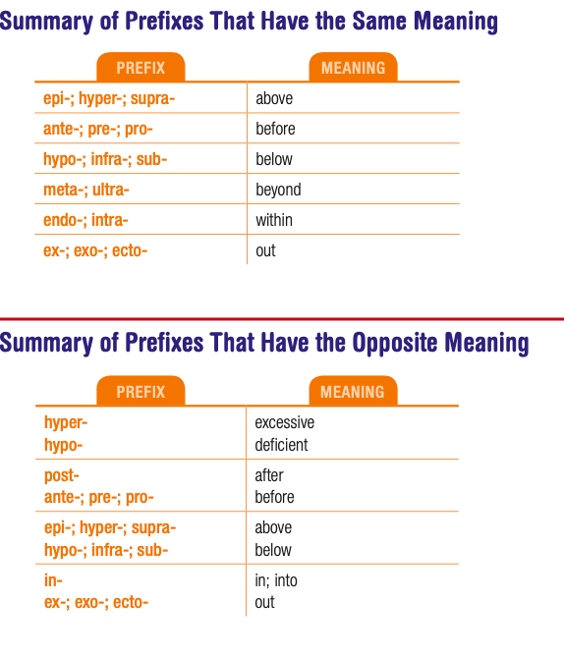

Slide 29
Abbreviations & symbols
Medical abbreviations and symbols are a “short hand” for medical professionals
Most have been standardized and are universally accepted
19

Slide 30
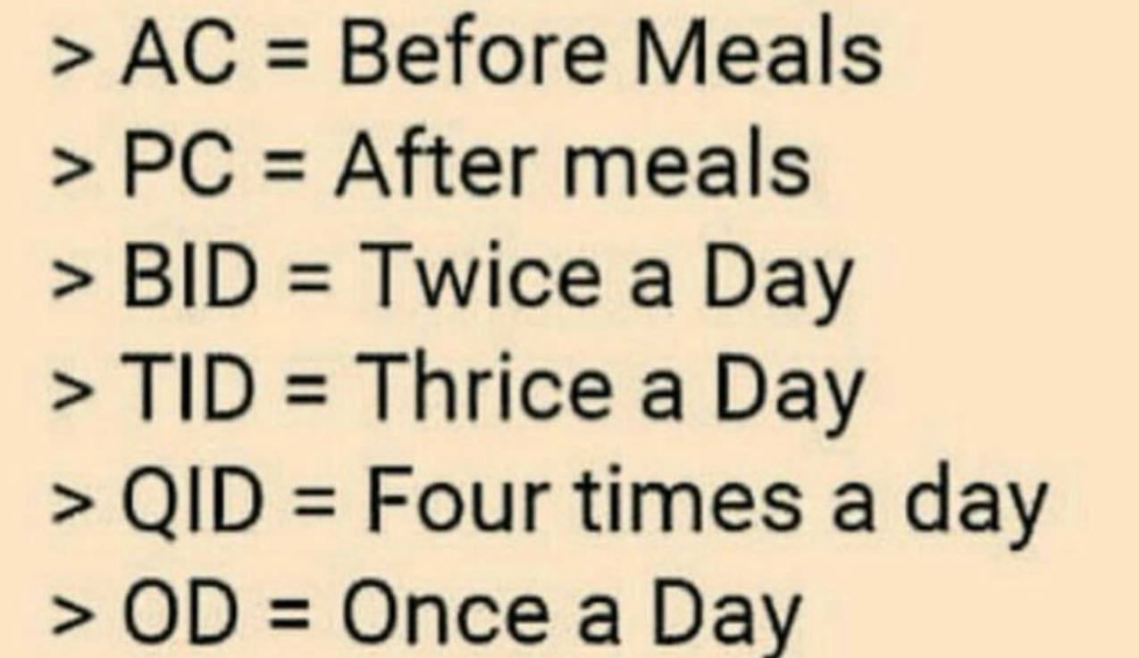
Using Abbreviations
Tid- three times a day Bid Twice daily
Qd- everyday four times 4 X daily
Po- by mouth

Slide 31
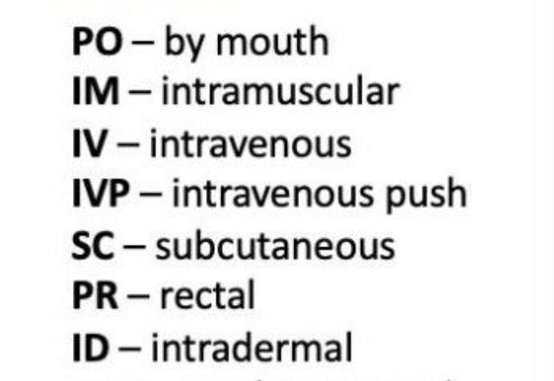

Slide 32
Abbreviations & symbols
In maternity care it is also used to mean “trimester”
21

Slide 33
The context indicates the meaning
A patient S.J., 24 yo,♀ 8 weeks gestation, 1st bleeding
22

Slide 34


