Slide 1
Medical Terminology
Dr. Lamees Abd ALRaheem
M.B.CH.B F.I.C.M.S

Slide 2
Basic Elements of a Medical Word
Medical words are made of parts. You need to learn what the parts are ,and what they mean in order to easily learn medical words.
1. Word Root
2. Combining forms
3. Suffix
4. Prefix
These four parts of a word are known as ELEMENTS.

Slide 3
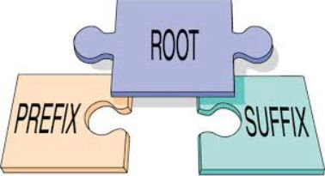
Medical Terminology
All MT have
A.Suffix
B.Prefix
C.Root
D.Vowel

Slide 4
Word Root
Main part or foundation of a word.
All words have at least one word root.
A word root may be used alone or
combined with other elements to form acomplete word.
IE: SPEAK (word root) + ER (suffix) =SPEAKER (complete word)

Slide 5
Most word roots are derived from Greek or Latin
Greek word roots are used to build words that describe a (disease, treatment, or diagnosis).
Latin Language (Anatomical terms ).
The word root usually refers to a body part.

Slide 6
By understanding the meanings of word roots,
one can determine the meaning of complex medical terms by putting together the smaller parts .

Slide 7
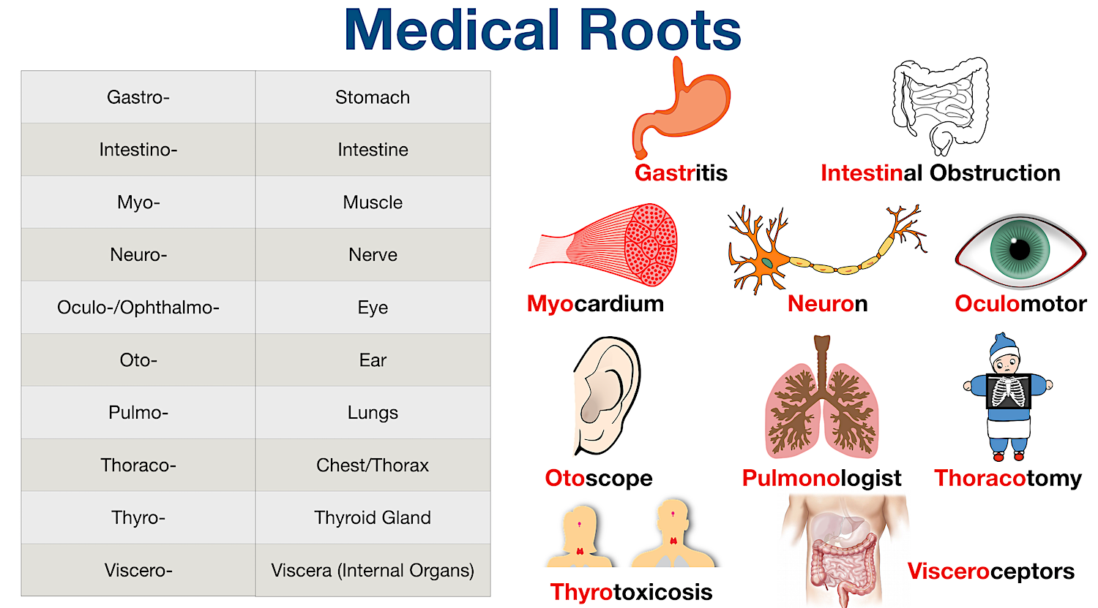

Slide 8
Word Root Examples
“dent” means tooth
“dermat” means skin
“cardi” means heart
“gastr” means stomach
“pancreat” means pancreas

Slide 9
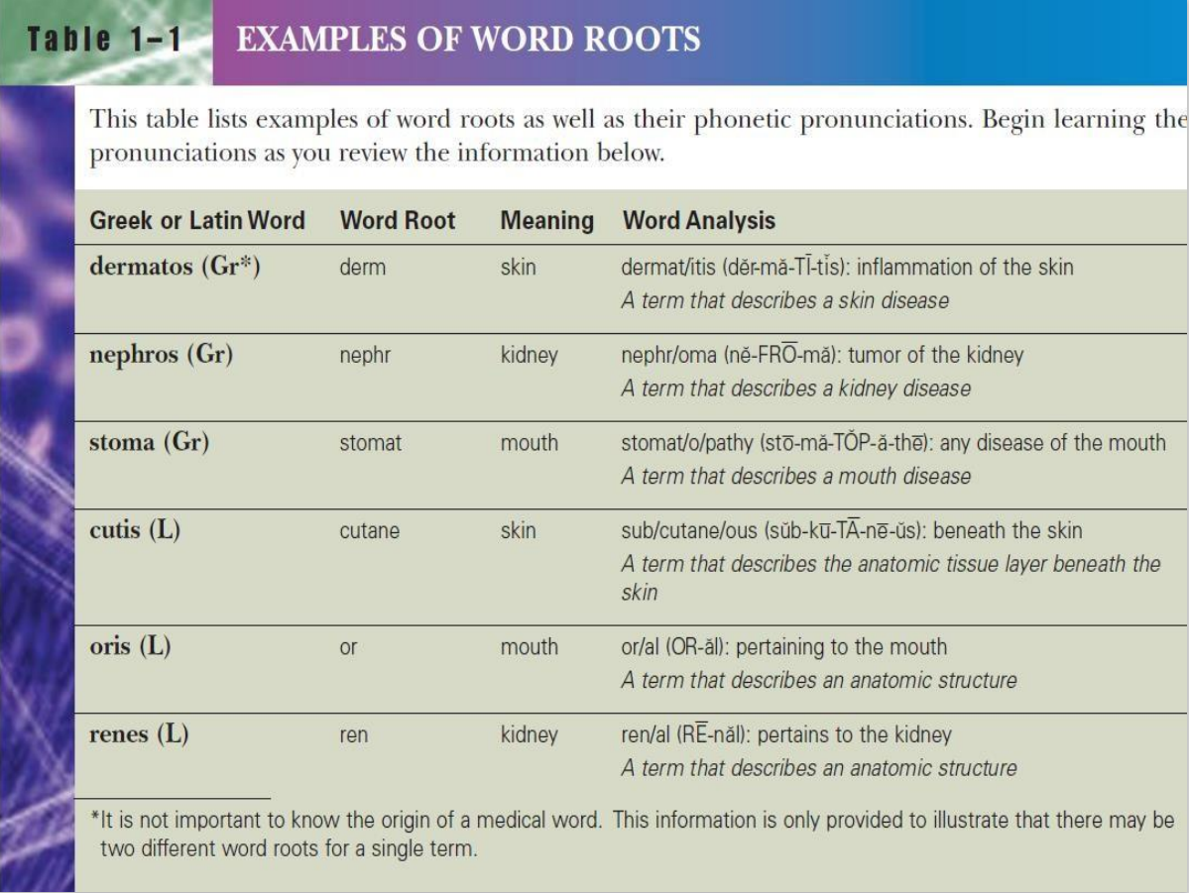

Slide 10
Combining Forms
Correct pronunciation of medical words is important.
In order to make the pronunciation of word roots easier,
sometimes it is necessary to insert a vowel after the root
The combination of a word root and a vowel
is known as a COMBINING FORM.

Slide 11
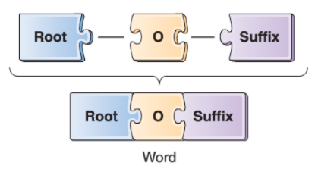
Combining vowel:
Vowels
a, e, i, o, u
Consonants
letters that are not vowels.
A combining vowel is used between a word root and a suffix that begins
with a consonant (not a vowel)
Combining Vowel usually “ o”

Slide 12
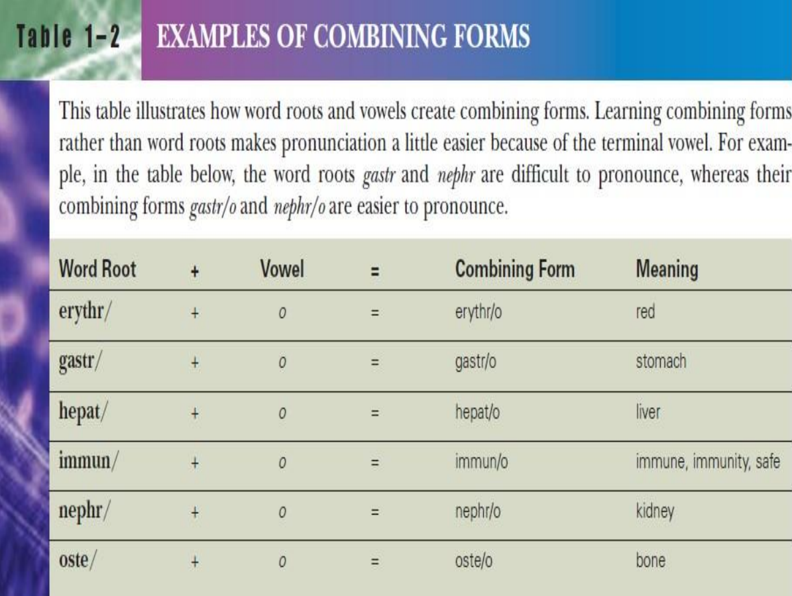

Slide 13
Leukocytopenia
Word Roots: Leuk / (white)
cyt / (cell)
Combining Vowel / o /
Suffix: penia / (decrease)

Slide 14
Word root: scler / (hardening)
Suffix: derma (skin)
Term: Scler / O / derma (hardening of the skin)
Combining vowel

Slide 15
Suffixes
A suffix is a word element placed at the end of a word or word root
that changes the meaning of the word.
In the terms tonsill/itis, and tonsill/ectomy, the suffixes
are
– -itis (inflammation)
– and -ectomy (excision, removal).
Changing the suffix changes the meaning of the word.
In medical terminology, a suffix usually indicates a
procedure, condition, disease, or part of speech.
Many suffixes are derived from Greek or Latin words

Slide 16
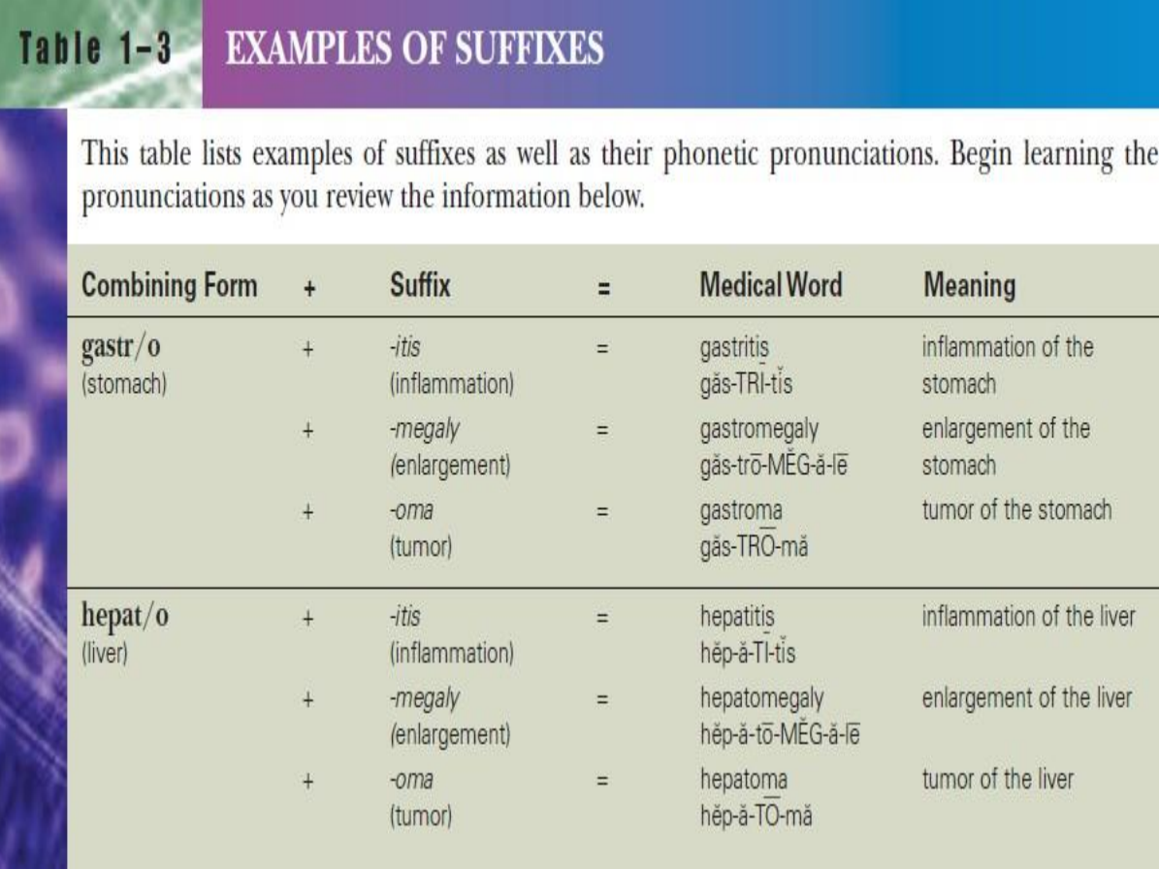

Slide 17
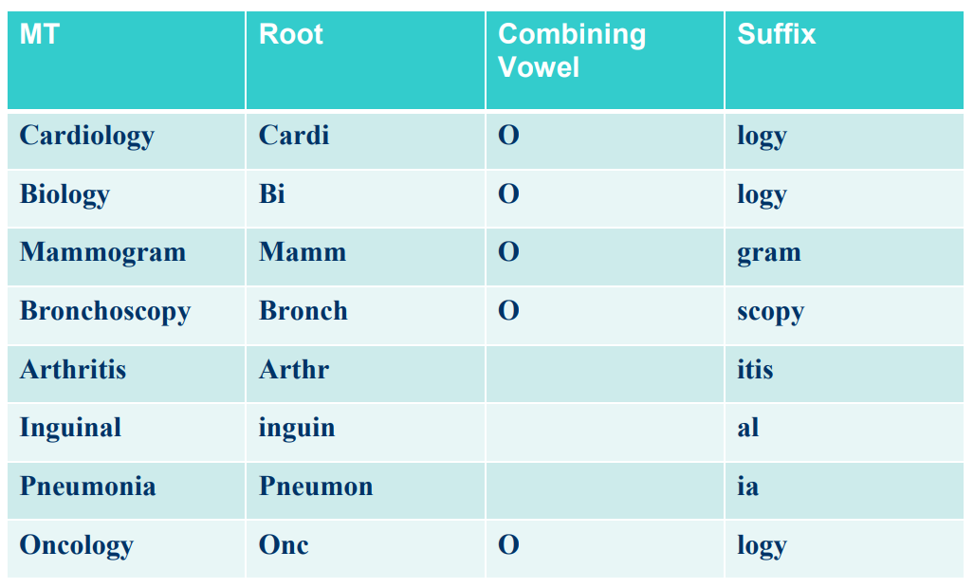
Divide into components word parts

Slide 18
Prefixes
A prefix is a word element attached to the beginning of a word or word root.
Adding or changing a prefix changes the meaning of the word.
The prefix usually indicates a number, time,
position, or direction
Many of the same prefixes found in medical terminology are also
found in the English language

Slide 19
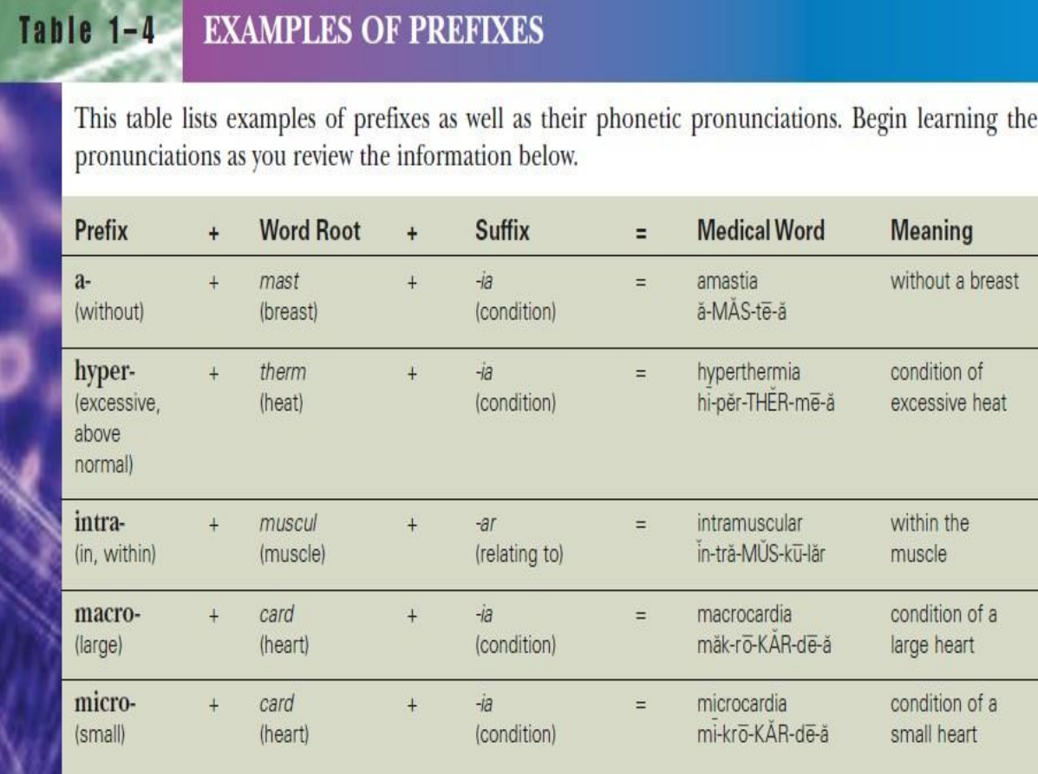

Slide 20
Hypoinsulinemia
Hypo / insulin / emia
Prefix Word root suffix
LOW INSULIN BLOOD
Notice that there is no combining vowel
in this word because the prefix ends with
a vowel and the suffix begins with a vowel.

Slide 21
Defining Medical Words:
Here are the three basic rules for defining medical words using the example term
Gastroenteritis.
Rule #1
– Define the suffix, or last part of the word. In this case, -itis, which
means inflammation.
Rule #2
– Define the first part of the word (which may be a word root,
combining form, or prefix). In this case, the combining form gastr/o
means stomach.
Rule #3
– Define the middle parts of the word. In this case, enter/ means
intestine.

Slide 22
When you analyze gastroenteritis following the three
previous rules, the meaning is revealed as:
1. inflammation (of)
2. stomach (and)
3. intestine
Thus, the definition of gastroenteritis is “inflammation
(of) stomach (and) intestine.”

Slide 23


Building Medical Words
There are three basic rules for building medical words.
Rule #1
– A word root links a suffix that begins with a vowel.
Rule #2
– A combining form (root + o) links a suffix that begins with a consonant.

Slide 24
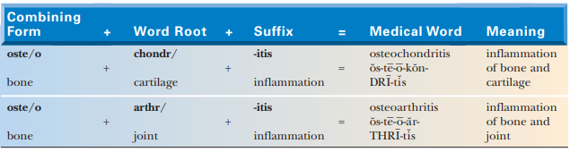
Rule #3
– Use a combining form to link a root to another root to form a compound word.
This rule holds true even if the next root begins with a vowel, as in osteoarthritis

Slide 25
Quiz :
The Root in pericarditis is
A . –itis
B. Peri -
C . Card

Slide 26
-Identifying suffixes and prefixes:
Thoracotomy ……………….
Gastroscope ……………….
Macroglossia ……………….
Intramuscular ……………….

Slide 27
-Gastroduodenoscopy
Two Root One Root Three root
-One combination do not need a combining Vowel :
A . Dermat + it is
B . Dermat + logy
C . Micr + Scopy

Slide 28
-When you make Analysis of the word begin with:
A . Beginning
B . End
C .Middle
-Adding Vowel to the word results in
A. Prefix
B. Suffix
C. Combining form
D. Complex word

Slide 29


