Slide 1
Medical Terminology
BODY STRUCTURE lec. 3
Dr. Lamees Abd ALRaheem
M.B.CH.B F.I.C.M.S

Slide 2
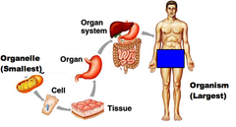
 levels of organization

The body is composed of several levels of structure and function
 -cells
 -tissue
 -organ
 - system
 -organism

Slide 3
Roots related to Cellular Structure:
Element | Meaning | Word analysis
Cyt/o | Cell | cyt/o/logist :specialist in thenstudy of the cells
Hist/o | Tissue | hist/o/logy : study of the microscopic structures of tissues

Slide 4

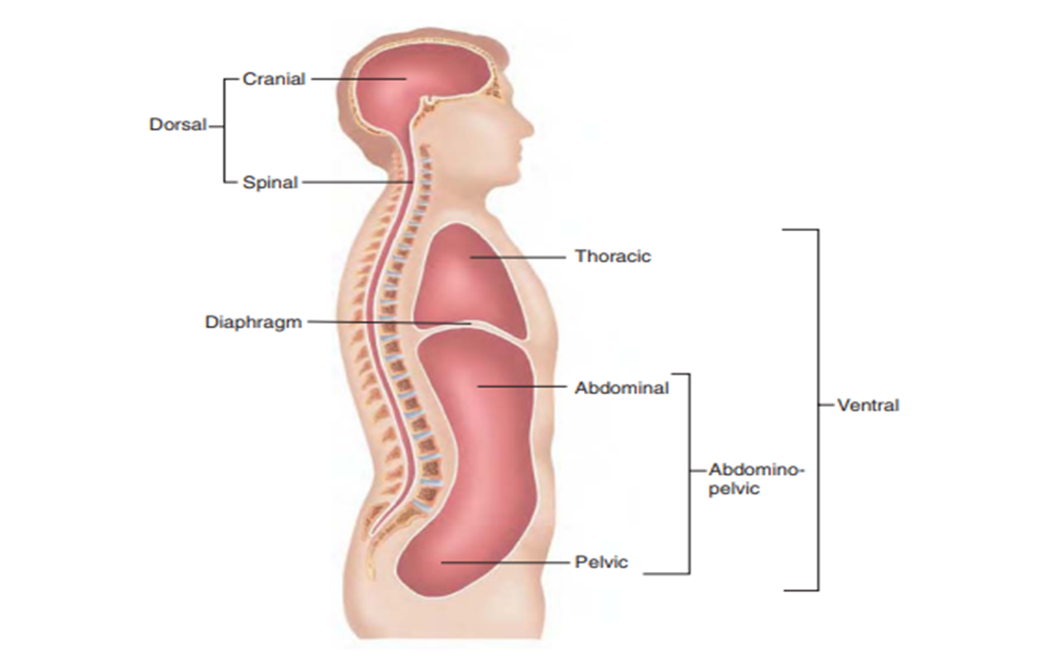
Body Cavities:
The body has two major cavities: the dorsal cavity (posterior) and the ventral cavity (anterior)

Slide 5
NEW ROOTS RELATED TO BODY CAVITIES:
Root | Origin | Meaning
abdomin/o | abdomen (French for “abdomen”) | abdomen
crani/o | cranium (from Greek kranion) | skull
spin/o | spine | spine
thorac/o | thorax (Greek for breastplate) | chest

Slide 6
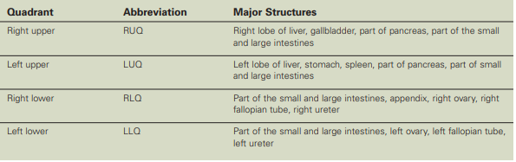
BODY QUADRANTS:

Slide 7
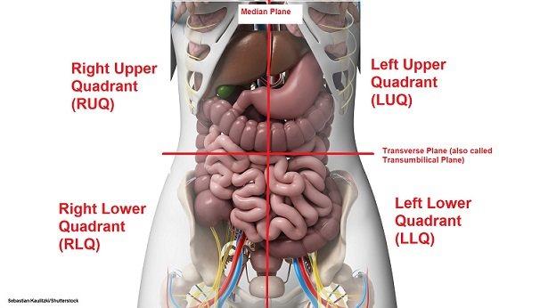

Slide 8
NEW ROOTS RELATED TO Regions of the Body:
Element | Meaning | Word analysis
Inguin/o | groin | inguin/al :the depression located between the thigh and trunk
Lumb/o | loin | Lumb/ar : pertaining to the loins, the lower back
pelv/i | pelvis | pelv/ic: relating to pelvis
Ili/o | ilium | ili/al: relating to ilium

Slide 9
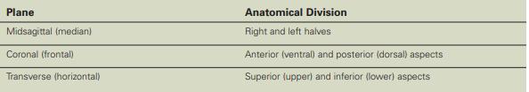
Planes of the Body
To identify various sections of the body, anatomists use an imaginary flat surface called a plane. prior to the development of modern imaging techniques
The most commonly used planes are midsagittal, coronal, and transverse

Slide 10
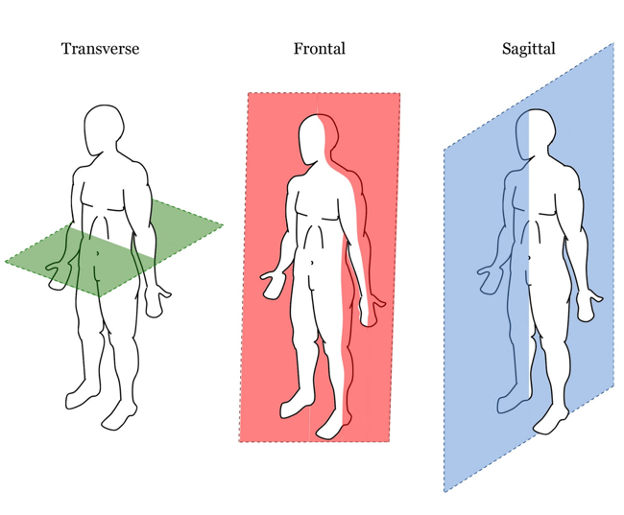
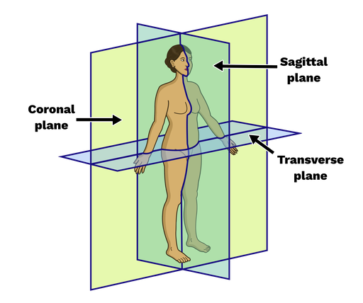
Planes of the Body

Slide 11
DIRECTIONAL ADJECTIVES:
Anatomic Position | Direction
anterior or ventral | -toward the front and away from the back of the body
distal | -away from the attachment point of a limb (arm or leg)
inferior | - away from the head
lateral | -away from the middle of and toward the side of the body
medial | - toward the middle of the body
posterior or dorsal | -toward the back and away from the front of the body
proximal or superior | -toward the attachment point of a limb (arm or leg)

Slide 12
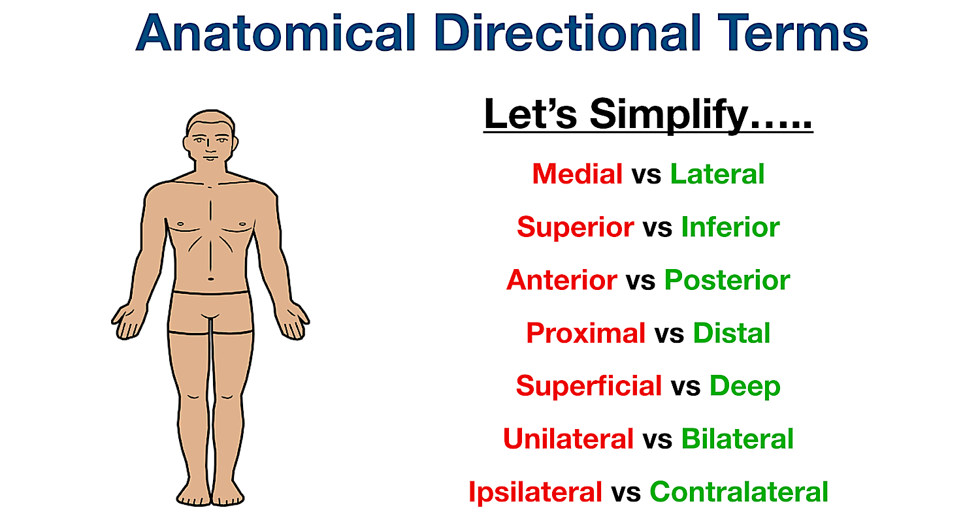

Slide 13
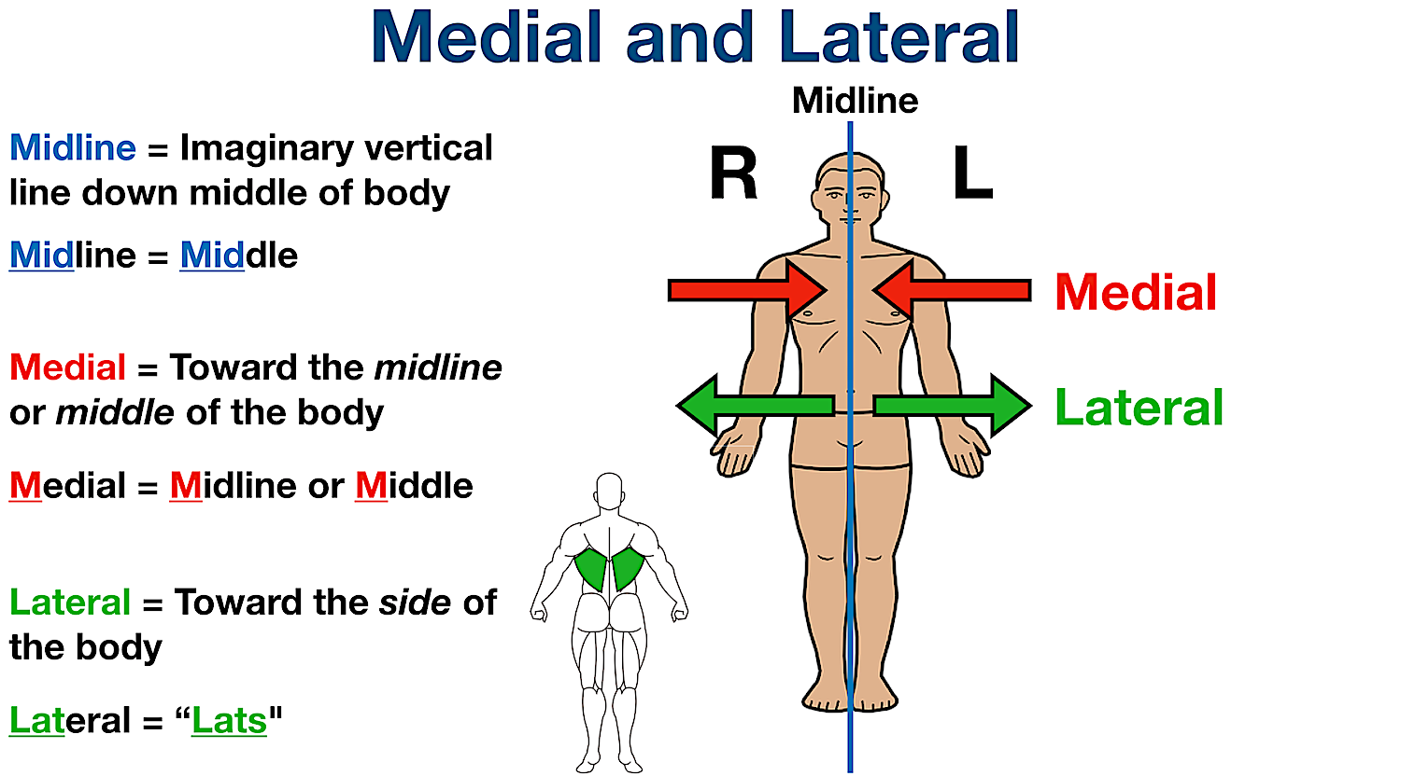

Slide 14
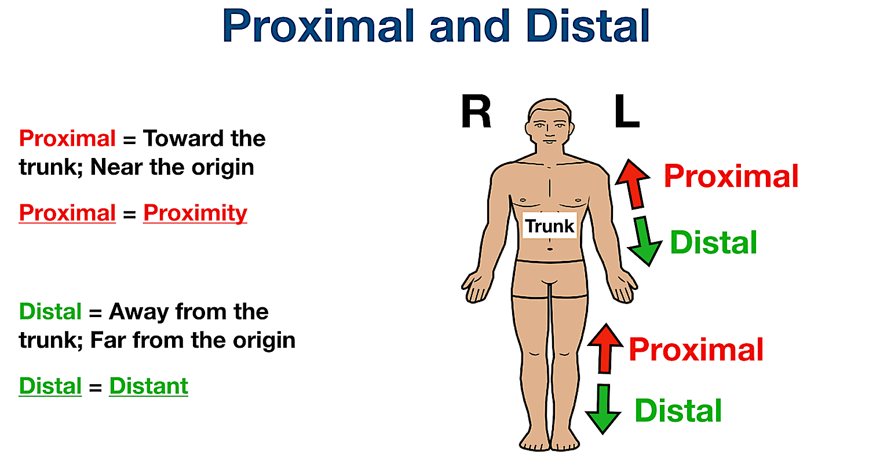
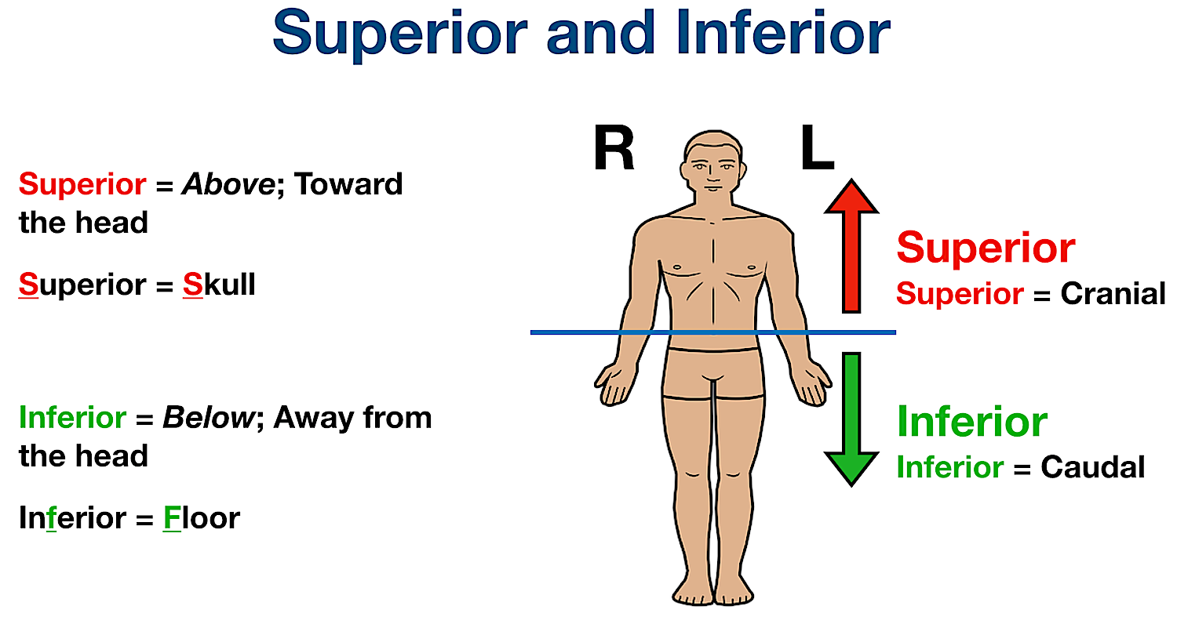

Slide 15
Abbreviations
Abbreviation | Meaning
Ant. | anterior
Post. | posterior
AP. | Anteroposterior
CT | computed tomography
MRI | magnetic resonance imaging
US | ultrasound
Dx | diagnosis

Slide 16


