Slide 1

The Endocrine System
Second messenger system of the body
Uses chemical messages (hormones) that are released into the blood
Hormones control several major processes
  Reproduction
  Growth and development
  Mobilization of body defenses
  Maintenance of much of homeostasis
  Regulation of metabolism

Slide 2
Hormone Overview
Hormones are produced by specialized cells
Cells secrete hormones into extracellular fluids
Blood transfers hormones to target sites
These hormones regulate the activity of other cells

Slide 3
The Chemistry of Hormones
Amino acid-based hormones
  Proteins
  Peptides
  Amines
Steroids – made from cholesterol
Prostaglandins – made from highly active lipids

Slide 4
Mechanisms of Hormone Action
Hormones affect only certain tissues or organs (target cells or organs)
Target cells must have specific protein receptors
Hormone binding influences the working of the cells

Slide 5
Effects Caused by Hormones
Changes in plasma membrane permeability or electrical state
Synthesis of proteins, such as enzymes
Activation or inactivation of enzymes
Stimulation of mitosis

Slide 6
Steroid Hormone Action
Diffuse through the plasma membrane of target cells
Enter the nucleus
Bind to a specific protein within the nucleus
Bind to specific sites on the cell’s DNA
Activate genes that result in synthesis of new proteins

Slide 7
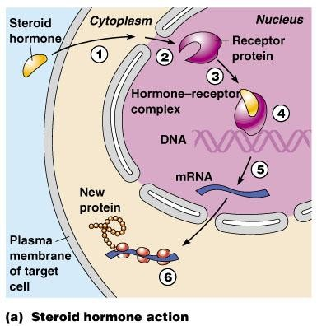
Steroid Hormone Action
Figure 9.1a

Slide 8
Nonsteroid Hormone Action
Hormone binds to a membrane receptor
Hormone does not enter the cell
Sets off a series of reactions that activates an enzyme
Catalyzes a reaction that produces a second messenger molecule
Oversees additional intracellular changes to promote a specific response

Slide 9
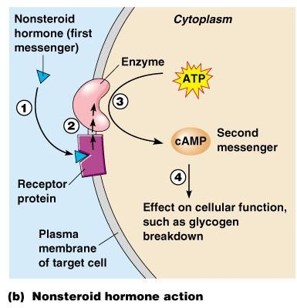
Nonsteroid Hormone Action
Figure 9.1b

Slide 10
Control of Hormone Release
Hormone levels in the blood are maintained by negative feedback
A stimulus or low hormone levels in the blood triggers the release of more hormone
Hormone release stops once an appropriate level in the blood is reached

Slide 11

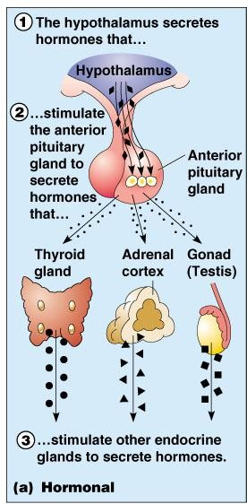
Hormonal Stimuli of Endocrine Glands
Endocrine glands are activated by other hormones
Figure 9.2a

Slide 12
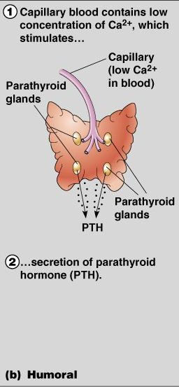
Humoral Stimuli of Endocrine Glands
Changing blood levels of certain ions stimulate hormone release
Figure 9.2b

Slide 13
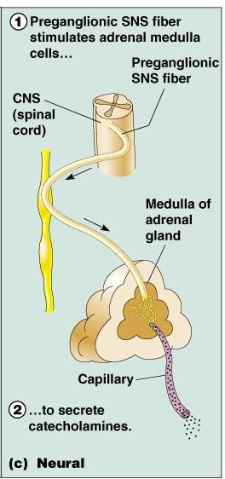
Neural Stimuli of Endocrine Glands
Nerve impulses stimulate hormone release
Most are under control of the sympathetic nervous system
Figure 9.2c

Slide 14
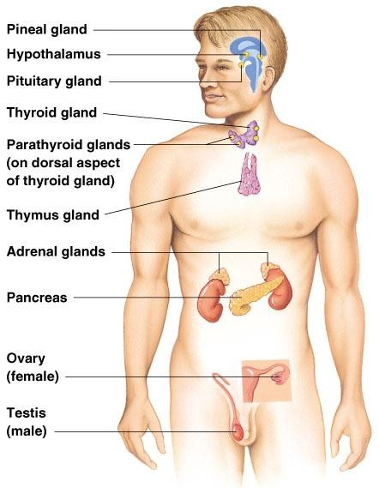
Location of Major Endrocrine Organs
Figure 9.3

Slide 15

Pituitary Gland
Size of a grape
Hangs by a stalk from the hypothalamus
Protected by the sphenoid bone
Has two functional lobes
  Anterior pituitary – glandular tissue
  Posterior pituitary – nervous tissue

Slide 16
Hormones of the Anterior Pituitary
Six anterior pituitary hormones
  Two affect non-endocrine targets
  Four stimulate other endocrine glands (tropic hormones)
Characteristics of all anterior pituitary hormones
  Proteins (or peptides)
  Act through second-messenger systems
  Regulated by hormonal stimuli, mostly negative feedback

Slide 17
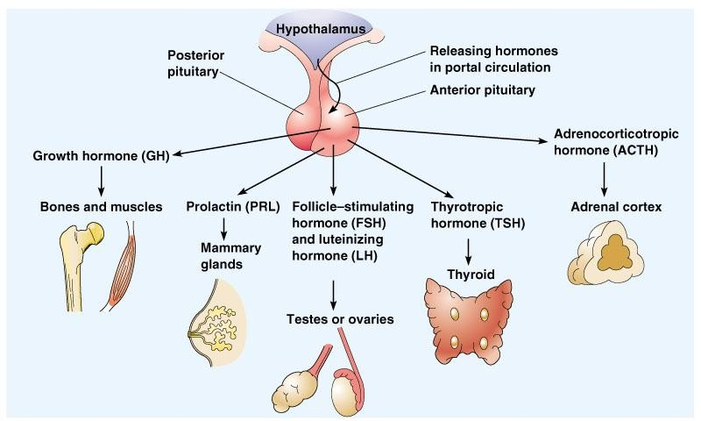
Hormones of the Anterior Pituitary
Figure 9.4

Slide 18

Growth Hormone (GH)
General metabolic hormone
Major effects are directed to growth of skeletal muscles and long bones
Causes amino acids to be built into proteins
Causes fats to be broken down for a source of energy

Slide 19

Functions of Other Anterior Pituitary Hormones
Prolactin (PRL)
  Stimulates and maintains milk production following childbirth
  Function in males is unknown
Adrenocorticotropic hormone (ACTH)
  Regulates endocrine activity of the adrenal cortex
Thyroid-stimulating hormone (TSH)
  Influences growth and activity of the thyroid

Slide 20
Functions of Other Anterior Pituitary Hormones
Gonadotropic hormones
  Regulate hormonal activity of the gonads
    Follicle-stimulating hormone (FSH)
      Stimulates follicle development in ovaries
      Stimulates sperm development in testes

Slide 21
Functions of Other Anterior Pituitary Hormones
Gonadotropic hormones (continued)
  Luteinizing hormone (LH)
    Triggers ovulation
    Causes ruptured follicle to become the corpus luteum
    Stimulates testosterone production in males
      Referred to as interstitial cell-stimulating hormone (ICSH)

Slide 22




Pituitary - Hypothalamus Relationship
Release of hormones is controlled by releasing and inhibiting hormones produced by the hypothalamus
Hypothlamus produces two hormones that are transorted to neurosecretory cells of the posterior pituitary
The poterior pituitary is not strictly an endocrine gland, but does release hormones

Slide 23
Hormones of the Posterior Pituitary
Oxytocin
  Stimulates contractions of the uterus during labor
  Causes milk ejection
Antidiuretic hormone (ADH)
  Can inhibit urine production
  In large amounts, causes vasoconstriction leading to increased blood pressure (vasopressin)

Slide 24
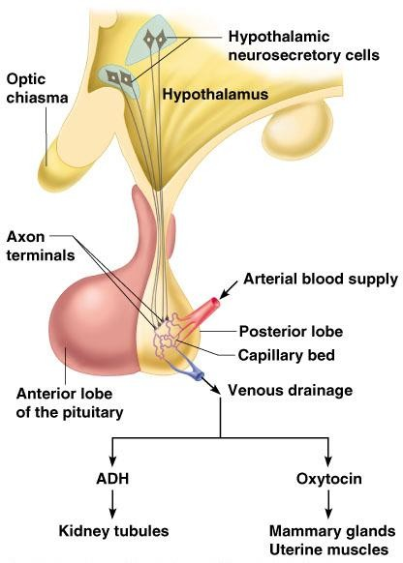
Hormones of the Posterior Pituitary
Figure 9.5

Slide 25

Thyroid Gland
Found at the base of the throat
Consists of two lobes and a connecting isthmus
Produces two hormones
  Thyroid hormone
  Calcitonin

Slide 26
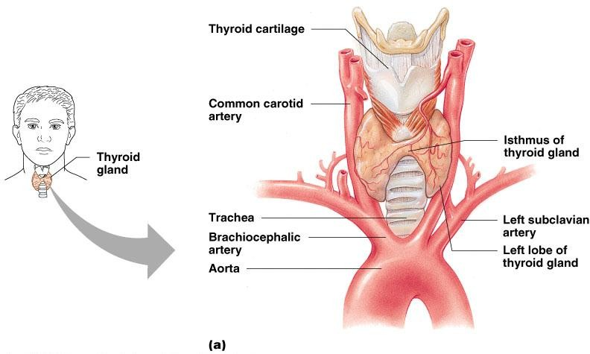
Thyroid Gland
Figure 9.6

Slide 27

Thyroid Hormone
Major metabolic hormone
Composed of two active iodine- containing hormones
  Thyroxine (T₄) – secreted by thyroid follicles
  Triiodothyronine (T₃) – conversion of T₄ at target tissues

Slide 28

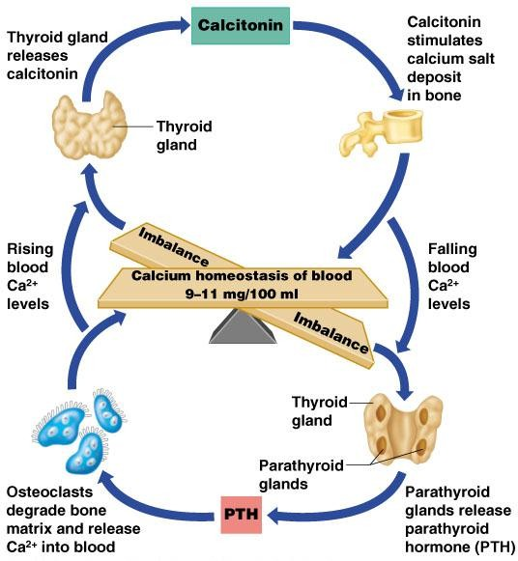
Calcitonin
Decreases blood calcium levels by causing its deposition on bone
Antagonistic to parathyroid hormone
Produced by C (parafollicular) cells
Copyright © 2003 Pearson Education, Inc. publishing as Benjamin Cumming
Figure 9.9

Slide 29

Parathyroid Glands
Tiny masses on the posterior of the thyroid
Secrete parathyroid hormone
  Stimulate osterclasts to remove calcium from bone
  Stimulate the kidneys and intestine to absorb more calcium
  Raise calcium levels in the blood

Slide 30

Adrenal Glands
Two glands
  Cortex – outer glandular region in three layers
  Medulla – inner neural tissue region
Sits on top of the kidneys

Slide 31
Hormones of the Adrenal Cortex
Mineralocorticoids (mainly aldosterone)
  Produced in outer adrenal cortex
  Regulate mineral content in blood, water, and electrolyte balance
  Target organ is the kidney
  Production stimulated by renin and aldosterone
  Production inhibited by atrial natriuretic peptide

Slide 32
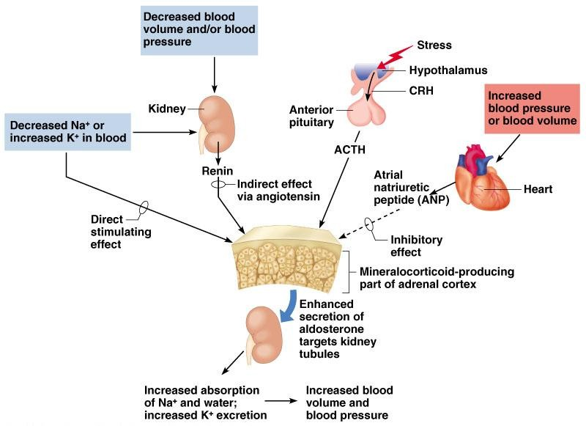
Hormones of the Adrenal Cortex
Figure 9.10

Slide 33
Hormones of the Adrenal Cortex
Glucocorticoids (including cortisone and cortisol)
  Produced in the middle layer of the adrenal cortex
  Promote normal cell metabolism
  Help resist long-term stressors
  Released in response to increased blood levels of ACTH

Slide 34
Hormones of the Adrenal Cortex
Sex hormones
  Produced in the inner layer of the adrenal cortex
  Androgens (male) and some estrogen (female)

Slide 35
Hormones of the Adrenal Medulla
Produces two similar hormones (catecholamines)
  Epinephrine
  Norepinephrine
These hormones prepare the body to deal with short-term stress

Slide 36

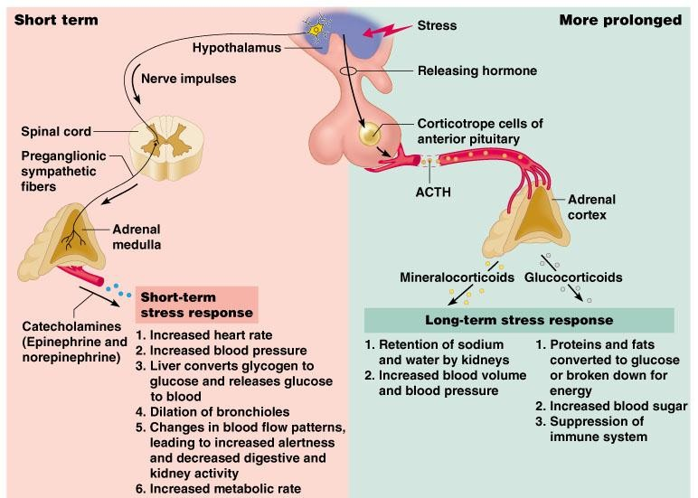
Roles of the Hypothalamus and Adrenal Glands in the Stress Response
Figure 9.12

Slide 37

Pancreatic Islets
The pancreas is a mixed gland
The islets of the pancreas produce hormones
  Insulin – allows glucose to cross plasma membranes into cells from beta cells
  Glucagon – allows glucose to enter the blood from alpha cells
  These hormones are antagonists that maintain blood sugar homeostasis
Copyright © 2003 Pearson Education, Inc. publishing as Benjamin Cummings

Slide 38
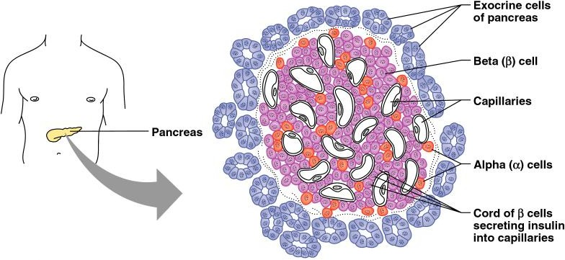
Pancreatic Islets
Figure 9.13

Slide 39
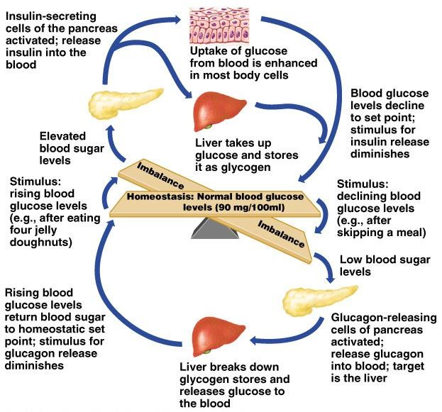
Pancreatic Hormones and Blood Sugar
Figure 9.14

Slide 40

Pineal Gland
Found on the third ventricle of the brain
Secretes melatonin
  Helps establish the body’s wake and sleep cycles
  May have other as-yet-unsubstantiated functions

Slide 41

Thymus
Located posterior to the sternum
Largest in infants and children
Produces thymosin
  Matures some types of white blood cells
  Important in developing the immune system

Slide 42
Hormones of the Ovaries
Estrogens
  Produced by Graafian follicles or the placenta
  Stimulates the development of secondary female characteristics
  Matures female reproductive organs
  Helps prepare the uterus to receive a fertilized egg
  Helps maintain pregnancy
  Prepares the breasts to produce milk

Slide 43
Hormones of the Ovaries
Progesterone
  Produced by the corpus luteum
  Acts with estrogen to bring about the menstrual cycle
  Helps in the implantation of an embryo in the uterus

Slide 44
Hormones of the Testes
Interstitial cells of testes are hormone- producing
Produce several androgens
Testosterone is the most important androgen
  Responsible for adult male secondary sex characteristics
  Promotes growth and maturation of male reproductive system
  Required for sperm cell production

Slide 45



Other Hormone-Producing Tissues and Organs
Parts of the small intestine
Parts of the stomach
Kidneys
Heart
Many other areas have scattered endocrine cells

Slide 46
Endocrine Function of the Placenta
Produces hormones that maintain the pregnancy
Some hormones play a part in the delivery of the baby
Produces HCG in addition to estrogen, progesterone, and other hormones

Slide 47

Developmental Aspects of the Endocrine System
Most endocrine organs operate smoothly until old age
  Menopause is brought about by lack of efficiency of the ovaries
  Problems associated with reduced estrogen are common
  Growth hormone production declines with age
  Many endocrine glands decrease output with age

