Slide 1








Waste Management part 1
M.Sc. Amna Shaker
College of Science
Medical Biotechnology Department
Al-Mustaqbal University

Slide 2
Waste Management
Waste control : is all the behaviors and acts necessary to handle the waste from its inception to its final disposal.
Type of waste
1- Solid Wastes
2- Liquid Wastes
3-Gaseous Wastes

Slide 3
Waste Management involves
1-Storage the waste.
2-Transport .
3- get rid or recycling of waste.

Slide 4
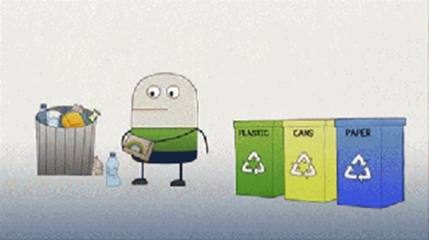
Types of Waste Management
1 –Recycling :

Slide 5
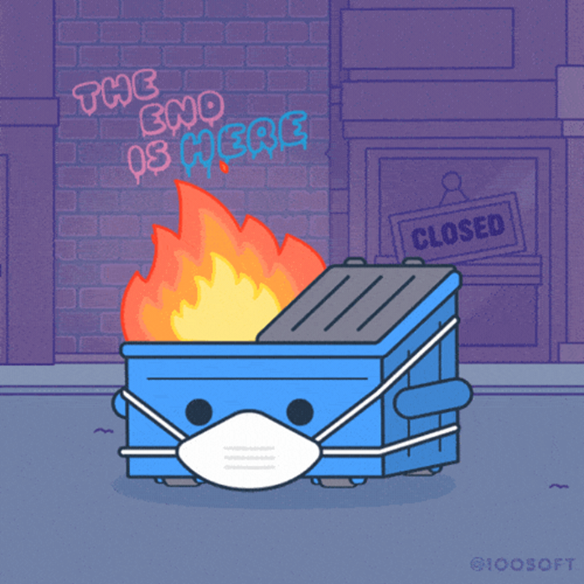
Types of Waste Management
2- Incineration :

Slide 6
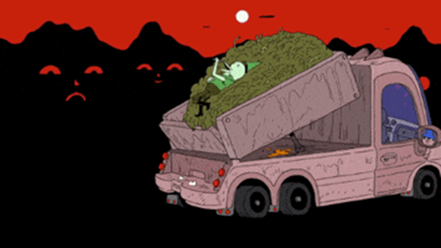
Types of Waste Management
3- Landfill :

Slide 7
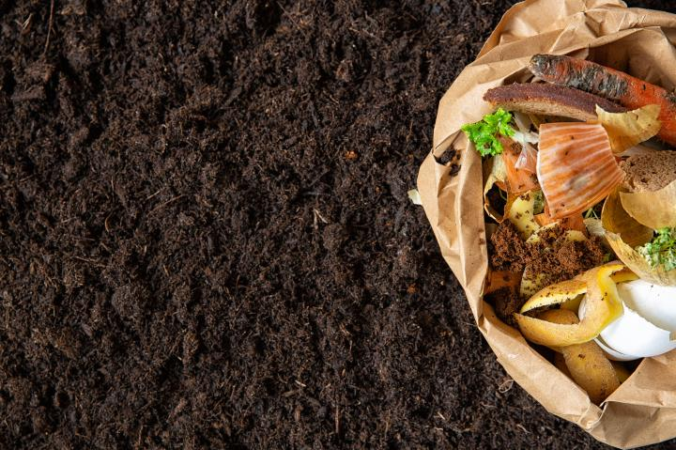
Types of Waste Management
4- Biological Reprocessing :

Slide 8
Laboratory waste :
During laboratory activities, different contaminated materials and liquids will be generated Some of the materials such as glassware, equipment, devices or laboratory clothing.
Examples of waste generated in laboratories are shows in table:

Slide 9
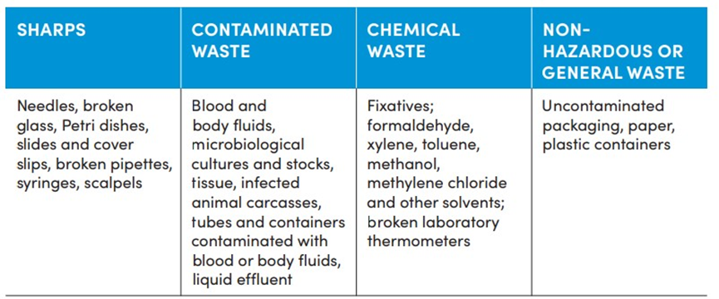

Slide 10
Waste management (part 2)
First: on site
Second: off-site
*Proper packaging methods secure the safety of all laboratory staff: For example, sharps should be collected in puncture-proof and closed containers.
A first-aid kit is essential and must exist

Slide 11
Types of treated contaminated Waste
First on site :The following elements need to be considered for treated the contamination :
1- nature of the waste, for example, liquids, solids
2- volume of the waste to process.
3- place where waste decontamination takes place (for example, in the laboratory itself,
4- type of packaging for storing the waste.

Slide 12
Second: off-site:
The waste transported to an off-site for treatment and final disposal.
The following information must be available to those transporting contaminated waste:
1-waste classes
2- waste type
3-waste producer (for example :laboratory or hospital )
4-The date
5-number of containers and volume

Slide 13
Decontamination waste
A : Decontamination of liquid waste:
1- Sewer system
2- Chemical disinfection
3- Autoclaving

Slide 14
B: Decontamination of solid waste
1-Autoclaving
2-Incineration
3-Alkaline digestion

Slide 15
تذكر...
السلامة أولاً!

