Slide 1







Biosafety
M.Sc. Amna Shaker
College of Science
Medical Biotechnology Department
Al-Mustaqbal University

Slide 2
Introduction to Biosafety
Biosafety is the safe working practices associated with handling of biological materials, particularly infectious agents.
It’s meaning apply technologies and practices to prevent the accidentally exposure to pathogens and toxins, or their accidental release.

Slide 3
Biosafety Levels
Each level has specific controls for containment of microbes and biological agents.
The risks that determine levels of containment are infectivity, severity of disease, transmissibility, and the nature of the work conducted.

Slide 4
Biosafety Levels
1. Biosafety Level -1 (BSL-1)
2. Biosafety Level-2 (BSL-2)
3. Biosafety Level-3 (BSL-3)
4. Biosafety Level 4 (BSL-4)

Slide 5
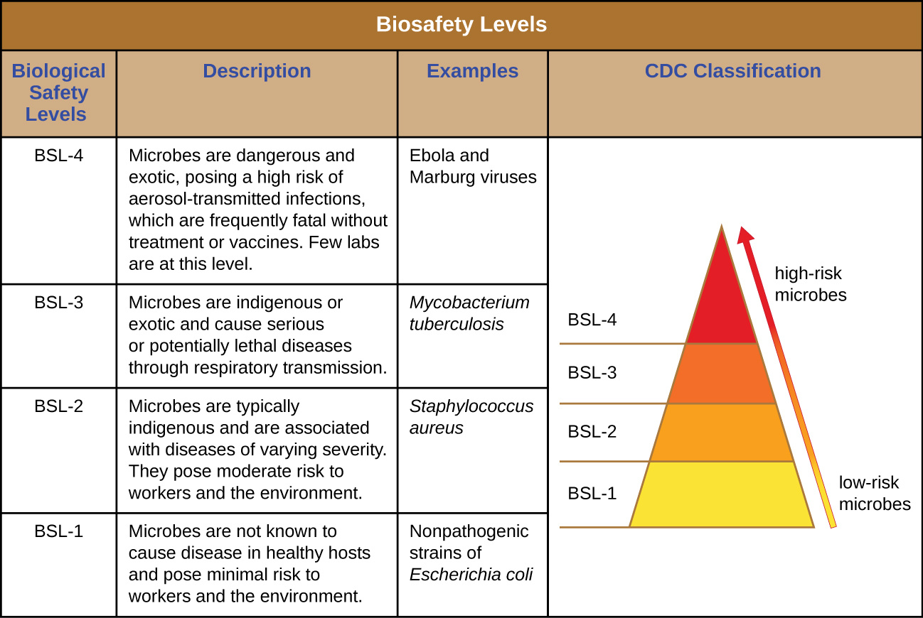

Slide 6
Biohazard : The potential source of harm caused by biological agents or toxins.
Biorisk :A combination of the probability of occurrence of harm and the severity of that harm where the source of harm is a biological agent or toxin

Slide 7
The source of harm may be an accidental exposure, accidental release or loss, misuse.
Biorisk management The management of biorisk places responsibility on manager (director) to demonstrate that biorisk reduction (minimization) procedures have been established.

Slide 8
Biological laboratory: A facility that dealing with microorganisms, their components or their derivatives are collected or stored.
Biological laboratories include:
1- clinical laboratories, 2- diagnostic facilities, 3-research centers (academic, pharmaceutical, environmental, etc.) , 4- production facilities (manufacturers of vaccines, pharmaceuticals) for human, veterinary and agricultural purposes.

Slide 9
Biorisk Management of Biological Hazards
can be broadly divided into:
1.Actions that take place before the biological hazard has been found (preventive measures);
2. Actions that take place during an outbreak
3. Actions aimed at reducing the consequences of the presence of the hazard.

Slide 10
تذكر...
السلامة أولاً!

