Slide 1

Child with Gastrointestinal Dysfunction
Dr . Reda Elfeshawy Assistant professor
of pediatric nursing

Slide 2
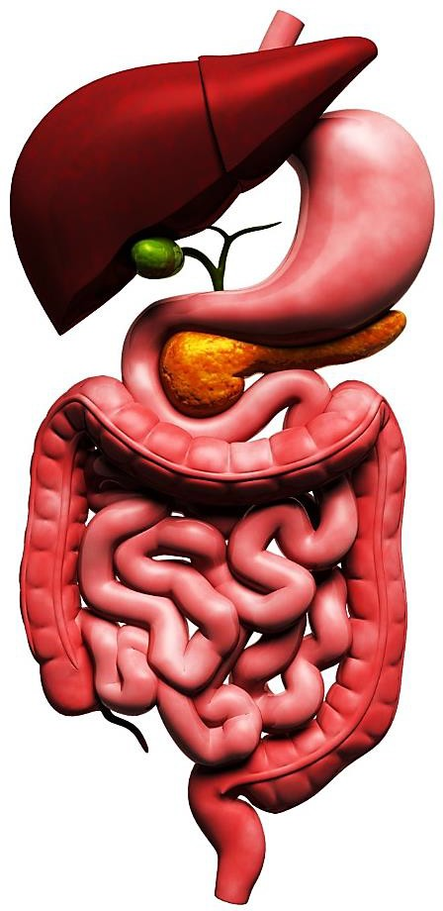
Outline
Definition
Signs and symptoms
Causes
Complication
Assessment and diagnostic evaluation
Therapeutic management
Nursing diagnosis
Nursing care management

Slide 3


Slide 4
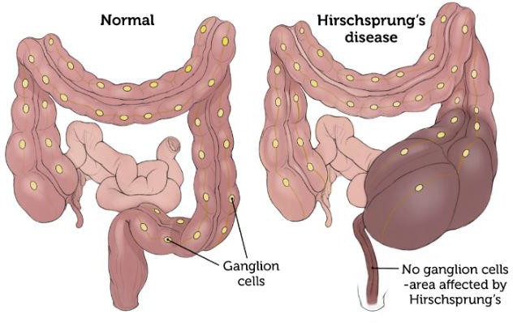
HIRSCHSPRUNG’S DISEASE (HD)
Congenital Aganglionic Megacolon is the most common cause of neonatal intestinal obstruction. The disease is characterized by Failure to pass meconium in the first 24 hours of life with increased abdominal distension due to a lack of ganglion cells in the bowel, which causes inadequate motility in part of the intestine. These ganglion cells can be absent from the rectosigmoid colon all the way into the small intestine.
Incidence occurs in 1 of every 5,000 newborns

Slide 5
These nerves are called ganglion cells. They make the colon contract so stool can move easily through the digestive system .
In Hirschsprung's disease, certain types of nerve cells (called ganglion cells) are missing from a part of the bowel. In areas without such nerves, the muscle within the bowel wall does not contract to push material through, which causes a blockage.

Slide 6
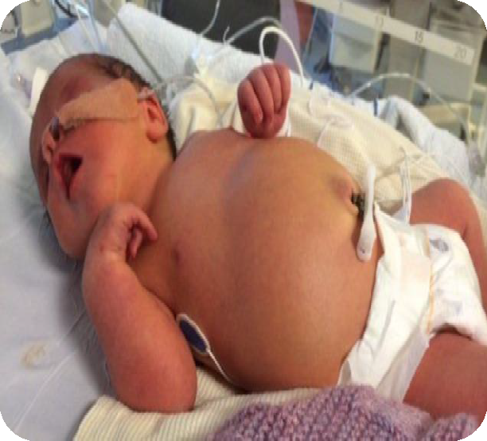

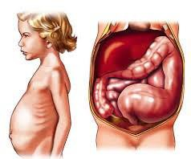









Clinical mnifestation of HD
Failure to pass meconium within 24 to 48 hours after birth
Refusal to feed
Bilious vomiting
Abdominal distention
Failure to thrive (Poor weight gain)
Ribbon-like or watery stools
Visible peristalsis
Easily palpable fecal mass
Enterocolitis can be life-threatening Complication
and requires immediate treatment.

Slide 7


Empty rectum on digital examination
Abdominal x-ray
Barium enema
Rectal biopsy (definitive test for diagnosis)
Anorectal manometry—more accurate for short or ultra- short segments

Slide 8
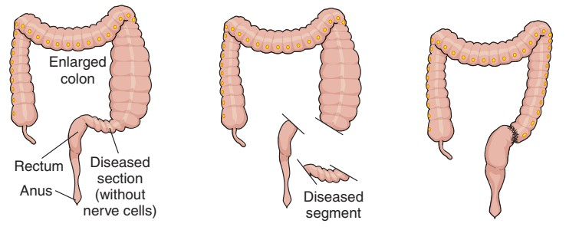
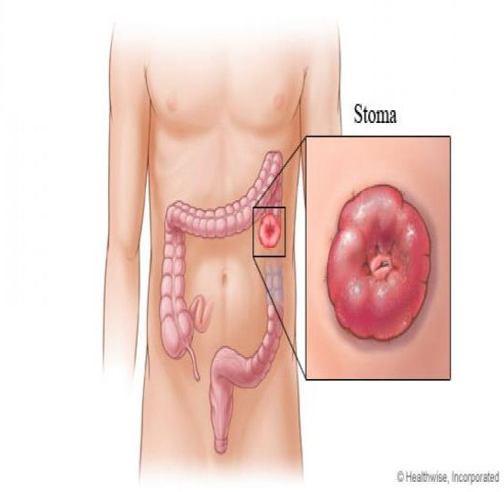
Surgical resection of the aganglionic bowel and reanastomosis of the remaining intestine are necessary to promote proper bowel function.The surgical resection requires the child to have an ostomy to divert the stool through a stoma on the abdomen. This allows the area of the resected bowel and anastomosis to heal before it is used. The ostomy is closed at a later date.

Slide 9
Intussusception

Slide 10
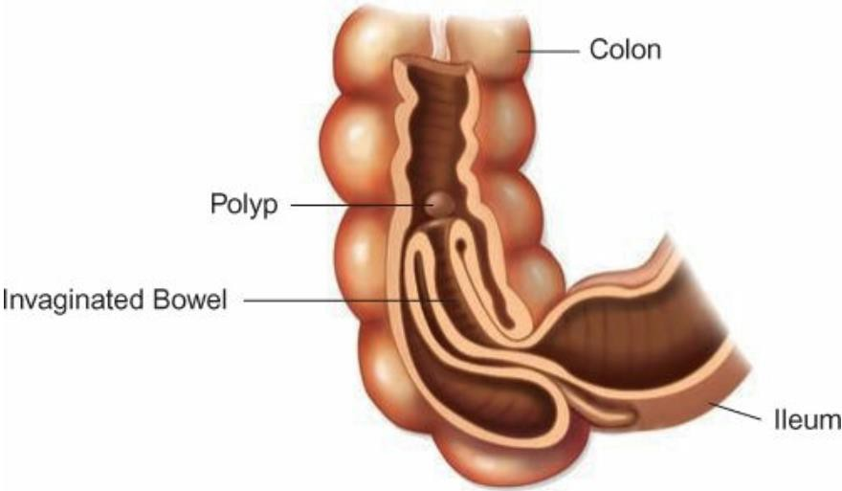
Intussusception
Is a process that occurs when a proximal segment of bowel “telescopes” into a more distal segment, causing edema, vascular compromise, and, ultimately, partial or total bowel obstruction
Intussusception is more common in males than in females and is more common in children under the age of 2 years, generally the cause is not known. May be caused by polyp, or enlargement of lymph tissue

Slide 11
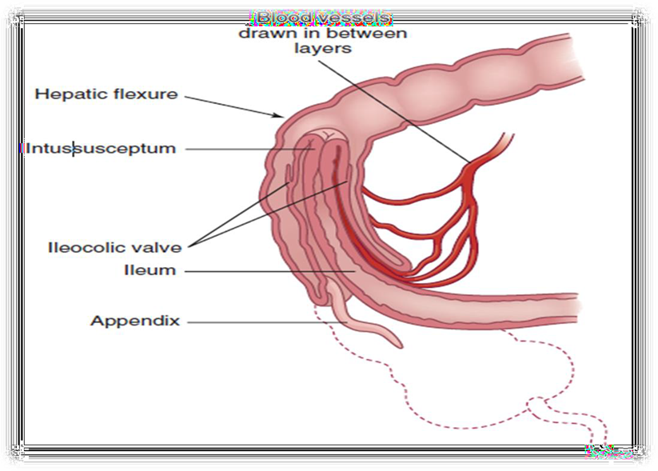
As the edema from the obstruction increases, pressure within the area of intussusception increases. When the pressure equals the arterial pressure, arterial blood flow stops, resulting in ischemia

Slide 12
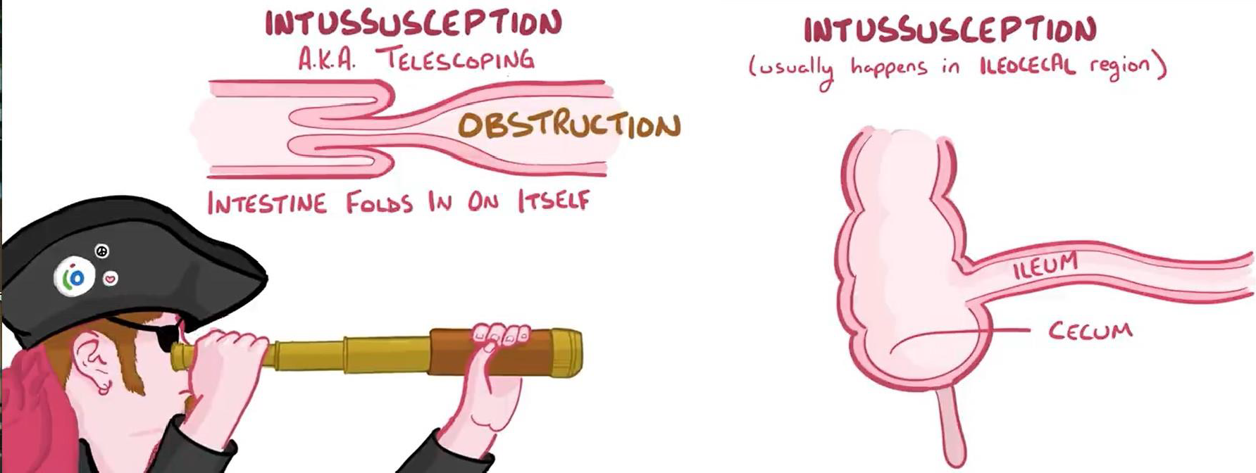
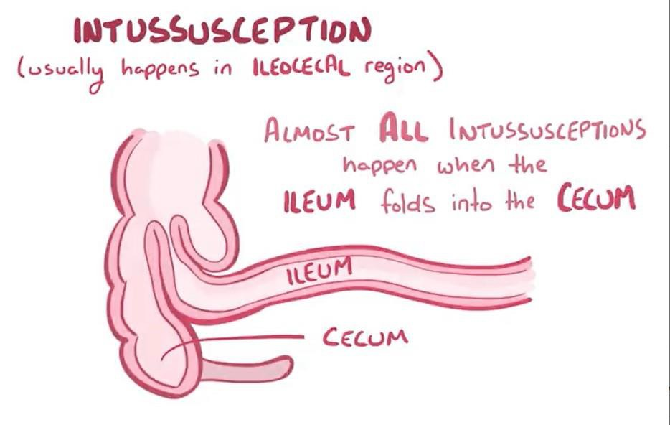

Slide 13

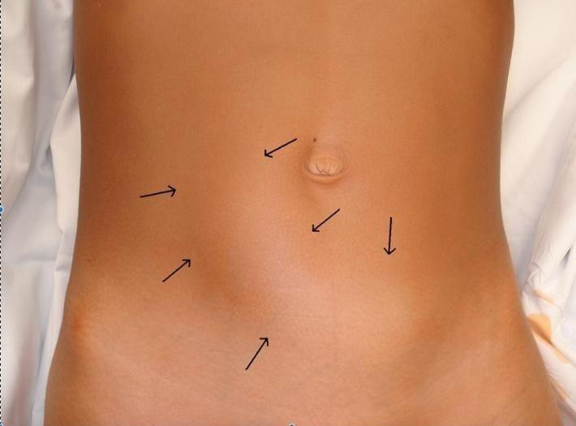




Clinical Manifestations of Intussusception
Sudden onset of intermittent, crampy abdominal pain
Severe pain (children usually draw up their knees and scream)
Vomiting and Diarrhea
Currant-jelly stools, gross blood
Lethargy
Palpable sausage-shaped mass in upper right quadrant
Empty lower right quadrant (Dance sign)
Complication are Peritonitis
bowel perforation

Slide 14
Diagnostic Evaluation
Frequently the diagnosis can be made on subjective findings alone. However, definitive diagnosis is based on ultrasonography
A rectal examination reveals mucus, blood, and occasionally a low intussusception itself.

Slide 15
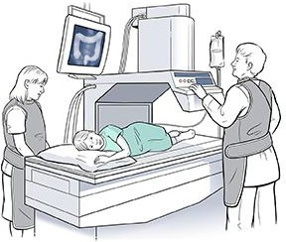
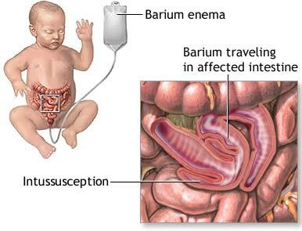
Therapeutic management
A barium enema is successful at reducing a large percentage of intussusception cases; other cases are reduced surgically. If surgical reduction is unsuccessful or bowel necrosis has occurred, a portion of the bowel must be resected

Slide 16
Nursing Diagnoses
Acute pain related to bowel invagination.
Deficient fluid volume related to vomiting and diarrhea.
Ineffective breathing pattern related to abdominal distention and rigidity.
Anxiety related to change in health status.

Slide 17
Nursing Care Management
The nurse can help establish a diagnosis by listening to the parent’s description of the child’s physical and behavioral symptoms. The description of the child’s severe colicky abdominal pain combined with vomiting is a significant sign of intussusception.
The nurse prepares the parents for the immediate need for hospitalization, the nonsurgical technique of hydrostatic reduction, and the possibility of surgery
Offer emotional support and provide appropriate preoperative and postoperative education to the family

Slide 18
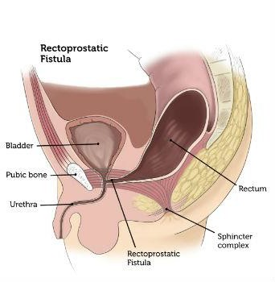
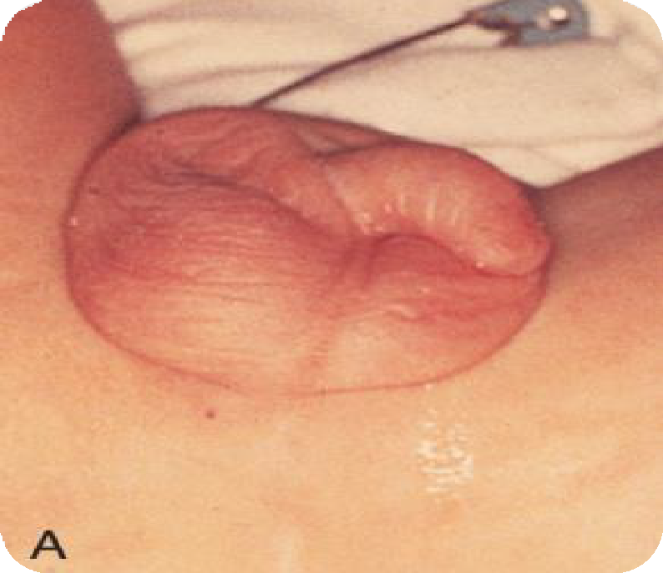
Anorectal Malformations
Imperforate anus is the more common congenital malformations caused by abnormal development, with an incidence of approximately 1 in 5000 births. These malformations may range from simple imperforate anus to include other associated complex anomalies of GU and pelvic organs, which may require extensive treatment for fecal, urinary, and sexual function. Anorectal malformations may occur in isolation or with another anomalies.

Slide 19
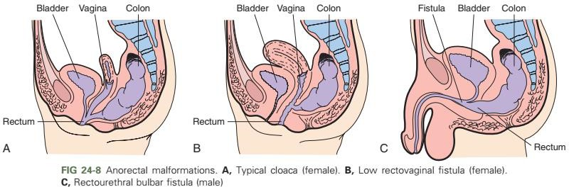
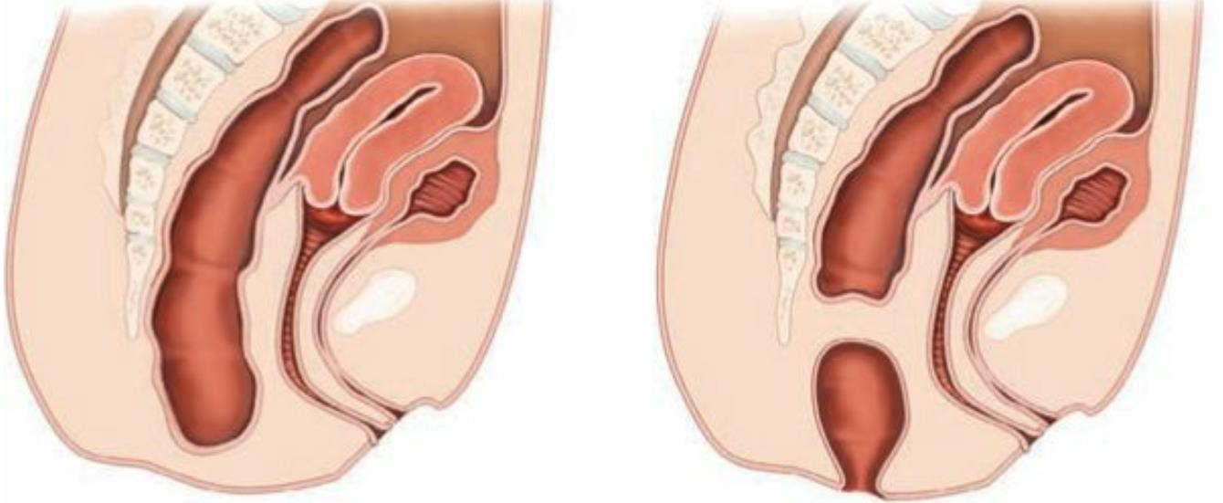

Slide 20
Diagnostic Evaluation
The diagnosis of an anorectal malformation is based on the physical finding of an absent anal opening. Other symptoms may include abdominal distention, vomiting, absence of meconium passage, or presence of meconium in the urine. Additional physical findings with an anorectal malformation are a flat perineum and the absence of a midline intergluteal groove. The appearance of the perineum alone does not accurately predict the extent of the defect and associated anomalies.

Slide 21
Therapeutic Management
The primary management of anorectal malformations is surgical. Once the defect is identified, take steps to rule out associated life-threatening defects, which need immediate surgical intervention. Infants often require a staged repair in which the bowel is connected to the anal opening or an anal opening is created. When the final repair is achieved, the stoma will be closed and the infant will pass stool through the anal opening. the newborn is stabilized and kept NPO for further evaluation. IV fluids are provided to maintain glucose and fluid and electrolyte balance.

Slide 22
Nursing Diagnoses
Fluid volume deficit related to excessive loss through vomiting.
Impaired skin integrity related to the colostomy.
Risk for infection related to surgical procedures.

Slide 23
Nursing Care management
The first nursing responsibility is assisting in identification of anorectal malformations. A newborn who does not pass stool within 24 hours after birth or has meconium that appears at a location other than the anal opening requires further assessment. Assess for signs of intestinal obstruction, which may occur as a result of the malformation. These include abdominal distention and bilious vomiting. Preoperative care includes diagnostic evaluation, GI decompression, bowel preparation, and IV fluids.

Slide 24
References
Hockenberry, M. J., & Wilson, D. (2009). Wong’s essentials of
pediatric nursing (8th ed). Mosby, Inc., an affiliate of Elsevier Inc.
Rudd, K., & Kocisko, D. (2014). Pediatric nursing : the critical components of nursing care. 1st edition Pp.
Terri Kyle, Susan Carman. (2013) Essentials of pediatric nursing, 2nd edition, Wolters Kluwer Health | Lippincott Williams & Wilkins.

Slide 25
Thank you

