Slide 1
Pharmaceutical chemistry
Central Nervous System Depressants

Slide 2
Central Nervous System Depressants
Central Nervous System (CNS) depressants are medicines that include sedatives, tranquilizers, and hypnotics. These drugs can slow brain activity, making them useful for treating anxiety, panic, acute stress reactions, and sleep disorders.
Central nervous system (CNS) depressants are drugs that can be used to slow down or “depress” the functions of the CNS.

Slide 3
GABAA Receptor modulators:
Benzodiazepines, and Related Compounds
They often have several structural features in common and likewise often share at least one mode of action, positive modulation of the action of ץ-aminobutyric acid (GABA) at GABAA receptor complex.
GABA is the most common and major inhibitory neurotransmitter (NT) in the brain and it exerts its rapid inhibitory action mostly through GABA receptors.

Slide 4
When benzodiazepines bind to a benzodiazepine recognition site, the benzodiazepines induce conformational (allosteric) changes in the GABA-binding site, thereby increasing the affinity of the receptor for GABA.
As a result, the frequency of Cl channel openings is increased over that resulting from the binding of GABA alone, and the cell is further hyperpolarized, yielding a more pronounced decrease in cellular excitability.
Benzodiazepines and related compounds can act as agonists, antagonists, or inverse agonists at the benzodiazepine binding site on GABAA receptor.

Slide 5
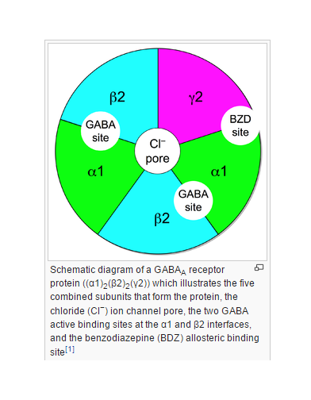

Slide 6
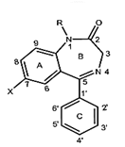
Structure–activity relationships (SARs) of benzodiazepines
Aromatic or hetero aromatic ring A is required for the activity that may participate in - stacking with aromatic amino acid residues of the receptor
2. An electronegative substituent at position 7 is required for activity, and the more electronegative it is, the higher the activity.
3. Positions 6, 8, and 9 should not be substituted.
4. A phenyl ring C at position 5 promotes activity.

Slide 7
If this phenyl group is ortho (2) or di ortho (2,6) substituted with electron-withdrawing groups, activity is increased. para substitution decreases activity greatly.
5. In diazepine ring B, saturation of the 4,5-double bond or a shift of it to the 3,4-position decreases activity.
6. Alkyl substitution at the 3-position decreases activity; substitution with a 3-hydroxyl does not.
7. The presence or absence of the 3-hydroxyl group is
important pharmacokinetically.
8. Compounds without the 3-hydroxyl group are non polar, 3-hydroxylated in liver slowly to active 3-hydroxyl metabolites, and have long overall half-lives.

Slide 8
10. In contrast, 3-hydroxyl compounds are much more polar, rapidly converted to inactive 3-glucuronides, which are
excreted in urine and thus are short-lived.
11. The 2- carbonyl function is important for activity, as is the nitrogen atom at position 1.
12. The N1-alkyl side chains are tolerated. A proton-accepting group at C2 is required and may interact with histidine residue (as a proton donor) in benzodiazepine binding site of GABAA receptor.
13. Other triazole or imidazole rings capable of H-bonding can be fused on positions 1 and 2 and increase the activity.

Slide 9
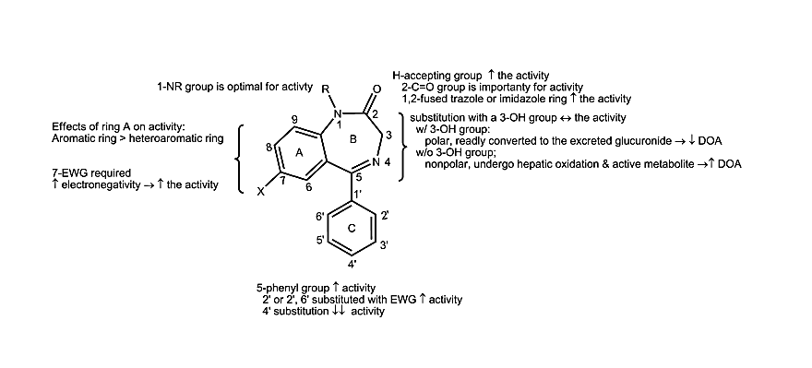
Most benzodiazepines are lipophilic, in the non ionized form and thus well absorbed from the GI tract, whereas the more polar compounds (e.g., those with a 3-hydroxyl group) tend to be absorbed more slowly than the more lipophilic compounds.
Metabolites of some benzodiazepines are not only active but also have long half-lives, thus these drugs are long acting.

Slide 10
Benzodiazepines
Chlordiazepoxide Hydrochloride(Librium), 7- chloro-2 (methylamino)-5-phenyl-3H-1,4-benzodiazepine 4-oxide mono hydrochloride, It is well absorbed after oral administration. Peak plasma levels are reached in 2 to 4 hours. The half-life of chlordiazepoxide is 6 to 30 hours.
N-demethylation and hydrolysis of the condensed amidino group are rapid and extensive, producing demoxepam as a major metabolite. Demoxepam can undergo four different metabolic fates.

Slide 11
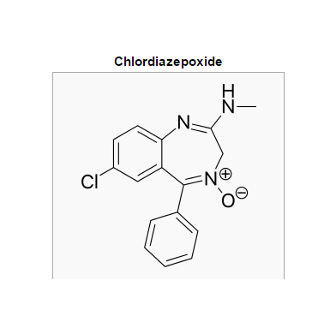
It is converted principally to its active metabolite nordazepam, Nordazepam, in turn, is converted principally to active oxazepam (marketed separately), which conjugated to the excreted glucuronide. Because of the long half-life of parent drug and its active metabolites, this drug is long acting and self-tapering.

Slide 12
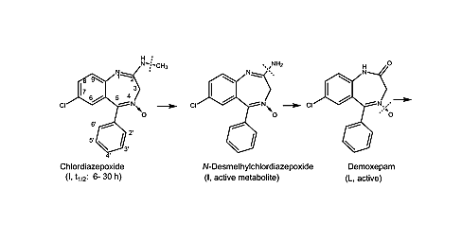
Metabolism of Chlordiazepoxide

Slide 13
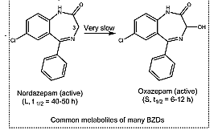

Slide 14
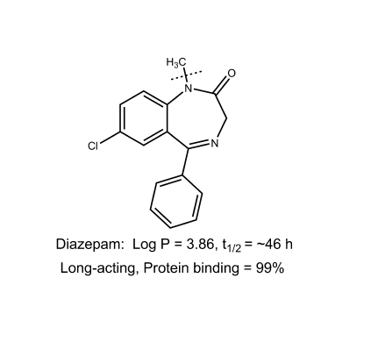
Diazepam, USP. Diazepam, 7-chloro-1,3-dihydro-1-methyl-5-phenyl-2H-1,4-benzodiazepine-2-one (Valium),
It is very lipophilic and is thus rapidly and completely absorbed after oral administration. Diazepam is metabolized by N-demethylation to active nordazepam, which is 3-hydroxylated to active oxazepam. This drug is a long acting. It is widely used for several anxiety states and has an additional wide range of uses (e.g., as an anticonvulsant,
a premedication in anesthesiology, and in various spastic disorders).

Slide 15
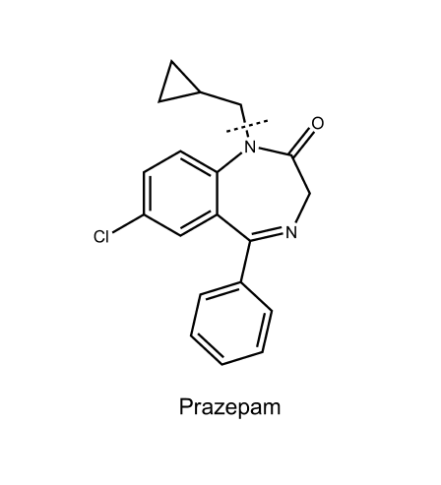
Prazepam, (Verstran)
7-chloro-1 (cyclopropylmethyl)- 1,3dihydro-5-phenyl-2H-1,4-benzodiazepine-2-one
Has a long overall half-life.
Extensive N-dealkylation occurs to yield active nordazepam.
3-Hydroxylation of both prazepam and nordazepam occurs.

Slide 16
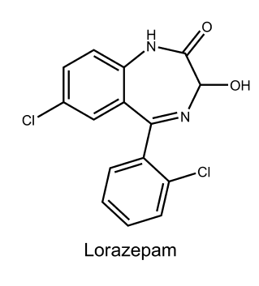
Lorazepam,(Ativan)
Lorazepam, 7-chloro-5-(2 chlorophenyl)- 3-dihydro-3-hydroxy-2H-1,4-benzodiazepine-2-one is the 2-chloro derivative of oxazepam. In keeping with overall SARs, the 2՝-chloro substituent increases activity.
As with oxazepam, metabolism is relatively rapid and uncomplicated because of the 3-hydroxyl group in the compound. Thus, it also has short half-life (2–6 hours) and similar pharmacological activity.

Slide 17
Clorazepate Dipotassium.
7-chloro-2,3-dihydro-2-oxo-5-phenyl-1H-1,4-benzodiazepine-3-carboxylic acid dipotassium salt monohydrate (Tranxene), can be considered a prodrug.
Inactive itself, it undergoes rapid decarboxylation by the acidity of the stomach to nordazepam (a major active metabolite of diazepam), which has a long half-life and undergoes hepatic conversion to active oxazepam. Despite the polar character of the drug as administered, because it is quickly converted in the GI tract to an active non polar compound, it has a quick onset, overall long half-life, and shares similar clinical and pharmacokinetic properties to Chlordiazepoxide and diazepam.

Slide 18
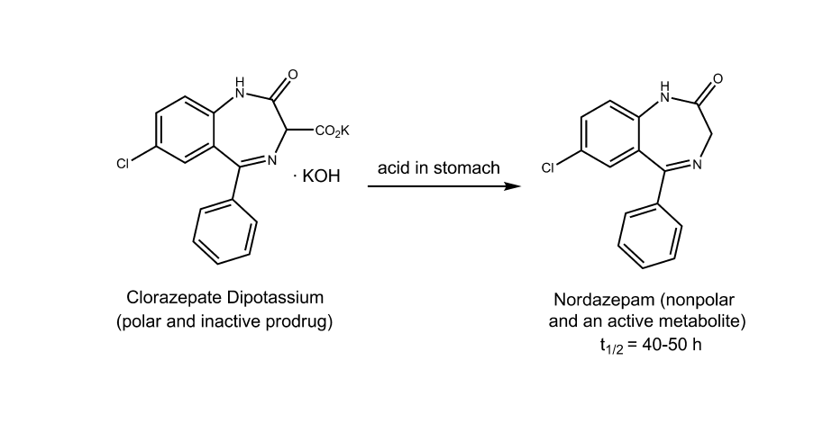

Slide 19
Triazolobenzodiazepines
Alprazolam, 8-chloro-1-methyl-6- phenyl-4H-s-triazolo [4,3-a][1,4]benzodiazepine (Xanax), is rapidly absorbed from the GI tract. Protein binding is lower (70%) than with most benzodiazepines because of its lower lipophilicity.
α-Hydroxylation of the methyl group to the methyl alcohol (a reaction analogous to benzylic hydroxylation) followed by conjugation is rapid; consequently, the duration of action is short. The drug is a highly potent anxiolytic on a milligram basis.

Slide 20
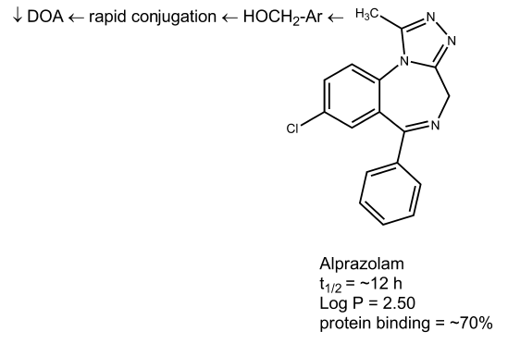

Slide 21
Triazolam, USP. Triazolam, 8-chloro-6-(o-chlorophenyl)- 1-methyl-4H-s-triazolo[4,3-a][1,4] benzodiazepine (Halcion), has all of the characteristic benzodiazepine pharmacological actions.
It is an ultra–short-acting hypnotic because it is rapidly α -hydroxylated to the 1-methyl alcohol, which is then rapidly conjugated and excreted.
Consequently, it has gained popularity as sleep inducers, especially in elderly patients, because it causes less daytime sedation. It is metabolically inactivated primarily by hepatic and intestinal CYP3A4.

Slide 22
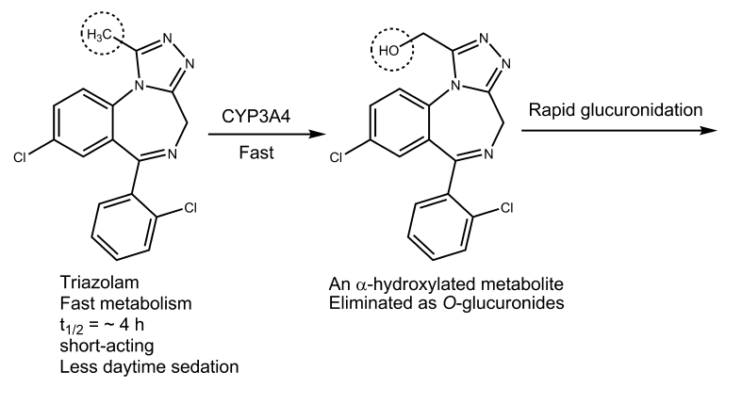

Slide 23
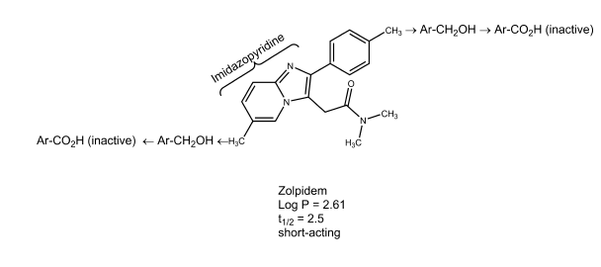
2. Non benzodiazepine
Zolpidem (Ambien, an imidazopyridine) Are non benzodiazepines and have been introduced as short- and moderate- acting hypnotics, respectively.
Zolpidem exhibits a high selectivity for the α1 subunit of benzodiazepine binding site on GABAA receptor complex

Slide 24
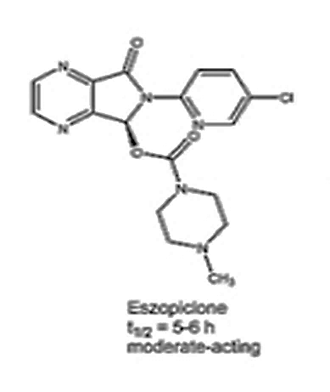
Eszopiclone (Lunesta, a cyclopyrrolone)
Eszopiclone is a “super agonist” at BzRs with the subunit composition α1 β2 γ2 and α1β2 γ3.

Slide 25
3. Barbiturates
The barbiturates were used extensively as sedative–hypnotic drugs. Except for a few specialized uses, they have been replaced largely by the much safer benzodiazepine.
Barbiturates act throughout the CNS. However, they exert most of their characteristic CNS effects mainly by binding to an allosteric recognition site on GABAA receptors that positively modulates the effect of the GABAA receptor— GABA binding.
Unlike benzodiazepines, they bind at different binding sites and appear to increase the duration of the GABA-gated chloride channel openings.

Slide 26
In addition, by binding to the barbiturate modulatory site, barbiturates can also increase chloride ion flux without GABA attaching to its receptor site on GABAA.
This has been termed a GABA mimetic effect.
The barbiturates are 5,5-disubstituted barbituric acids.
Consideration of the structure of 5,5-disubstituted barbituric acids reveals their acidic character.
The free acids have poor water solubility and good lipid solubility (the latter largely a function of the two hydrocarbon substituents on the 5-position, although in the 2-thiobarbiturates,the sulfur atom increases lipid solubility).

Slide 27
Structure–activity relationships
The barbituric acid is 2,4,6-trioxohexahydropyrimidine, which lacks CNS depressant activity.
The replacement of both hydrogens at position 5 with alkyl or aryl groups confers the activity.
Both hydrogen atoms at the 5-position of barbituric acid
must be replaced.
4. There is an inverse correlation between the total number of carbon atoms substituted on the 5-position and the duration of action.

Slide 28
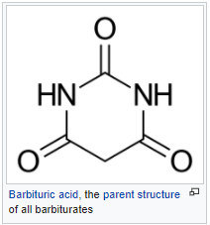
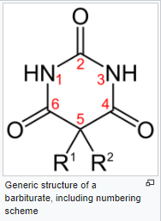

Slide 29
5. Quaternary carbon at position 5 is necessary for activity
Unsubstituted compound is more acidic than di-substituted derivatives and do not depress CNS- unionized drug can penetrate the membrane
6. Introduction of one alkyl or aryl group at position 5 has little effect on acidity, whereas two groups decrease the acidity
7. When the sum of C-atoms at position 5 is larger than 7 or 8 activity drops for example dibenzyl barbituric acid produces no effect
8. Introduction of a polar functional group such as ether, keto, hydroxyl, amino and carboxyl, on the side chain usually destroys the depressant effect

Slide 30
9. Increasing lipophilicity increases hypnotic potency and the onset of action and decreases the duration of action.
The length of the side chains in the 5 position influences both the potency and the duration of action of the barbituric acid derivatives; secobarbital and thiamylal are slightly more potent than pentobarbital and thiopental, respectively, because the former drugs have slightly longer (three-carbon versus two-carbon) side chains in position 5
10. Replacing the oxygen atom with a sulfur atom at position 2 of an active barbiturate produces a barbiturate with a more rapid onset and a shorter duration of action; the thiobarbiturates, thiopental and thiamylal, have faster onsets and shorter durations of action than their oxybarbiturate analogues, pentobarbital and secobarbital.

Slide 31
Increasing the lipophilicity generally increases the rate of metabolism, except for compounds with an extremely high lipophilicity (e.g., thiopental), which tend to depotize and are thus relatively unavailable for metabolism.
11. N-methylation decreases duration of action, in large part, probably, by increasing the concentration of the lipid-soluble free barbituric acid.
2-Thiobarbiturates have a very short duration of action because its lipophilicity is extremely high, promoting depotization.
Barbiturates find use as sedatives, as hypnotics, for induction of anesthesia, and as anticonvulsants.

Slide 32
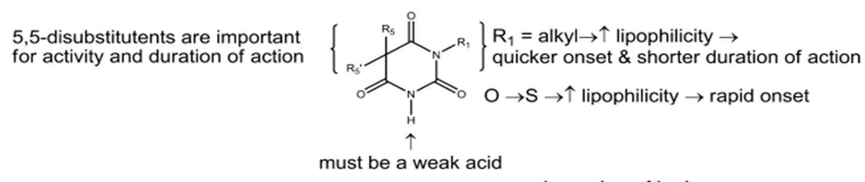
Barbiturates act as positive allosteric modulators and, at higher doses, as agonists of GABAA receptors

Slide 33
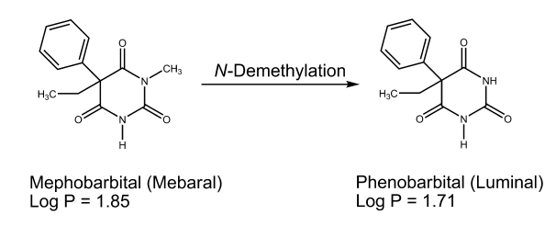
Barbiturates with a long duration of action (more than 6 hours)
Mephobarbital, 3-methyl-5- ethyl-5-phenylbarbituric acid (metharbital), is metabolically n-demethylated to Phenobarbital, which many consider to account for almost all of the activity. its principal use is as an anticonvulsant.

Slide 34
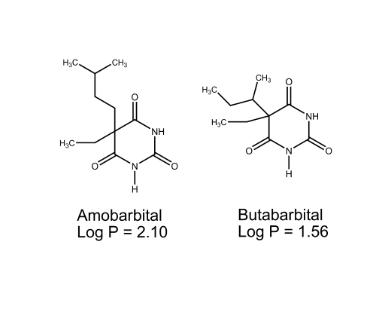
Barbiturates with an intermediate duration of action (3–6 hours)
Barbiturates with an intermediate duration of action are used
principally as sedative–hypnotics. They include:
Amobarbital, (amytal)
Amobarbital sodium, (Aprobarbital [alurate]);
Butabarbital sodium, (butisol sodium).

Slide 35
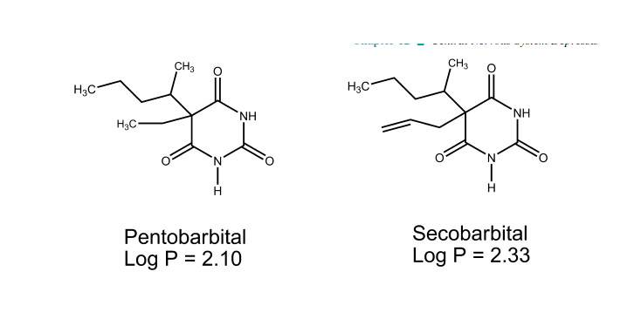
Barbiturates with a short duration of action (less than 3 hours)
Pentobarbital- sodium, (Nembutal);
Secobarbital, (Seconal)
Sodium Secobarbital
Barbiturates with an ultra short duration of action are discussed under anesthetic agents.

Slide 36
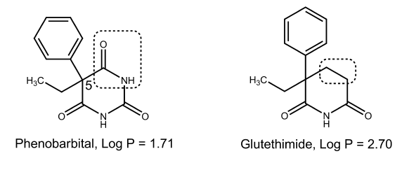
4. Miscellaneous Sedative–Hypnotics
Amides and imides
Glutethimide ( 2-ethyl-2 phenylglutarimide) (Doriden),
One of the most active non barbiturate hypnotics that is structurally similar to the barbiturates, especially Phenobarbital.

Slide 37
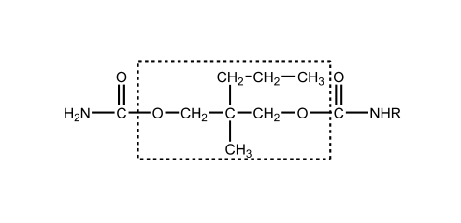
Alcohols and Their Carbamate Derivatives
The very simple alcohol ethanol has a long history of use as a sedative and hypnotic.
Meprobamate ( 2-methyl-2- propyl trimethylene dicarbamate) is officially indicated as an anti anxiety agent.
It is also a sedative– hypnotic agent. Meprobamate is also a centrally acting skeletal muscle relaxant.

Slide 38
The trichloroethanol is metabolized by oxidation to chloral and then to the inactive metabolite, trichloracetic acid which is also extensively metabolized to acyl glucuronides via conjugation with glucuronic acid.
It appears to have potent barbiturate-like binding to GABAA receptors.
Although an old drug, it still finds use as a sedative in non operating room procedures for the pediatric patient.

Slide 39
Aldehydes and their derivatives
Chloral hydrate, trichloroacetaldehyde monohydrate, CCl3CH(OH)2 (Noctec)
Chloral hydrate is a weak acid because its CCl3 group is very strong electron withdrawing.
Chloral hydrate as a capsule, syrup, or suppository is currently available.
Although it is suggested that chloral hydrate may act as a hypnotic, chloral hydrate is very quickly converted to trichloroethanol, which is generally assumed to account for almost all of the hypnotic effect.

Slide 40
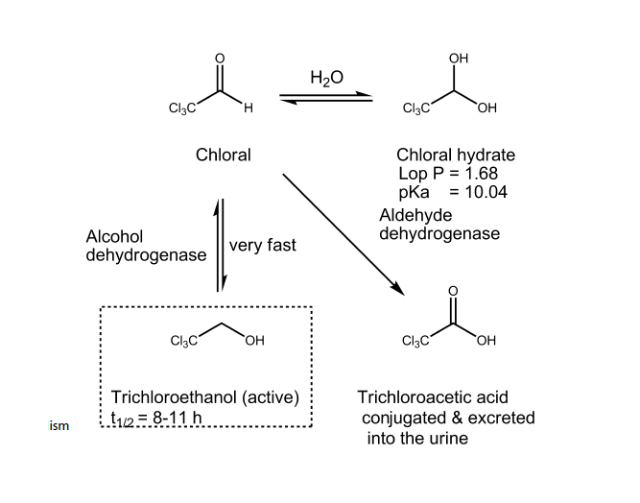
Reaction and metabolism of chloral

Slide 41


