Slide 1

Dr. Reda Elfeshawy
Assistant Professor of Pediatric Nursing

Slide 2
Hydrocephalus

Slide 3
DEFINITION
Hydrocephalus is a central nervous system disorder characterized by excessive accumulation of cerebrospinal fluid (CSF) in the ventricles of the brain.
(CSF) is an ultrafiltrate of plasma contained within the ventricles of the brain and the subarachnoid spaces of the cranium and spine
It performs vital functions, including providing nourishment, waste removal, and protection to the brain.

Slide 4
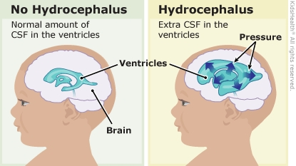

Slide 5
THE CHILD WITH NEUROLOGICAL PROBLEMS
Hydrocephalus:
It is caused by an imbalance in the production and absorption of the CSF in the ventricular system
It occurs in 3-4/1000 live births
Causes:
Congenital. As a result of a mal development or an intrauterine infection
Acquired. Can be caused by infection, neoplasm, or hemorrhage

Slide 6
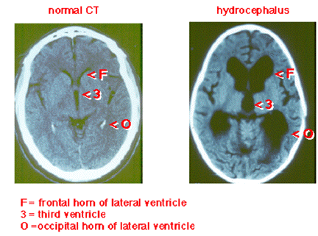

Slide 7
Mechanism of SCF imbalance
Causes are variable but the result is either:
Impaired absorption of CSF within the subarachnoid space known as (Communicating hydrocephalus) or
Obstruction to the flow of CSF through the ventricular system (Non communicating hydrocephalus
Rarely a tumor of the arachnoid plexus causes increase of CSF production

Slide 8
Effect of CSF imbalance:
Any imbalance of secretion causes an increased accumulation of CSF in the ventricles which become dilated and compresses the brain substance against the surrounding rigid bony cranium
When this occurs before fusion of the cranial sutures it leads to enlargement of the skull as well as dilatation of the ventricles

Slide 9
Most cases of noncommunicating hydrocephalus are due to:
Developmental malformations it is usually apparent in early infant but may become evident at any time from prenatal period to late childhood, or early adult hood.
Other causes could be neoplasm, infection, or trauma
Obstruction can occur at any point in the CSF path

Slide 10
Other causes:
Space occupying lesions, intra cranial infections, hemorrhages or preexisting developmental defects are seen more in older children
Hydrocephalus is often associated with myelomeningocele and all Infants should be observed for its occurrence

Slide 11
Diagnostic Evaluation:
Two factors that influence the clinical picture in hydrocephalus are:
Time of onset
The presence of preexisting structural lesions.

Slide 12
Clinical manifestations of hydrocephalus:
Infancy, early:
Abnormally rapid head growth
Bulging fontanels (especially the anterior fontanel) some times without head enlargement.
Tense - Non pulsating fontanels
Dilated scalp veins
Separated sutures
Mecewen sign (cracked pot’s sound)
Thinning of the skull bones
10

Slide 13
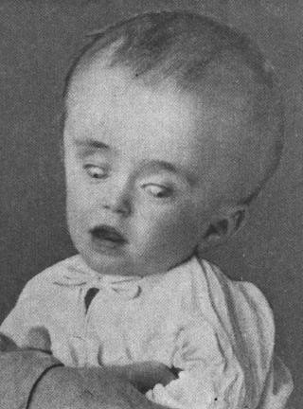
Infancy, late:
Frontal enlargement or “bossing”
Depressed eyes
Setting sun sign eye balls
Pupils sluggish with unequal response to light

Slide 14
Infancy, general manifestations:
  Irritability
  Lethargy
  Infant cries when picked up or rocked and quiets
when allowed to lie still
  Early infantile reflex acts fail to appear
May also display:
  Change in the level of consciousness
  Opisthotonus (often extreme)
  Lower extremities spasticity
Advanced cases may have:
  Difficulty in sucking
  Shrill, brief high-pitched cry
  Cardiopulmonary embarrassments

Slide 15
Childhood manifestations:
Headache on awakening and improves following emesis or upright positioning
Papillidema
Strabismus
Extrapiramidal tract signs e.g. Ataxia
Irritability
Lethargy
Apathy
Confused
Often incontinence
Head circumpherance one or more above grid lines of the measurement chart within 2-4 weeks
Associated neurological signs that are progressive
Signs of increased intracranial pressure and focal
lesions

Slide 16
Investigations:
CT scan and MRI the primary diagnostic tools, sedation is used to do these studies
Therapeutic Management:
Objectives:
To relief hydrocephalus
Treatment of complications
Management of problems related to the effect of the disorder on psychomotor development

Slide 17
Treatment is usually surgical:
If it is caused by tumor the tumor is removed
A shunt procedure to drain the CSF from the ventricles to an extracranial compartment usually the peritoneum
The shunt system consists of:
  Flush pump
  Unidirectional flow valve
  Distal catheter
  The valves are designed to open at a predetermined intraventricular pressure and close when the pressure falls below that level, thus preventing back flow of secretions.

Slide 18
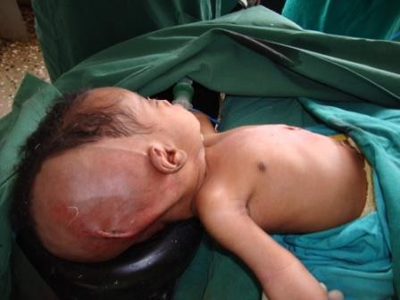
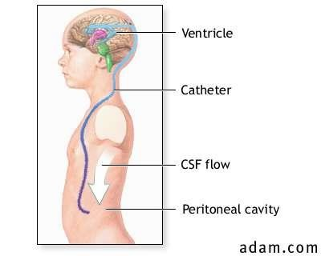
Medical treatment:
Incase of increased production of CSF,
Acetazolamide medication is given to help decrease the production
Ventriculo-peritoneal-shunt

Slide 19
Complications of Ventriculo-peritoneal shunt:
Infection
Malfunction
Kinking
Plugging or
Separation or
Migration of the tubing
Obstruction could be either within the ventricle from matter (tissue or exudates) or at the distal end from thrombosis or displacement as a result of growth

Slide 20
Prognosis:
80% survival rate, highest mortality within the first year of treatment
Of the surviving children, approximately 1/3 is both intellectually and neurologically normal
½ of children have neurological disabilities

Slide 21
Nursing considerations for V.P shunt:
Assessment:
Head circumference
Palpation of fontanels and suture lines gently for size, signs of bulging, tenseness, and separation.
Behavior changes
Altered vital signs and feeding behavior
Signs of increased intra cranial pressure
Nursing diagnosis:
High risk for infection R/T presence of mechanical drainage system
High risk for impaired skin integrity R/T pressure area, paralysis, relaxed sphincter.
Altered family process R/T situational crises (child with a physical defect)

Slide 22
Planning:
Goal:
Prevent complications of hydrocephalus or the surgical repair
Provide education and emotional support to the family
Implementation:
General nursing care
Maintain adequate nutrition, requires flexible feeding
schedules; small frequent feeds are better tolerated.
Difficult to feed infants require extra time.
Prepare the child for diagnostic tests
If surgery is anticipated I.V. lines should not be placed in
the scalp veins of hydrocephalus
Support of the head when the child is fed or moved to prevent extra strain on the child’s neck muscles
Measures to prevent pressure sores.
20

Slide 23
Post operative care:
Child is placed on unoperated side to prevent pressure on the shunt valve and pressure areas
Flat position is maintained to prevent too rapid reduction of intracranial fluid
The position is maintained according to the surgeon’s indications, the head may be elevated to decrease ICP to allow gravity flow through the shunt
Sedations are avoided to observe the level of consciousness (LOC)

Slide 24
Observe for signs of increased ICP which indicate obstruction of the shunt ( dilated pupils, neurological signs and increased B/P)
Observe for signs of abdominal distension, because CSF may cause peritonitis or ileus
Intake and out put monitoring is done carefully
Signs of infection ; fever, poor feeding, vomiting, decreased responsiveness, and seizures
Signs of focal inflammation along the shunt tract are observed.

Slide 25
Family support
Education about the problem
Education about treatment and management
Decrease their anxiety by answering their questions
Encouraging their participation
Follow up care is explained and stressed.
Evaluation:
By, continuous assessment of the child, and the family.

Slide 26

Thank you

