Slide 1


Al-Mustaqbal University.
College of Engineering and Engineering Technologies.
Biomedical Engineering Department.
Subject: laboratory instrumentation
Class (code): 4th
Lecture: 5
By: Zainab Sattar Jabbar M.SC. IN BME
BME

Slide 2
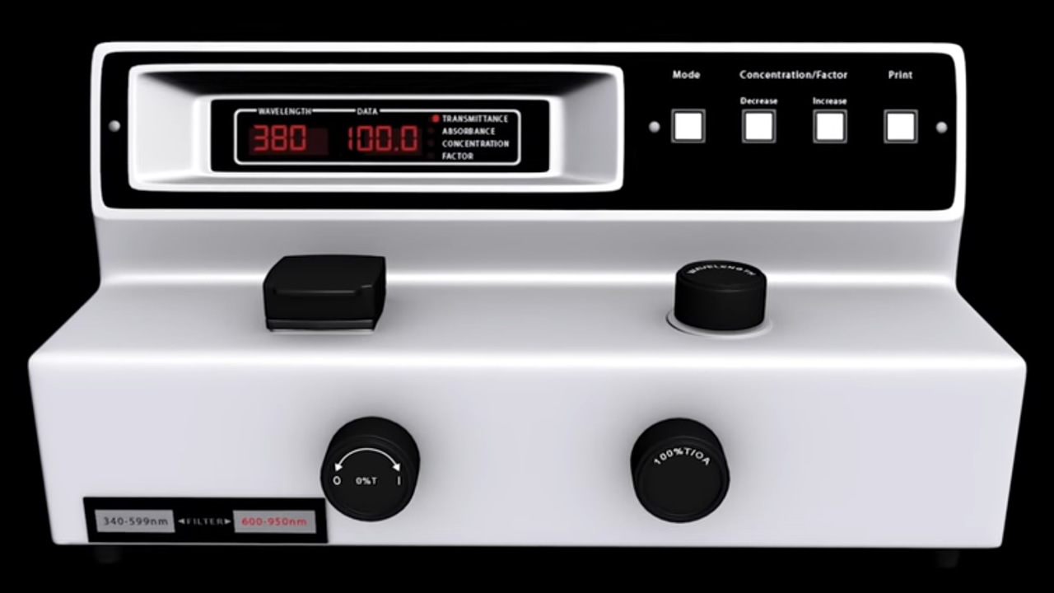
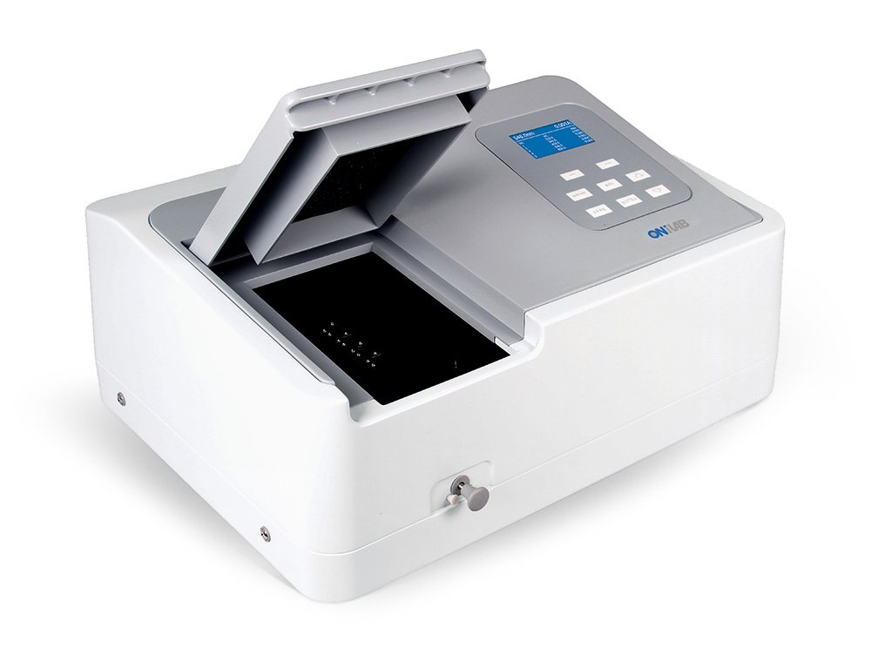
Spectrophotometer

Slide 3
Spectrophotometer
Spectroscopy: the study of how light interacts with matter .
Spectrophotometry: works because light gets absorbed by a matter .
The measurement of these parameters are essential to determine the acid-base balance in the body.
Spectrophotometry is based on the fact that substances of clinical interest selectivity absorb or emit electromagnetic energy at different wavelengths.

Slide 4
Purpose
A spectrophotometer is an analytical instrument used to make qualitative and quantitative measurement of an analyte in a solution.
It is the most versatile, reliable, and widely used instrument in clinical chemistry to examine blood, urine, or tissues for clinical diagnosis.
The majority of clinical chemistry procedures have been tailored to produce an end product (color), which can be detected and measured by some type of a spectrophotometer.
Even highly automated analyzer systems make use of a spectrophotometer as a final readout device.

Slide 5
Principle
Every chemical compound absorbs, transmits, or reflects light (electromagnetic radiation) over a certain range of wavelength.
Spectrophotometry is the method that is based on the absorption of electromagnetic radiation in the visible, ultraviolet (UV), and infrared (IR) ranges.
This electromagnetic spectrum ranges from very short wavelengths including X‐rays to very long wavelengths including microwaves and broadcast radio waves.
The nature of all these radiations is the same and all travel with the speed of light.
They differ from each other in terms of their frequency and wavelength and the effect they produce on interaction with matter.

Slide 6
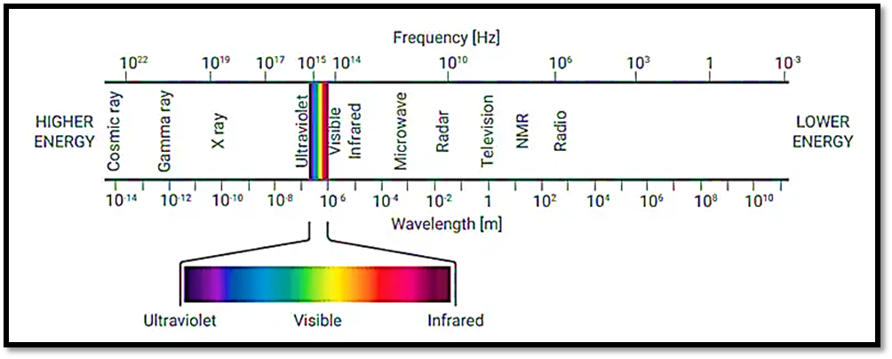

Slide 7
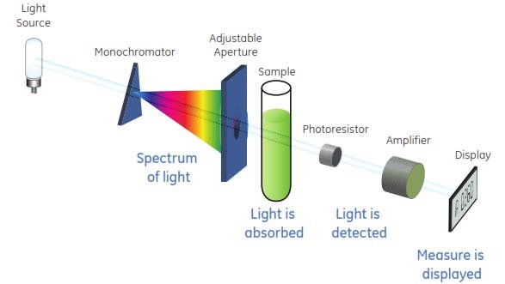
Basic components
Spectrophotometer: is an instrument that measures the amount of light absorbed by a sample.

Slide 8
Spectrophotometer main components
1- A source of radiant energy, which may be a tungsten lamp, a xenon-mercury arc, hydrogen discharge lamp, etc.
2- Monochromator or filter : For the selection of a narrow band of radiant energy.
3- An optical system for producing a parallel beam of filtered light for passage through an absorption cell (cuvette). The system may include lenses, mirrors, slits, diaphragm, etc.
4- A detecting system for the measurement of unabsorbed radiant energy, which could be the human eye, a barrier-layer cell, phototube or photo-multiplier tube.
5- A readout system or display, which may be an indicating meter or a numerical display.

Slide 9
Power Sources
Hydrogen discharge lamps are used to provide power in the 200-to-360 nm range. While, tungsten lamps are used for the 360-to-800 nm range.
Hydrogen lamps produce a continuous spectrum; but a problem with this power source is that they produce many of their power in the infrared range.
The output in the ultraviolet and visible ranges can be increased by operating the lamp at voltages above the rated value, but this stratagem significantly reduces the expected life of the lamp

Slide 10
Wavelength Selectors
A variety of devices are used to select those portions of the power spectrum produced by the power source that are to be used to analyze the sample.
These devices can be divided into two classes: filters and monochromators.
There are two basic types of filters: glass filters and interference filters.

Slide 11
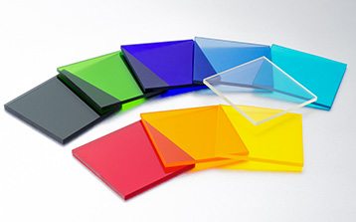
Glass filters
Glass filters function by absorbing power.
For example, a blue colored filter absorbs in the higher-wavelength visible range (red region) and transmits in the lower wavelength visible range (blue green region).
Glass filters are used in applications in which only modest accuracy is required.

Slide 12
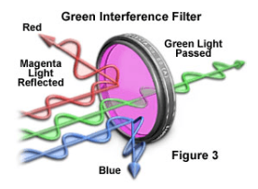
Interference filters
Interference filters are made by spacing reflecting surfaces such that the incident light is reflected back and forth a short distance.
The distance is selected such that light in the wavelength band of interest tends to be in phase and to be reinforced; light outside this band is out of phase and is canceled (the interference effect).
Interference filters are used in many spectrophotometers, devices that use filters as their wavelength selectors are called colorimeters or photometers.

Slide 13
Monochromators
Monochromators are devices that utilize prisms and diffraction gratings.
They provide very narrow bandwidths and have adjustable nominal wavelengths.
The basic principle of operation of these devices is that they disperse the input beam spatially as a function of wavelength.
A mechanical device is then used to allow wavelengths in the band of interest to pass through a slit.

Slide 14
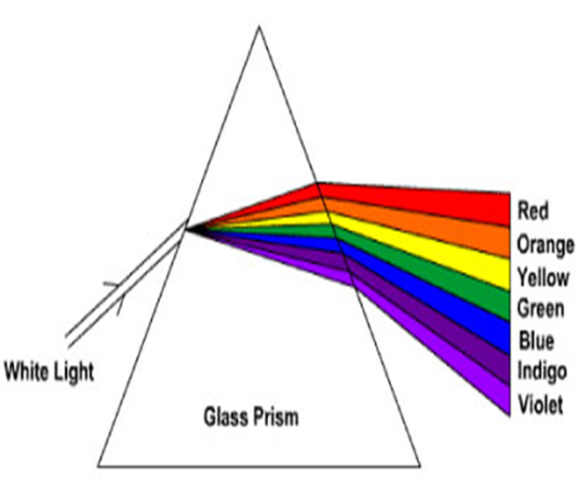
Monochromators

Slide 15
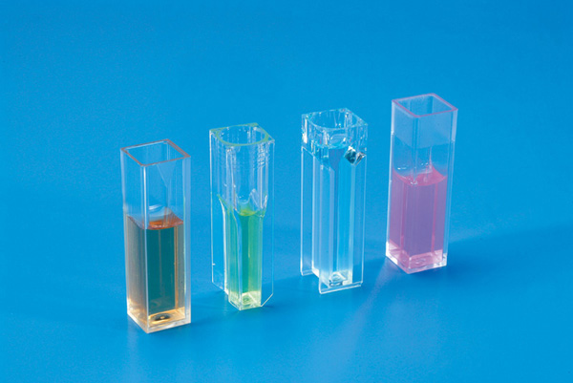
Cuvette
The cuvette holds the substance being analyzed.
Its optical characteristics must be such that it does not significantly alter the spectral characteristics of the light as that light enters or leaves the cuvette.
The degree of care and expense involved in cuvette design is a function of the overall accuracy required of the spectrophotometer

Slide 16
Thank you

