Slide 1



Digital Electronic
Prof. Dr. Ehssan Al-Bermany
2nd semester
© Department of Physics, University of Babylon, 2019.

Slide 2
Chapter Three
Lecture 8
© Department of Physics, University of Babylon, 2019.

Slide 3
3.7 The exclusive-OR function

Slide 4

3.8 De Morgan’s theorem
De Morgan’s theorem may be thought in terms of breaking a long bar symbol.
When a long bar is broken, the operation directly implies the changes from addition to multiplication or vice versa,
And the broken bar pieces remains over the individual variables.
© Department of Physics, University of Babylon, 2019.

Slide 5
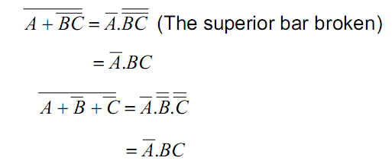
  Remark 3.4:
When multiple layers of bar exist in an expression, you may only break one bar at a time.
Example 3.1:
Let us simplify the following expressions:
© Department of Physics, University of Babylon, 2019.

Slide 6
3.9 Converting truth table into Boolean expression:
We can convert truth table into Boolean expression using one of the following methods:
Sum of Products (SOP)
Product of Sums (POS)
3.9.1 Sum of products:
Boolean expressions may be generated from truth table quite easily using the following steps:
Determine which rows of the table have an output of 1;
Write one product for each raw;
Sum all the product terms.
This creates a Boolean expression representing the truth table as a whole.
© Department of Physics, University of Babylon, 2019.

Slide 7
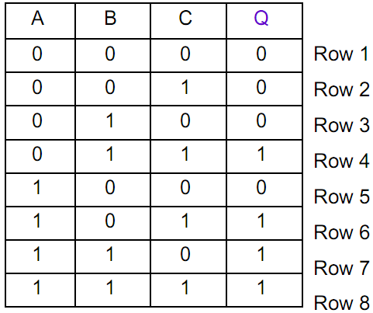

    Example 3.2:
Let’s consider a logic circuit having the following truth table:
The rows 4, 6, 7 and 8 have an output of 1, each raw gives us a product. By summing those products, we obtain the following Boolean expression which is that of the output Q.
© Department of Physics, University of Babylon, 2019.

Slide 8
Exercise 3.2:
Simplify the expression of the output Q treated in the example above using Boolean Algebra and generate the schematic diagram of the simplest expression.
3.9.2 Product of sums:
Boolean expression may be also generated from truth table quite easily by determining which rows of the table have an output of 0, writing one sum term for each row and finally multiplying all the terms.
© Department of Physics, University of Babylon, 2019.

Slide 9
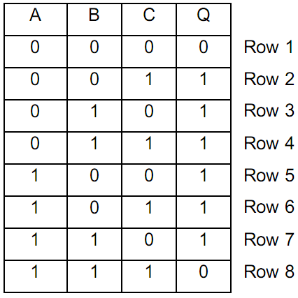
Example 3.3:
Let us consider a logic circuit having the following truth table.
The rows 1 and 8 have an output of 0; each row gives us a sum. The product of those sums gives us a Boolean expression which is that of the output of the logic circuit. In fact, we have:
© Department of Physics, University of Babylon, 2019.

Slide 10
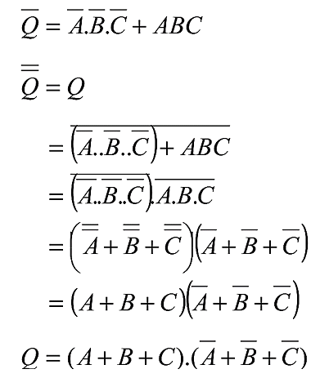
In reality for each row having an output of 0, we should notice that we have but the inverted output product ( 𝑄̅ ). By inverting that output ( 𝑄̿ ), we obtain a sum using De Morgan’s theorem. Finally, the product of all those sums gives us the output of the logic circuit.
Remark:
Generally, the sum of products is more used than the product of sums to convert a truth table into Boolean expression.
However, when a few number of rows have an output of 0, it is preferable to use the POS than to use the SOP.
© Department of Physics, University of Babylon, 2019.

Slide 11

Exercise 3.3:
Generate the logic diagram of the circuit treated the example 3.3.
Exercise 3.4:
Assuming that
Proof that
© Department of Physics, University of Babylon, 2019.

