Slide 1
Digital Electronic
Asst.lec Israa Hussein
2nd semester

Slide 2
Chapter One
Lecture 2

Slide 3
Binary versus decimal numeration system:
Let us count from 0 to 15 using binary and decimal systems of numeration

Slide 4
Binary |  |  |  | Decimal
D(MSB) | C | B | A(LSB)
0 | 0 | 0 | 0 | 0
0 | 0 | 0 | 1 | 1
0 | 0 | 1 | 0 | 2
0 | 0 | 1 | 1 | 3
0 | 1 | 0 | 0 | 4
0 | 1 | 0 | 1 | 5
0 | 1 | 1 | 0 | 6
0 | 1 | 1 | 1 | 7
1 | 0 | 0 | 0 | 8
1 | 0 | 0 | 1 | 9
1 | 0 | 1 | 0 | 10
1 | 0 | 1 | 1 | 11
1 | 1 | 0 | 0 | 12
1 | 1 | 0 | 1 | 13
1 | 1 | 1 | 0 | 14
1 | 1 | 1 | 1 | 15

Slide 5
The representation of a quantity in the binary numeration system takes more ciphers than in the decimal system.
We can therefore ask ourselves why the binary system is preferred to the decimal system in computer sciences.
The reason is that in electronics, it is easier to materialize two quantities “0” and “1” (by two different voltages, for example) than to materialize 10 different quantities “0”,”1”,”2”,”3”,”4”,”5”,”6”,”7”,”8”, and ”9” (by 10 different voltages).
In fact, in digital circuits, 0 and 1 are materialized by specific ranges of voltages or current; this will be discussed later.

Slide 6
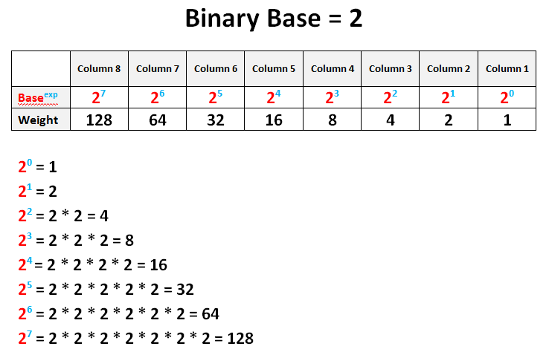

Slide 7
Find the binary equivalent of number 35
 | Dividers | Remainder
35 | 2 | 1
17 | 2 | 1
8 | 2 | 0
4 | 2 | 0
2 | 2 | 0
1 | 2 | 1
0
LSD
Remainder
MSD
Therefor, the binary equivalent of number 35 = 100011

Slide 8
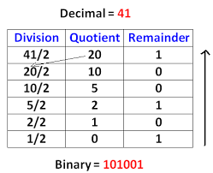

Slide 9

Remark 1.1:
With n bits, we can represent 2^{n} different binary numbers.
The higher H number is given using the following formula.

Slide 10


    Example 1.4:
With 4 bits we can represent
Different binary numbers (from 0 to 15),
And the higher number is

Slide 11
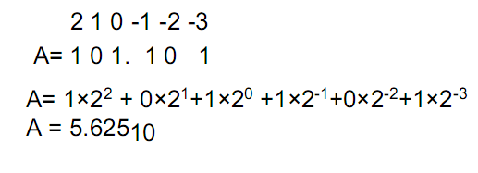
    Remark 1.2:
    Conversion from binary to decimal
To convert a number written in a binary numeration system to its equivalent in decimal,
We just have to calculate the products of the bits with their respective weights, as in example 1.3 above.
For binary numbers with “binary point” (the equivalent of the decimal point for decimal numbers), the conversion is done as follows.

Slide 12
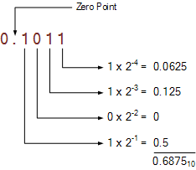

Slide 13
1.3.4 Octal numeration system:
The octal numeration system is a place weighted system with a base of eight.
Valid ciphers include the symbols “0”,”1”,”2”,”3”,”4”,”5”,”6”, and ”7”.
To convert from binary to octal numeration system, we just have to divide the number into groups of binary numbers having 3 bits each.
And each group of 3 bits is replaced by its equivalent in octal.

Slide 14
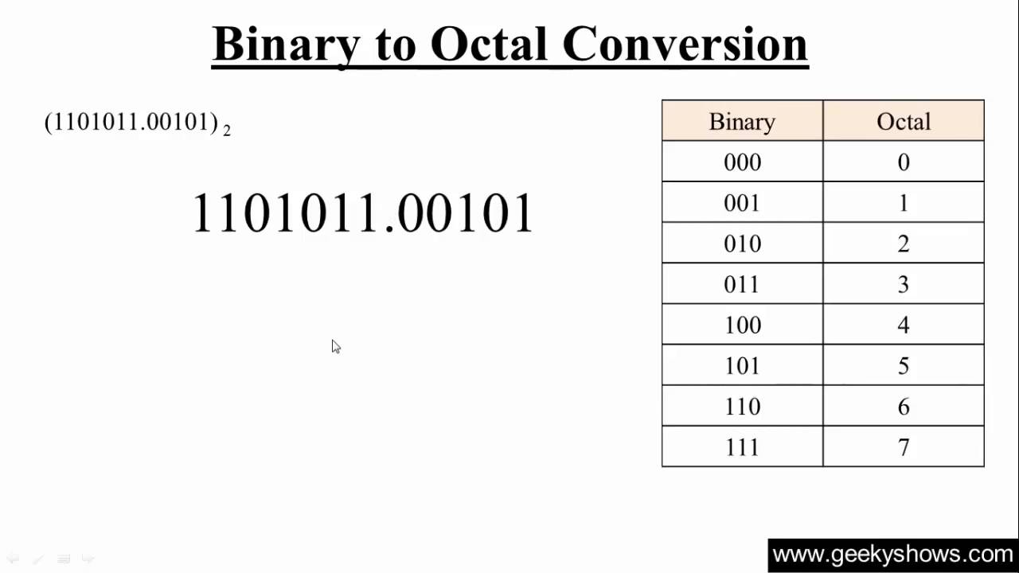

Slide 15
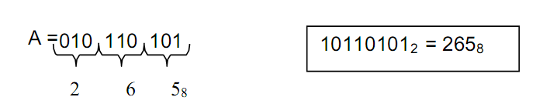
Example 1.5:
Let’s convert the following binary numbers in octal:
A = 10110101
B = 11010111.01

Slide 16
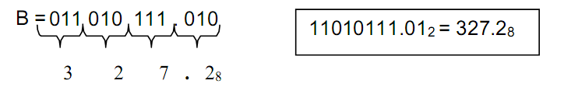
Example 1.5:
The bits are grouped from the right to the left.
A zero has been added to the two firs bits to form a group of 3 bits. That zero is called an implied zero.

Slide 17
Example 1.5:
The bits are grouped from the right to the left.
A zero has been added to the two firs bits to form a group of 3 bits. That zero is called an implied zero.
Two implied zeros have been added to the number to form groups of 3 bits.

Slide 18
Exercise 1.2:
Convert the following binary numbers to decimal numbers: om to the Octal number.
A = 10110.01
B = 11110111.1011
C = 111.111
D = 10110101101.111101
Watch the videos
https://www.youtube.com/watch?v=OezK_zTyvAQ
https://www.youtube.com/watch?v=bmgZf4VMhHc

