Slide 1

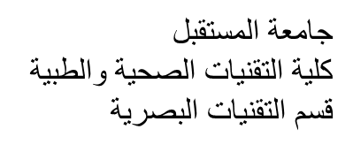
Al-Mustaqbal University
Department/ Optical techniques
Medical glasses
3rd stage
By
Dr. Marrwan Hisham Mohammed
2024/02/11

Slide 2
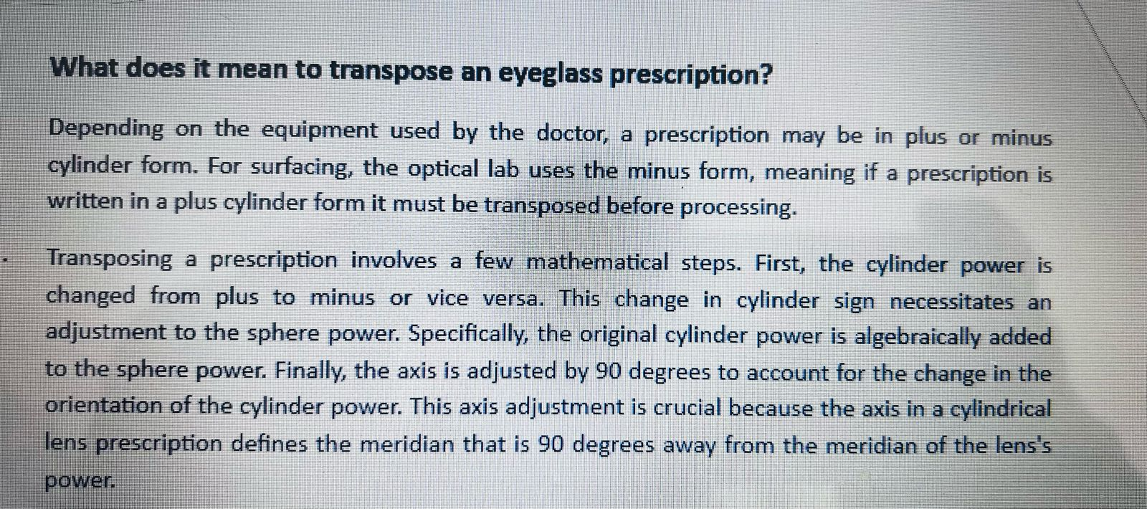

Slide 3
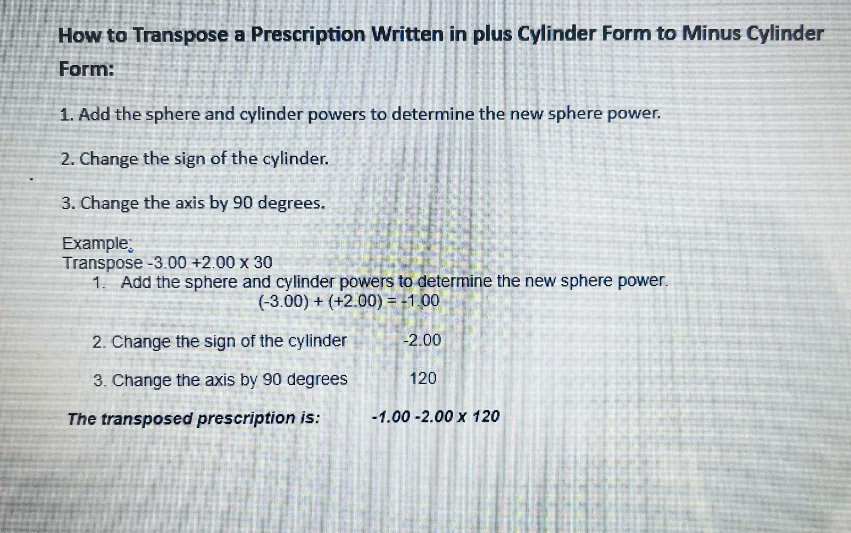

Slide 4
EX:
RE: - 1.00/-0.50 c * 90
LE: -1.25 / -0.50 c * 90 Add + 2.00 Dsph
الحل
RE: + 1.00/ -0.50 c * 90 +0.50/+0.50c *180
LE: +0.75/ -0.50 c * 90 +0.25 /+ 0.50 c* 180

Slide 5
EX
: -0.50/+1.25 c *125
+0.75 /-1.25 c *35

Slide 6
Homework
1. RE: -2.50 /-0.75 c *180
LE: -1.25 /-1.00 c *180 Add+3.00
2. RE: -3.00/+2.25 c *145
LE: -1.75 /+ 1.25 c* 25

Slide 7
Thank you

