Slide 1

AL- Mustaqbal University
Pharmacy College
Principles of Pharmacy Practice
Lectuer: 6
Prof. Dr. Jabar Faraj AL-Wakeel
Assist. Lecturer. Mustafa Ewad

Slide 2

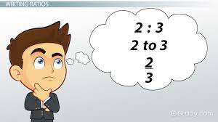
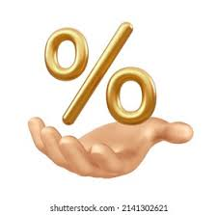
Ratio Strength, and Part Per Million

Slide 3
Ratio Strength
The concentrations of weak solutions are frequently expressed in terms of ratio strength.
All percentages are a ratio of parts per hundred, For example, 5% means 5 parts per 100 or 5:100.
When a ratio strength, for example, 1:1000, is used to designate a concentration, it is to be interpreted as follows:
  For solids in liquids1 g of solute or constituent in 1000 mL of solution or liquid preparation.
  For liquids in liquids 1 mL of constituent in 1000 mL of solution or liquid preparation.
  For solids in solids 1 g of constituent in 1000 g of mixture.
The ratio and percentage strengths of any solution or mixture of solids are proportional, and either is easily converted to the other by the use of proportion.
Notes:
Percentage is an essential part of pharmaceutical calculations. The pharmacist encounters it
frequently and uses it as a convenient means of expressing the concentration of an active or
inactive material in a pharmaceutical preparation.

Slide 4
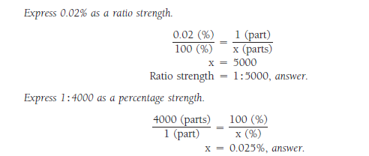
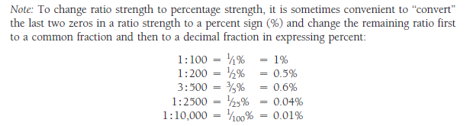
Example Calculations Using Ratio Strength

Slide 5
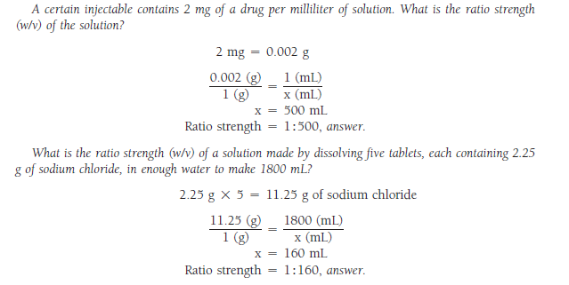
Calculating the ratio strength of a solution or liquid preparation, given the weight of solute or constituent in a specified volume of solution or liquid preparation involves the following.
Notes:
The use of percentage concentrations in the manufacture and labeling of
pharmaceutical preparations is restricted to instances in which the dose of the
active therapeutic ingredient (ATI) is not specific. For example, the ATIs in
ointments, lotions, external solutions, and similar products may commonly be
expressed in percent strength (e.g., a 1% hydrocortisone ointment).
However, in most dosage forms, such as tablets, capsules, injections, oral
solutions, and syrups, among others, the amounts of ATIs are expressed in
definitive units of measure, such as milligrams per capsule, milligrams per
milliliter, or other terms.

Slide 6


Example-1: How many grams of potassium permanganate should be used in preparing 500 mL of a 1:2500 solution?
Example-2: How many milligrams of gentian violet should be used in preparing the following solution?
Gentian Violet Solution 500 mL
1:10,000
Sig. Instill as directed.

Slide 7
Simple Conversions of Concentration to ‘‘mg/mL’’
Milligrams Percent
The term milligrams percent (mg%) expresses the number of milligrams of substance in 100 Ml of liquid. It is used frequently to denote the concentration of a drug or natural substance in a biologic fluid, as in the blood. Thus, the statement that the concentration of nonprotein nitrogen in the blood is 30 mg% means that each 100 mL of blood contains 30 mg of nonprotein nitrogen.
Quantities of substances present in biologic fluids also commonly are stated in terms of milligrams per deciliter (mg/dL) of fluid.
Occasionally, pharmacists, particularly those practicing in patient care settings, need to convert rapidly product concentrations expressed as percentage strength, ratio strength, or as grams per liter (as in IV infusions) to milligrams per milliliter (mg/mL). These conversions may be made quickly by using simple techniques. Some suggestions follow.

Slide 8
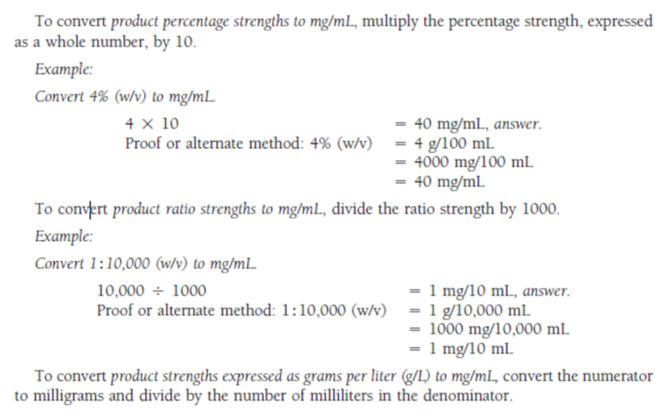
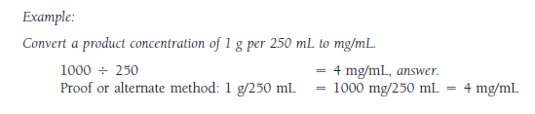

Slide 9

Parts per Million (PPM) and Parts per Billion (PPB)
The strengths of very dilute solutions are commonly expressed in terms of parts per million (ppm) or parts per billion (ppb), i.e., the number of parts of the agent per 1 million or 1 billion parts of the whole.
For example, we are all familiar with fluoridated drinking water in which fluoride has been added at levels of between 1 to 4 parts per million (1:1,000,000 to 4:1,000,000) for the purpose of reducing dental caries.
Example Calculations of Parts per Million and Parts per Billion
Example-1: Express 5 ppm of iron in water in percentage strength and ratio strength
Example-2:The concentration of a drug additive in an animal feed is 12.5 ppm. How many milligrams of the drug should be used in preparing 5.2 kg of feed?

Slide 10


