Slide 1


Al-Mustaqbal University
Department/ Optical techniques
Medical glasses
3rd stage
By
Dr. Marrwan Hisham Mohammed
2024/01/27

Slide 2
The Prescription:
To write and read the prescription, we need to know the prescription symbols and how to read them correctly.
* When you look at your prescription for eyeglasses, you will see numbers listed under the headings of OS and OD.
OD (oculus dexterous) means the right eye.
OS (oculus sinister) means the left eye.

Slide 3
you will see a notation for OU, which means something involving both eyes.
SPH: The (SPH) refers to the "spherical" portion of the prescription.
CYL: The (cyl) refers to the "cylinder" or astigmatism, and can be a negative or a positive number. It measures in diopters the degree of astigmatism that you have.
﻿﻿
Axis: The Axis is a number anywhere between 0 and 180 degree.

Slide 4
* IPD: The inter-pupillary distance (IPD) is the distance between the centers of your eyes.
* ADD: ADD is an abbreviation for Near Addition.
"Plano" or "PL“.
To understand what is added, we have to understand what is presbyopia: Presbyopia is physiological insufficiency of accommodation associated with the aging of the eye that results in progressively worsening ability to focus clearly on close objects. Also known as age-related farsightedness

Slide 5
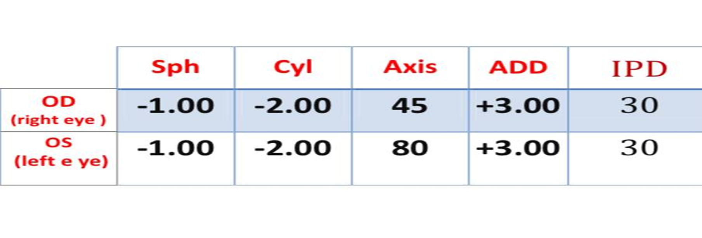
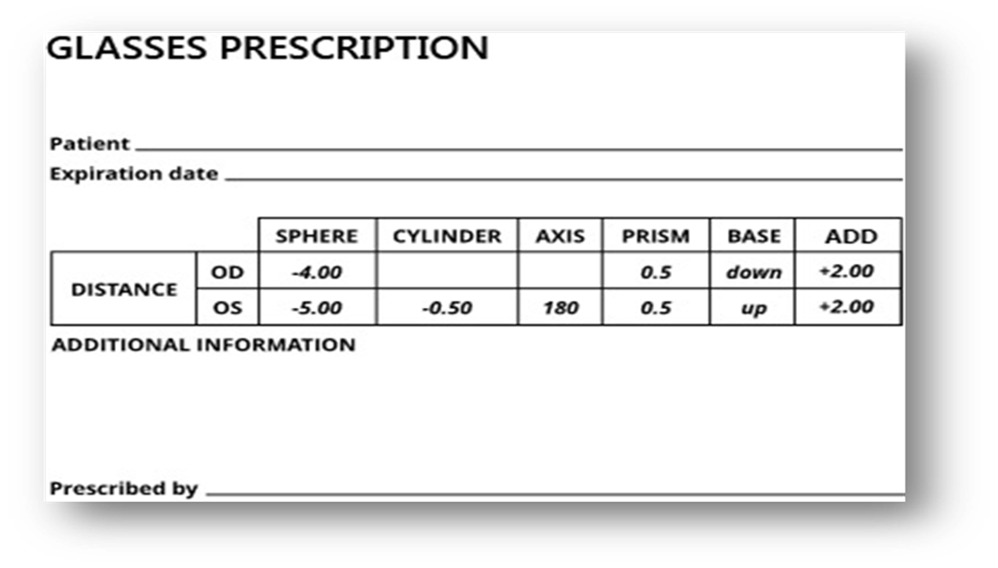
Patients information.
a. Name b. age
c. Gender e. history
2. Visit date
Day/month/year
3. Distance corrected.
Right Eye ( RE ) = sphere _ cylinder _ axis
Left Eye ( LE ) = sphere _ cylinder _ axis
4. Near correction ( ADD )
5. I.P.D inter- pupillary distance
6. Prism Diopter
7. Recommendations
8. Optometrist Signature

Slide 6
_ After taking the patient’s information, full name, age, gender & and visit date. we should take the patient’s history ( vision history ) and ask about the chief complaint of the patient.
There are some / who work far and don’t care for near and others / who work near and don’t care for far vision if there is a simple VA uncorrected like 6/12.
_ After that we should know the correct vision by Spherical lens or Aspherical lens or both.
As we know there are two types of spherical lenses, a. concave lens ( - ) and b. convex lens ( + ) .
With a spherical lens we write the number of diopter power with sign – or + depending on the lens.
For example -1.00 D sph , + 1.00 D sph
* It means we right the number of minus diopters for the concave lens.
* The number of plus diopters for the convex lens was corrected.
.

Slide 7
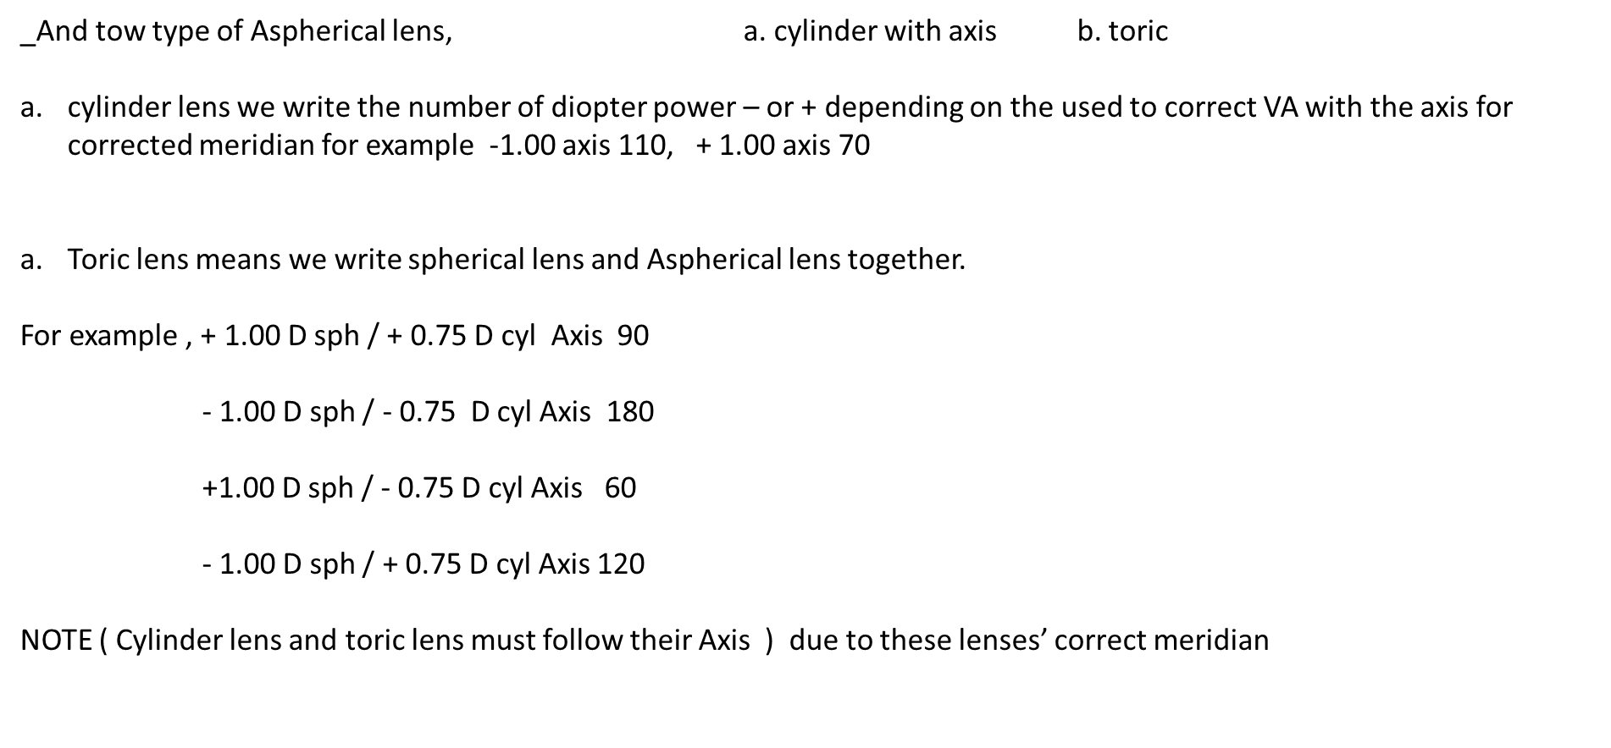

Slide 8
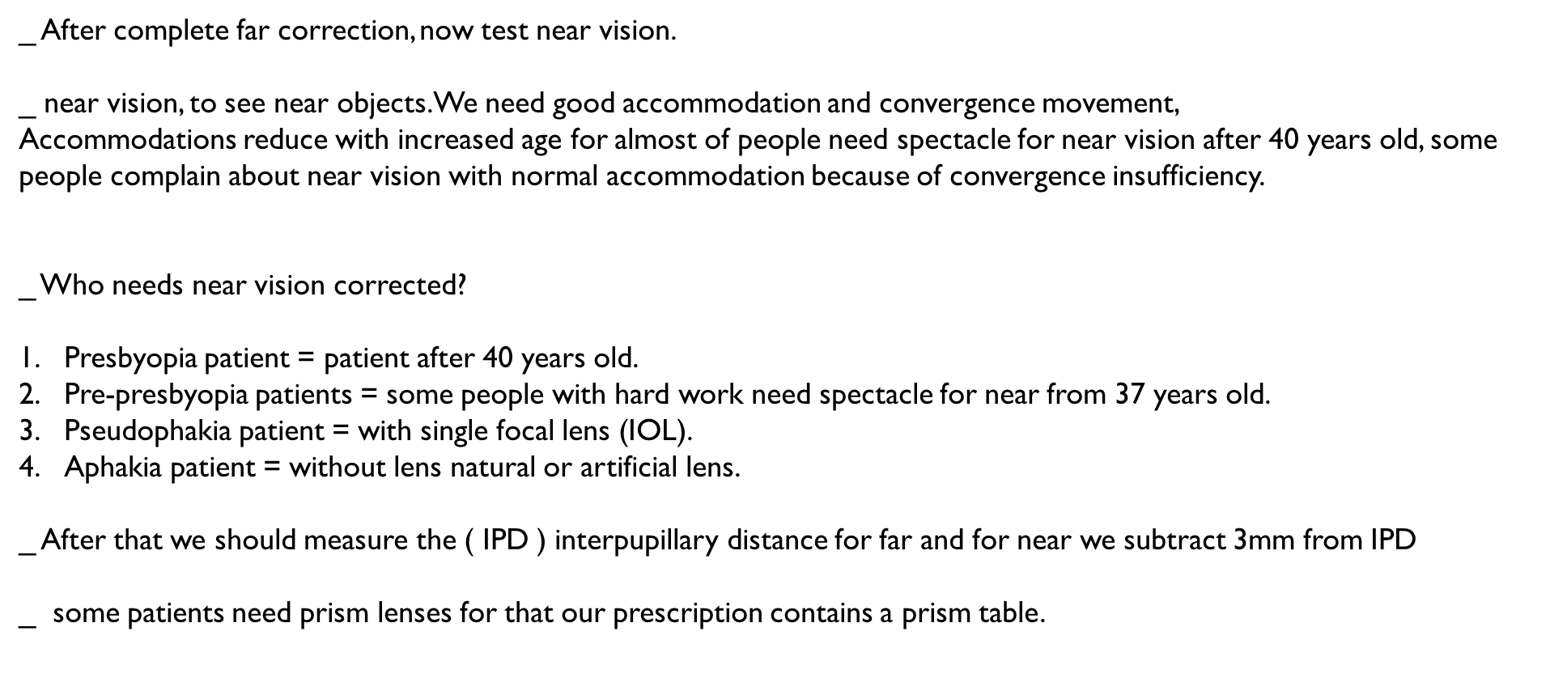

Slide 9
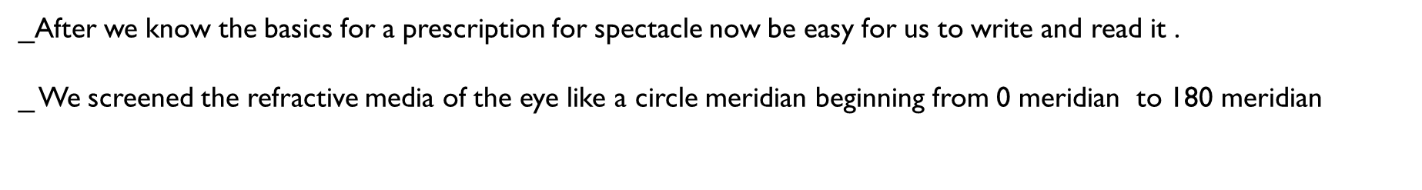
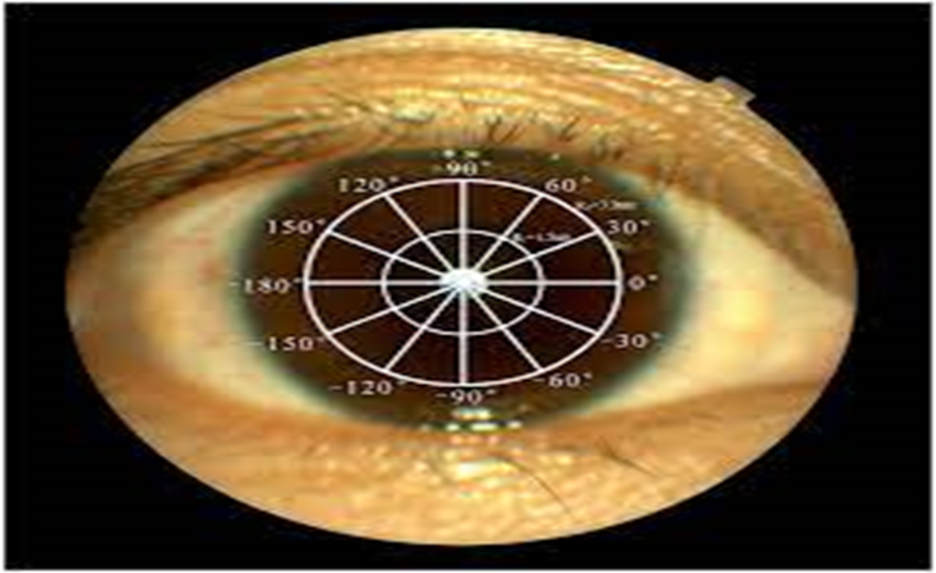

Slide 10


