Slide 1

AL- Mustaqbal University College
Pharmacy Department
Principles of Pharmacy Practice
Lectuer: 1
Prof. Dr. Jabar Faraj AL-Wakeel
Assist. Lecturer. Mustafa Ewad

Slide 2
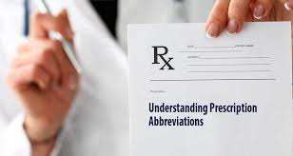
Interpretation of Prescription
or
Medication Orders

Slide 3
Prescription
Prescription is an order for medication issued by a physician, dentist, or other properly licensed medical practitioner.
Contain specific medication and dosage to be prepared by a pharmacist and administered to a particular patient.

Slide 4
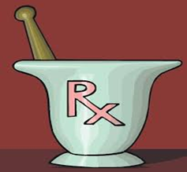
Prescription
A prescription is usually written on pre-printed forms containing the traditional symbol ℞ (meaning ‘‘recipe,’’ ‘‘take thou,’’ or ‘‘you take’’), name, address, telephone number, and other related information regarding the physician or other prescriber.
In addition, blank spaces are used by the prescriber to provide information about the patient, the medication desired, and the directions for use.

Slide 5
Components of a Typical Prescription
(1) Prescriber information and signature
(2) Patient information
(3) Date prescription was written
(4) ℞ symbol (the Superscription), meaning ‘‘take thou,’’ ‘‘you take,’’ or ‘‘recipe’’
(5) Medication prescribed (the Inscription)
(6) Dispensing instructions to the pharmacist (the Subscription)
(7) Directions to the patient (the Signa)
(8) Special instructions.
It is important to note that for any Medicated or Medicare prescription and according to individual state laws, a handwritten language by the prescriber, such as ‘‘Brand necessary,’’ may be required to disallow generic substitution.

Slide 6
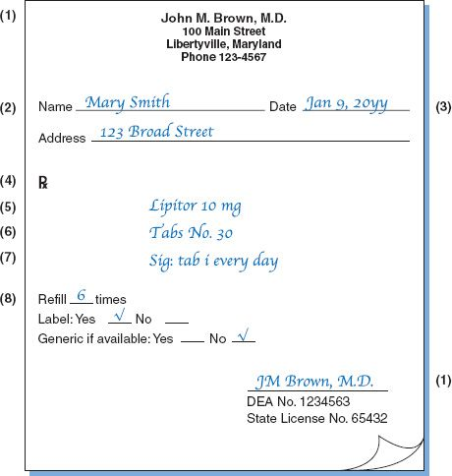

Slide 7
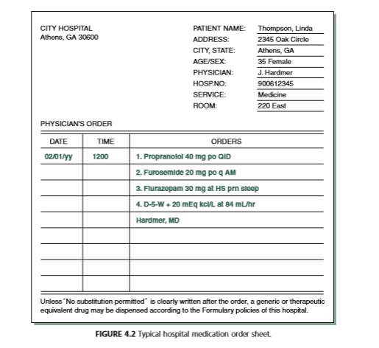
Hospital Prescription
In hospitals and other institutions, the forms are somewhat different and are referred to as medication orders.
The orders shown in this example are typed; typically, these instructions are written by the physician in ink.

Slide 8
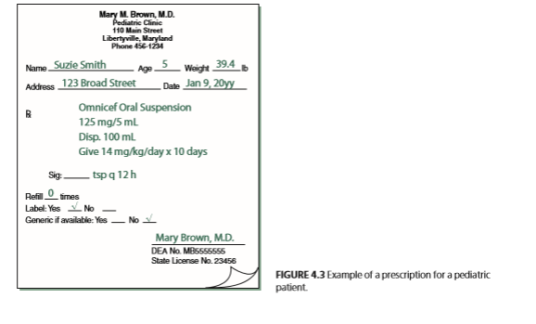
Child or Elderly Prescription
A prescription or medication order for an infant, child, or an elderly person may also include the age, weight, and/or body surface area (BSA) of the patient.
This information is sometimes necessary in calculating the appropriate medication dosage.

Slide 9
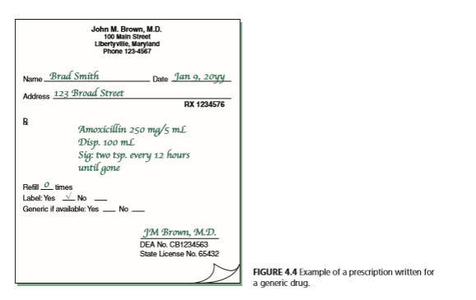
Types of Prescriptions
It is important to recognize two broad categories of prescriptions:
Those written for a single component or prefabricated product and not requiring compounding or admixture by the pharmacist:
Such prescription may include the chemical, scientific name, or non proprietary (generic) name of the substance or the manufacturer’s brand or trademark name

Slide 10
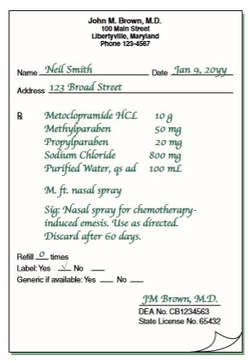
Types of Prescriptions
(2)Those written for more than a single component and requiring compounding:
Prescriptions requiring compounding contain the quantities of each ingredient required
Medications are prepared into various types of dosage forms (e.g., capsules, syrups, drops).

Slide 11
Units of Prescription Ingredients
The quantities of ingredients to be used almost always are expressed in SI metric units of weight and measurement.
In rare instances, units of the apothecaries’ system may be used.
In the use of the SI(metric system),the decimal point may be replaced by a vertical line that is imprinted on the prescription blank or hand drawn by the prescriber. In these instances, whole or subunits of grams of weight and milliliters of volume are separated by the vertical line.
Sometimes the abbreviations g (for gram) and mL (for milliliter) are absent and must be presumed.

Slide 12
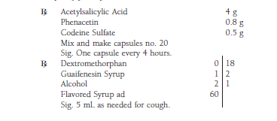
Examples of prescriptions written in SI metric units:

Slide 13
Prescriptions & Medication Order Accuracy
Once the prescription or medication order is filled and the label prepared, before dispensing, the pharmacist should make certain of the following:
  The filled prescription or medication order contains the correct drug, strength, dosage form, & quantity.
  The label has the name of the correct patient and physician, the correct drug name, quantity, and strength, the name or initials of the pharmacist who filled the order, & the number of refills remaining.
  For the patient in a hospital or other health care facility, each medication must be administered to the correct patient, at the correct time, and by the correct rate and route of administration.
Notes:
Among the items that the pharmacist should check for the correct
reading and interpretation of a prescription or medication order
are:
prescriber information, including address and telephone
number, Drug Enforcement Administration (DEA) number (for
authority to prescribe schedule drugs including narcotics), state
license number and/or the National Provider Identifier (NPI), an
identification number for participating health care providers, and
signature;
date of the order and its currency to the request for filling;
patient information, including dose-relevant information, such
as the age and/or weight of the patient if the dose of the drug is
so based
drug prescribed, including dose, preparation strength, dosage
form, and quantity;
clarity of any abbreviations, symbols, and/or units of measure;
clarity and completeness of directions for use by the patient or
caregiver;
refill and/or generic substitution authorization;
need for special labeling, such as expiration date, conditions
for storage, and foods and/or other medications not to take
concomitantly; and
a listing of the ingredients and quantities for orders to be
compounded; calculations performed should be checked and
double-checked, as should the positive identification of all
ingredients used along with their measurements
Once the prescription or medication order is filled and the label
prepared, before dispensing, the pharmacist should make certain
of the following:
The filled prescription or medication order contains the correct
drug, strength, dosage form , and quantity. Placing a medication’s
indication (use) on the prescription label has been shown
to be of benefit in understanding of the use of their medication
for some patients, particularly older patients and those taking
multiple medications. The bar-coding of pharmaceutical
products used in hospital settings is required by the federal Food
and Drug Administration (FDA) as an added protection to ensure
accurate product dispensing and administration
The pharmacy-imprinted serial number on the label matches
that on the order.

Slide 14
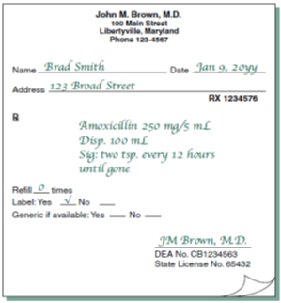
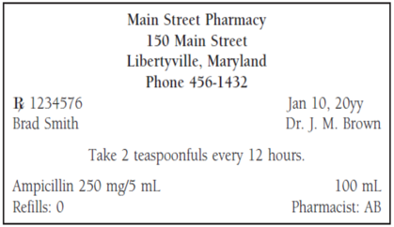
Example:
Refer to the prescription shown in Figure below to identify any errors and/or omissions in the following prescription label
Error: Drug name incorrect.
Omission: Directions incomplete.

Slide 15
E-Prescriptions
The use of electronic means for the generation and transmission of prescriptions is accepted throughout the United States.
In the inpatient or outpatient setting, a medication order, for a patient is entered into an automated data entry system (PC) or a handheld device loaded with e-prescribing software and sent to a pharmacy as an e-prescription. When received, a pharmacist immediately reduces the order to a hard copy and or stores it as a computer file.
Among the advantages cited fore e–prescriptions over traditional paper prescriptions are:
  reduced errors due to prescription legibility;
  concurrent software screens for drug interactions;
  reduced incidence of altered or forged prescriptions;
  efficiency for both prescriber and pharmacist;
  convenience to the patient, whose prescription would likely be ready for pick-up upon arrival at the pharmacy

Slide 16
To be continued with
Abbreviations and Symbols

Slide 17


