Slide 1
Digital Electronic
2nd semester

Slide 2
Lecture 6 and 7

Slide 3
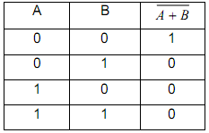

2.4.4 The NOR gate:
The NOR gate is an OR gate with its output inverted.
Truth table:
Symbol:
The NOR gate can also be manufactured with more than two inputs.

Slide 4
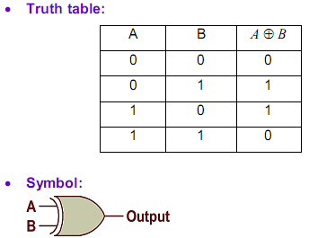
2.4.5 The exclusive-OR gate:
The exclusive-OR gate outputs a high level only
If the inputs are at different logic levels, either 0 and 1 or 1 and 0. Conversely, its output is low
If the inputs are at the same logic levels. The exclusive-OR gate is sometimes called XOR gate.
Truth table:

Slide 5
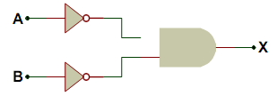
Remark 2.3:
The negative AND gate and the negative OR gate.
Let us consider the following digital circuit:
a. Draw the truth table of this circuit.
b. Show that this circuit is equivalent to a NOR gate.

Slide 6
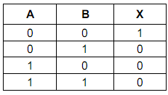

Digital signals and gates:
The expression of the output X can be written as follow:
Therefore, the truth table of the circuit can be easily deduced:
We can notice that the truth table of this circuit is identical to that of a NOR gate.
The gate described in this exercise is called the negative AND gate and its symbol is given as follow:

Slide 7
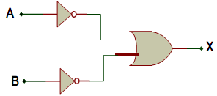
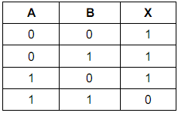
Let us consider the following gate circuit:
Draw the truth table of the circuit.
Show that the circuit is equivalent to
a NAND gate.
The expression of the output X can be written as follow:
Therefore, the truth table of the circuit can be easily deduced:

Slide 8
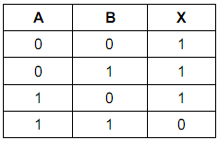

We can notice that the truth table of this circuit is identical to that of a NAND gate.
The circuit described in this exercise is called the negative OR gate.
Its symbol is given as follow:

Slide 9

The previous remark leads us to two important theorems of the Boolean algebra (the Boolean algebra will be studied in detail in the next chapter).
Those theorems are called De Morgan’s theorems:
Where A and B are two Boolean variables
(A Boolean variable is that which can only take values 0 and 1).

Slide 10
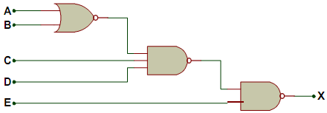
Exercise 2.9:
Let us consider the following digital circuit:
a. Give the expression of the output X.
b. Draw the truth table of the circuit.

Slide 11
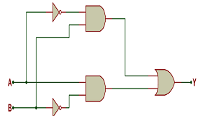
Exercise 2.10:
Let us consider following gate circuit:
a. Determine the expression of the output.
b. Deduce the truth table.
c. Conclude.
Remark 2.5:
From the exercise above the following property can be deduced:

Slide 12
1.1 Introduction
The Boolean algebra was created by the English mathematician George Boole (1815-1864).
The Boolean algebra codifies rules of relationship between mathematical quantities to one of two possible values: true or false, 1 or 0.
All arithmetic operations performed with Boolean quantities have but one of two possible outcomes: either 1 or 0.
There are three basic Boolean arithmetic operations:
1. Boolean addition which is equivalent to the OR logic function, as well as parallel switch contacts.
2. Boolean multiplication, which is equivalent to the AND function as well as series switch contacts.
3. Boolean complementation which is equivalent to the NOT logic function.

Slide 13
  3.2 Boolean Arithmetic:
This section presents the basic relationship concerning the three basic Boolean arithmetic operations.
3.2.1 Boolean addition:
Boolean addition is equivalent to the OR logic function. Therefore, following relationships:
0 + 0 = 0
0 + 1 = 1
1 + 0 = 1
1 + 1 = 1

Slide 15
  Remark 3.1:
  There is a difference between Boolean addition and binary addition; for binary addition we have the following relationships.
  0 + 0 = 0
  0 + 1 = 1
  1 + 0 = 1
  1 + 1 = 10 (1 + 1 = 0 + report of 1).

Slide 16
3.2.2 Boolean Multiplication:
Is equivalent to the AND logic function:
0 x 0 = 0
0 x 1 = 0
1 x 0 = 0
1 x 1 = 1

Slide 17
    3.2.3 Boolean Complementation:
Is equivalent to the NOT logic function.
3.3 Boolean algebraic identities:
An identity is a statement that is true for all possible values of its variables. There are two groups of Boolean algebraic identities: additive identities and multiplicative identities.

Slide 18
    3.3.1 Additive identities
If A is a Boolean variable, then the following statements are always true.
A + 0 = A
A + 1 = 1
A + A = A
A + /A = 1

Slide 19
3.3.2 Multiplicative identities:
A being a Boolean variable, the following statements are always true.
0 x A = 0
1 x A = A
A x A = A
A x/A = 0

Slide 20

Remark 3.2: Double complementation
Complementing a variable twice results in the original Boolean value.
3.4 Boolean algebraic properties:
Let us consider three Boolean Variables A, B and C.
The following properties are true.

Slide 21
3.4 Boolean algebraic properties:
Let us consider three Boolean Variables A, B and C.
The following properties are true.
Commutative property:
- Addition: A + B = B + A
Multiplication: A x B = B x A
Associative property:
- Addition: A + (B + C) = (A + B) + C
Multiplication: A(B.C) = (A.B)C
Distributive property:
A(B + C) = A.B + A.C

Slide 22
3.5 Boolean rules for simplification:
There are several rules for Boolean algebra intended to be used in reducing complex Boolean expressions to their simplest forms.
The simplification of the Boolean expressions of logic circuits brings have many advantages:
- Higher operating speed (less delay time from input signal transition to output signal transition).
- Less power consumption (few IC used).
- Less cost.
- Greater reliability.

Slide 23
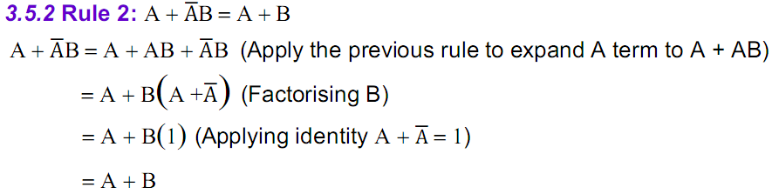
3.5 Boolean rules for simplification:
3.5.1 Rule 1:
A + AB = A
A + AB = A (1 + B)
= A (1)
= A

Slide 24
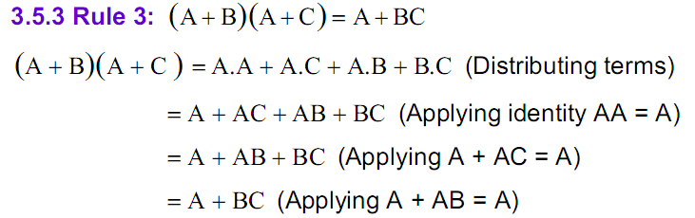
3.5 Boolean rules for simplification:
3.5.3 Rule 3:

Slide 25
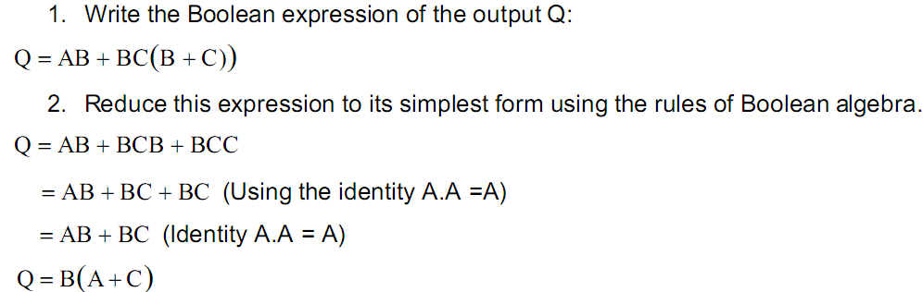
3.6 Circuit simplification example:
Let us consider the following logic circuit.

Slide 26
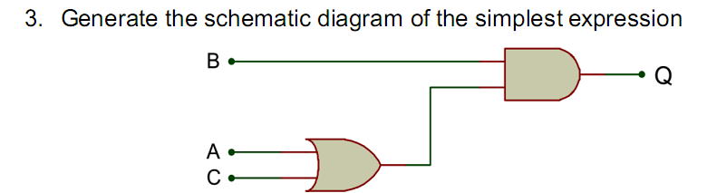
3.6 Circuit simplification example:

