Slide 1


Lecture 11
Subject
Pressure Ulcer
Theoretical
Prepared by
Dr. Ali Ahmed
Dr: Hayder Mohammed
Dr. Rania Abd ELmohsen Abo Elnour
Notes:
Electrolyte = k , mg, PO, SO ()inside of cell
Na, Cl, Hco3 (out side of cell)
Normal fluid intake = 2.400-2.700
Normal fluid output= 2.300-2.600

Slide 2
Pressure Ulcers
Pressure ulcers consist of injury to the skin and/or underlying tissue, usually over a bony prominence, as a result of force alone or in combination with movement.
Pressure ulcers were previously called decubitus ulcers, pressure sores, or bedsores.

Slide 3
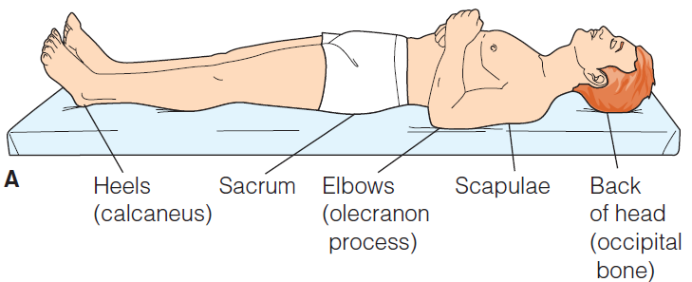
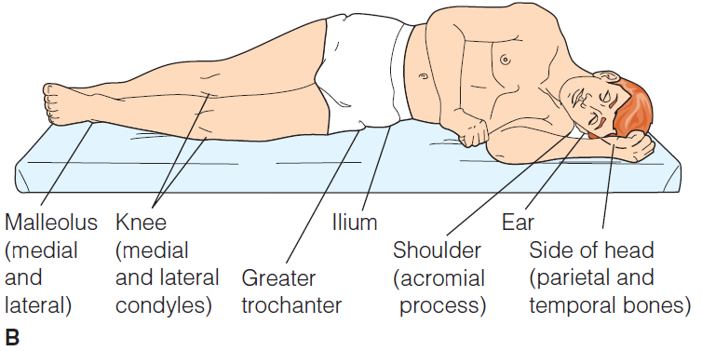
Assessing Common Pressure Sites
supine position
B. lateral position

Slide 4
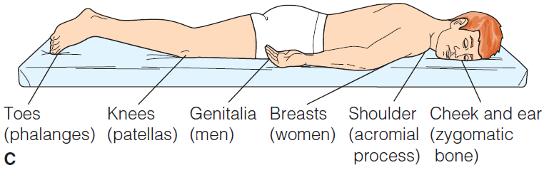
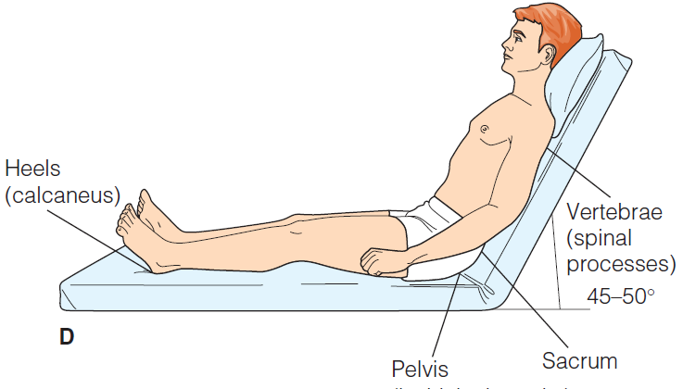
Assessing Common Pressure Sites
C. Prone position
D. Semi-fowler
position

Slide 5
Risk Factors
Friction.
Immobility.
Inadequate nutrition.
Fecal and urinary incontinence.
Decreased mental status
Diminished sensation
Excessive body heat
Advanced age
Chronic medical conditions

Slide 6
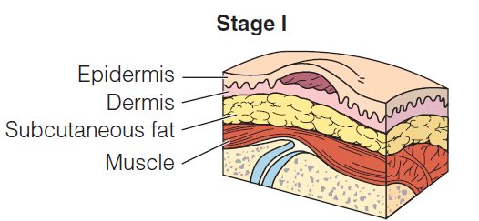
Stages of pressure ulcer
Stage I
Redness of a localized area.
Intact skin.
Area may be painful, firm, soft, and warmer

Slide 7
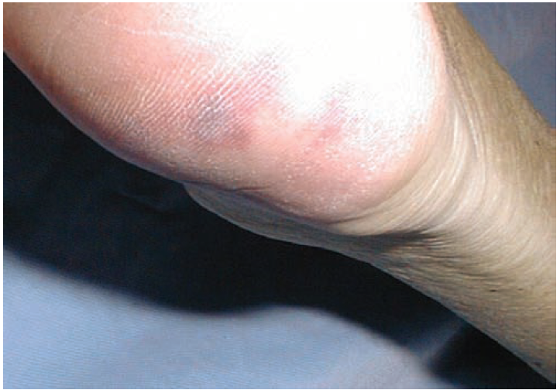

Slide 8
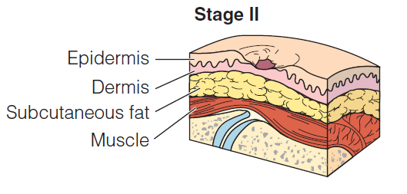
Stage II
Partial thickness loss of dermis.
A shallow open ulcer.
Red-pink wound
May present as an intact or open serum-filled blister

Slide 9
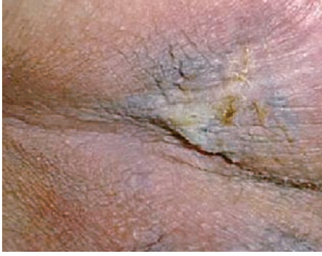

Slide 10
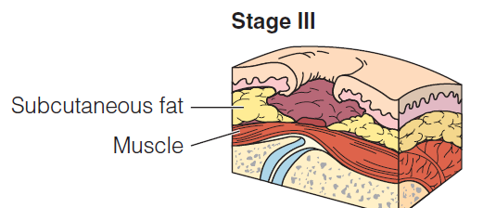
Stage III
Full-thickness tissue loss.
Subcutaneous fat may be visible.
Slough may be present.

Slide 11
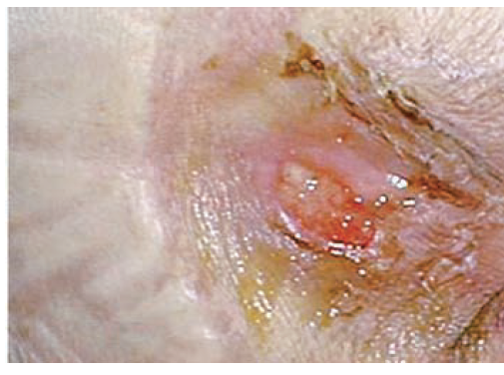

Slide 12
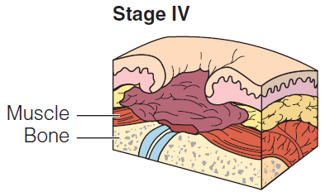
Stage IV
Full-thickness tissue loss
Exposed bone, tendon, or muscle.
Slough present on some parts of the wound.
Exposed bone/tendon is visible or directly palpable.
Notes:
Lathery = same skin color

Slide 13
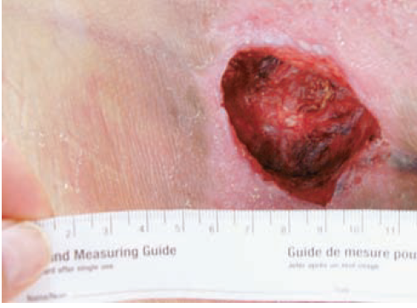
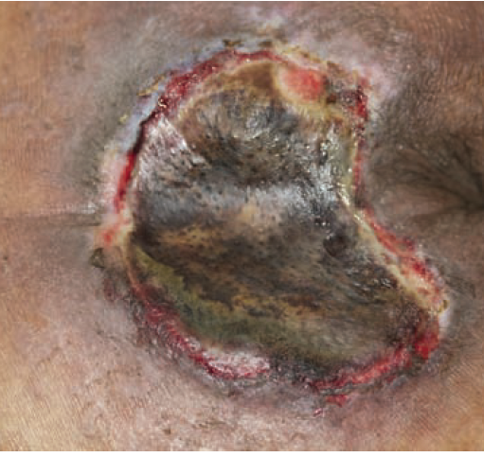

Slide 14
Nursing management
Minimize direct pressure on the ulcer.
Schedule reposition the client at least every 2 hours.
Provide devices to minimize pressure areas.
Use solutions such as isotonic saline to clean or irrigate wounds.
Use gauze squares and avoid using cotton because shed fibers onto the wound surface.
Improvement nutritional status for patient.

Slide 15
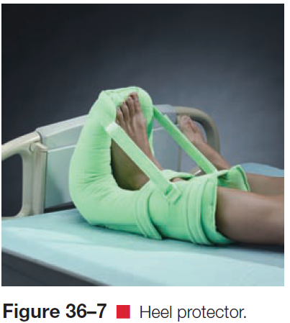
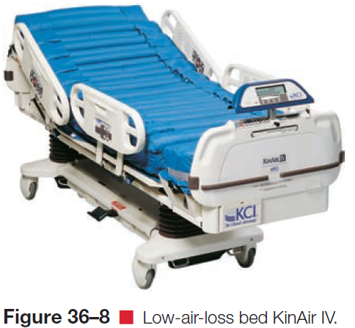

Slide 16
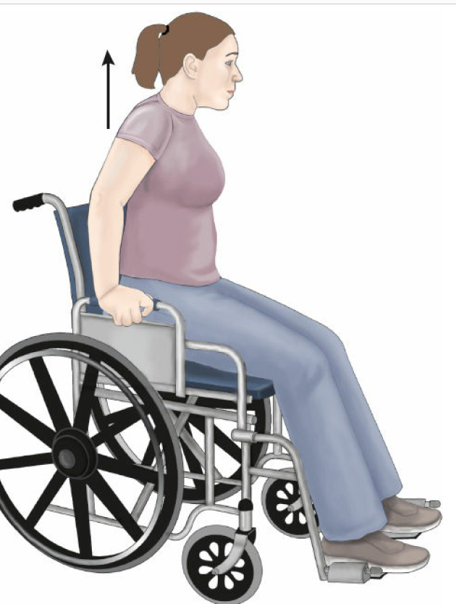

Slide 17


