Slide 1


Lecture 9
Subject
Medication Administration
Part 2
Theoretical
Prepared by
Dr. Ali Ahmed
Dr: Hayder Mohammed
Dr. Rania Abd Elmohsen Abo Elnour

Slide 2
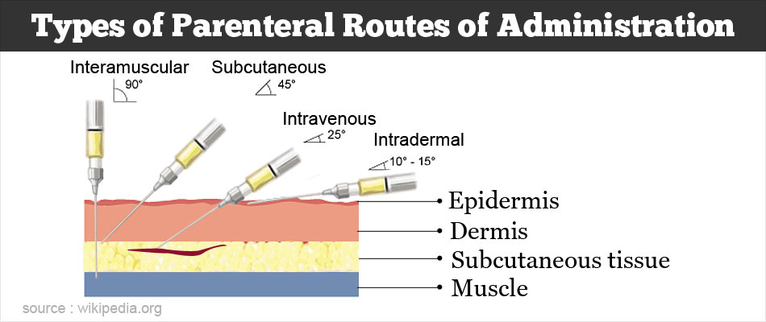
Parenteral medications
Parenteral administration of medications is a common nursing procedure. Nurses give parenteral medications intradermally (ID), subcutaneously, intramuscularly (IM), or intravenously (IV).

Slide 3
1- Intradermally (ID)
Intradermal (ID): injection into the dermis just below the epidermis.
The angle of injection is from 5 to 15 degrees.
Used a small amount of liquid, for example, 0.1 mL.
Used for allergy testing and tuberculosis (TB) screening.
The test result appears after 10 minutes for allergy and 48 – 72 hours for (TB) test .
The common sites for injection are the anterior aspect of the forearm, the upper chest, and the back beneath the scapulae

Slide 4
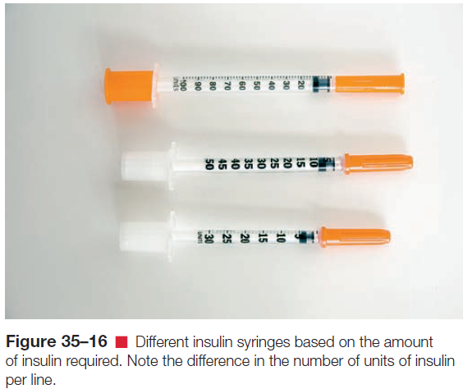

Slide 5
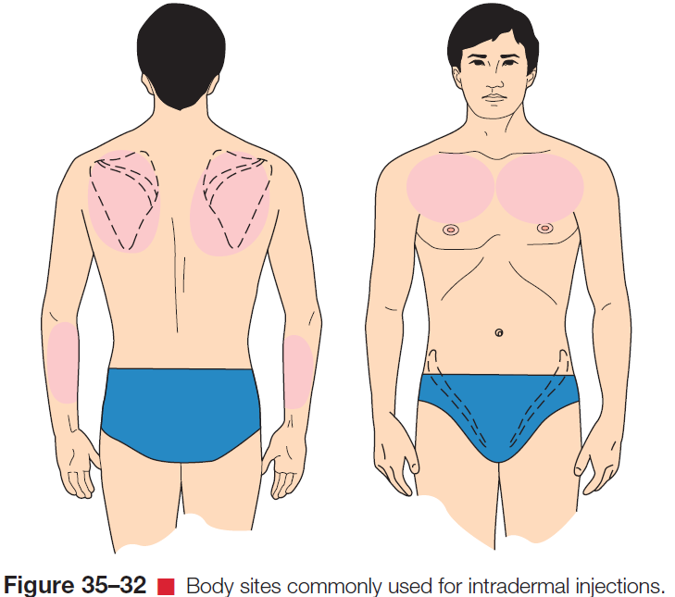
Site of intradermal injection

Slide 6
Administration Intradermal (ID) Medication
Perform hand hygiene.
Introduce self and explain procedure.
Explain to the client that the medication will produce a small wheal, sometimes called a bleb.
Provide for client privacy.
Select site (Avoid sites that are tender, inflamed, or swollen)
Apply gloves.
Expel any air bubbles from the syringe.

Slide 7
Cleanse the skin at the site using a firm circular motion starting at the center and widening the circle outward.
With the nondominant hand, pull the skin at the site until it is taut.
Insert the tip of the needle and inject the medication carefully and slowly.
Withdraw the needle quickly, Apply a bandage if indicated. Do not massage the area.
Dispose of the syringe and needle into the sharps container.
Documented all information.

Slide 8
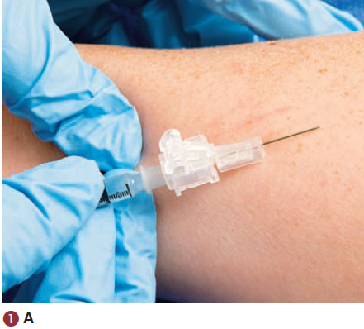
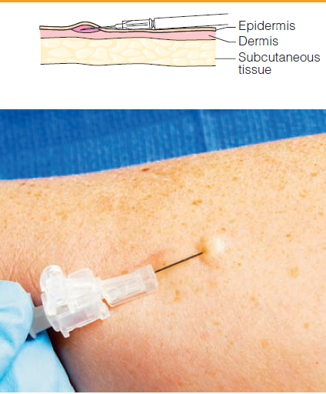

Slide 9
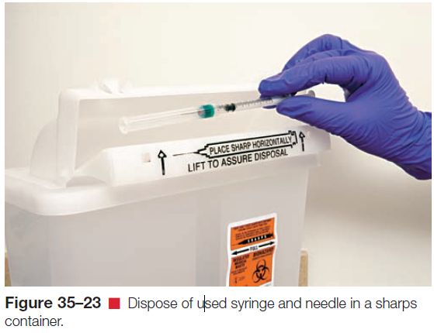
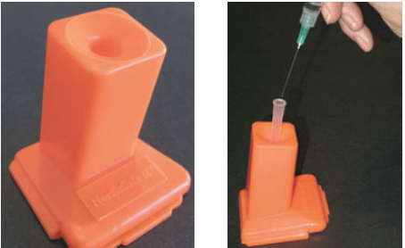
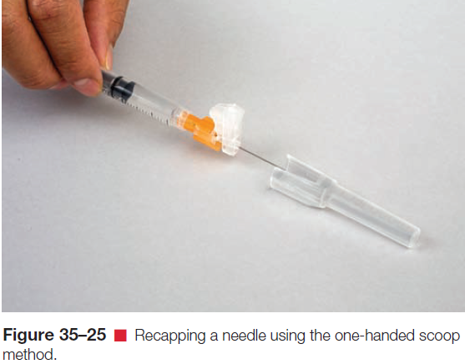

Slide 10
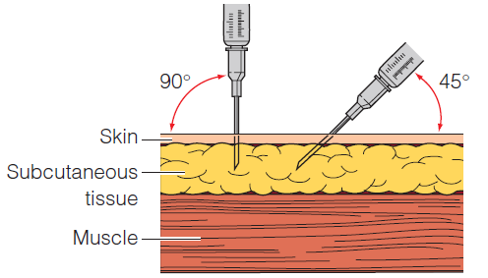
2- Subcutaneous Injections (SC)
Many kinds of drugs administered subcutaneously (vaccines, insulin, and heparin).
Only small doses (0.5 to 1 mL) of medication.
The angle of injection is 45° and in some area and cases 90 °
Notes:
Subcutaneous injection sites need to be rotated in an orderly fashion to minimize tissue damage, aid absorption, and avoid discomfort. This is especially important for clients who must receive repeated injections, such as those with diabetes. Rotate the injection sites weekly to prevent lipoatrophy and lipohypertrophy

Slide 11
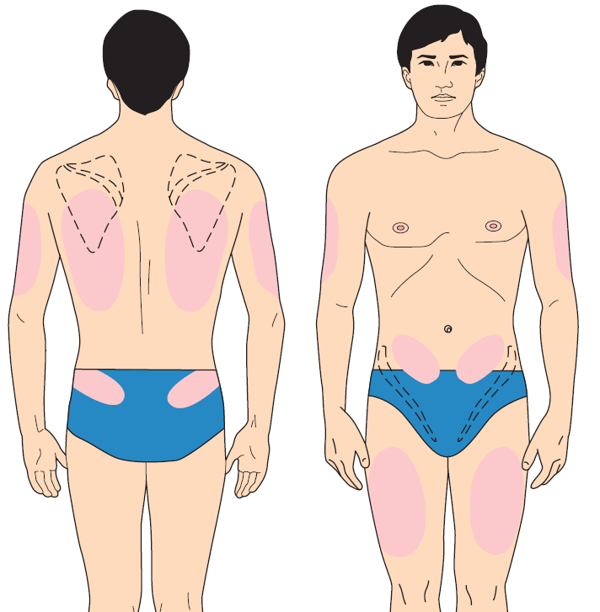
Common sites for injections are:-
the outer aspect of the upper arms (Common) (why??)
the anterior aspect of the thighs.(Common)
the abdomen
the scapular
Notes:
These areas are convenient and normally have good blood circulation.

Slide 12
Administering a Subcutaneous Injection
Perform hand hygiene and wear clean gloves.
Provide for client privacy.
Introduce your self to the client.
Explain the purpose of the medication.
Select a site free of tenderness, hardness, swelling, scarring, itching, burning, or localized inflammation.
Clean the site with an antiseptic swab, start at the center of the site and clean in a widening circle to about 5 cm.
Prepare the syringe for injection.

Slide 13
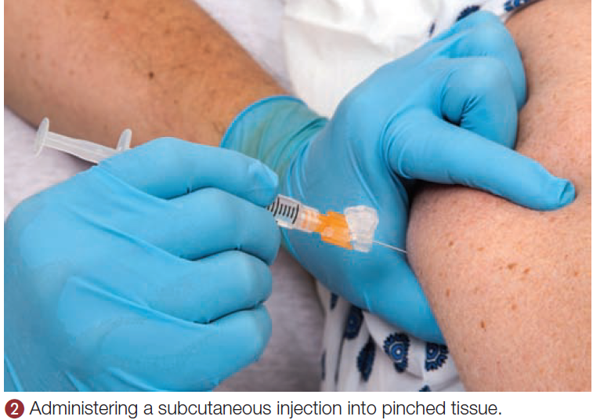
Inject the medication at 45° angle insertion or a 90° angle insertion.
Remove the needle.
If bleeding occurs, apply pressure to the site with dry sterile gauze until it stops.
Document the medication given, dosage, time, route, and any assessments.

Slide 14
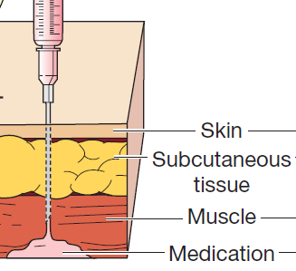
3- Intramuscular Injections (IM)
Injections into muscle tissue, are absorbed more quickly than subcutaneous injections because of the greater blood supply.
Take a larger volume of fluid (1 – 5 ml).
The angle of injection is 90 degree.

Slide 15
Sites of intramuscular injection
The dorsogluteal muscle site.
The ventrogluteal muscle site.
The vastus lateralis muscle site.
The rectus femoris muscle site.
The deltoid muscle site.

Slide 16
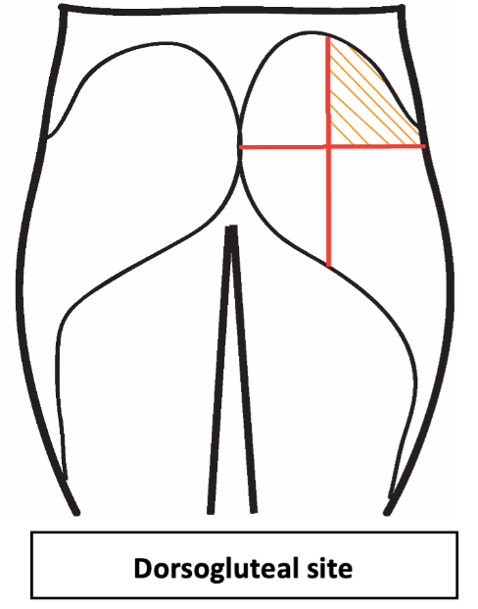
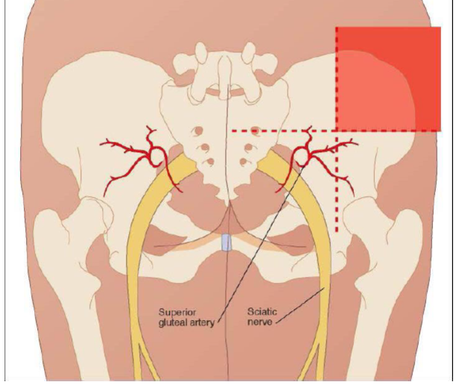
A- The dorsogluteal muscle site (1-5 ml).
Notes:
Historically, the dorsogluteal site was primarily used for intramuscular injections.
As a result, complications (e.g., numbness, pain, paralysis) occurred if the nurse injected a medication near or into the sciatic nerve.

Slide 17
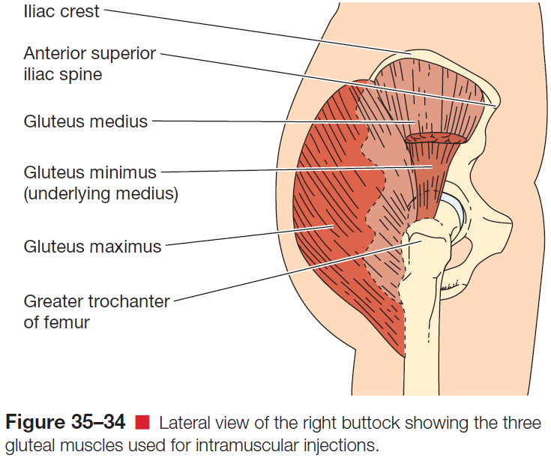
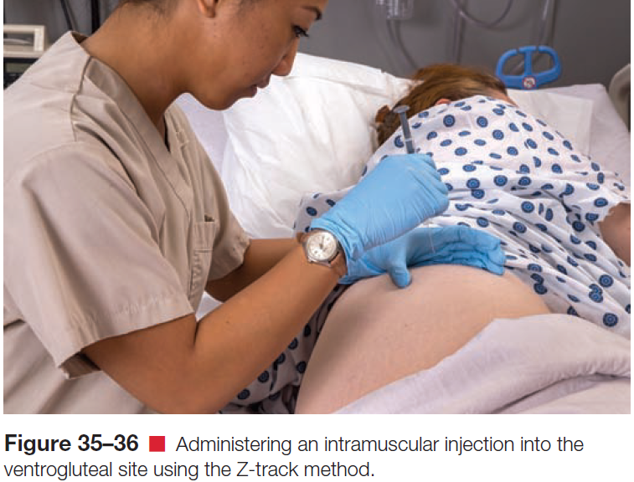
B- The ventrogluteal site.
Notes:
It is recommended as the site of choice for intramuscular
injections for infants and young children because it is the
largest muscle mass
The middle third of the muscle is suggested as the site. In the adult, the landmark is established by dividing the area between the greater trochanter of the femur and the lateral femoral condyle into thirds and selecting the middle third

Slide 18
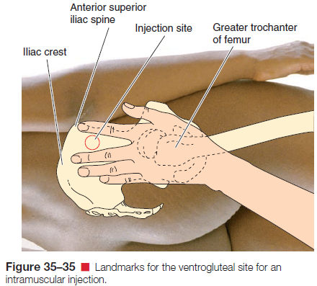

Slide 19
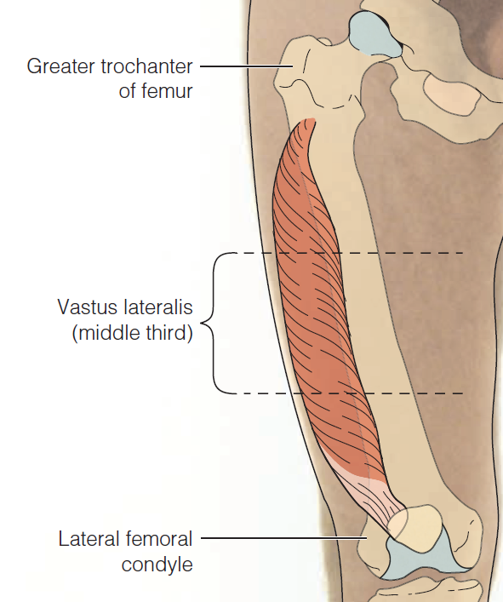
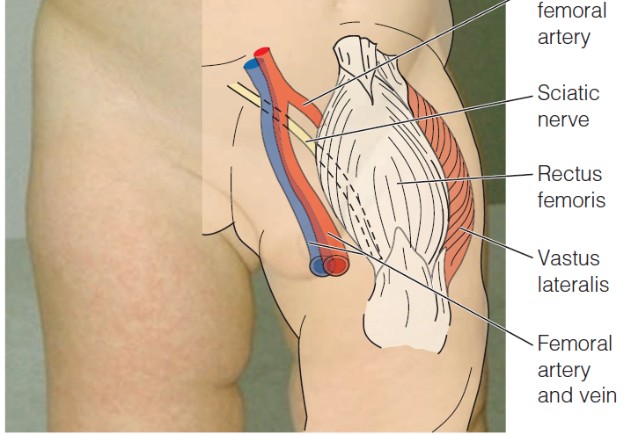
C- The vastus lateralis site.

Slide 20
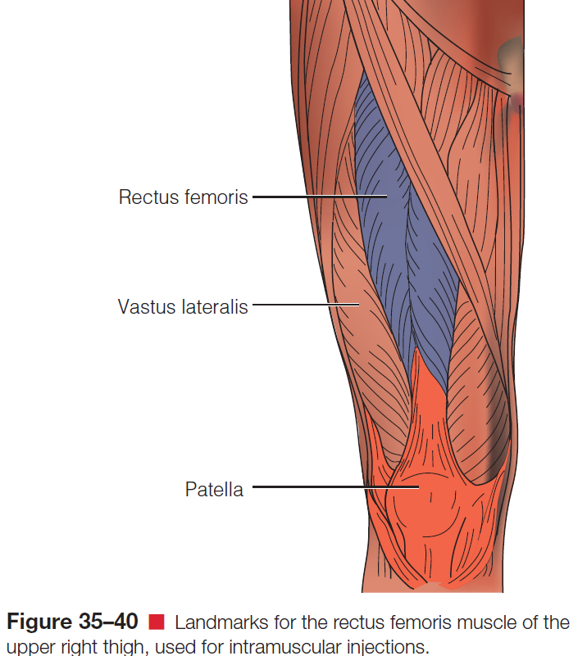
D- The rectus femoris site.

Slide 21
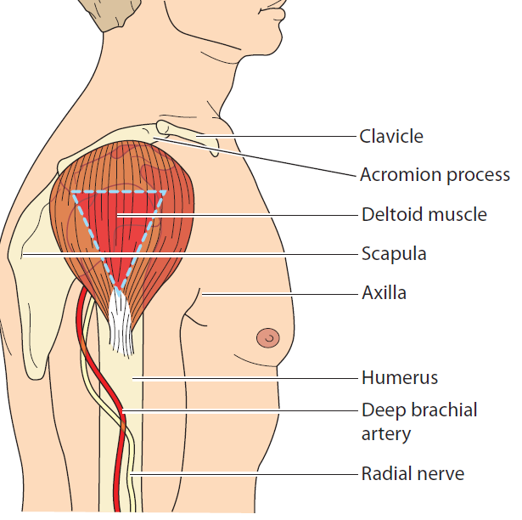
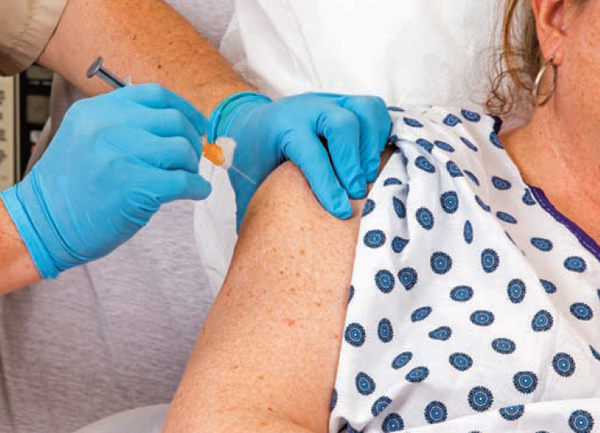
E- The deltoid muscle site (1 ml).
Notes:
It is not used often for intramuscular injections because it is a relatively small muscle and is very close to the radial nerve and radial artery. It is sometimes considered for use in adults because of rapid absorption from the deltoid area, but no more than 1 mL of solution can be administered.

Slide 22
Administering an Intramuscular Injection
Assess client allergies to medication(s).
Perform hand hygiene.
Prepare the medication from the ampule or vial.
Provide for client privacy and introduce your self.
Assist the client to a supine, lateral, prone, or sitting position, depending on the chosen site.
Select a site free of tenderness, hardness, swelling, scarring, itching, burning, or localized inflammation.

Slide 23
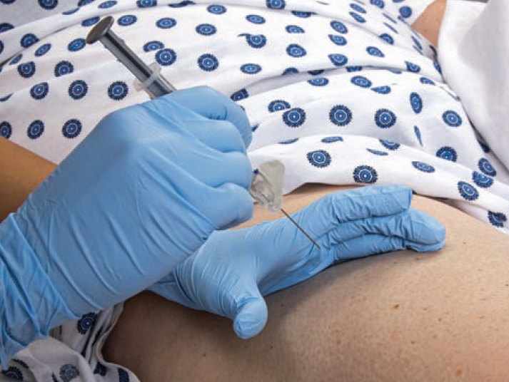
Clean the site with an antiseptic swab, start at the center of the site and clean in a widening circle to about 5 cm.
Prepare the syringe for injection.
Inject the medication using the Z-track technique.
Holding the syringe between
the thumb and forefinger
(as if holding a pen).

Slide 24
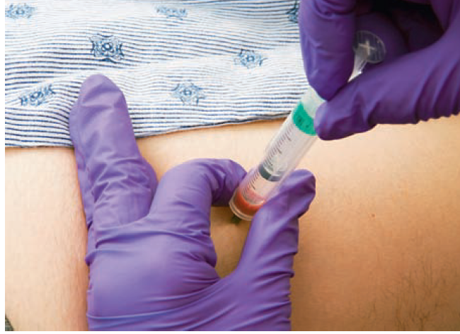
Hold the barrel of the syringe steady with your nondominant hand and aspirate for 5 to 10 seconds.
If blood does not appear, inject the medication steadily and slowly (approximately 10 seconds per milliliter).
Withdraw the needle smoothly at the same angle of insertion.
Apply gentle pressure (avoid massage) at the site with a dry sponge.
Activate the needle safety device.
Document all relevant information.

Slide 25
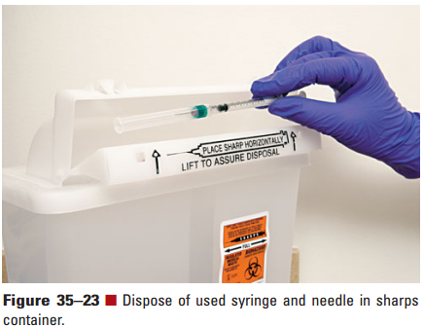
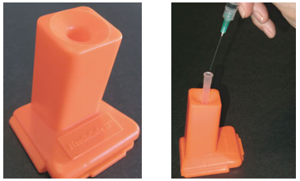
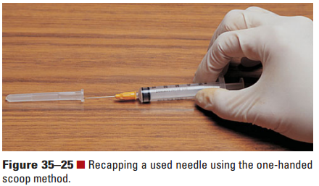

Slide 26
Complication of intramuscular injection
Hematoma or hemorrhage: a hematoma due to perforation of a blood vessel during entry, managed by light pressure on it.
Nerve damage: This occurs when choosing the wrong area for injection. It is the most dangerous complication
Pain or discomfort: We always notice, the pain may be severe with rapid injections, large quantities, and some types of medicines.
Abscess formation: as a result of not observing the correct sterilization rules, or an injection was made within the adipose tissue
Fat necrosis: Repeated injections in the same place lead to the occurrence of fat necrosis, where the skin is lowered, forming a hole.

Slide 27
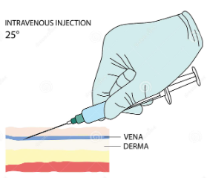
4- Intravenous Medications
Rapid effect.
Avoids the discomfort.
Large-volume infusion.
Appropriate when medications are too irritating to tissues.
Large volume of fluid causes hypervolemia.
The angle of injection is 25°

