Slide 1
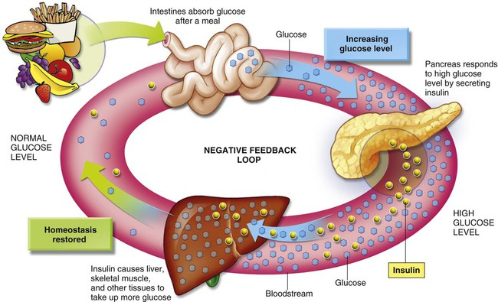
Metabolic Pathways for Carbohydrates
Lecture :2
Dr. Shaimaa Munther

Slide 2
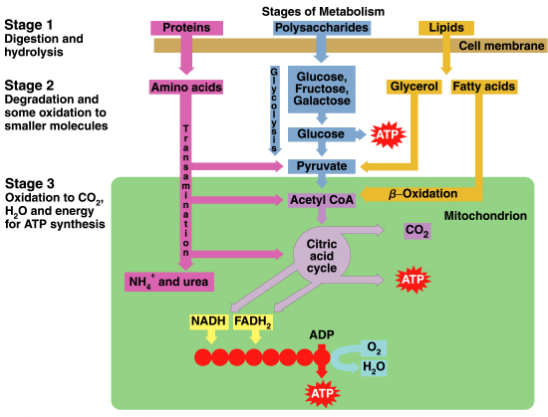
Stages of Metabolism

Slide 3
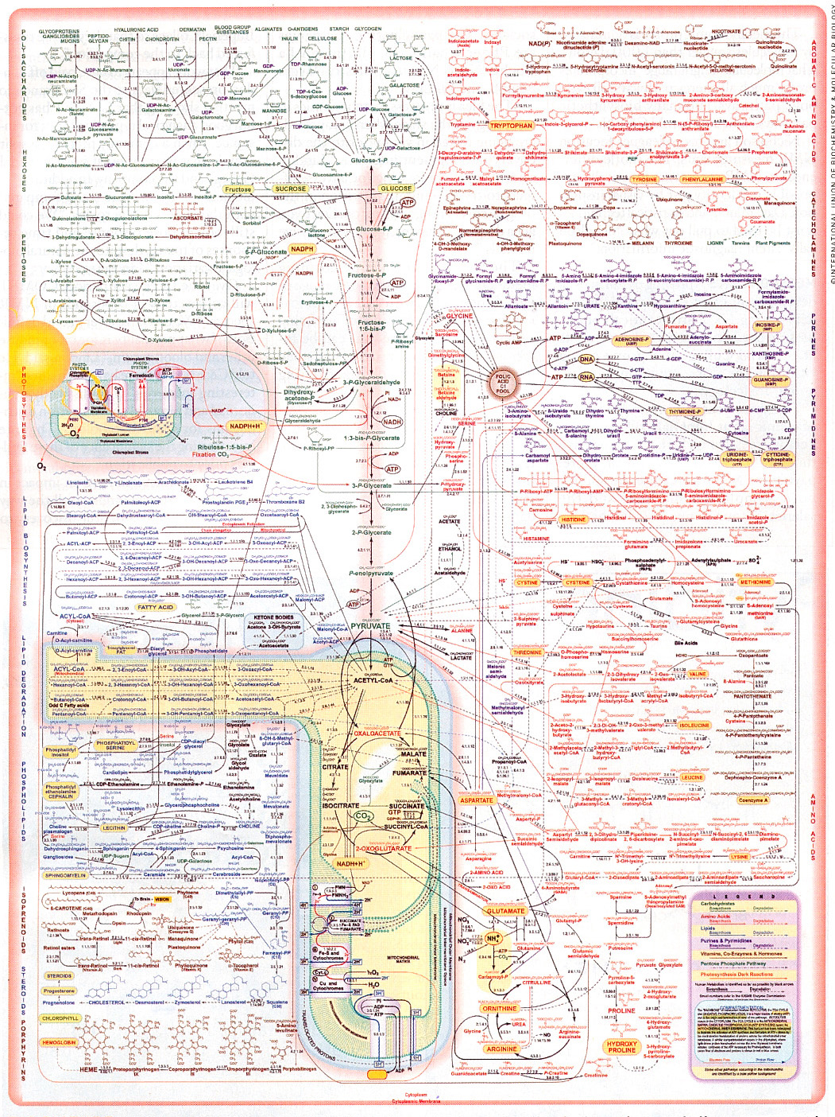
A Map of The Major Metabolic Pathways in A Typical Cell

Slide 4
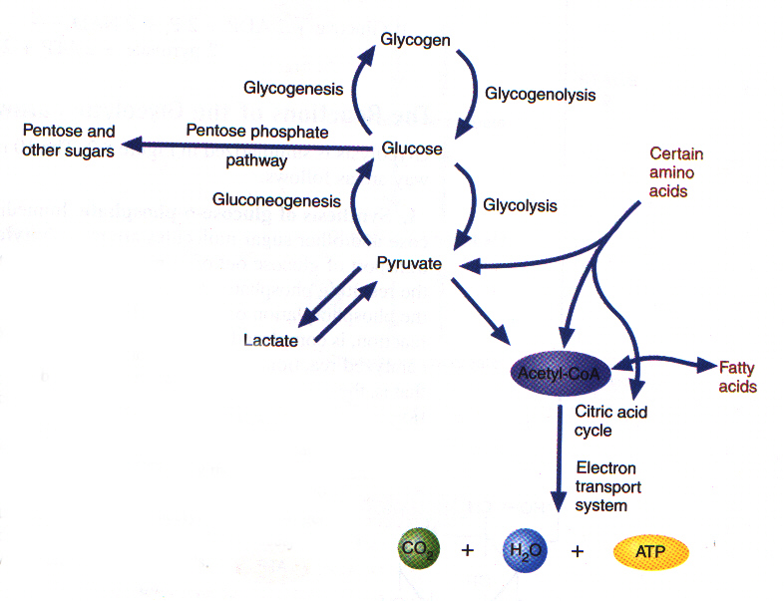
Major Pathways of CHO Metabolism
CHO metabolism in mammalian cells can be classified into:
Glycolysis: Oxidation of glucose to pyruvate (aerobic state) or lactate (anaerobic state)
Krebs cycle: After oxidation of pyruvate to acetyl CoA, acetyl CoA enters the Krebs cycle for the aim of production of ATP.
Hexose monophosphate shunt: Enables cells to produce ribose-5-phosphate and NADPH.
Glycogenesis: Synthesis of glycogen from glucose, when glucose levels are high
Glycogenolysis: Degradation of glycogen to glucose when glucose in short supply.
Gluconeogenesis: Formation of glucose from noncarbohydrate sources.
Glucose is the major fuel of most organisms. The major pathways of CHO metabolism either begin or end with glucose.

Slide 5
I. Glycolysis (Embden Meyerhof Pathway):
A. Definition:
1. Glycolysis means oxidation of glucose to give pyruvate (in the
presence of oxygen) or lactate (in the absence of oxygen).
B. Site:
Cytoplasm of all tissue cells, but it is of physiological importance in:
1. Tissues with no mitochondria: mature RBCs, cornea and lens.
2. Tissues with few mitochondria: Testis, leucocytes, medulla of the
kidney, retina, skin and gastrointestinal tract.
3. Tissues undergo frequent oxygen lack: skeletal muscles especially
during exercise.

Slide 6
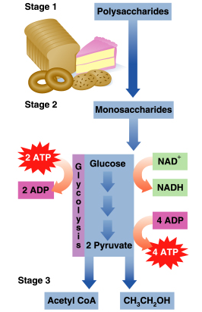
Glycolysis
Glycolysis uses glucose, a digestion product. Degrades six-carbon glucose molecules to three-carbon, pyruvate molecules.

Slide 7
Stages of Glycolysis
1. Stage one (the energy requiring stage):
a) One molecule of glucose is converted into two molecules of
glycerosldhyde-3-phosphate.
b) These steps requires 2 molecules of ATP (energy loss)
2. Stage two (the energy producing stage(:
a) The 2 molecules of glyceroaldehyde-3-phosphate are converted into
pyruvate (aerobic glycolysis) or lactate (anaerobic glycolysis).
b) These steps produce ATP molecules (energy production).

Slide 8
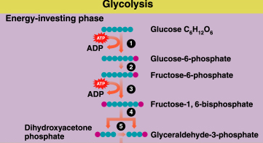
Glycolysis: Energy-Investment
In reactions 1-5 of glycolysis,
Energy is required to add phosphate groups to glucose.
Glucose is converted to two three-carbon molecules.

Slide 9
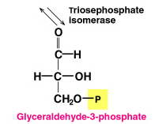
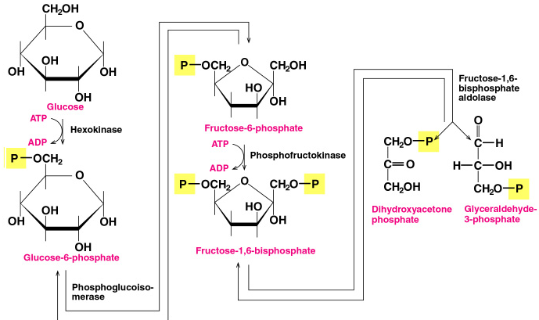
Glycolysis: Energy Investment
4
1
3
5
5
2

Slide 10
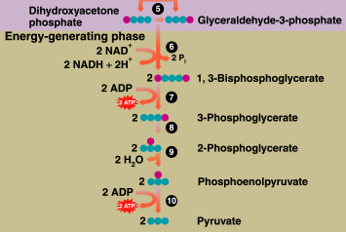
Glycolysis: Energy-Production
In reactions 6-10 of glycolysis, energy is generated as:
Sugar phosphates are cleaved to triose phosphates.
Four ATP molecules are produced.

Slide 11
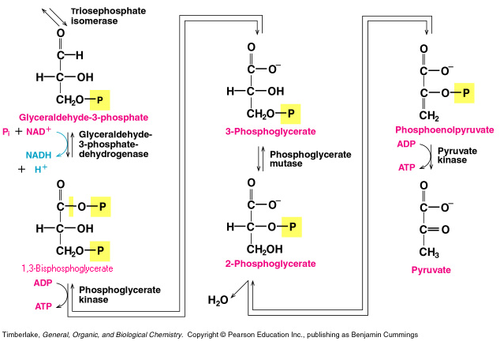
Glycolysis: Reactions 6-10
9
6
8
10
7

Slide 12
Glycolysis: Overall Reaction
In glycolysis:
Two ATP add phosphate to glucose and fructose-6-phosphate.
Four ATP are formed in energy-generation by direct transfers of phosphate groups to four ADP.
There is a net gain of 2 ATP and 2 NADH.
C₆H₁₂O₆ + 2ADP + 2Pi + 2NAD⁺ 2C₃H₃O₃⁻ + 2ATP + 2NADH + 4H⁺
glucose Pyruvate

Slide 13
Regulation of Glycolysis
Rate of glycolysis is controlled primarily by allosteric regulation of the 3 key enzymes (irreversible steps), hexokinase, PFK-1, and pyruvate kinase.
Reaction 1
Hexokinase is inhibited by high levels of glucose-6-phosphate, which prevents the phosphorylation of glucose.
Reaction 3
Phosphofructokinase, an allosteric enzyme, is inhibited by high levels of ATP and activated by high levels of ADP and AMP.
Reaction 10
Pyruvate kinase, another allosteric enzyme is inhibited by high levels of ATP or acetyl CoA.
Notes:
PFK-1 is the major regulatory enzyme of glycolysis. In the liver only, PFK-1 is activated by fructose-2,6-diphosphate (F-2,6-DP).
PFK-2, the enzyme that synthesize the activator F-2,6-DP, is itself a regulatory enzyme. It is inhibited by citrate & ATP and by phosphorylation. The reverse reaction is catalyzed by fructose-2,6-diphosphatase(F-2,6-DPase).
Hormones also regulate glycolysis e.g., glucagon inhibits glycolysis by repressing the synthesis of F-2,6-DP. Insulin promotes glycolysis by stimulating the synthesis of F-2,6-DP.

Slide 14
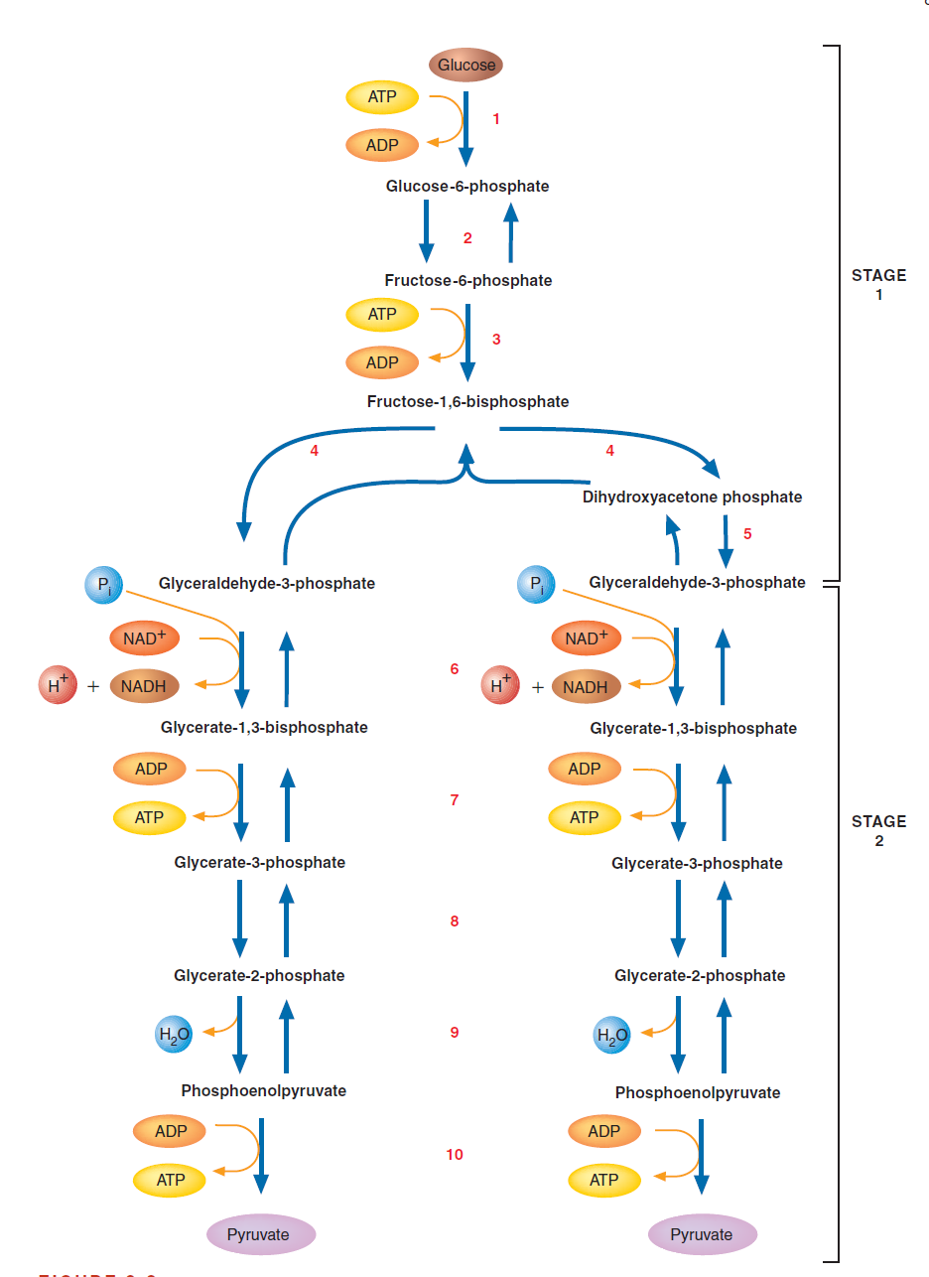
GLYCOLYSIS

Slide 15
Pathways for Pyruvate
Three pathways present:
1- Pyruvate: Aerobic Conditions
2- Pyruvate: Anaerobic Conditions
3- Fermentations (yeast)

Slide 16
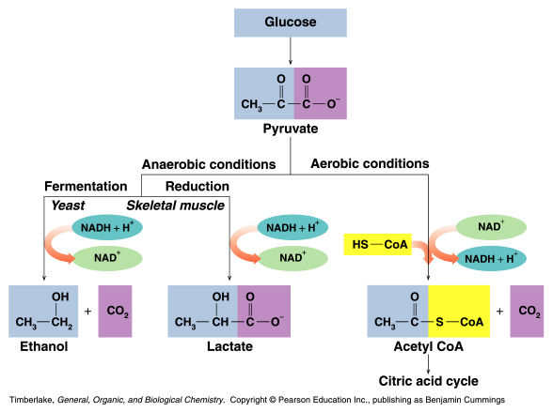
Pathways for Pyruvate

Slide 17
Pyruvate: Aerobic Conditions
Under aerobic conditions (oxygen present):
Three-carbon pyruvate is decarboxylated.
Two-carbon acetyl CoA and CO₂ are produced.
O O
|| ||
CH₃—C—C—O⁻ + HS—CoA + NAD⁺
pyruvate
O
||
CH₃—C—S—CoA + CO₂ + NADH +H ⁺
acetyl CoA

Slide 18
Pyruvate: Anaerobic Conditions
Under anaerobic conditions (without oxygen):
Pyruvate is reduced to lactate.
NADH oxidizes to NAD⁺ allowing glycolysis to continue.
O O lactate
|| || dehydrogenase
CH₃—C—C—O⁻ + NADH + H⁺
pyruvate
OH O
| ||
CH₃—CH—C—O⁻ + NAD⁺
lactate

Slide 19
Lactate in Muscles
During sever exercise:
Oxygen in the muscles is depleted.
Anaerobic conditions are produced.
Lactate accumulates. OH
│
C₆H₁₂O₆ + 2ADP + 2P_{i} 2CH₃–CH–COO⁻ + 2ATP
glucose lactate
Muscles tire and become painful.
After exercise, a person breathes heavily to repay the
oxygen debt and reform pyruvate in the liver.

Slide 20
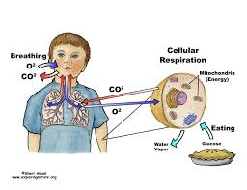
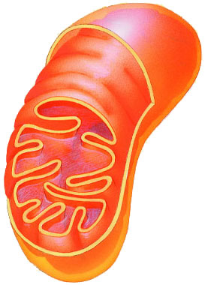
Cellular Respiration Stage 3:Oxidation of Pyruvate & Krebs Cycle

Slide 21
Glycolysis is only the start
Glycolysis
Pyruvate has more energy to yield
  3 more C to strip off (to oxidize)
  if O₂ is available, pyruvate enters mitochondria
  enzymes of Krebs cycle complete the full oxidation of sugar to CO₂
glucose → → → → → pyruvate
6C
2x
3C
pyruvate → → → → → → CO₂
3C
1C
Notes:
Can’t stop at pyruvate == not enough energy produced
Pyruvate still has a lot of energy in it that has not been captured.
It still has 3 carbons! There is still energy stored in those bonds.

Slide 22
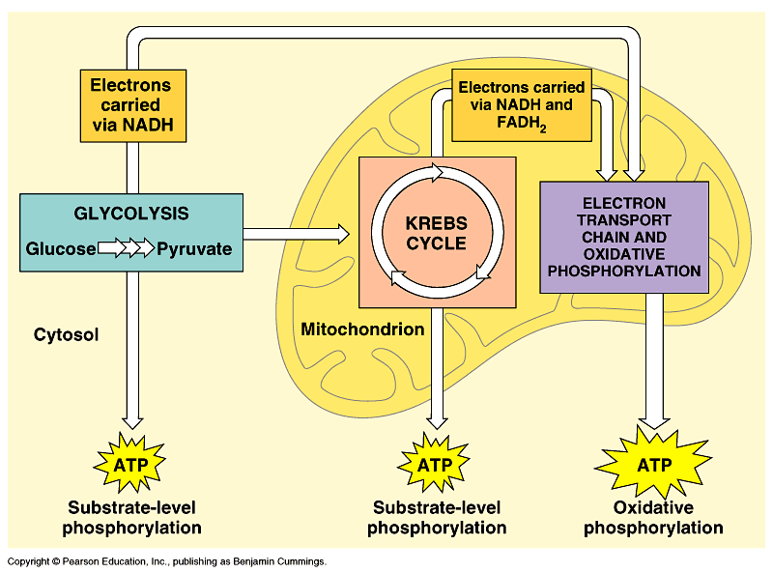
Cellular Respiration

Slide 23
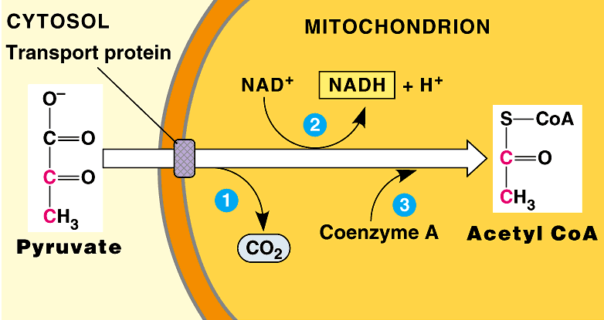
Pyruvate oxidized to Acetyl CoA
C-C
C-C-C
Yield = 2C sugar + NADH + CO₂
Notes:
Release CO₂ because completely oxidized…already released all energy it can release … no longer valuable to cell….
Because what’s the point?
The Point is to make ATP!!!

Slide 24
Krebs Cycle
Citric Acid Cycle
  Occurs in mitochondrial matrix
  8 step pathway
    each catalyzed by specific enzyme
    step-wise catabolism of 6C citrate molecule
Hans Krebs
1900-1981
Notes:
The enzymes of glycolysis are very similar among all organisms. The genes that code for them are highly conserved.
They are a good measure for evolutionary studies. Compare eukaryotes, bacteria & archaea using glycolysis enzymes.
Bacteria = 3.5 billion years ago
glycolysis in cytosol = doesn’t require a membrane-bound organelle
O₂ = 2.7 billion years ago
photosynthetic bacteria / proto-blue-green algae
Eukaryotes = 1.5 billion years ago
membrane-bound organelles!
Processes that all life/organisms share:
Protein synthesis
Glycolysis
DNA replication

Slide 25
CITRIC ACID CYCLE: (KREB’S CYCLE)
Under aerobic conditions the end product of glycolysis is pyruvic acid, in which ,the next step is the formation of acetyl coenzyme A (acetyl CoA) this step is technically not a part of the citric acid cycle, but is shown on the diagram on the top left.
Acetyl CoA, whether from glycolysis or the fatty acid spiral, is the initiator of the citric acid cycle.
In carbohydrate metabolism, acetyl CoA is the link between glycolysis and the citric acid cycle.
The initiating step of the citric acid cycle occurs when a four carbon compound (oxaloacetic acid) condenses with acetyl CoA (2 carbons) to form citric acid (6 carbons).
The whole purpose of a “turn” of the citric acid cycle is to produce two carbon dioxide molecules.
This general oxidation reaction is accompanied by the loss of hydrogen and electrons at four specific places.
These oxidations are connected to the electron transport chain where many ATP are produced.

Slide 26
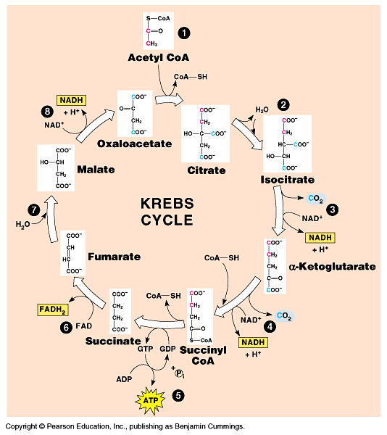
Krebs Cycle
The fully oxidized glucose (C₆H₁₂O₆ ) to CO₂ & ended up with 2 ATP

Slide 27
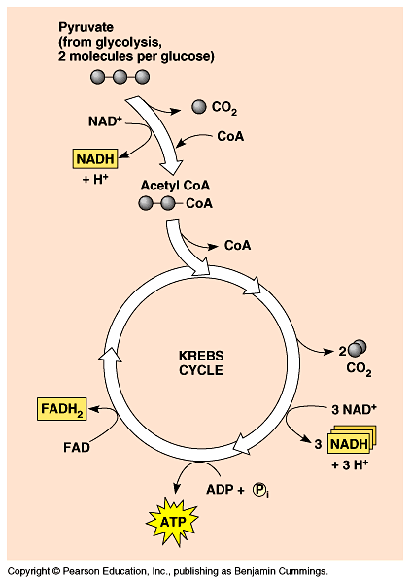
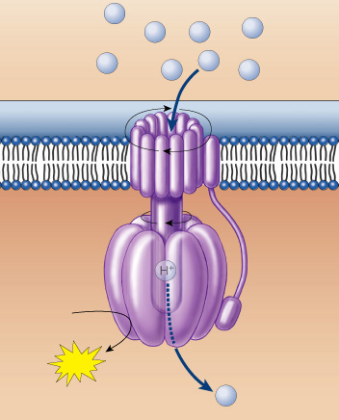
Electron Carriers = Hydrogen Carriers
Krebs cycle produces large quantities of electron carriers
  NADH
  FADH₂
  go to Electron Transport Chain
H⁺
H⁺
H⁺
H⁺
H⁺
H⁺
H⁺
H⁺
H⁺

Slide 28
Reactions of Citric Acid Cycle
Step 1
The acetic acid subunit of acetyl CoA is combined with oxaloacetate to form a molecule of citrate. The acetyl coenzyme A acts only as a transporter of acetic acid from one enzyme to another. After Step 1, the coenzyme is released by hydrolysis so that it may combine with another acetic acid molecule to begin the Krebs cycle again.
Step 2
The citric acid molecule undergoes an isomerization. A hydroxyl group and a hydrogen molecule are removed from the citrate structure in the form of water. The two carbons form a double bond until the water molecule is added back. Only now, the hydroxyl group and hydrogen molecule are reversed with respect to the original structure of the citrate molecule. Thus, isocitrate is formed.
Step 3
In this step, the isocitrate molecule is oxidized by a NAD molecule. The NAD molecule is reduced by the hydrogen atom and the hydroxyl group. The NAD binds with a hydrogen atom and carries off the other hydrogen atom leaving a carbonyl group. This structure is very unstable, so a molecule of CO2 is released creating alpha-ketoglutarate.

Slide 29
Reactions of Citric Acid Cycle
Step 4
In this step, coenzyme A, returns to oxidize the alpha-ketoglutarate molecule. A molecule of NAD is reduced again to form NADH and leaves with another hydrogen. This instability causes a carbonyl group to be released as carbon dioxide and a thioester bond is formed in its place between the former alpha-ketoglutarate and coenzyme A to create a molecule of succinyl-coenzyme A complex.
Step 5
A water molecule sheds its hydrogen atoms to coenzyme A. Then, a free-floating phosphate group displaces coenzyme A and forms a bond with the succinyl complex. The phosphate is then transferred to a molecule of GDP to produce an energy molecule of GTP. It leaves behind a molecule of succinate.

Slide 30
Reactions of Citric Acid Cycle
Step 6
In this step, succinate is oxidized by a molecule of FAD (Flavin adenine dinucleotide). The FAD removes two hydrogen atoms from the succinate and forces a double bond to form between the two carbon atoms, thus creating fumarate.
Step 7
An enzyme adds water to the fumarate molecule to form malate. The malate is created by adding one hydrogen atom to a carbon atom and then adding a hydroxyl group to a carbon next to a terminal carbonyl group.
Step 8
In this final step, the malate molecule is oxidized by a NAD molecule. The carbon that carried the hydroxyl group is now converted into a carbonyl group. The end product is oxaloacetate which can then combine with acetyl-coenzyme A and begin the Krebs cycle all over again.

Slide 31
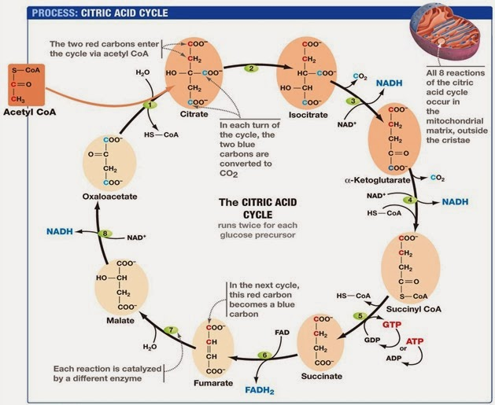

Slide 32
Energy Yield
1) Glycolysis
2 ATP
2 NADH (= 6ATP)
2) 2 X Pyruvate to Acetyl-CoA
2 NADH (= 6 ATP)
3) 2X Citric acid cycle
2GTP (= 2 ATP)
6 NADH ( = 18 ATP)
2 FADH2 (= 4ATP)
= 38 ATP

Slide 33


