Slide 1

English common idioms
Al- Mustaqbal Uni.
College of Arts and Human Sciences
Department of English
Presentation prepared by;
Dr. Ahmed Hani

Slide 2
Idioms
What is an idiom?
It is a word or phrase that means something different than you would think from the individual words.
e.g
I smell a rat
Cat got your tongue?
Butterflies in my stomach
A cold day in July
Up in the air

Slide 3
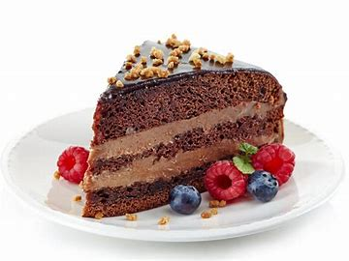
A ‘piece of cake’

Slide 4
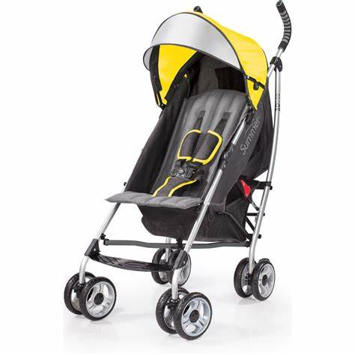
A piece of cake (easy)
it is an idiomatic expression that means something is very easy to do.
The spelling test was so easy, I thought it was a piece of cake.
Assembling this stroller was a piece of cake, since the frame arrived in one piece.

Slide 5
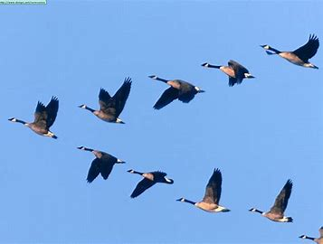
A wild goose chase (fruitless, pointless)

Slide 6
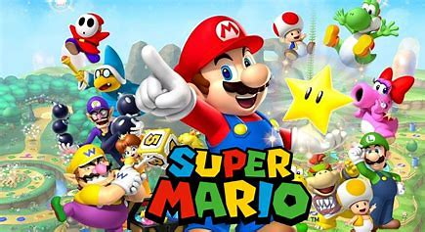
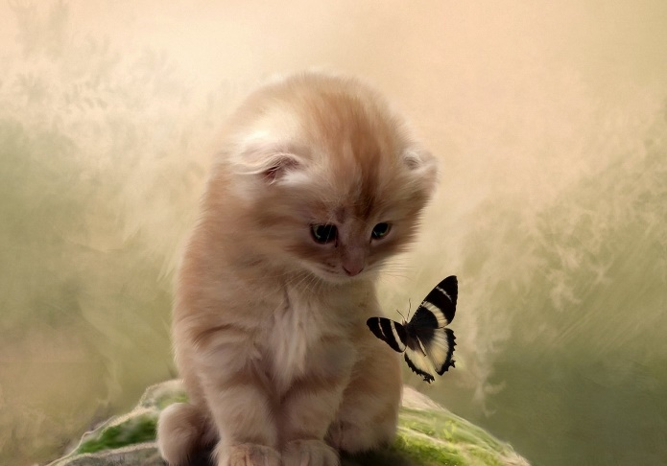
A pointless or useless chase
Jack wanted to buy the new Super Mario game but it was sold out everywhere. He went on a wild goose chase to five different stores and came home empty- handed.
The little kitten followed the butterfly on a wild goose chase.

Slide 7
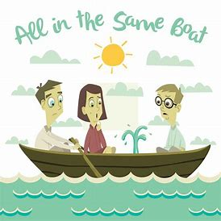
All in the same boat

Slide 8
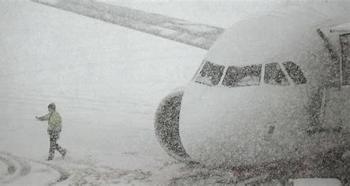
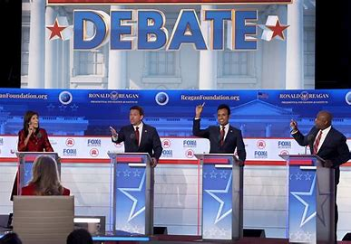
People with the same problem
When the snowstorm closed the airport, we were all in the same boat, stuck at the airport with no way to leave.
It is clear from the debate that we need to act because we are all in the same boat.

Slide 9
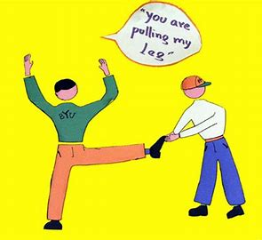
pulling my leg

Slide 10
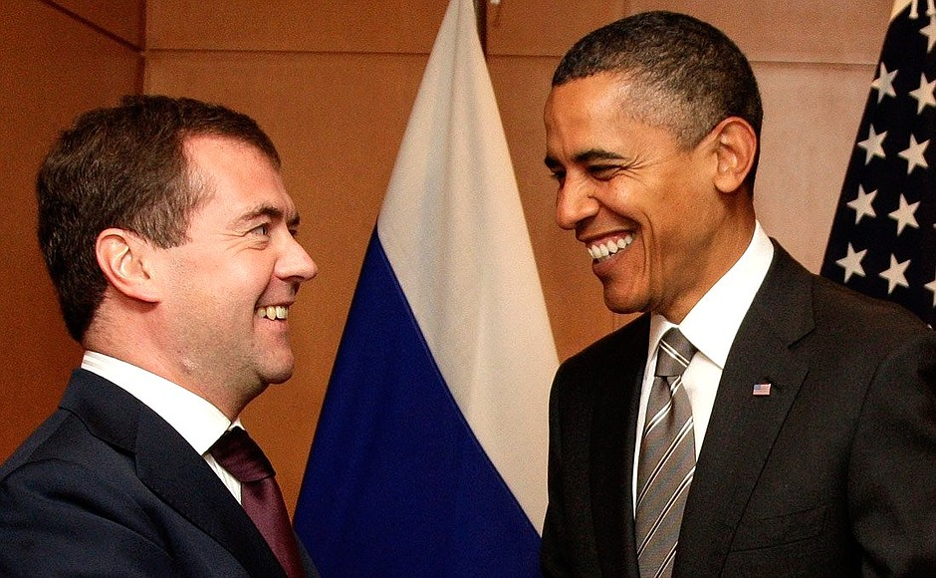
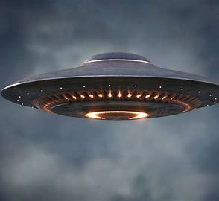
To trick someone by saying something false
Do you really meet President Barack Obama or are you just pulling my leg?
I didn’t believe him when he said he saw a UFO; I knew he was just pulling my leg.

Slide 11
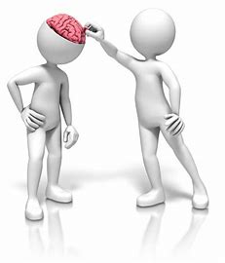
Pick your brain

Slide 12
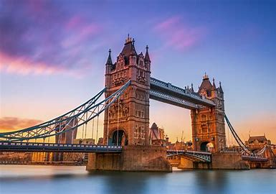
To get an advice from an expert
You have been to London three times, but this will be my first trip. I would like to pick your brain and find out where the best beaches are.

Slide 13
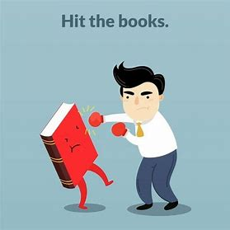
Hit the books

Slide 14
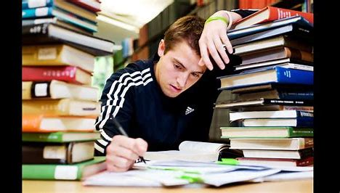
To study hard
I have a big math test tomorrow so I am going to hit the books and study really hard.

Slide 15
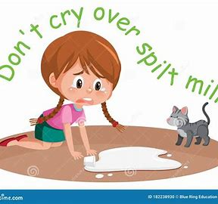
Don’t cry over spilled milk

Slide 16
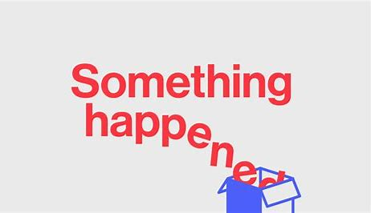
It means expressing regret or frustration over something that has already happened and truly can’t be changed.

Slide 17
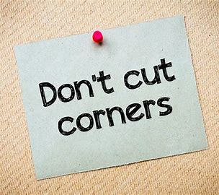
Cut corners

Slide 18
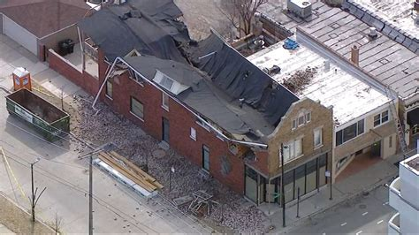
To do something fast but sloppily
The roof fell in because the builder had cut corners and not used strong materials.

Slide 19
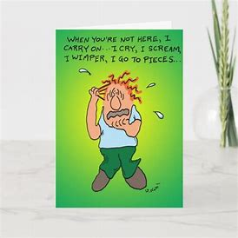
Go to pieces

Slide 20
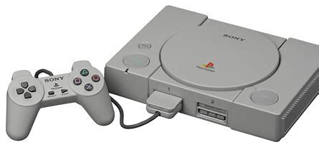
To lose control of your emotions
When Jimmy heard that he was not getting a new Play Station for his birthday, he started to go to pieces and began crying and wailing.

Slide 21
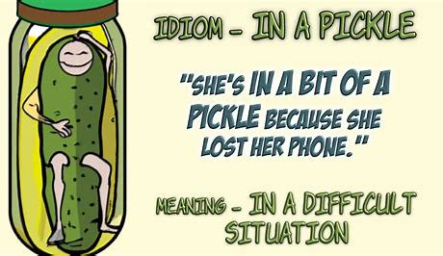
In a pickle

Slide 22
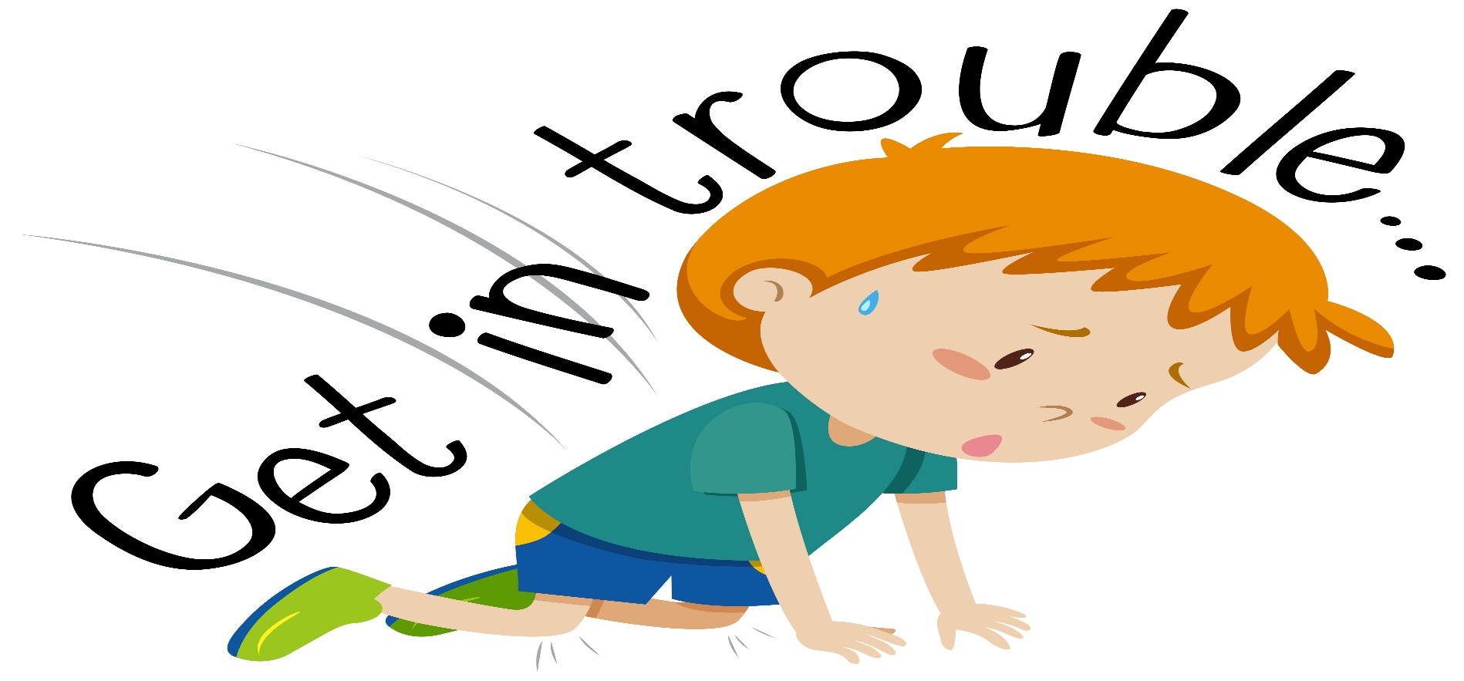
In trouble
I came downtown on the bus then I lost my wallet. I do not have money to buy a ticket back, and now I am in a pickle.

Slide 23
Exercises/ choose the correct answer
1. piece of cake means ------------.
A. difficult b. easy c. difficult
2. wild goose chase means -----------.
A. useful b. useless c. fruitful
3. All in the same boat means ------------.
A. sharing same hope b. sharing same problem
4. pulling one’s leg means ----------------.
A. to help b. to trick c. to drag a leg
5. to pick one’s brain.
A. to take one’s brain b. to take one’s advice
6. hit the books means -----------------.
A. to tear books b. to study hard
7. cry over spilled milk -------------------.
A. to regret b. to laugh
8. go to pieces means ------------------.
A. smile b. To weep c. to play

Slide 24
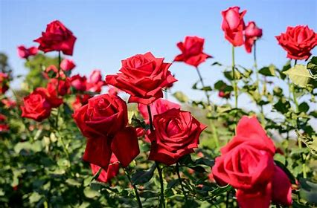
Thank you

