Slide 1
Al-Mustaqbal University
Biomedical Engineering Department
Class: 4th
Subject: Clinical issues of BME
Lecturer: M.SC. ZAINAB SATTAR JABBAR
1st term – Lect. 8: Hospital communication systems
Email: zainab.sattar.jabbar@uomus.edu.iq

Slide 2

Hospital communication systems
Hospital communication systems are platforms that facilitate the ability for healthcare providers and supporting staff to connect, collaborate, and exchange information in order to treat patients. They support the collaboration of the many departments and roles within a single hospital or a group of affiliated medical facilities.

Slide 3
Hospital communication systems
Hospital communication systems are crucial to the effective and efficient delivery of healthcare.
These systems ensure that healthcare providers can communicate with each other, patients, and external entities, facilitating decision-making, patient care, and operational workflows.
In the context of biomedical engineering, the design and management of hospital communication systems involve a deep understanding of technology integration, data flow, and patient safety.

Slide 4
Types of Communication Systems in a Hospital
Internal Communication Systems:
Voice Communication:
Telephones & Intercom Systems: Used for internal voice communication among hospital staff, including doctors, nurses, and administrative personnel.
Radio Communication: Widely used for staff on the move, particularly in larger hospitals, emergency medical services, and patient transportation.
2. Data Communication
Hospital Information Systems (HIS): Centralized systems that store, manage, and transmit patient records and hospital management data. HIS integrates multiple departments like radiology, laboratory, pharmacy, etc.
Electronic Health Records (EHR): Digital versions of patients’ medical histories, updated with each visit and used to share information across multiple healthcare providers.

Slide 5
Types of Communication Systems in a Hospital
3. Nurse Call Systems:
Vital for facilitating communication between patients and healthcare providers, allowing patients to request assistance, track response times, and manage workflow efficiently.
b. External Communication Systems
1.Telemedicine
Telemedicine has become a significant part of modern healthcare, allowing for remote consultation and diagnosis. It uses video conferencing, secure messaging, and cloud-based platforms to facilitate patient-doctor interactions.
2.Emergency Medical Services (EMS) Communication
EMS utilizes radio communication, GPS, and real-time data transmission to manage patient transportation to and from the hospital. This ensures optimal care is administered during transport, with data (such as ECGs) being sent in real-time.

Slide 6
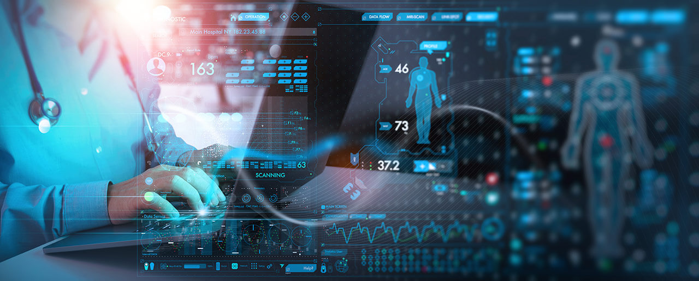
Data networks in hospitals
One of the elements that has gained the most weight recently has been that related to sensitive data that is collected in hospitals and health centers and that, although indirectly, also contributes to good patient care and proper functioning both from a medical and organizational point of view.

Slide 7
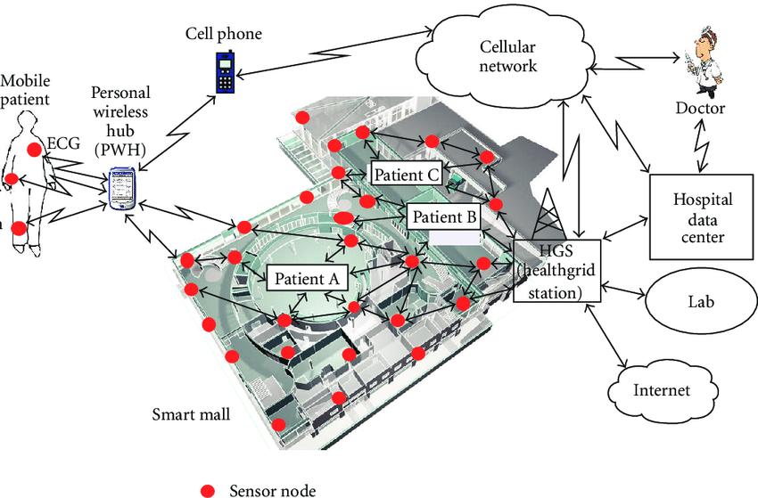
Network Basics
What are hospital data networks
A data network is a system used for communication and exchange of information between people or organizations, from one point to another thanks to transmission lines, system control, etc.

Slide 8
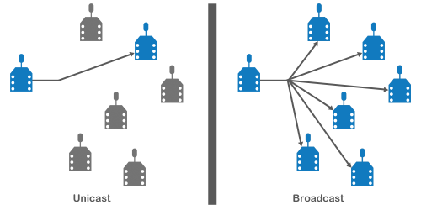
Types of networks
Broadcast networks: information is transmitted from one node to several simultaneously.
Point-to-point networks: Each transmitter maintains communication with a receiver.

Slide 9
Advantages of Data Networks
1. Allows sharing of resources
Thanks to the data network it is possible to share any type of information and resources such as the Internet, printers, computers, etc.
2. Opportunity of quick and agile communication
With the use of emails or online file transfers, it is possible to use the data network to connect computers and make communication more fluid and easy.
3. It favours collaboration
Between people or users from different teams, places and departments remotely.
4. Allows centralized storage
The software copy is stored centrally in a single resource. Users with access credentials can remotely access a backup copy of said software.
5. A central database is shared and can be accessed by any member of the organization through the data networks and with their access credentials.

Slide 10
Big data used for in health
Medical history, medical prescriptions, visit schedule, test results… In the health sector there are countless data sources that provide us with information about patients, their illnesses, medical centers, etc. Collecting and storing all this information is a fundamental step for patient care and the proper functioning of a hospital or health center.
Nowadays, thanks to big data, all kinds of data can be consulted online.

Slide 11
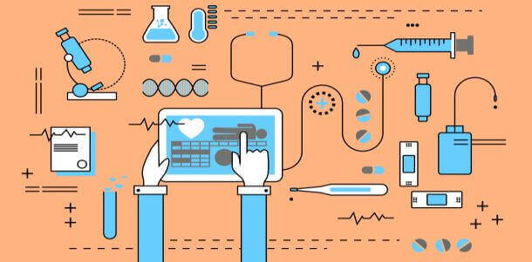
Big data used for in health
Certain big data techniques also allow us to go a step further and offer telemedicine systems or predictive models to offer more personalized and efficient medical care, while optimizing resources and reducing costs

Slide 12
Data protection
Data protection is one of the rights that patients have. In fact, data related to a person’s health or clinical history is considered sensitive information, so its protection is especially important and is imperative for health centers and organizations.
From hospitals to clinics or medical centers… Any center in the field of health must comply by law with a whole series of requirements related to the treatment of information or medical data of patients

Slide 13

Ethics of collecting data
Avoid or minimize anything that will cause physical or emotional harm to participants. Make participants aware of any potential harms prior to their participation. Try to remain neutral and unbiased. Don't let your personal preconceptions or opinions interfere with the data collection process.

Slide 14
Challenges in Hospital Communication Systems
1.Data Security and Privacy:
Hospitals must comply with strict regulations (e.g., HIPAA in the U.S.) to protect patient data.
Encryption, secure transmission protocols, and access controls are critical to safeguarding sensitive health information.
2. System Integration:
Hospitals utilize a variety of systems that must be integrated effectively. This includes HIS, EHR, laboratory management systems, and patient monitoring devices. Ensuring smooth data flow across these platforms without compromising functionality is a complex challenge.

Slide 15
Challenges in Hospital Communication Systems
3. Interoperability:
Communication systems must work seamlessly across diverse devices and technologies from various manufacturers. For example, medical devices from different brands should be able to communicate and share data with HIS and EHR systems.
4. Network Reliability:
Hospitals rely on their communication systems to ensure accurate, timely information sharing. Any disruption (due to power failure, network congestion, etc.) can have a significant impact on patient care and hospital operations.
5. Human Factors:
Proper training of healthcare personnel in using communication systems is vital. Mistakes, such as misinterpretation of messages or failure to use the system effectively, can affect patient care.

Slide 16
Biomedical Engineering's Role in Communication Systems
Designing and Maintaining Medical Communication Devices: Biomedical engineers ensure that monitoring systems like ECG, pulse oximeters, and blood pressure monitors can communicate patient data to centralized hospital systems in real-time.
Ensuring Integration of Medical Devices with HIS: Many medical devices, including ventilators, infusion pumps, and imaging systems, must be integrated into the hospital's data system. Biomedical engineers design solutions to make this data accessible in the hospital’s EHR for improved diagnosis and patient management.
Security and Compliance: Biomedical engineers work to ensure that medical devices and communication technologies meet healthcare security standards, including patient privacy regulations. They help implement cybersecurity measures to protect against breaches and ensure compliance with legal and ethical standards.
Developing Telemedicine Solutions: Engineers design and maintain telemedicine systems that ensure secure, reliable, and high-quality remote consultations between patients and doctors.

Slide 17


