Slide 1
Al-Mustaqbal University
Biomedical Engineering Department
Class: 4th
Subject: Biomedical Instrumentation Design I
Lecturer: Mr. Mahir Rahman Al-Hajaj
1st term – Extra Lecture: Lab Equipments, part 2.
Email: mahir.rahman@uomus.edu.iq

Slide 2
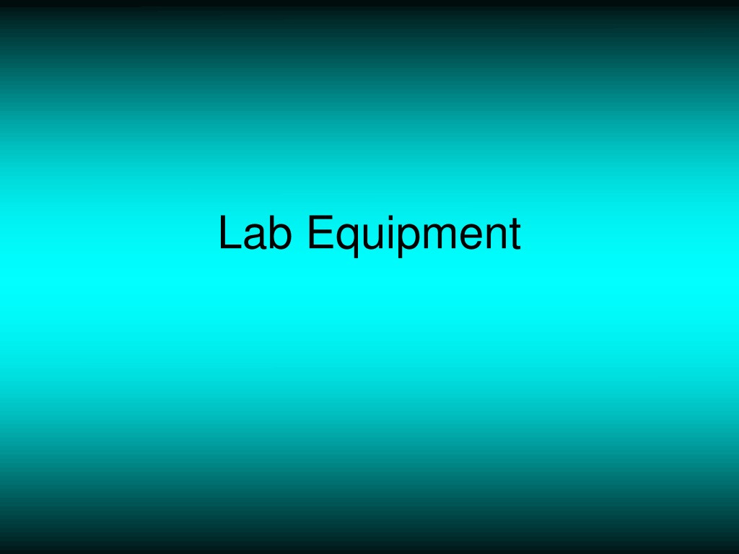

Slide 3
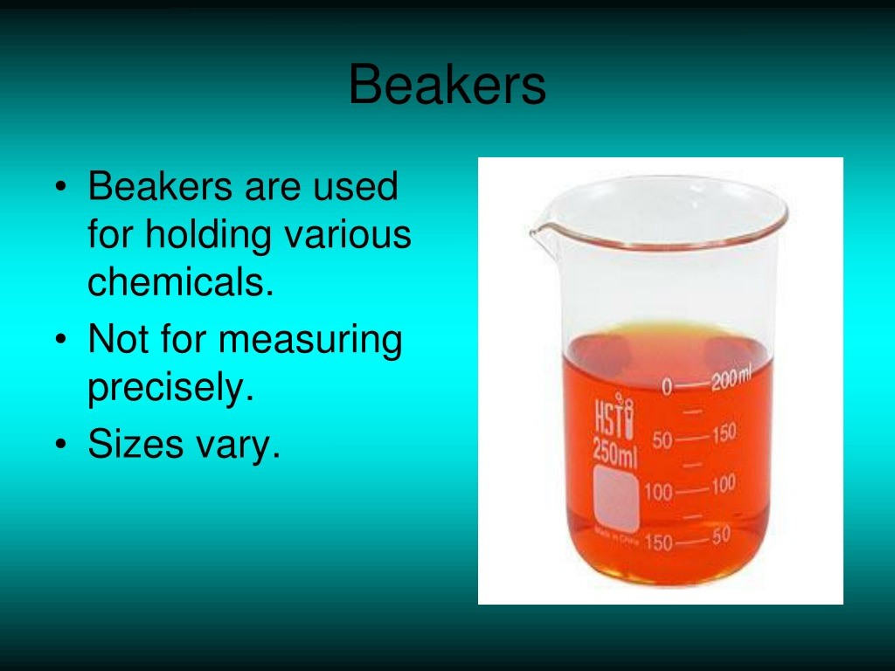

Slide 4
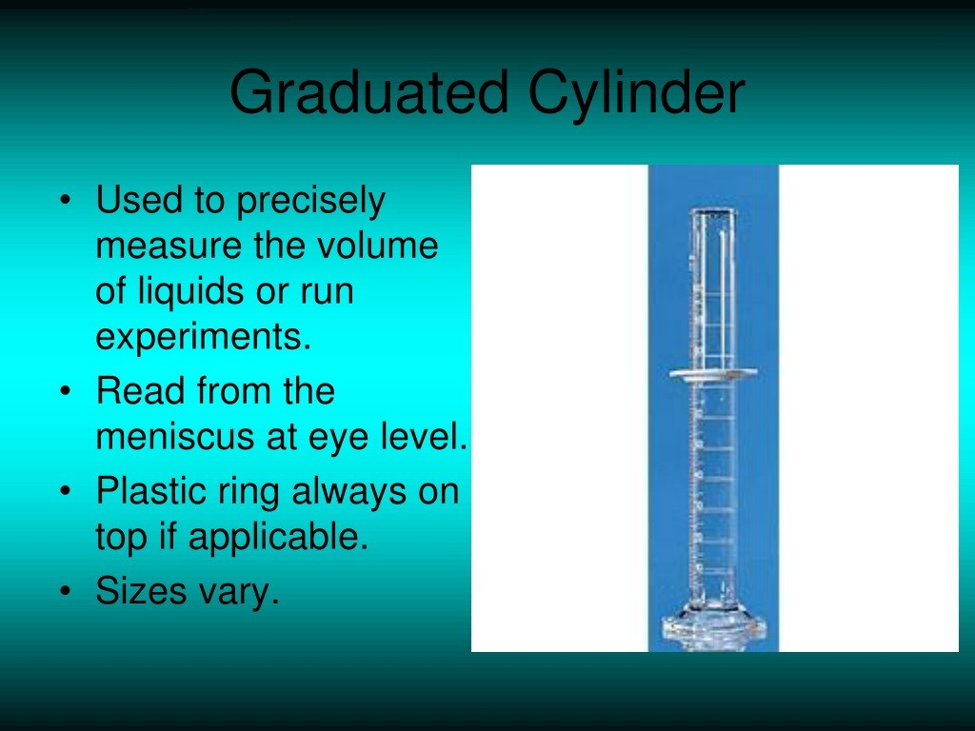

Slide 5
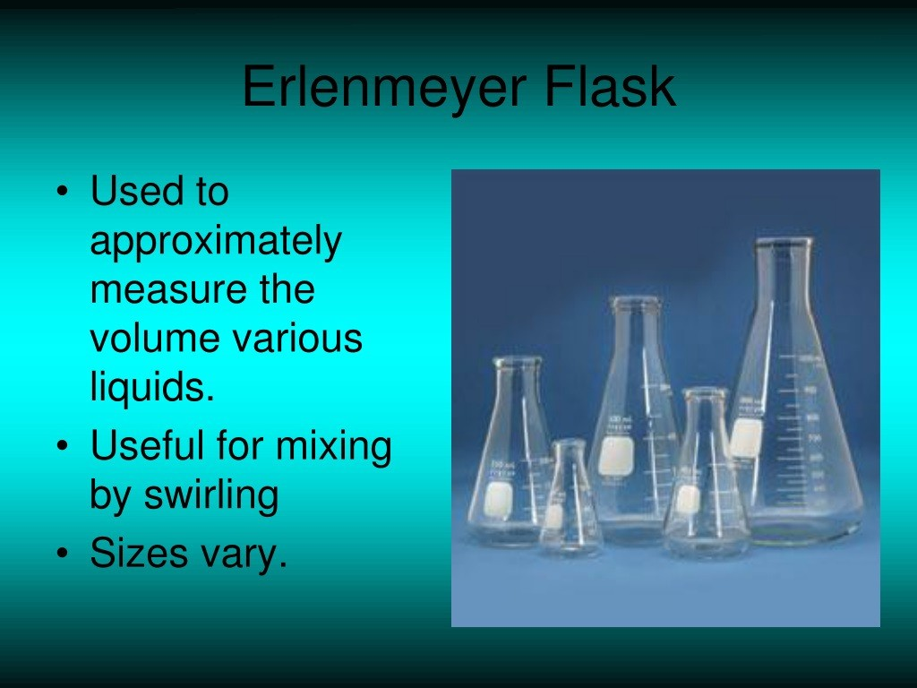

Slide 6
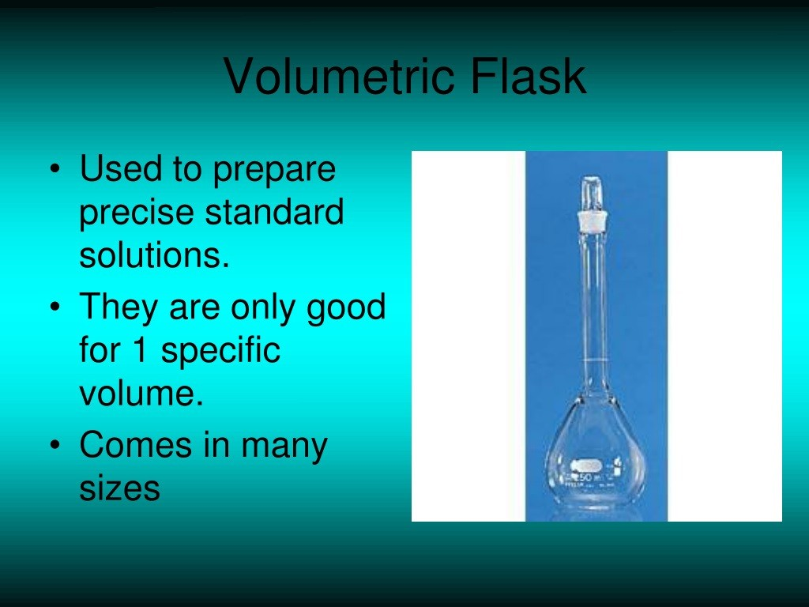

Slide 7
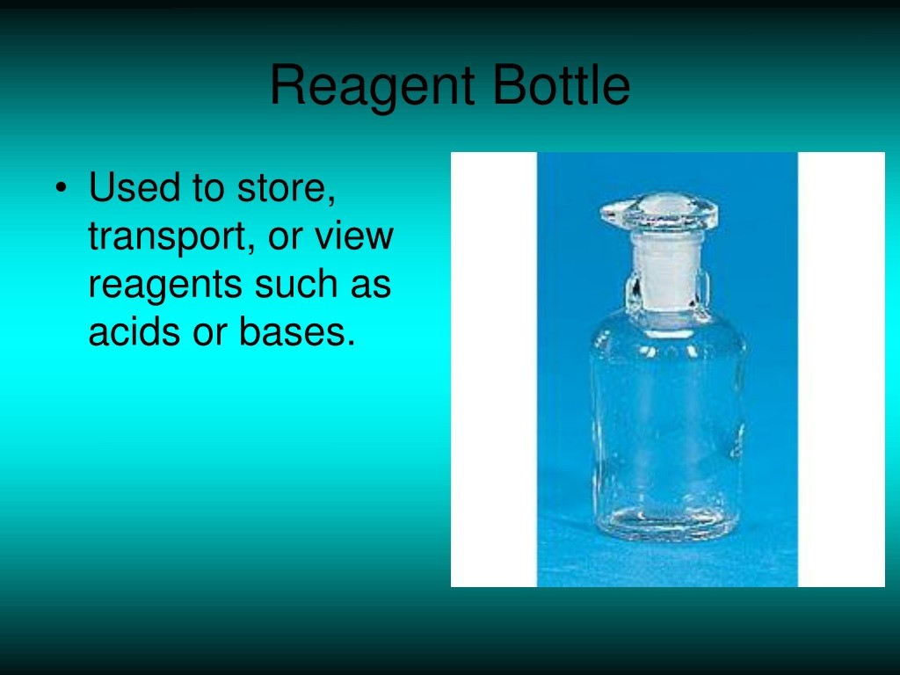

Slide 8
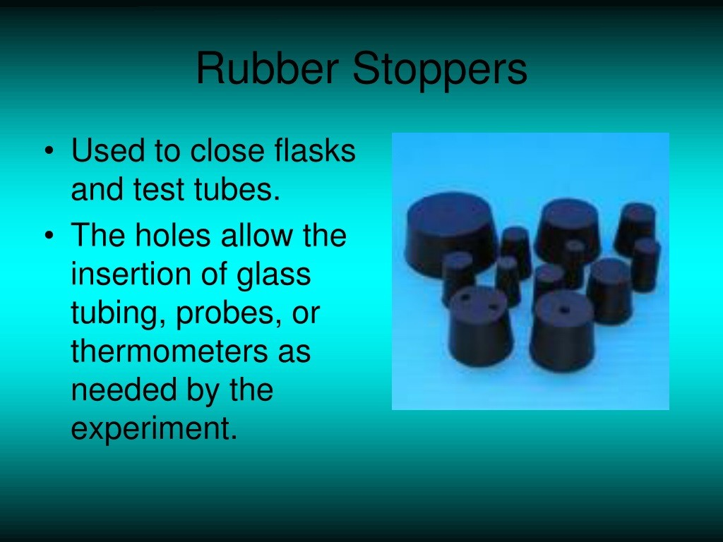

Slide 9
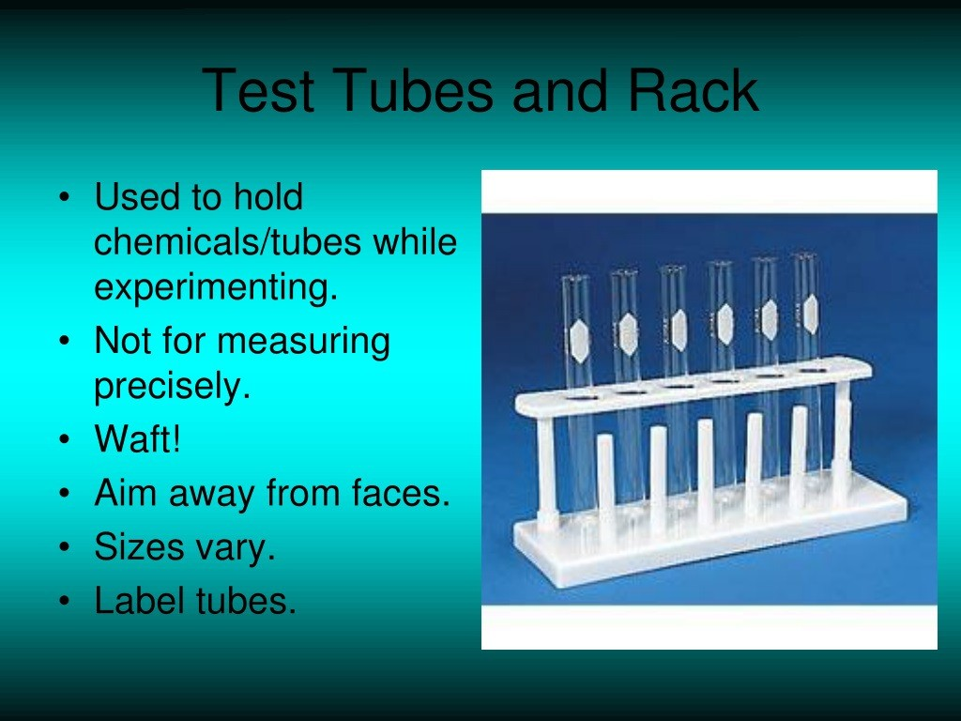

Slide 10
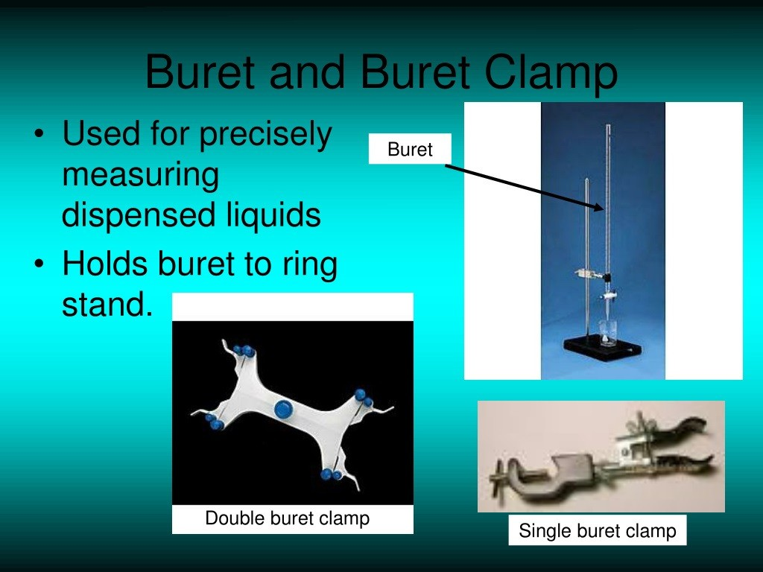

Slide 11
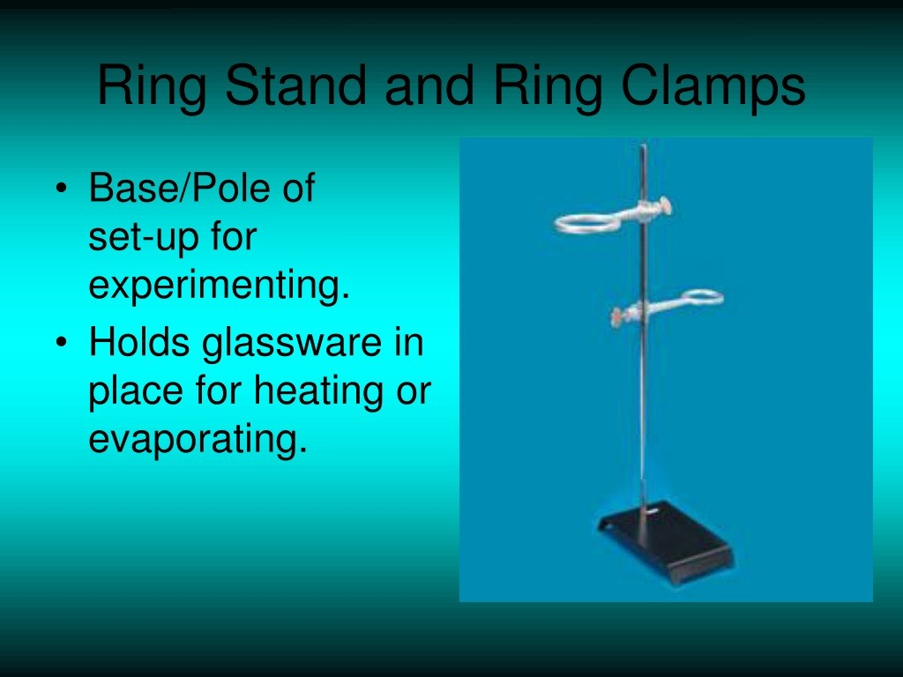

Slide 12
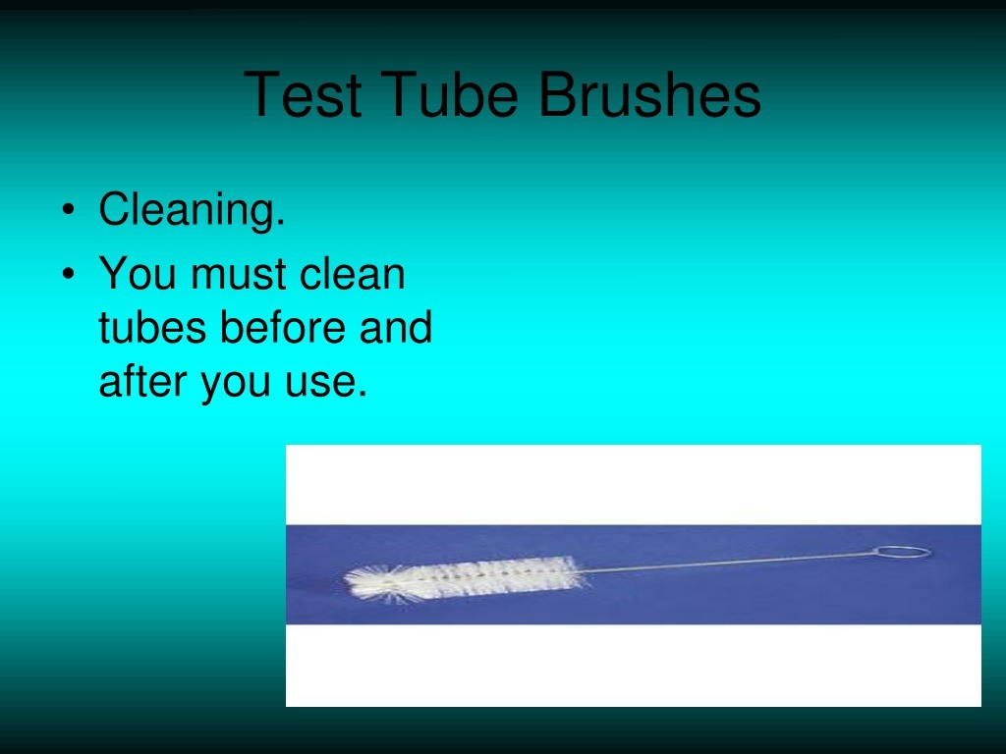

Slide 13
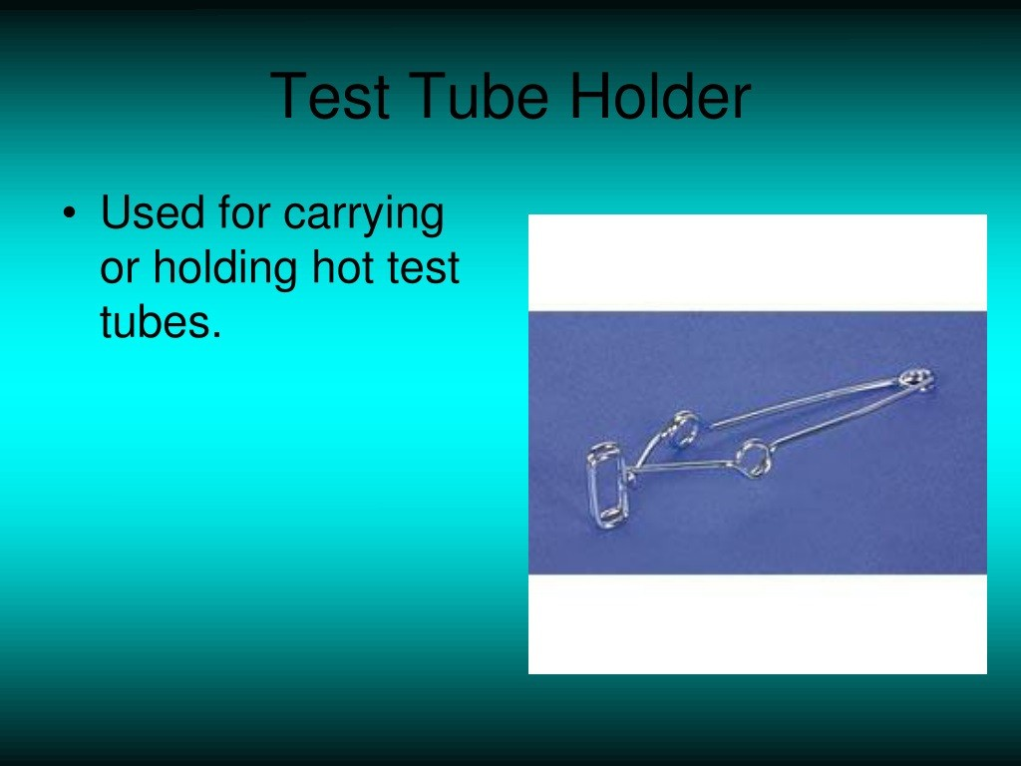

Slide 14


