Slide 1


Al-Mustaqbal University
Department/ Optical techniques
Medical glasses
3rd stage
By
Dr. Marrwan Hisham Mohammed
2024/02/05

Slide 2
Groups of materials for single vision lenses
For single vision lenses, materials like CR-39 (plastic), polycarbonate, and high-index plastics are common choices. These materials offer different levels of thickness, weight, and impact resistance.

Slide 3
Significance of Lens Materials in Optometry
Lens materials play a crucial role in optometry by influencing:
1. Optical performance:
  Refractive index: Determines the lens thickness and curvature needed to correct refractive errors
  Dispersion: Affects the way light bends at different wavelengths, potentially causing chromatic aberration.
  Abbe value: Indicates the degree of chromatic aberration. Higher Abbe values represent better color fidelity.

Slide 4
Significance of Lens Materials in Optometry
2. Physical properties:
  Weight: Plastic lenses are significantly lighter than glass, making them more comfortable for everyday wear.
  Impact resistance: Polycarbonate and Trivex are exceptionally strong and shatterproof, ideal for children and active individuals.
  Scratch resistance: Hard coatings enhance durability and maintain lens clarity over time.
  UV protection: Most materials offer built-in UV protection for eye health.
  Hydrophobicity: Water-repellent coatings prevent smudges and facilitate lens cleaning.

Slide 5
Significance of Lens Materials in Optometry
3. Special functionalities:
  Photochromic: Transitions automatically between clear and dark depending on light conditions for added comfort and sun protection.
  Polarized: Blocks horizontal glare for enhanced visual clarity and reduced eye strain, especially outdoors.
  Blue light filtering: Helps reduce eye fatigue and digital eye strain caused by prolonged exposure to blue light emitted from digital screens

Slide 6
Significance of Lens Materials in Optometry
4. Patient considerations:
  Lifestyle: Active individuals might require impact-resistant lenses, while those working extensively on screens might benefit from blue light filtering.
  Age: Children and teenagers require shatterproof options for safety, while older adults might prioritize lightweight lenses for comfort.
  Occupational needs: Specific professions might require specialized lenses, such as bifocals for close-up work.

Slide 7
Types of Single Vision Lens Materials
Plastic (CR-39)
Polycarbonate
Trivex
High-index (1.60, 1.67, 1.74
MR-8
Glass

Slide 8
Types of Single Vision Lens Materials
Plastic (CR-39):
is a type of plastic polymer commonly used in the manufacture of eyeglass lenses. It is also known as Columbia Resin #39, after the project that developed it in 1940.
However, CR-39 lenses can be thicker than lenses made from other materials, such as polycarbonate or Trivex, especially for high prescriptions.
CR-39 lenses are a good choice for people with low to moderate prescriptions who are looking for a cost-effective and durable option. They are also a good choice for people who are sensitive to the weight of their glasses.

Slide 9
Types of Single Vision Lens Materials
Polycarbonate:
Polycarbonate is a synthetic thermoplastic polymer widely used in various applications, including eyeglass lenses.
It is known for its excellent combination of properties, making it a popular choice for both everyday and specialized eyewear.
Properties of Polycarbonate:
Impact resistance: Polycarbonate is incredibly strong and shatterproof, making it ideal for active individuals and children. It's 10 times more resistant to impact than CR-39 plastic and 250 times more resistant than glass.
Lightweight: Polycarbonate lenses are significantly lighter than glass lenses, offering improved comfort and wearability.

Slide 10
Types of Single Vision Lens Materials
Polycarbonate:
Optical clarity: While not as clear as glass, polycarbonate offers good optical quality, making it suitable for most vision needs.
UV protection: Polycarbonate naturally blocks 100% of harmful UV rays, protecting your eyes from the sun's damaging effects.
Scratch resistance: Polycarbonate is naturally scratch-resistant, although scratches can become more noticeable over time. Applying a scratch-resistant coating can further enhance durability.
Affordability: Compared to other high-performance lens materials like Trivex or high-index plastic, polycarbonate is relatively affordable

Slide 11
Types of Single Vision Lens Materials
Trivex:
is a unique and innovative lens material developed specifically for ophthalmic applications. It offers a remarkable balance of essential properties, making it a popular choice for individuals seeking high performance, comfort, and durability in their eyewear.
Properties of Trivex:
Exceptional impact resistance: While not as shatterproof as polycarbonate, Trivex surpasses most other plastic materials in terms of impact resistance.
Lightweight: Trivex is even lighter than polycarbonate, making it ideal for comfortable all-day wear.

Slide 12
Types of Single Vision Lens Materials
Trivex:
Superior optical clarity: Trivex boasts excellent optical clarity, exceeding both polycarbonate and high-index plastic in this aspect.
High Abbe value: Trivex has a high Abbe value, resulting in minimal chromatic aberration and sharper, truer-to-life vision.
UV protection: Trivex naturally blocks 100% of harmful UV rays, safeguarding your eyes from the sun's damaging effects.
Scratch resistance: Trivex is inherently scratch-resistant, withstanding daily wear and tear without easily showing scratches.
Chemical resistance: Trivex is resistant to various chemicals, making it suitable for use in environments with chemical exposur

Slide 13
Types of Single Vision Lens Materials
High-index (1.60, 1.67, 1.74):
are a popular choice for individuals with strong prescriptions who want thinner and lighter glasses.
They are made from materials with a higher refractive index than standard plastic, which means they can bend light more effectively, resulting in thinner lenses with the same corrective power.
There are three main types of high-index lenses:
1.60 index: This is the most affordable high-index option, offering a good balance between thinness and cost. It is suitable for prescriptions up to approximately -4.00 or +4.00.
1.67 index: This is a popular choice for stronger prescriptions, offering a significant reduction in lens thickness compared to standard plastic. It is suitable for prescriptions up to approximately -6.00 or +6.00.
1.74 index: This is the thinnest and lightest high-index option, ideal for very strong prescriptions. It is suitable for prescriptions exceeding -6.00 or +6.00

Slide 14
Types of Single Vision Lens Materials
High-index (1.60, 1.67, 1.74):
Benefits of High-Index Lenses:
Improved aesthetics: Thinner lenses are more aesthetically pleasing and less noticeable than thicker lenses.
Increased comfort: Thin and lightweight lenses are more comfortable to wear for extended periods, reducing pressure on the nose and ears.
Wider field of view: Thinner lenses offer a wider field of view, especially beneficial for individuals with strong prescriptions.
Reduced risk of lens damage: Thinner lenses are less likely to be damaged from accidental drops or bumps.
Improved compatibility with rimless frames: Thinner lenses are better suited for rimless frames, providing a clean and stylish look.

Slide 15
Types of Single Vision Lens Materials
MR-8: High Abbe value high refractive index lens material developed by Mitsui Chemicals. MR-8 has an Abbe value of 42, which is significantly higher than most other high index materials. This means that MR-8 lenses produce less chromatic aberration, resulting in sharper and more comfortable vision.
some of the benefits of MR-8 lenses:
  Superior color fidelity and image clarity
  Thinner and lighter lenses for high prescriptions
  Improved aesthetics and wider field of view
  Excellent impact resistance and scratch resistance
  100% UV protection

Slide 16
Types of Single Vision Lens Materials
Glass materials are diverse and offer a wide range of properties for various applications, including in the realm of optometry.
Properties of Glass Materials:
Transparency: Glass is known for its excellent transparency, allowing light to pass through with minimal distortion. This property is crucial for lens applications, enabling clear vision.
Chemical inertness: Glass is highly resistant to chemical reactions, making it durable and safe for use in contact with the eyes.
Scratch resistance: Glass is naturally scratch-resistant, providing better durability compared to some plastic lens materials.
High refractive index: Glass has a higher refractive index than most plastic materials, meaning thinner lenses can be made for the same corrective power.
Excellent optical clarity: Glass provides superior optical clarity with minimal chromatic aberration, resulting in sharper and truer-to-life vision.
Weight: Glass is heavier than most plastic materials, making glasses made with it slightly heavier to wear.
Brittleness: Glass is brittle and prone to breakage, requiring careful handling and maintenance.

Slide 17
Types of Single Vision Lens Materials
Glass materials
Types of Glass Materials:
Crown glass: This is the most common type of glass used for lenses. It is known for its good optical clarity and low dispersion.
Flint glass: This type of glass has a higher refractive index than crown glass, allowing for thinner lenses. However, it also has higher dispersion, which can lead to chromatic aberration.
High-index glass: This type of glass has a very high refractive index, allowing for even thinner and lighter lenses compared to crown and flint glass.
Photochromic glass: This type of glass automatically darkens in sunlight and lightens indoors, providing convenient sun protection without needing separate sunglasses.

Slide 18
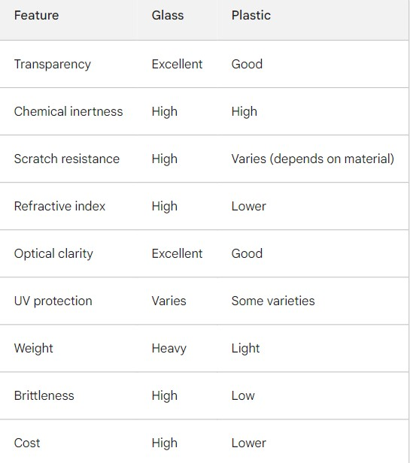

Slide 19


