Slide 1
Lecture# 4
semester# 1
Basic and Advanced Life Support
(BLS and ALS)
:by
lecturer
M.Sc.N: Ali J. Mohammed
Al-Mustaqbal University
College of Nursing
2th Class
The Clinical Part of Critical Care Nursing

Slide 2
Cardiac Arrest
Cardiac arrest describes the sudden and complete loss of cardiac output due to asystole, ventricular tachycardia or fibrillation, or loss of mechanical cardiac contraction (pulseless electrical activity).

Slide 3
The Reversible Causes of Cardiac Arrest:
The 6 H's and 4 T's Reversible Causes of Cardiac Arrest.
H's:
Hypoxia – Lack of oxygen (e.g., airway obstruction, respiratory failure).
Hypovolemia – Low blood volume (e.g., hemorrhage, dehydration).
Hydrogen ion (Acidosis) – High acidity in the blood (e.g., diabetic ketoacidosis, lactic acidosis).
Hypothermia – Low body temperature.
Hypokalemia – Low potassium levels.
Hyperkalemia – High potassium levels.
T's:
Tension Pneumothorax – Air trapped in the chest cavity compressing the heart.
Tamponade – Fluid around the heart (cardiac tamponade) restricting heart function.
Toxins – Drug overdose or poisoning (e.g., opioids, cyanide).
Thrombosis – Blood clots (e.g., pulmonary embolism, myocardial infarction).
These conditions can often be treated to restore heart function during cardiac arrest.

Slide 4
Clinical Signs of Cardiac Arrest
1- Unresponsiveness:
The patient is unresponsive to verbal commands, shaking, or any form of stimulation.
No purposeful movement or reaction to external stimuli.
2- Absence of Normal Breathing:
Agonal gasping or no respiratory effort.
Normal breathing ceases within seconds to minutes after cardiac arrest onset.
3- Absence of a Detectable Pulse:
No palpable pulse at major arteries (e.g., carotid or femoral artery).
Pulse checks should not exceed 10 seconds during assessment.

Slide 5
Clinical Signs of Cardiac Arrest
4- Loss of Circulatory Function:
Signs include cyanosis (bluish discoloration of skin, lips, or nail beds) and pallor.
Rapid decline in oxygen delivery to tissues.
5- Cardiac Arrest Rhythms on ECG:
Ventricular Fibrillation (VF): Chaotic, irregular electrical activity.
Pulseless Ventricular Tachycardia (pVT): Rapid, organized rhythm without pulse.
Asystole: Flatline, indicating no electrical activity.
Pulseless Electrical Activity (PEA): Organized electrical rhythm without mechanical heart activity or pulse.

Slide 6
The main difference between BLS (Basic Life Support) and ACLS (Advanced Cardiovascular Life Support)
BLS (Basic Life Support):
  Focuses on providing immediate, essential life-saving interventions in emergency situations.
  Includes CPR (Cardiopulmonary Resuscitation), the use of automated external defibrillators (AED), and performing basic airway management.
  Can be performed by laypersons, first responders, and healthcare providers.
ACLS (Advanced Cardiovascular Life Support):
  Involves more advanced techniques and interventions for patients experiencing cardiac arrest, strokes, or other life-threatening cardiovascular emergencies.
  Includes all BLS skills plus advanced airway management, medications (like epinephrine, amiodarone), and advanced defibrillation techniques.
  Requires more extensive medical knowledge and training, typically provided to healthcare professionals.

Slide 7
CPR Steps for Adults (Summary):
Check for Pulse: Feel for the carotid pulse on the side of the neck for no more than 10 seconds. If unsure, begin CPR with 30 chest compressions and 2 breaths.
Chest Compressions:
  Place the heel of one hand on the lower half of the sternum.
  Place the other hand on top of the first and press down with straight arms.
  Compress the chest 2 to 2.4 inches (5-6 cm) deep at a rate of 100-120 compressions per minute.
  Allow the chest to fully recoil between compressions.
Airway Opening: After 30 compressions, tilt the head back and lift the chin to open the airway. If a neck injury is suspected, use the jaw-thrust maneuver instead.
Rescue Breaths: Give 2 breaths over 1 second each, watching for the chest to rise.
Resume Compressions: Quickly alternate between chest compressions and rescue breaths, minimizing interruptions.

Slide 8
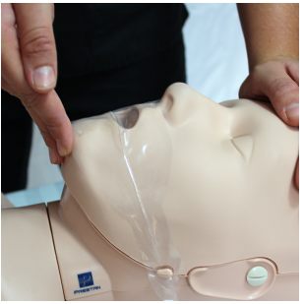
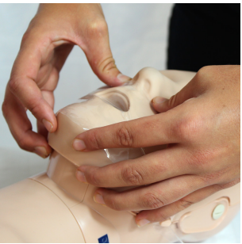
Tilt The Head Back and Lift The Chin to Open The Airway
Jaw-thrust Maneuver

Slide 9
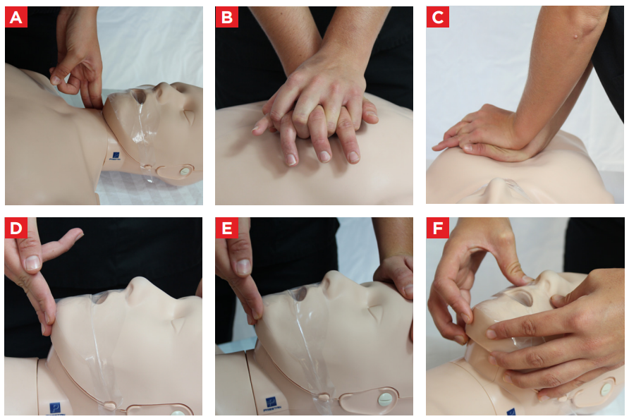

Slide 10
Key Aspects of Airway Management in ACLS:
Ensure Airway Patency: The first step is to open the airway. This can be done using the head-tilt, chin-lift or jaw-thrust maneuver, depending on the patient's condition.
Oxygenation and Ventilation:
  Rescue Breaths: Provide effective mouth-to-mouth or mouth-to-barrier device breaths for a non-breathing patient.
  For patients in cardiac arrest, perform high-quality chest compressions along with ventilations (if appropriate, 30:2 compression-to-ventilation ratio for adults).
Advanced Airway Techniques: If the airway is not patent or ventilations are ineffective, advanced techniques are used:
    Endotracheal Intubation (ETT): Insertion of a tube into the trachea to secure the airway.
    Supraglottic Airway Devices (e.g., LMA): Used as alternatives to endotracheal intubation, especially if intubation is difficult or unsuccessful.

Slide 11
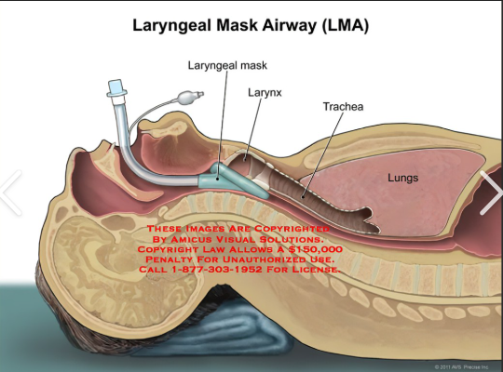
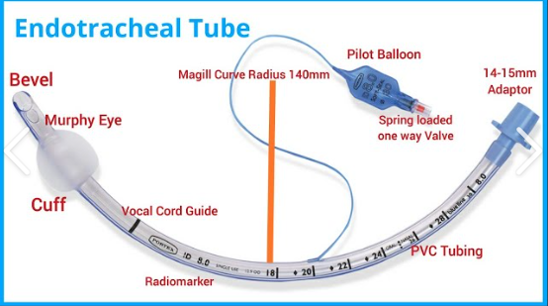

Slide 12


Cardiac Arrest Rhythm
Shockable Rhythms:
Ventricular Fibrillation (VF) and Pulseless Ventricular Tachycardia (VT).
These are treated with an electrical shock to reset the heart's electrical activity.
VF
PVT

Slide 13

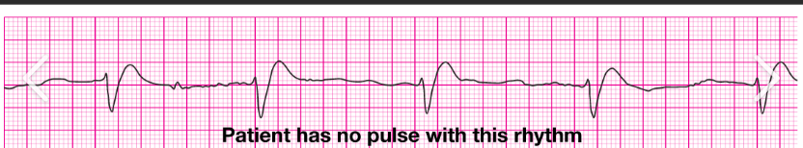
Cardiac Arrest Rhythm
Non-Shockable Rhythms:
Asystole (flatline) and Pulseless Electrical Activity (PEA).
These do not respond to shocks. Treatment focuses on CPR, medications (like epinephrine), and improving circulation.
Asystole
PEV

Slide 14
overview of the most commonly used medications during ACLS
Epinephrine:
  Use: Administered during cardiac arrest (for both shockable and non-shockable rhythms) to increase heart rate, improve blood pressure, and enhance coronary and cerebral blood flow.
  Dosage: 1 mg IV/IO every 3-5 minutes during resuscitation.
Amiodarone:
  Use: Used for ventricular fibrillation (VF) or pulseless ventricular tachycardia (VT) unresponsive to defibrillation.
  Dosage: 300 mg IV push for the first dose, followed by 150 mg if needed.
Lidocaine:
  Use: An alternative to amiodarone for VF and pulseless VT.
  Dosage: 1-1.5 mg/kg IV push, may repeat at 0.5-0.75 mg/kg every 5-10 minutes if needed.
Atropine:
  Use: Administered for bradycardia (slow heart rate) to increase the heart rate.
  Dosage: 1 mg IV push every 3-5 minutes (max 3 mg).
Bicarbonate:
  Use: Used in cases of severe acidosis, prolonged arrest, or specific poisoning (e.g., tricyclic antidepressant overdose).
  Dosage: 1 mEq/kg IV, may repeat depending on response.

