Slide 1
Medical Psychology for Nursing
Behaviors

Slide 2
Objectives
At the end of this lecture, students will identify:
Health behaviors.
Types of health behaviors.

Slide 3
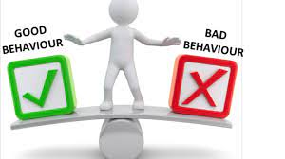
Behavior:
It is the actions or reactions of a person or animal in response to external or internal stimuli.

Slide 4
Characteristics of normal behavior
A perception of realty
Positive attitude towards one’s self-acceptance of weakness and pride in strengths.
Capacity for with standing anxiety and stress
Adequate in work and play.
Willingness to use problem solving approaches in live process..
Characteristics of abnormal behavior
Change in persons thinking process, perception and judgment.
work efficiency well be reduced
forgetfulness
unhappiness
unable to cope
lack of self confidence
Feeling of stress and anxiety

Slide 5
Health behaviours:
Are defined as any activity undertaken for the purpose of preventing or detecting disease or for improving health and well-being. In addition, health behaviours defined as behaviour patterns, actions and habits that relate to health maintenance, to health restoration and to health improvement. Such behaviours include exercise, fruit and vegetable consumption, and condom use in response to the threat of sexually transmitted diseases.

Slide 6
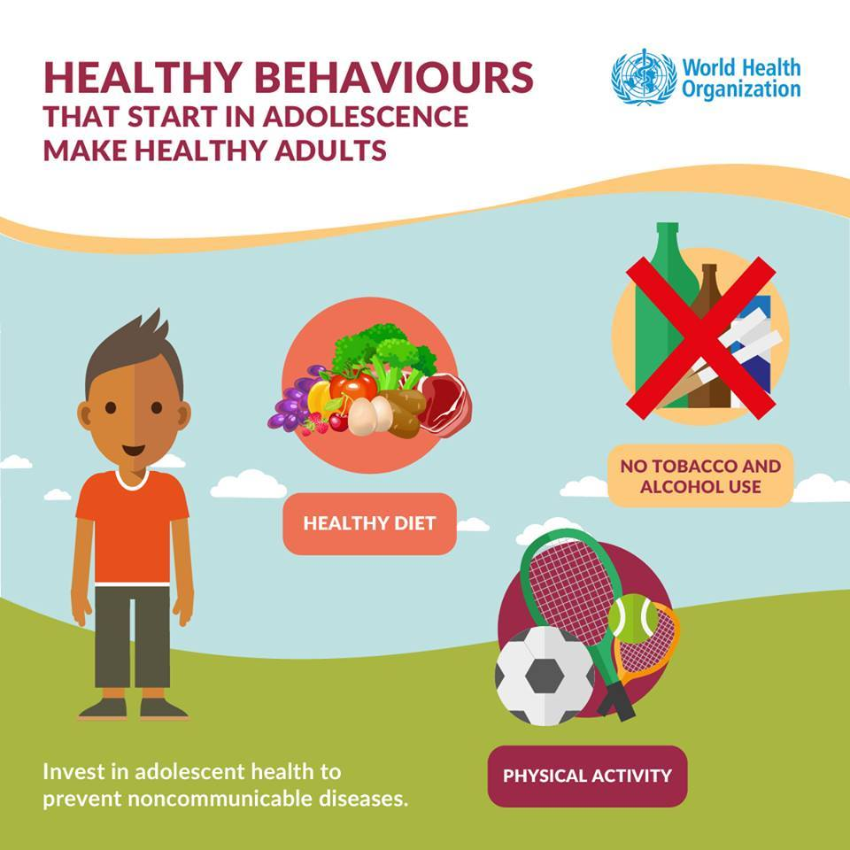

Slide 7
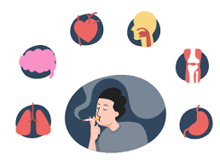
Health impairing behaviours:
are the behaviors that have harmful effects on health or otherwise predispose individuals to disease. Such behaviors include smoking, excessive alcohol consumption, and high dietary fat consumption

Slide 8
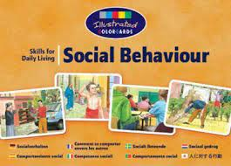
Social behaviour:
Behavior can be social in nature (for the good of the community) or anti-social in nature (unacceptable to the community), as in the manner of
conducting oneself according to social norms (or not).

Slide 9
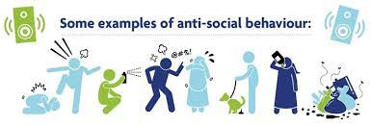
Anti-social behaviour
Anti-social behavior is behavior that is unacceptable to other people (the community), behavior that violates another person‘s right. Such behavior violates the rights of others and may therefore be defined as violence.

Slide 10
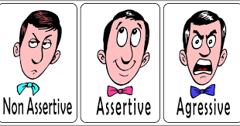
Non-Assertive Behavior
is that type of interpersonal behavior, which enables the person‘s rights to be violated by another. A non-assertive person inhibits her/his honest,
spontaneous reactions and typically feels hurt, anxious and sometimes angry as a result of being non-assertive in a situation.

Slide 11
Assertive Behavior
is that type of interpersonal behavior in which a person stands up for their legitimate rights in such a way that the rights of others are not violated. It communicates respect for that person‘s behavior. Assertive behavior is an honest, direct and appropriate expression of one‘s feelings, beliefs, and
opinions.

Slide 12
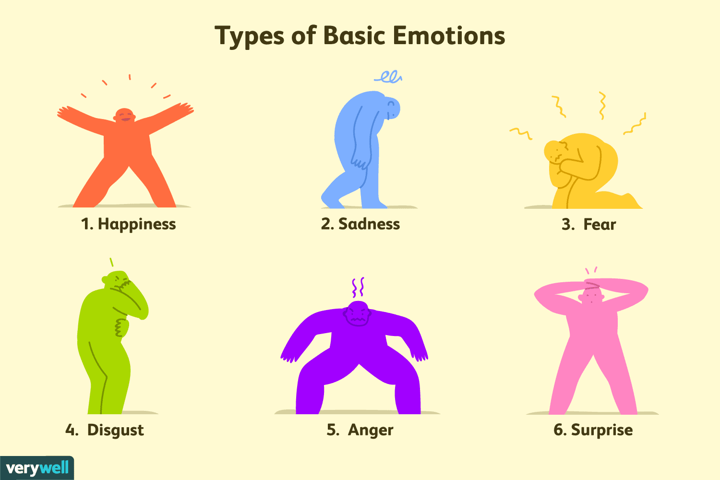
Emotional behavior
There are situations where a person or animal may respond emotionally with anger, fear, joy, excitement. Love and hate are emotions, but they do not seem to be distinct reactions, as are with the other
emotions. The way a person or animal emotionally responds or reacts to a stimulus determines his or her emotional behavior.

Slide 13

Uncontrolled behavior:
There are situations where a person or animal may respond in a manner that is uncontrolled.
Often this is related to emotional behavior, but it also may be due to addictions of some sort. For example, while everyone may get angry, there are some who easily lose their temper and even go into an uncontrolled rage.

Slide 14
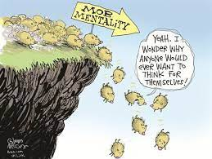
Group behavior
There are situations where a group of people or animals act as an entity itself or may result in anti-social or uncontrolled behavior by the individuals in the group. Sometimes this is called the "mob mentality."

Slide 15
Several types of health behaviors:
1. Smoking: is the health behavior most closely linked with long-term negative health outcomes.
2. Diet: The impact of diet upon morbidity and mortality are well established. Diet has been implicated in cardiovascular diseases (CVDs), strokes and high blood pressure, cancer, diabetes, obesity, osteoporosis, and dental disease.
3. Exercise: The potential health benefits of engaging in regular exercise include reduced cardiovascular morbidity and mortality, lowered blood pressure, and the increased metabolism of carbohydrates and fats, as well
as a range of psychological benefits such as improved self-esteem, positive mood states, reduced life stress and anxiety

Slide 16
Several types of health behaviours:
4. Health Screening: Individuals may seek to protect their health by participating in various screening programs which attempt to detect disease at an early, or asymptomatic, stage.
5. Alcohol Use: Moderate alcohol consumption has been linked to positive health outcomes. However, high alcohol consumption has been linked to a range of negative health outcomes including high blood pressure, heart disease and cirrhosis of the liver. High levels of alcohol consumption have also been associated with accidents, injuries, suicides, crime, domestic violence, rape, murder and unsafe sex.

Slide 17


