Slide 1
DVT

Slide 2
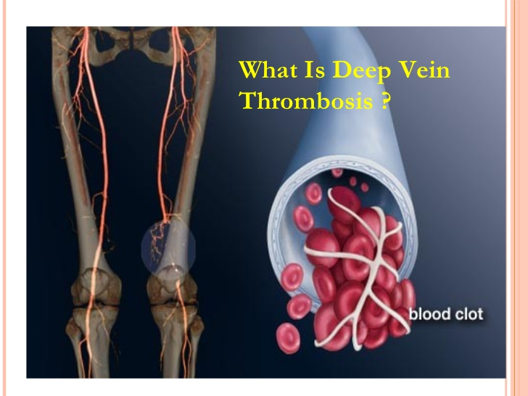
Deep Vein thrombosis

Slide 3
DVT
Deep vein thrombosis, or deep venous thrombosis (DVT), is the formation of a blood clot (thrombus) in one of the deep vein, of the body usually in the legs

Slide 4
Causes
Deep vein thrombosis occurs when a blood clot forms in the veins that are deep in your body, often in your legs. Blood clots can be caused by anything that prevents your blood from circulating normally or clotting properly.

Slide 5
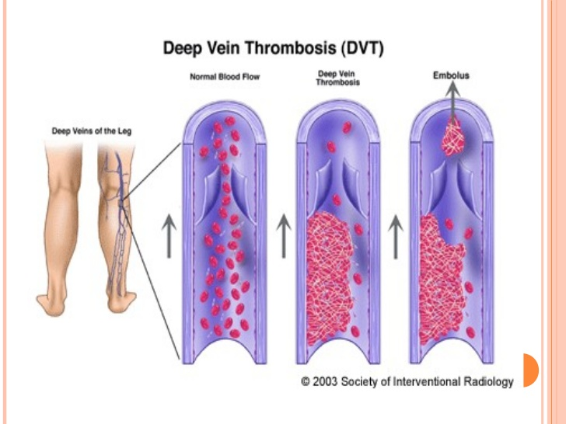

Slide 6
Risk Factors for DVT
Inheriting a blood-clotting disorder. Some people inherit a disorder that makes their blood clot more easily. This inherited condition may not cause problems unless combined with one or more other risk factors
Prolonged bed rest, such as during a long hospital stay, or paralysis. When your legs remain still for long periods, your calf muscles don't contract to help blood circulate, which can increase the risk of blood clots
Injury or surgery. Injury to your veins or surgery can increase the risk of blood clots
Notes:
‹#›

Slide 7
Risk Factors for DVT
Pregnancy. Pregnancy increases the pressure in the veins in your pelvis and legs. Women with an inherited clotting disorder are especially at risk. The risk of blood clots from pregnancy can continue for up to six weeks after you have your baby
Birth control pills or hormone replacement therapy. Birth control pills (oral contraceptives) and hormone replacement therapy both can increase your blood's ability to clot.
Being overweight or obese. Being overweight increases the pressure in the veins in your pelvis and legs
Notes:
‹#›

Slide 8
Risk Factors for DVT
Smoking. Smoking affects blood clotting and circulation, which can increase your risk of DVT.
Cancer. Some forms of cancer increase the amount of substances in your blood that cause your blood to clot. Some forms of cancer treatment also increase the risk of blood clots.
Heart failure. People with heart failure have a greater risk of DVT and pulmonary embolism. Because people with heart failure already have limited heart and lung function

Slide 9
Risk Factors for DVT
A personal or family history of deep vein thrombosis or pulmonary embolism (PE). If you or someone in your family has had DVT or PE before, you're more likely to develop DVT.
Age. Being over age 60 increases your risk of DVT, though it can occur at any age.
Sitting for long periods of time, such as when driving or flying. When your legs remain still for many hours

Slide 10
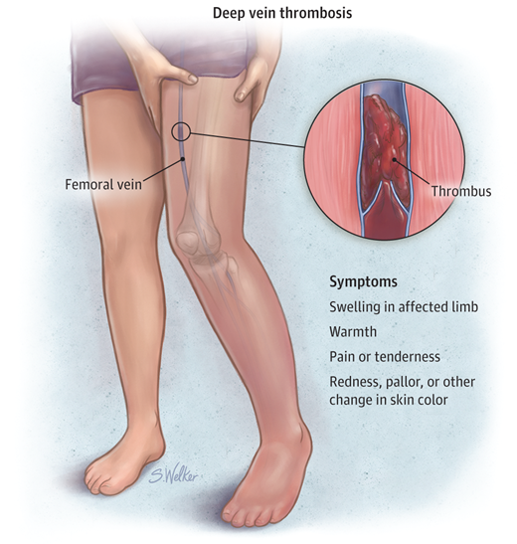
Signs and Symptoms of DVT
• Sudden swelling of one limb
• Pain or tenderness
• Skin that is warm to the touch
• Fullness of the veins just beneath the skin
• Change in color (blue, red or very pale)

Slide 11
Diagnosis
Ultrasound. This is the most common test for diagnosing deep vein blood clots. Ultrasound uses sound waves to create pictures of blood flowing through the arteries and veins in the affected leg.
A D-dimer test. This test measures a substance in the blood that’s released when a blood clot dissolves. If the test shows high levels of the substance, you may have a deep vein blood clot. If your test is normal and you have few risk factors, DVT isn’t likely.
Venography. This test is used if ultrasound doesn’t provide a clear diagnosis. Dye is injected into a vein, and then an x ray is taken of the leg.
Other less common tests used to diagnose DVT include magnetic resonance imaging (MRI) and computed tomography (CT) scanning. These tests provide pictures of your organs and tissues .

Slide 12
Treatment
anticoagulant medicines
Heparin and warfarin are two types of anticoagulant often used to treat DVT. Heparin is usually prescribed first because it works immediately to prevent further clotting. After initial treatment, you may also need to take warfarin to prevent another blood clot forming.

Slide 13
Nursing Intervention for Deep Vein Thrombosis
Assess for and reports sign and symptoms of Deep Vein Thrombosis.
Keep the affected leg elevated and comfortable position
Administer anticoagulants as ordered to reduce the risk of additional clotting.
Administer analgesics (Morphine) as ordered to manage pain

Slide 14
Nursing Intervention for Deep Vein Thrombosis
Check and monitor any sign of bleeding.
Check any sign of complication (Pulmonary embolism)
Advise the patient to take care when brushing teeth in order to reduce risk of bleeding gums.
Ensure intake of vitamin-k rich food including green, leafy vegetable

Slide 15
Preventing DVT
Take any prescribed medications as directed.
Avoid sitting still.
Make lifestyle changes. Lose weight and quit smoking. Obesity and smoking increase your risk of deep vein thrombosis.
Get regular exercise. Exercise lowers your risk of blood clots, which is especially important for people who have to sit a lot or travel frequently

Slide 16
PATIENT EDUCATION
Take the anticoagulant medication at the same time each day.
Keep all appointments for blood tests
Because other medications affect the action of the anticoagulant medication do not take any of the following medications or supplements without consulting with the primary health care provider: vitamins, cold medicines, antibiotics, aspirin,mineral oil, and anti-inflammatory agents, such as ibuprofen (Motrin) and nutritional supplements.The primary health care provider should becontacted before taking any over-the-counter drugs

Slide 17
PATIENT EDUCATION
Avoid alcohol, because it may change the body’s response to an anticoagulant medication.
Avoid food fads, crash diets, or marked changes in eating habits.
Avoid injury that can cause bleeding
If any of the following signs appear, report them immediately to the primary health care provider:Faintness, dizziness, or increased weakness Severe headaches or abdominal pain Reddish or brownish urine

Slide 18


