Slide 1
Lecture# 4
semester# 1
Basics of ECG Interpretation
:by
lecturer
M.Sc.N: Ali J. Mohammed
Al-Mustaqbal University
College of Nursing
4th Class
The Clinical Part of Critical Care Nursing

Slide 2
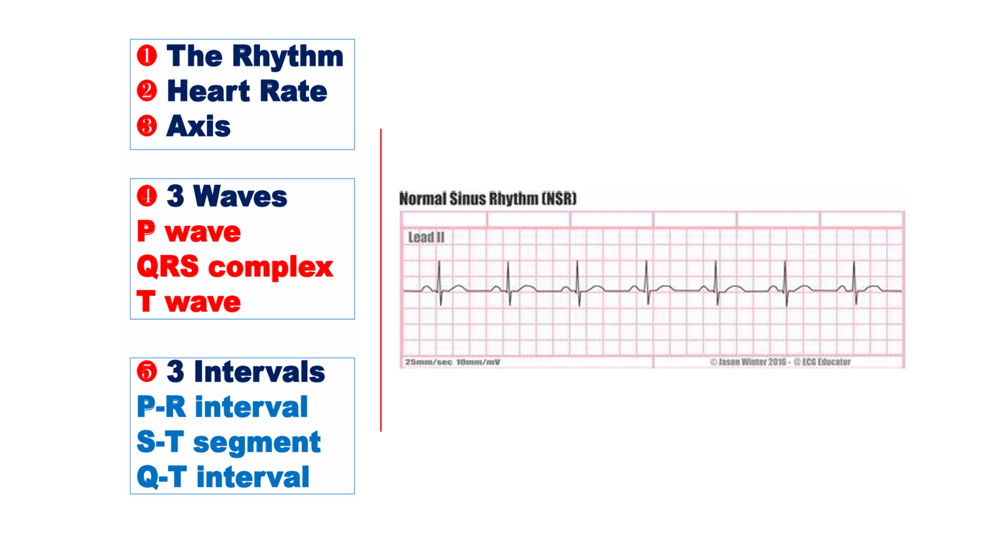

Slide 3


Slide 4
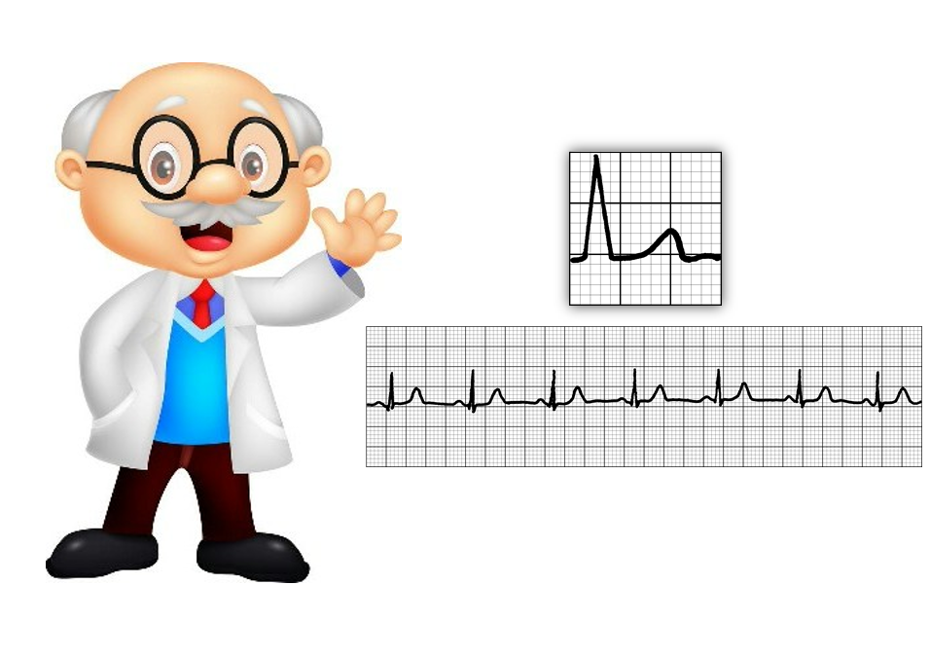
Overview of the ST Segment
The ST segment in an electrocardiogram (ECG) represents the period between ventricular depolarization (end of the QRS complex) and repolarization (start of the T wave).

Slide 5
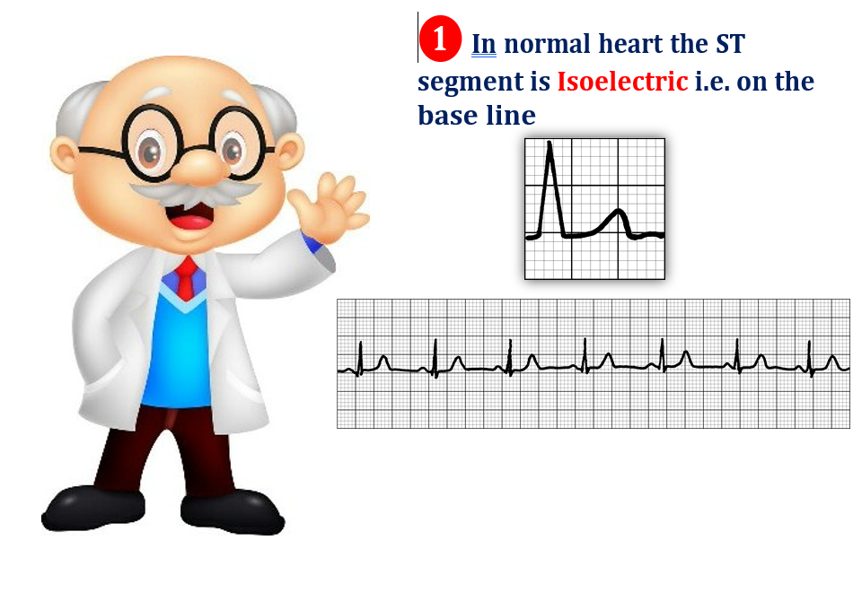

Slide 6
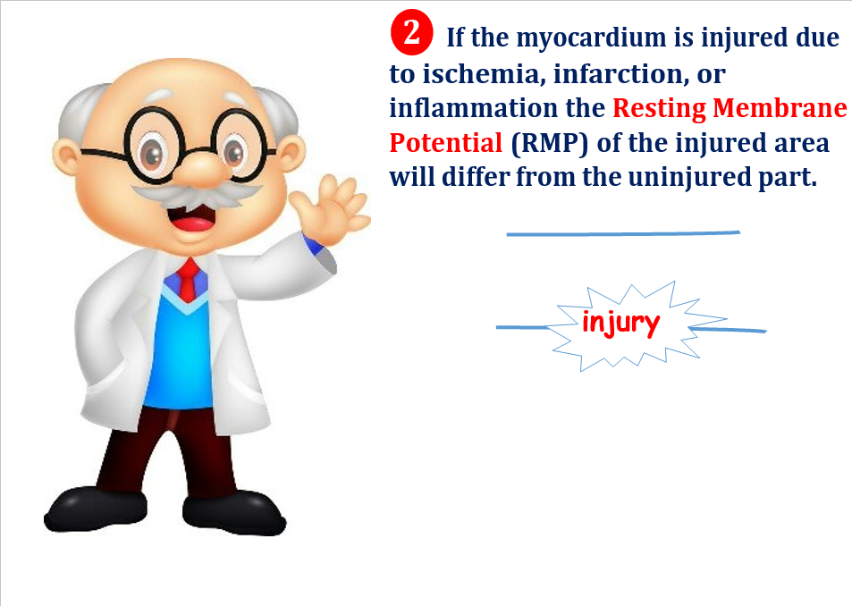

Slide 7
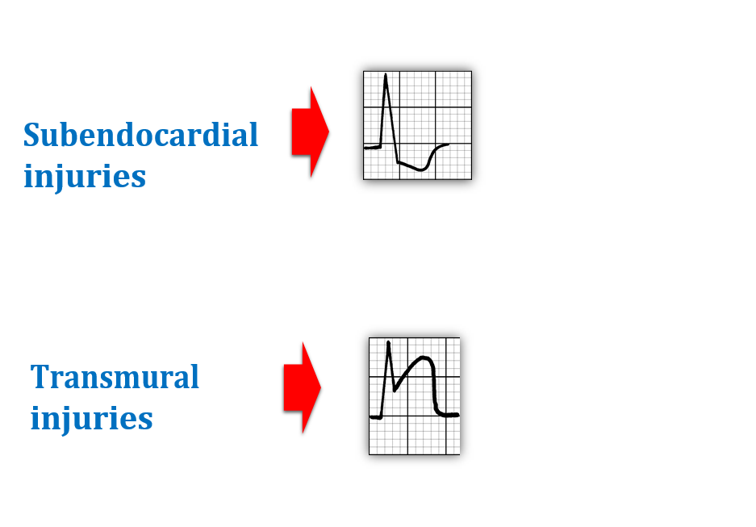
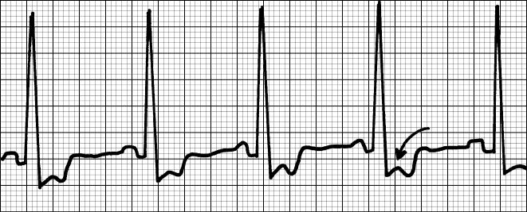
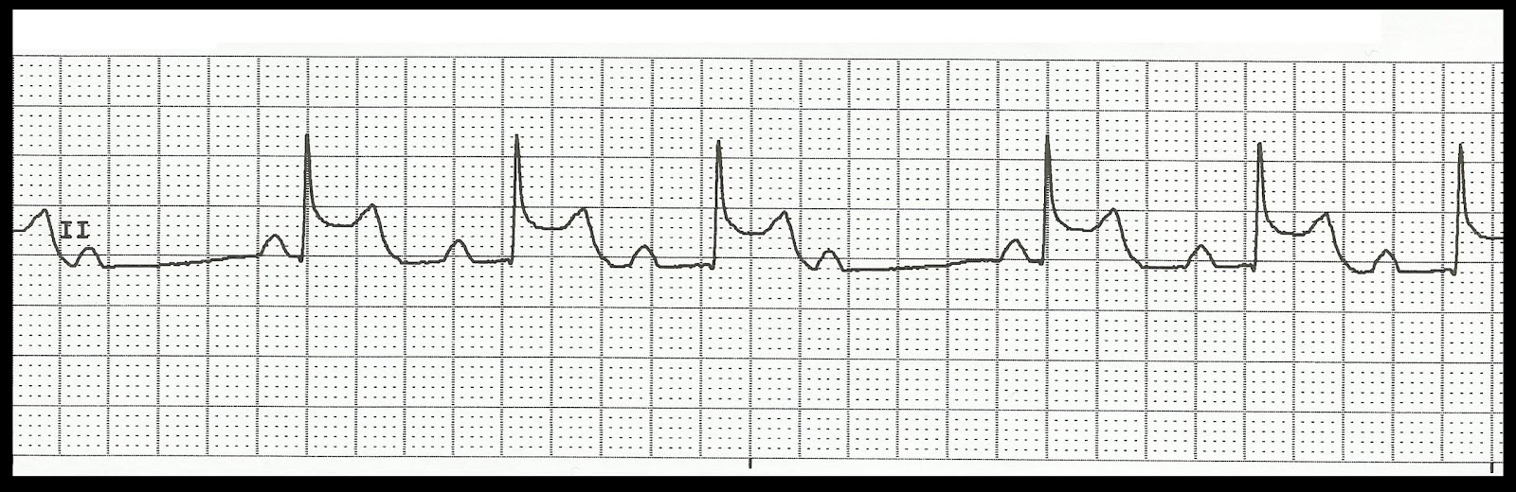

Slide 8
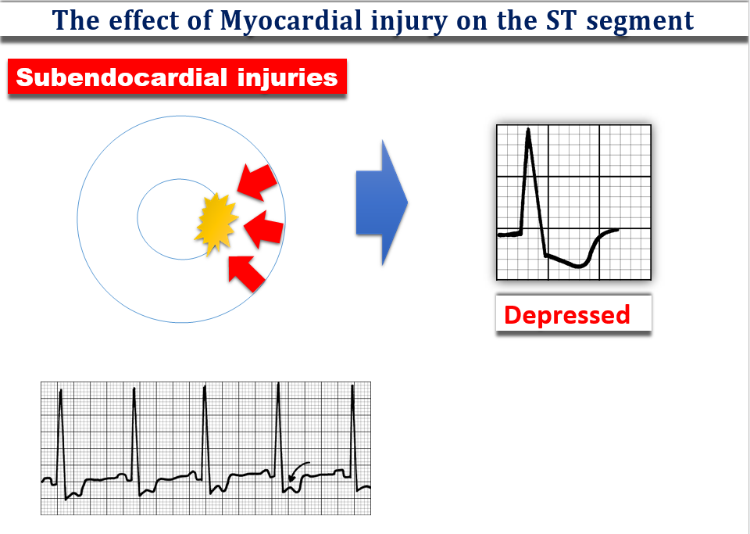
ST Depression: refers to a downward displacement of the ST segment relative to the baseline. It is defined as a depression of 0.5 mm (less than 1 small square) or more in two or more contiguous ECG leads .
Angina
Common Causes: Cardiac Ischemia
Non- STEMI

Slide 9
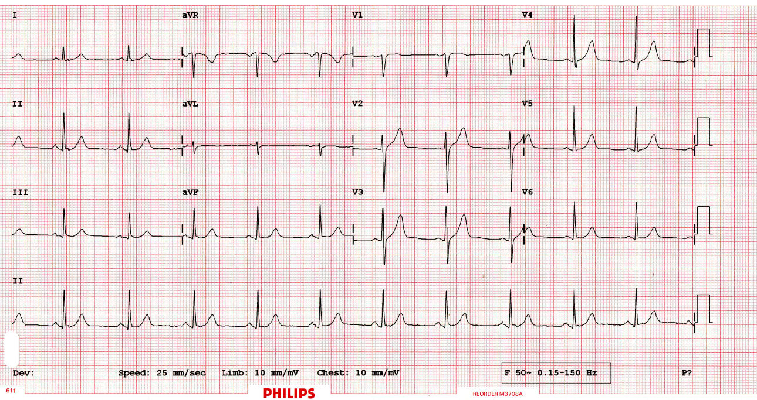
Normal ST Segment

Slide 10
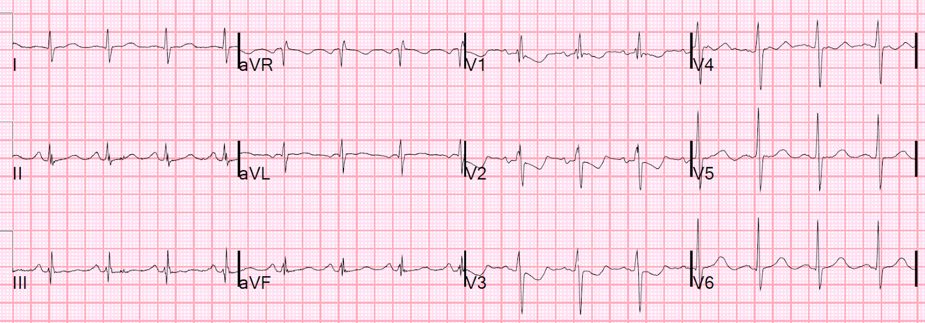
ST Depression in V1,V2,V3 Anterior cardiac ischemia

Slide 11
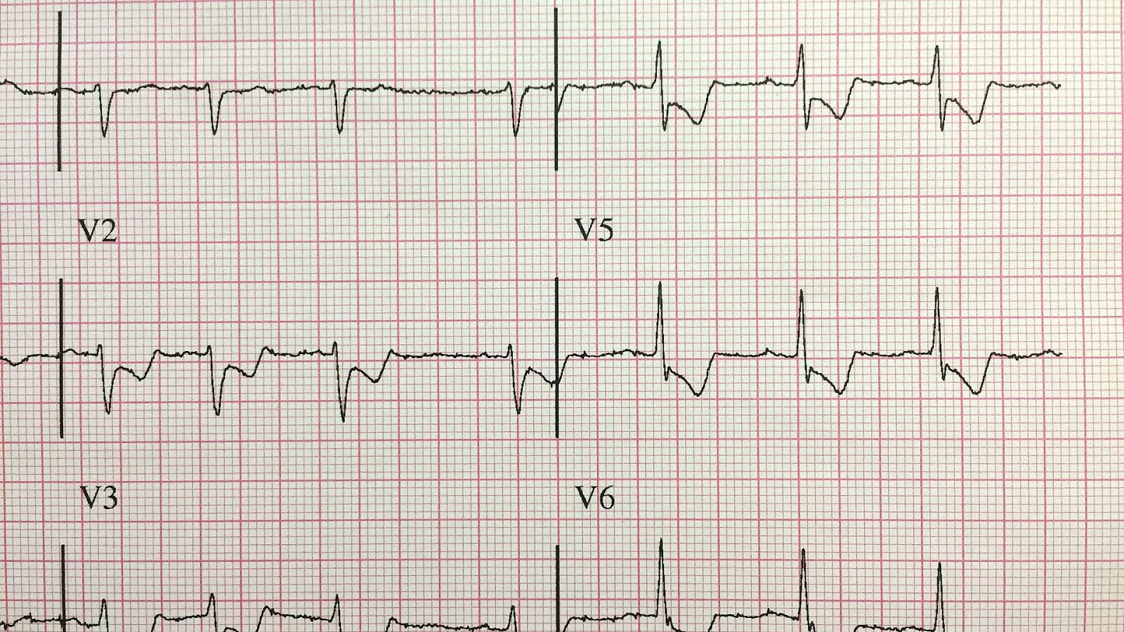
ST Depression in V1,V2,V3 Anterolateral cardiac ischemia

Slide 12
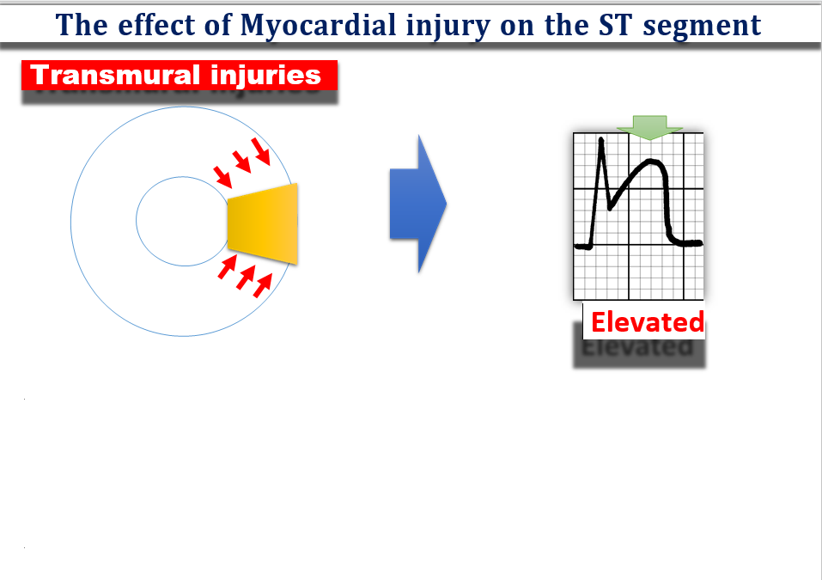
ST Elevation: Elevation of the ST segment above the isoelectric line by at least:>1 mm (1 small square) in two or more contiguous limb leads, or >2 mm (2 small squares) in two or more contiguous chest leads.
Common Causes: Acute Myocardial Infarction (STEMI)

Slide 13
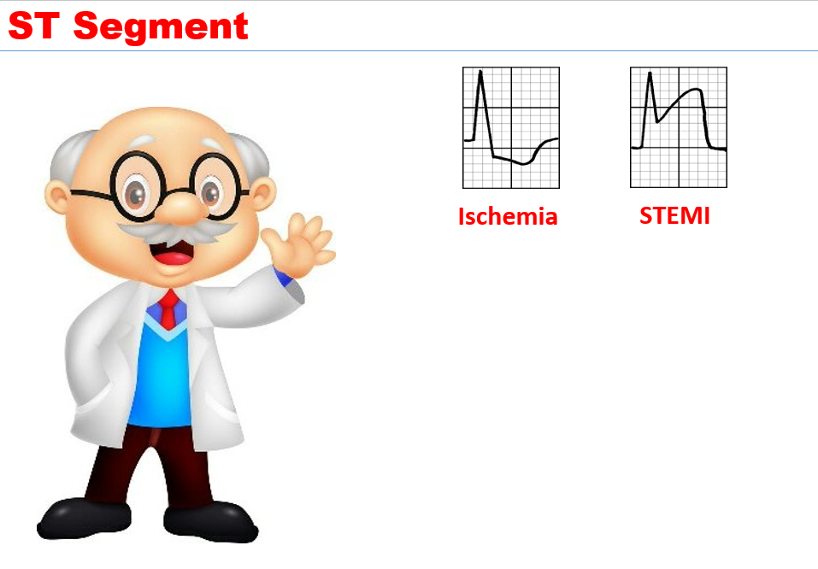
Angina MI (Non-STEMI)
MI
Location of MI according to ST changes in ECG
Anterior MI: ST elevation in V1,V2,V3,V4 (LAD artery).
Inferior MI: ST elevation in II, III, aVF (RCA artery).
Lateral MI: ST elevation in I, aVL, V5-V6 (LCX artery).

Slide 14
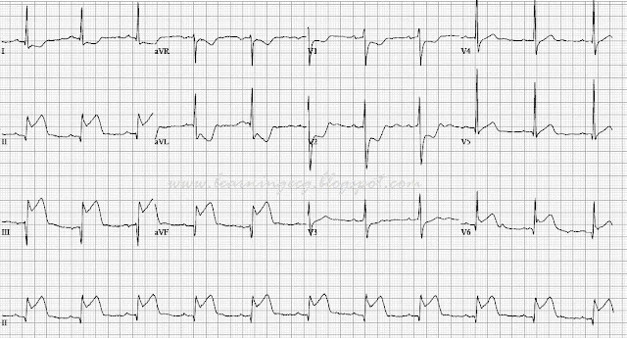
ST Elevation in II,III,avF Inferior STEMI

Slide 15
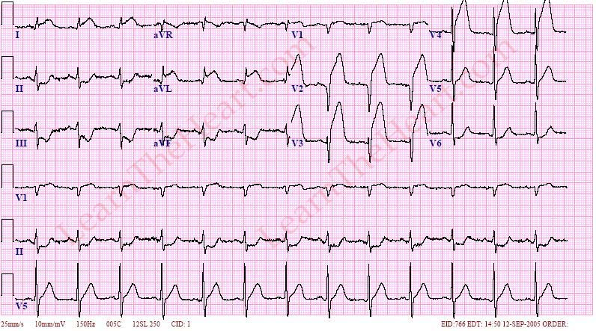
ST Elevation in I,aVL, v2,v3,v4 Anterolateral STEMI

Slide 16
Reciprocal changes
In ST-Elevation Myocardial Infarction (STEMI), reciprocal changes refer to ST-segment depression in ECG leads opposite those showing ST-segment elevation.
ST elevation indicates the area of myocardial injury.
Reciprocal ST depression appears in leads facing the opposite side, reflecting either a "mirror image" of the injury or true ischemia.
Examples:
Inferior STEMI: ST elevation in II, III, aVF; reciprocal ST depression in I, aVL.
Anterior STEMI: ST elevation in V1-V4; reciprocal ST depression in II, III, aVF.
Significance: Confirms STEMI, indicates infarct size and severity.

Slide 17


Slide 18
Comment on ECG

Slide 19
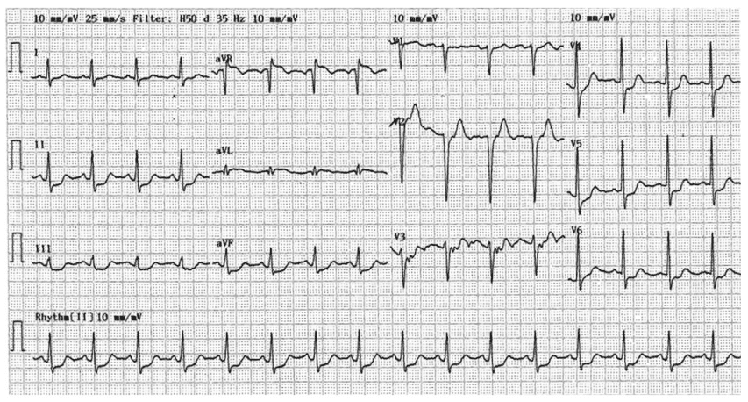
Comment on ECG

Slide 20
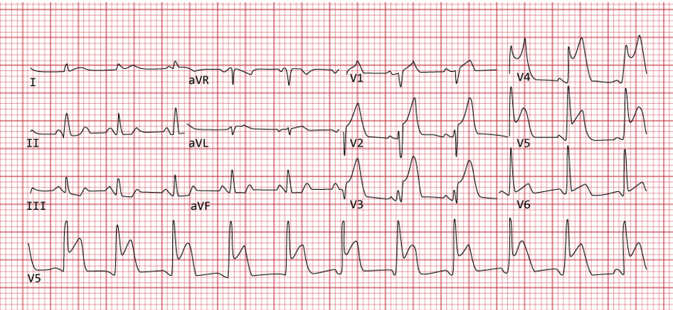
Comment on ECG

Slide 21
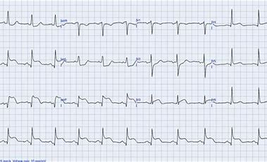
Comment on ECG

Slide 22
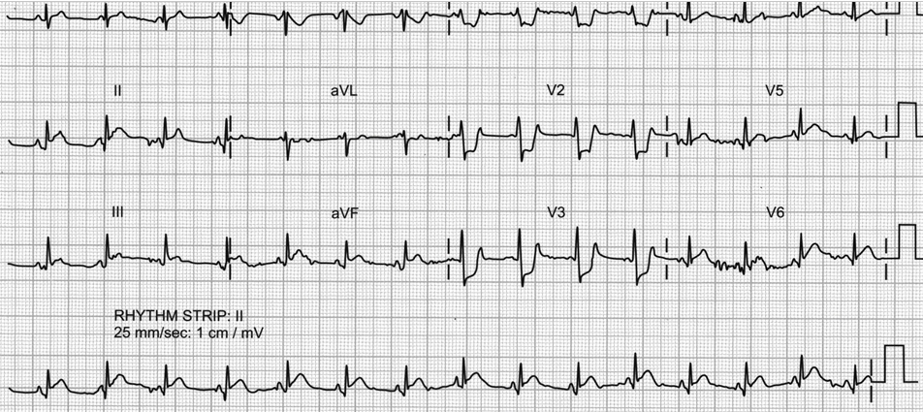
Comment on ECG

Slide 23


