Slide 1
Organic Chemistry II
1st Semester, Year 2
Lecture 4
Aromatic Compounds and Their Reactions 3
Based on Organic Chemistry, T.W. GRAHAM SOLOMONS and CRAIG B. FRYHLE 10e.

Slide 2
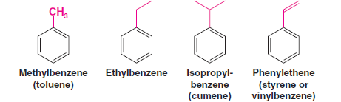
Reactions of the Side Chain of Alkylbenzenes
Hydrocarbons that consist of both aliphatic and aromatic groups are also known as arenes.
Phenylethene, usually called styrene, is an example of an alkenylbenzene.
The aliphatic portion of these compounds is commonly called the side chain.

Slide 3
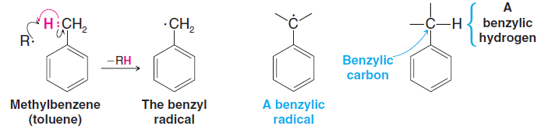
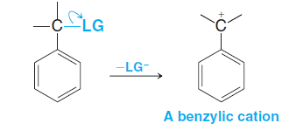
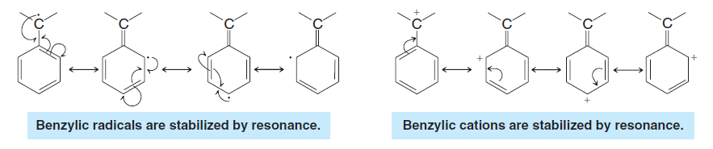
Benzylic Radicals and Cations:
Hydrogen abstraction from the methyl group of methylbenzene (toluene) produces a radical called the benzyl radical:
Departure of a leaving group (LG) from a benzylic position produces a benzylic cation:

Slide 4
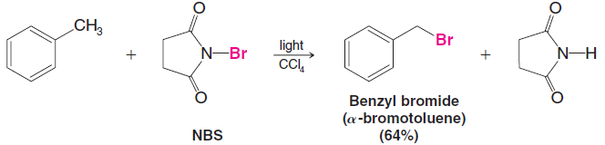
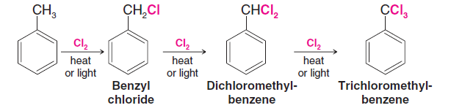
Halogenation of the Side Chain: Benzylic Radicals
Benzylic halogenation is carried out in the absence of Lewis acids and under conditions that favour the formation of radicals.
Side-chain chlorination
Benzylic and allylic radicals are even more stable than tertiary radicals.

Slide 5
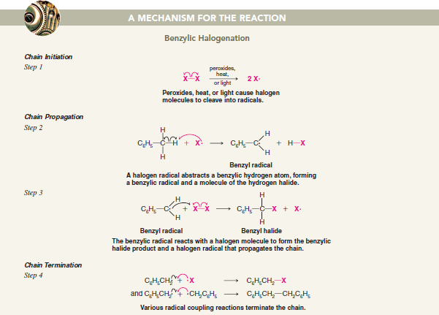

Slide 6
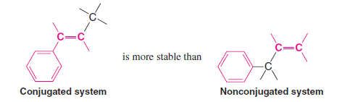
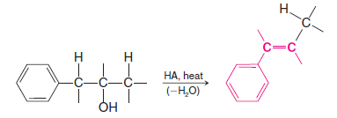
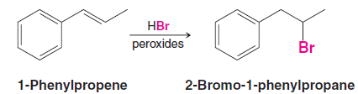
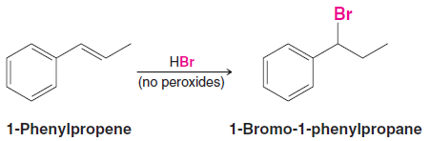
Alkenylbenzenes
Stability of Conjugated Alkenylbenzenes
Additions to the Double Bond of Alkenylbenzenes

Slide 7
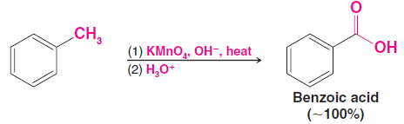
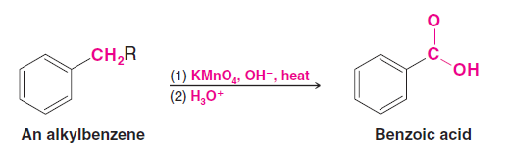
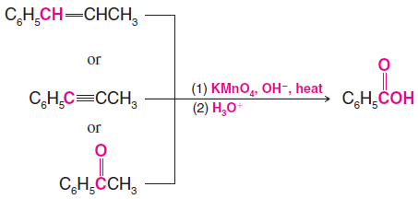
Oxidation of the Side Chain
Alkylbenzenes with alkyl groups longer than methyl are ultimately degraded to benzoic acids:
Side-chain oxidation is not restricted to alkyl groups. Alkenyl, alkynyl, and acyl groups are also oxidized by hot alkaline potassium permanganate.

Slide 8

Oxidation of the Benzene Ring
The benzene ring carbon where an alkyl group is bonded can be converted to a carboxyl
group by ozonolysis, followed by treatment with hydrogen peroxide.

Slide 9
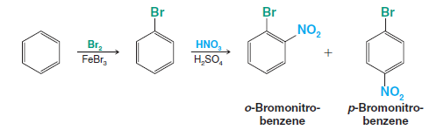
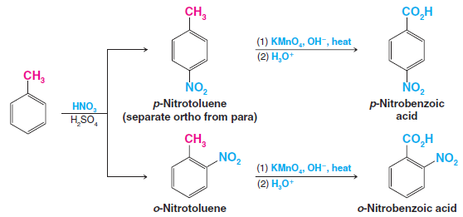
Synthetic Applications
Part of the skill in planning a synthesis is deciding in what order to carry out the reactions.
Example, we want to synthesize o-bromonitrobenzene
Other examples in which choosing the proper order for the reactions is important are
the syntheses of the ortho-, meta-, and para-nitrobenzoic acids

Slide 10
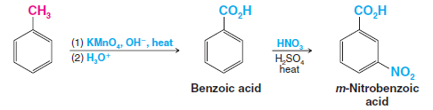
We can synthesize m-nitrobenzoic acid by reversing the order of the reactions

Slide 11
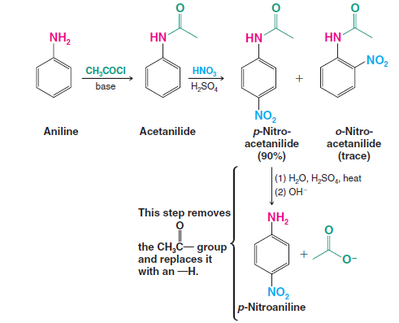
Use of Protecting and Blocking Groups
Very powerful activating groups such as amino groups and hydroxyl groups cause the benzene ring to be so reactive that undesirable reactions may take place.

Slide 12
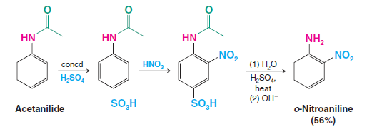
Suppose, however, that we need o-nitroaniline. The synthesis that we just outlined would obviously not be a satisfactory method, for only a trace of o-nitroacetanilide is obtained in the nitration reaction.

Slide 13
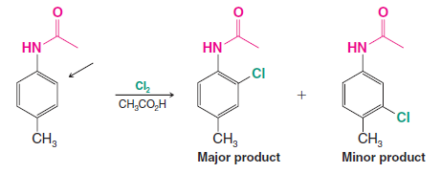
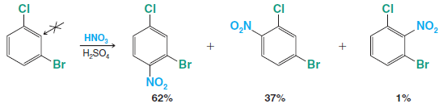
Orientation in Disubstituted Benzenes
When two different groups are present on a benzene ring, the more powerful activating
group generally determines the outcome of the reaction.
An ortho–para director takes precedence over a meta director in determining the position of substitution because all ortho–para-directing groups are more activating than meta directors.
Steric effects are also important in aromatic substitutions.
Substitution does not occur to an appreciable extent between meta substituents if another position is open.

Slide 14
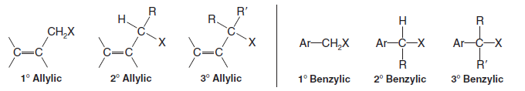
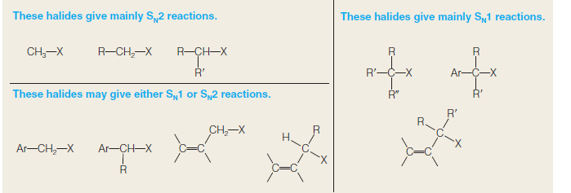
Allylic and Benzylic Halides in Nucleophilic Substitution Reactions

Slide 15


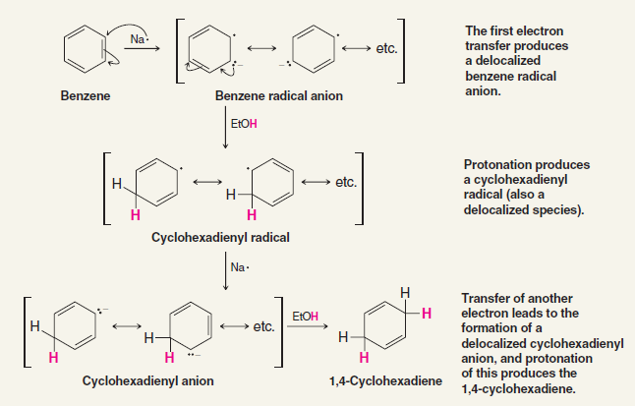
Reduction of Aromatic Compounds
The Birch Reduction

Slide 16
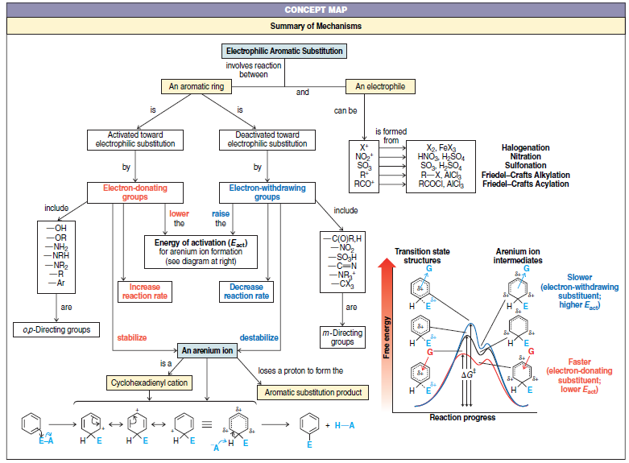

Slide 17
