Slide 1


Al-Mustaqbal University.
College of Engineering and Engineering Technologies.
Biomedical Engineering Department.
Subject: Biomedical Clinical issues of Biomedical
Engineering.
Class : 4th
Lecture: 3
BY: M.SC. ZAINAB SATTAR JABBAR
BME

Slide 2
Clinical (Biomedical) Engineering levels
Executive (Engineers and technicians )
Senior
Manager (supervisor)

Slide 3
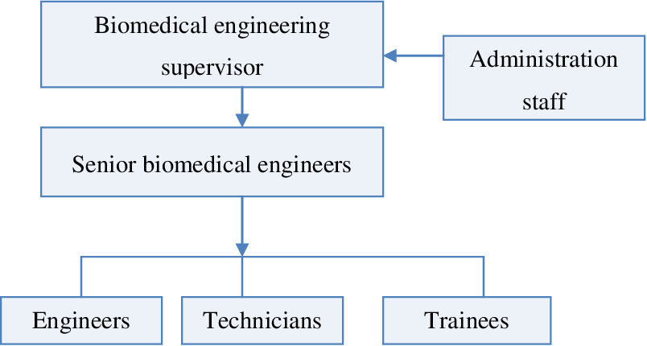
Hierarchical Structure
The responsibilities of the staff depend on their place in the hierarchy

Slide 4
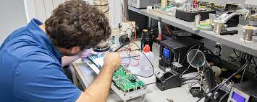
Executive (Engineers and technicians )
Executive (Engineers and technicians ) are frontline staff who carry out day-to-day biomedical engineering-related tasks.

Slide 5
Senior
The Senior Clinical (Biomedical) Engineering leads clinical engineering initiatives to provide superior customer service and operational efficiency.
The supervisors plans and manages day-to-day biomedical activities and assists the manager in decision making. Senior biomedical engineers are more involved in special projects.

Slide 6
Manager
The manager has overall responsibility for the department.
Develop, direct, organize, and manage overall operations and distribution of resources (staffing, budgets, and outside vendor services) of the clinical engineering equipment support services program.

Slide 7
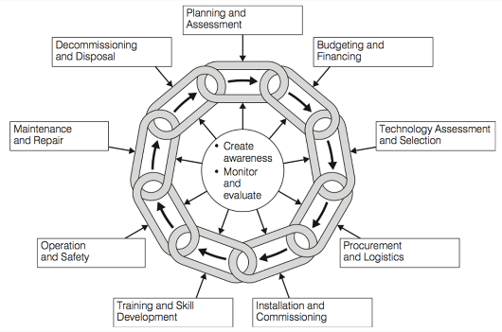
Identifying the equipment life cycle

Slide 8
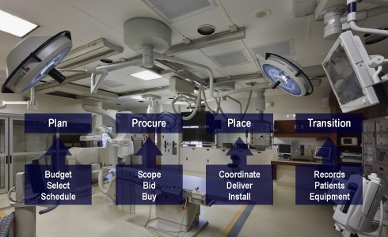
Medical Equipment Planning
Medical Equipment Planning is a very important process at the Project Stage of any Healthcare Facility. It is actually the key to success of the entire Project. With over 35% of the Total Project Cost going for Equipment Procurement, the proper planning of this activity is crucial to the entire feasibility of the Project.

Slide 9

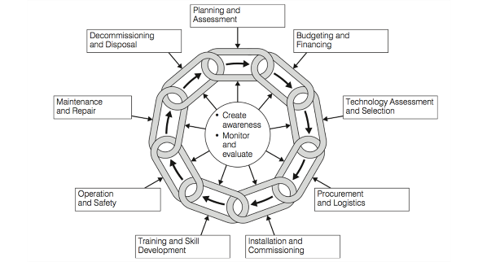
Planning for medical equipment
Identifying equipment planning stake holders
Identifying equipment standard list for each level of health facility.
Implementing equipment development plan
Budgeting for equipment acquisition, operation and maintenance

Slide 10
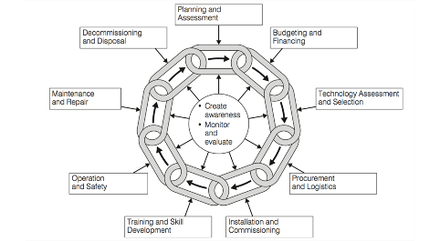
Procuring medical equipment
Identify clinical needs and benefits
Identify equipment procurement stake holders
Define technical specification for medical equipment
Identify funding agency for equipment procurement
Prepare tender documents

Slide 11
Installing and commissioning medical equipment
Receive medical equipment
Comply with technical specifications
Assemble medical equipment component
Conduct electrical safety and function tests
Prepare site for installation
Commission medical equipment
Conduct user training for medical equipment
Store records of work

Slide 12
Commissioning
Prepare
Check availability of documents available (manuals, instructions, …)
Prepare equipment, plug in, attach accessories.
Safety tests
  Adequate insulation and earth connections
  Verify that tests for electrical and medical safety standards to guarantee patient and operator safety have been done.
  If harmful radiation is produced (X-rays, ..) carry out tests to ensure correct calibration and safe use.
Calibration
Adjust equipment to local climate, altitude, etc. so readings are true (air conditioners, …) Execute manufacturer defined calibration procedures.
Function tests
Run manufacturer defined protocols on phantoms, known samples,
Process a few control samples (users and maintainers to cooperate in these tests) .
Record results
Keep records of all test results – store in Equipment file
©

Slide 13

Preventive Maintenance and Calibration
Carry out preventive maintenance.
Write preventive maintenance procedures.
Manage maintenance (preventive) programs.
Ensure availability of preventive maintenance consumable and calibration kits.
Ensure availability of test equipment.
Calibrating test equipment.
Prepare record of works done on medical equipment.
©

Slide 14
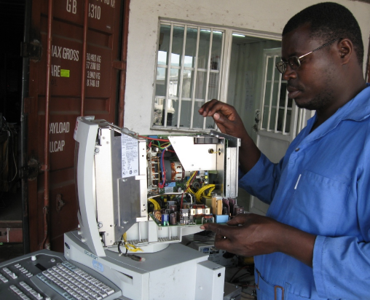
Repairing medical equipment
Troubleshooting faults in medical equipment
Perform root cause analysis
Order spares for medical equipment
Rectify faults
Use test equipment
Prepare and keep records of works
©

Slide 15
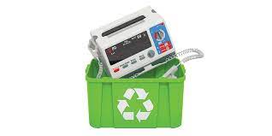
Decommissioning And Disposing
Evaluate medical equipment status
Decommission medical equipment
Use guidelines on disposal of medical equipment
Plan replacement of medical equipment
Record works on medical equipment

Slide 16

Conducting Inventory
Conduct inventory of medical equipment
Update medical equipment inventory
Identify service and training gaps in medical equipment
Contact stakeholders on medical equipment inventory
Use different inventory systems

Slide 17
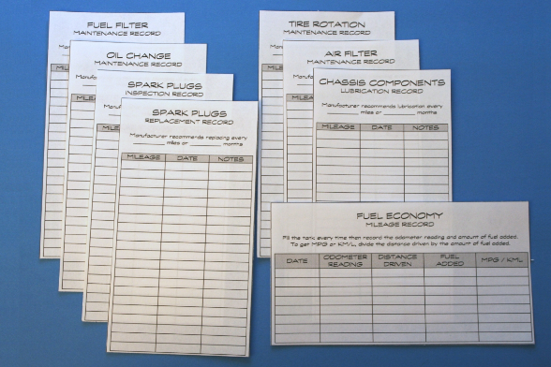
Maintaining record systems
Prepare job requisition forms on medical equipment
Maintain records on medical equipment
Update inventory medical equipment records
Write reports on management of medical equipment

Slide 18

Managing external service contractors
Interpret service contracts
Work with external service personnel on medical equipment
Identify responsibilities of different parties medical management servicing
Write reports on management of medical equipment
Evaluate external service work on medical equipment

Slide 19
THANK YOU

