Slide 1
The Orbit
Dr. Lamees Abd ALRaheem
M.B.CH.B F.I.C.M.S
Al Mustaqbal university

Slide 2
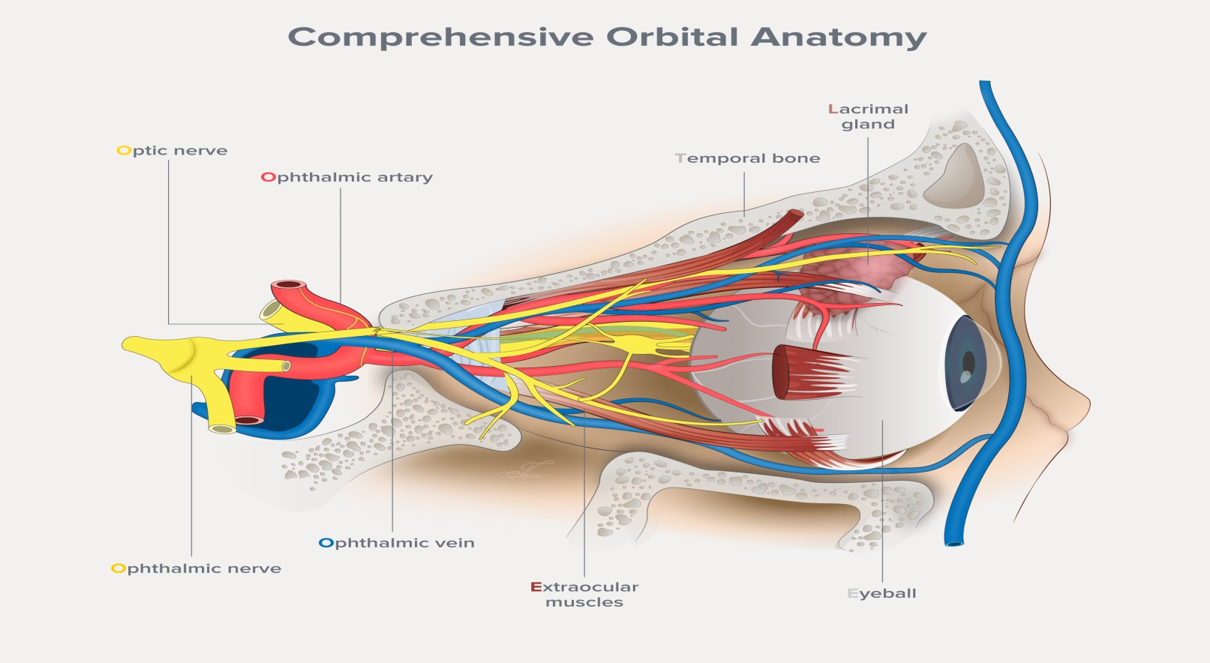
The orbit
is the cavity or socket of the skull in which the eye and its appendages are situated.

Slide 3
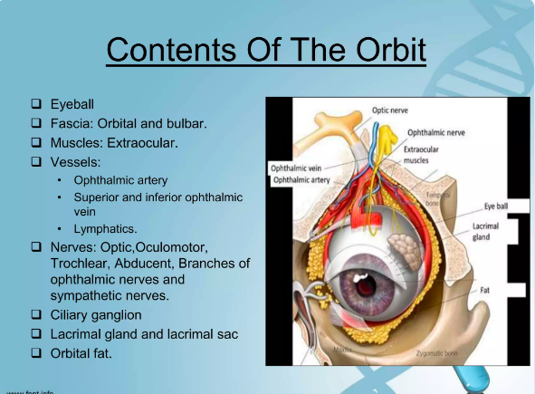

Slide 4
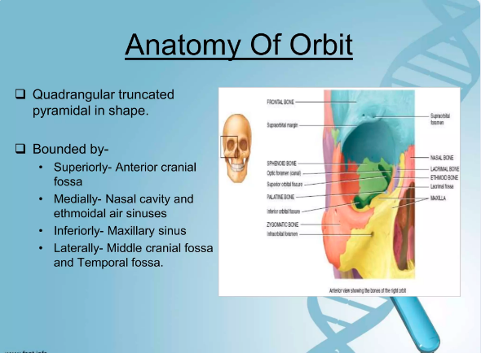
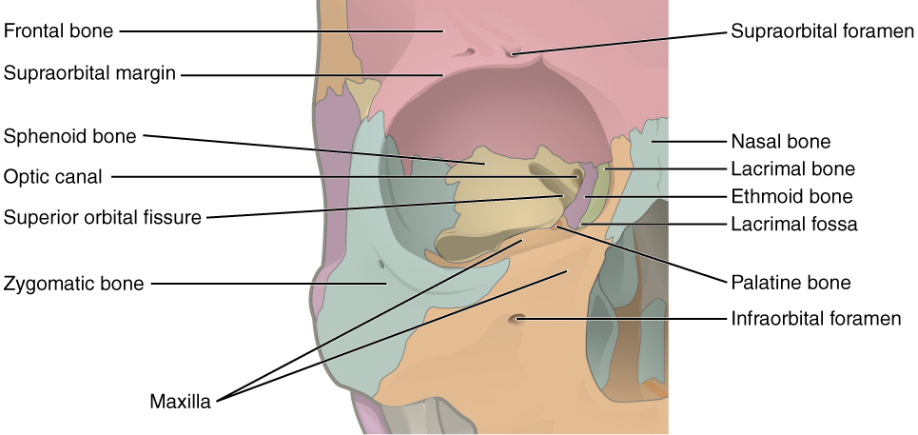

Slide 5
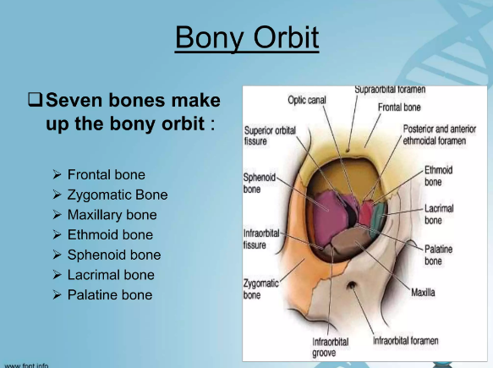
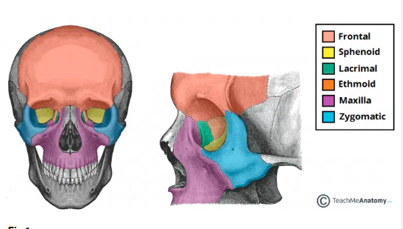

Slide 6
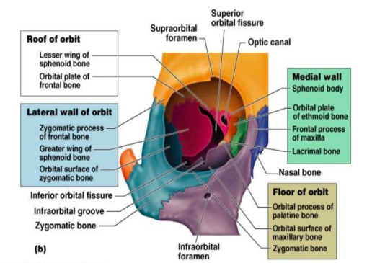
Walls of the Orbit
The bony orbit has four walls
Medial wall
Lateral wall
Roof
Floor

Slide 7
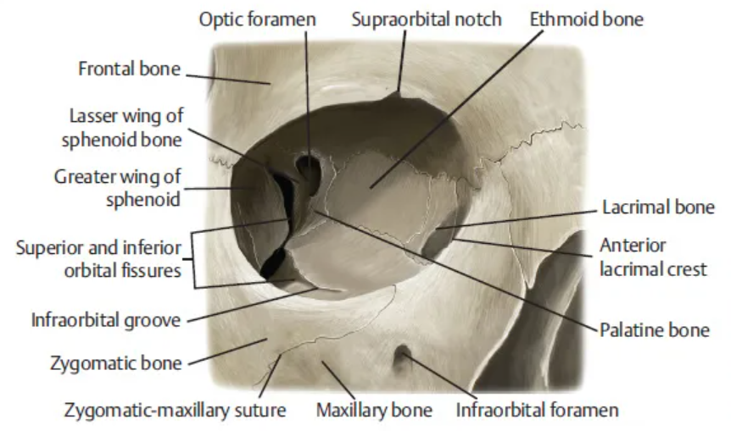
Roof (superior wall)
Formed by the frontal bone and the lesser wing of the sphenoid.
The frontal bone separates the orbit from the anterior cranial fossa.

Slide 8
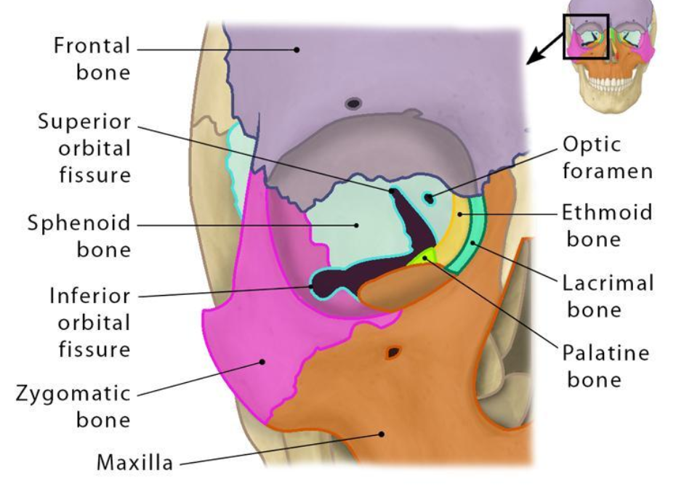
Floor (inferior wall)
Formed by the maxilla, palatine and zygomatic bones.
The maxilla separates the orbit from the underlying maxillary sinus.

Slide 9
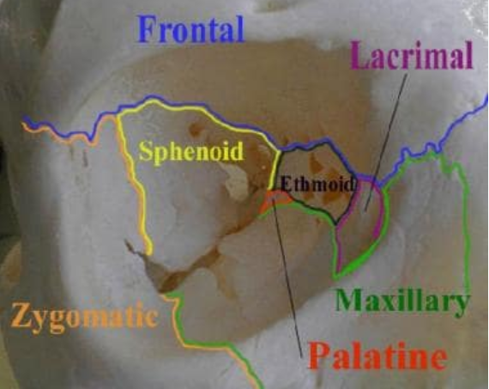
Medial wall
Formed by the ethmoid, maxilla, lacrimal and sphenoid bones. The ethmoid bone separates the orbit from the ethmoid sinus.

Slide 10
Lateral wall – Formed by the zygomatic bone and greater wing of the sphenoid.
Apex – Located at the opening to the optic canal, the optic foramen.
Base – Opens out into the face, and is bounded by the eyelids. It is also known as the orbital rim.

Slide 11
Orbit Content
Extra-ocular muscles –They are responsible for the movement of the eyeball and superior eyelid.
Eyelids – These cover the orbits anteriorly.
Nerves: Several cranial nerves supply the eye and its structures; optic II, oculomotor III , trochlear IV , trigeminal V and abducent VI nerves.
Blood vessels: The eye receives blood primarily from the ophthalmic artery. Venous drainage is via the superior and inferior ophthalmic veins.
Any space within the orbit that is not occupied is filled with orbital fat. This tissue cushions the eye, and stabilises the extraocular muscles.

Slide 12
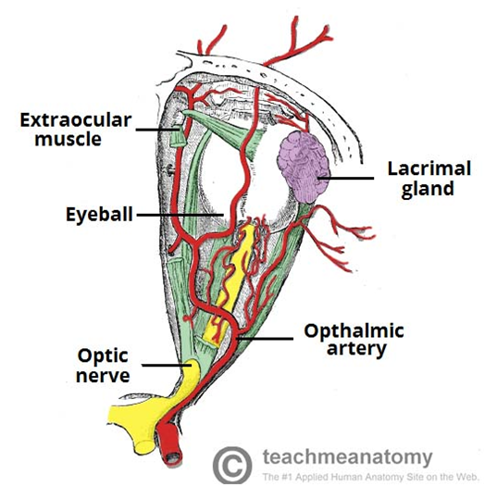

Slide 13
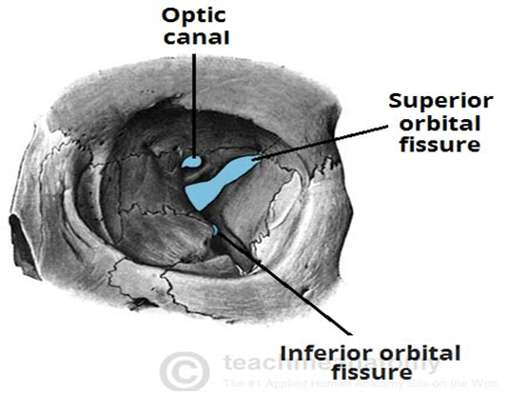
Orbital foramens
There are three pathways in orbit
Optic canal – transmits the optic nerve and ophthalmic artery.
Superior orbital fissure – transmits the lacrimal, frontal N, trochlear (CN IV), oculomotor N (CN III), abducents N (CN VI) nerves.
Inferior orbital fissure – transmits the zygomatic branch of the maxillary nerve, the inferior ophthalmic vein, and sympathetic nerves.

Slide 14
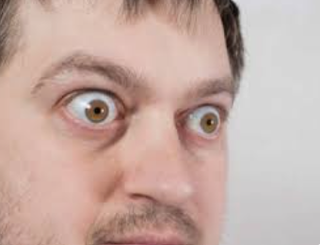
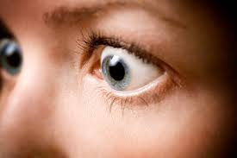
Clinical significance
Exophthalmos (also called , proptosis,) is a bulging of the eye anteriorly out of the orbit.
Exophthalmos can be either bilateral (as is often seen in Graves' disease) or
unilateral (as is often seen in an orbital tumor).

Slide 15
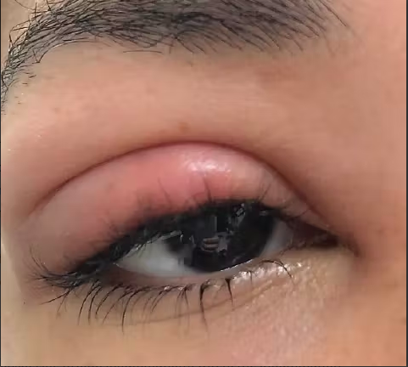
Infections
also referred to as orbital cellulitis
managed with a short course of oral antibiotics and
close follow-up.

Slide 16
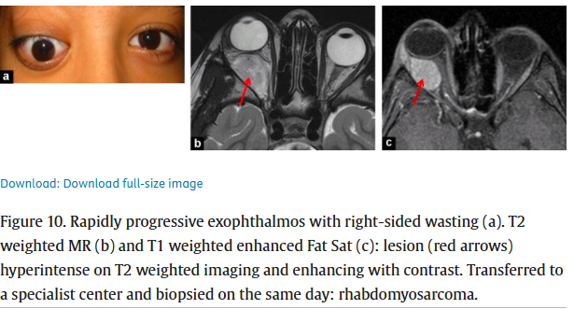
Tumors
A variety of tumors can manifest in the eye socket in both adults and children.

Slide 17
Fractures
Orbital rim fracture:- fracture of the bones forming the outer rim of the bony orbit.
‘Blowout’ fracture – This refers to partial herniation of the orbital contents through one of its walls. The medial and inferior walls are the weakest, with the contents herniating into the ethmoid and maxillary sinuses respectively.
Any fracture of the orbit will result in raising the pressure in the orbit, causing exophthalmos (protrusion of the eye). There may also be involvement of surrounding structures, – e.g haemorrhage into one of the neighboring sinuses.

Slide 18
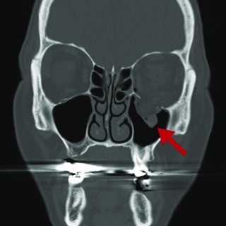
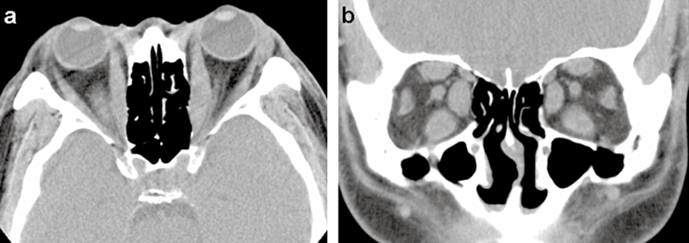
‘Blowout’ fracture
Thyroid eye disease

Slide 19
The three main imaging techniques for the brain and orbit are
First:- X-rays We use the skull X-ray examine patients with a suspicion for metallic foreign body prior to MR studies. As a general rule, patients who have an indication for orbital imaging should undergo a CT or an MR study, if not contraindicated, for improved bone or soft-tissue resolution.
Second:- CT scanning is sufficient for many orbital conditions e.g. thyroid eye disease and orbital tumors .
Third:- MRI provides better soft-tissue discrimination of intracranial anatomy (e.g. meninges, cavernous sinus, posterior fossa and dural venous sinuses).Even After CT, follow-up MR scan may still be required for optimal evaluation of pathology.

Slide 20
INDICATION FOR emergent orbital CT. scan include the following:
acute orbital trauma (e.g. suspected orbital fracture, orbital- hematoma, metallic or wooden foreign bodies, or traumatic optic neuropathy);
acute proptosis (e.g. orbital cellulitis, , thyroid eye disease ,compressive optic neuropathy, retrobulbar haemorrhage);

Slide 21
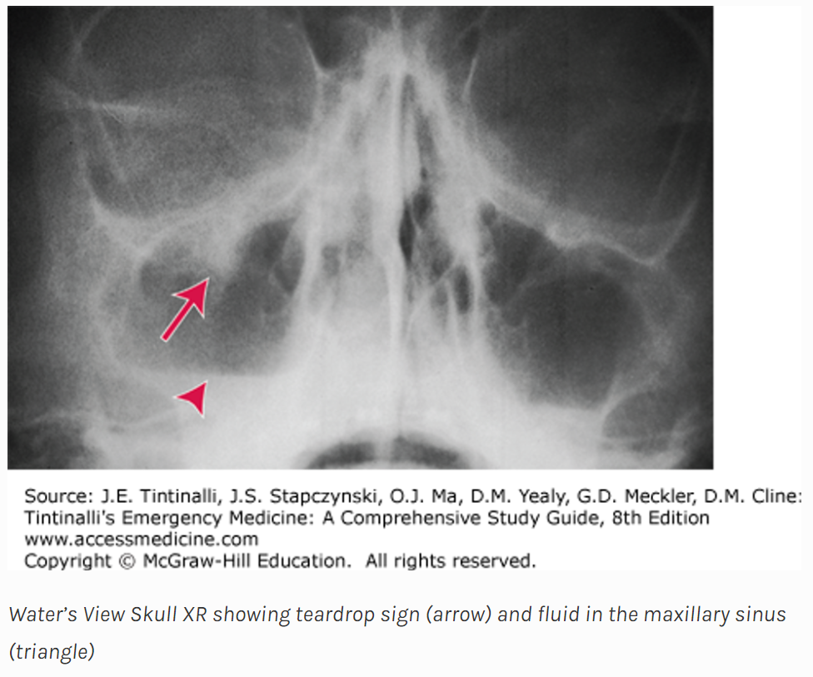

Slide 22
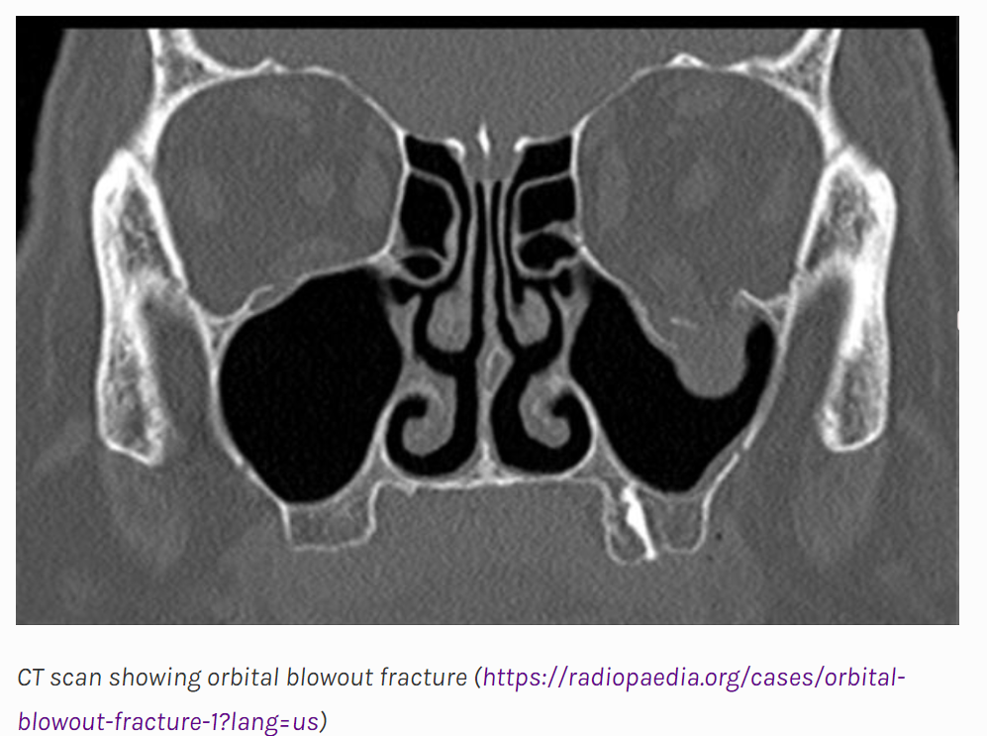

Slide 23
Quiz

Slide 24
Which of the following bones does not contribute to the floor of the orbit?
A- Maxilla
B- Palatine
C- Frontal
D- Zygomatic

Slide 25
Which of the following nerves is not found within the orbit?
A- Optic nerve
B- Oculomotor nerve
C- Facial nerve
D- Abducens nerve

Slide 26
Which of the following structures does not pass through the inferior orbital fissure?
A- Optic nerve
B- Maxillary nerve
C- Inferior opthalmic vein
D- Sympathetic branches

