Slide 1




Lecture 5

Slide 2
CME | Cystoid Macular Edema
CNVM | Central Neovascular Membrane
CRAO | Central Retinal Artery Occlusion
CRVO | Central Retinal Vein Occlusion
CSDME | Clinically Significant Diabetic Macular Edema
CSR | Central Serous Retinopathy
DME | Diabetic Macular Edema
MH | Macular Hole

Slide 3
OCT | Ocular Coherence Tomography
ON | Optic Nerve
ONH | Optic Nerve Head
NV | Neovascularization
U/S | Ultrasound
HSV | Herpes Simplex Virus
HZV | Herpes Zoster Virus
ARN | Acute Retinal Necrosis

Slide 4
DFE | Dilated Fundus Exam | Dilated fundus examination (DFE) is a diagnostic procedure that uses mydriatic eye drops to dilate or enlarge the pupil in order to obtain a better view of the fundus .
IOAI | Intraocular Avastin Injection | injected into the eye to help slow vision loss from these diseases.
BRVO | Branch Retinal Vein Occlusion | a blockage of one or more branches of the central retinal vein, which runs through the optic nerve.
BRAO | Branch Retinal Artery Occlusion | Branch retinal artery occlusion describes decreased arterial blood flow to the retina leading to ischemic damage.
EUA | Exam under Anesthesia | EUA is an investigation carried out under a general anaesthetic .
um | Micron | a unit of length equal to one millionth of a metre.
Sx | Surgery | the treatment of injuries or diseases in people or animals by cutting open the body and removing or repairing the damaged part.
RT | Retinal Tear | happens when the gel-like vitreous in your eye pulls on your retina and causes a split.

Slide 5
Tint | Color lens | Layer of color usually applied to surface of lens.
RGP CL | Rigid gas permeable contact lenses | made from silicon dioxide. These allow oxygen to pass through them so they don't cause corneal hypoxia. They need to be removed at night
Aphakia | Absent of crystalline lens | This is an ocular condition in which the crystalline lens is absent.
Diplopia | double vision | Diplopia is the simultaneous perception of two images of a single object that may be displaced horizontally or vertically in relation to each other.
AC | Anterior Chamber | fluid-filled space between the iris and the endothelium.
AC/A | Accommodative convergence / Accommodation ratio | the portion of the range of convergence that occurs in response to accommodation.
BSV | Binocular single vision | (BSV) is the ability to use both eyes together to achieve a single fused percept, even in the presence of disparity of the image seen by each eye.
Hx | History | the process of compiling background information about a patient history.

Slide 6
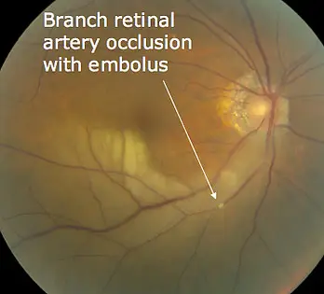
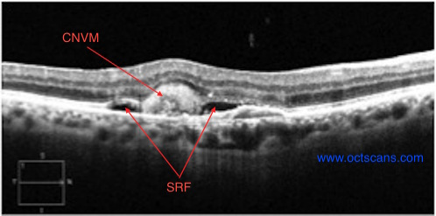
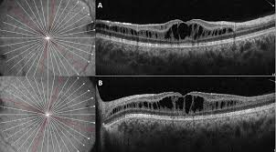
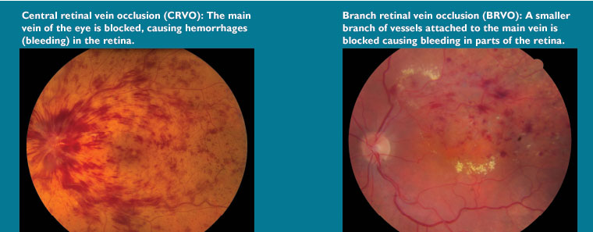
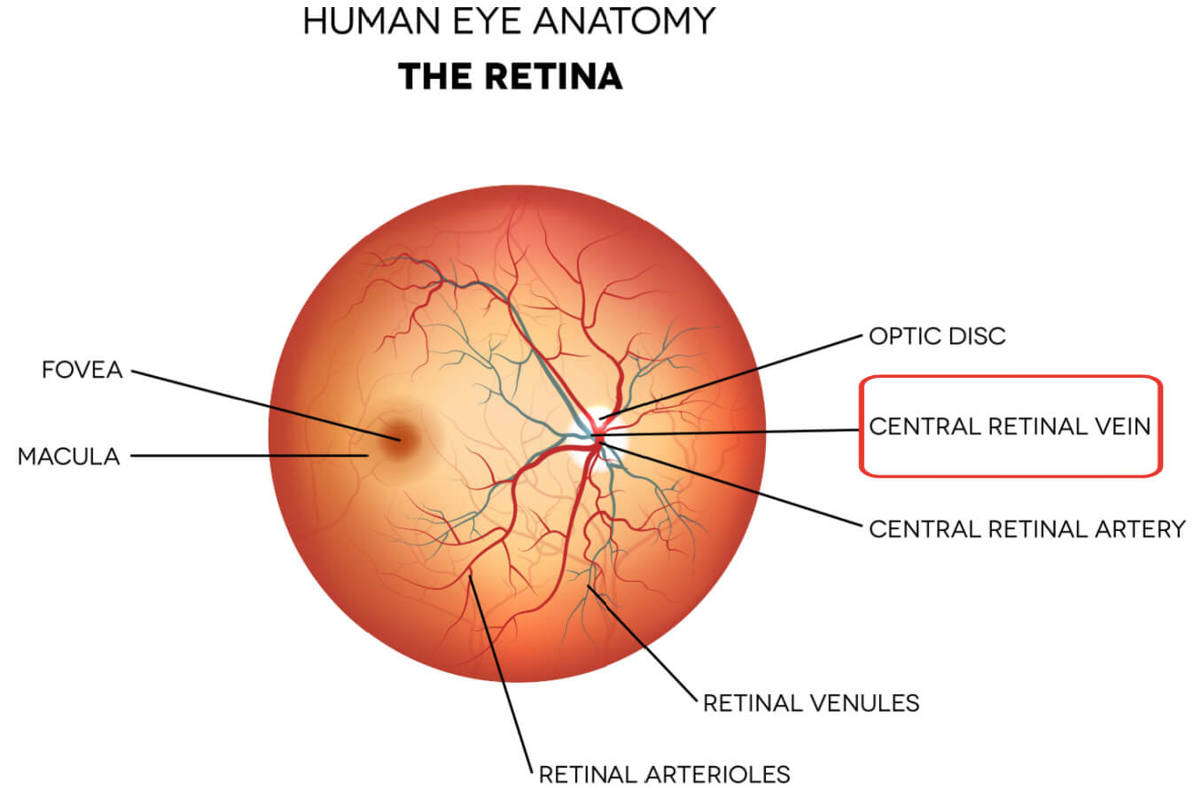

Slide 7
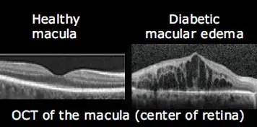
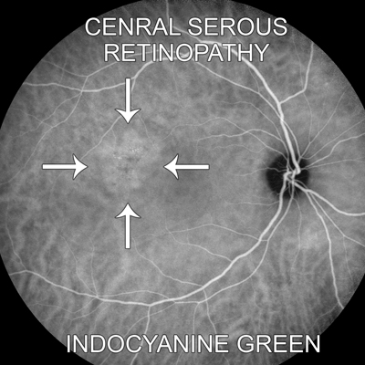
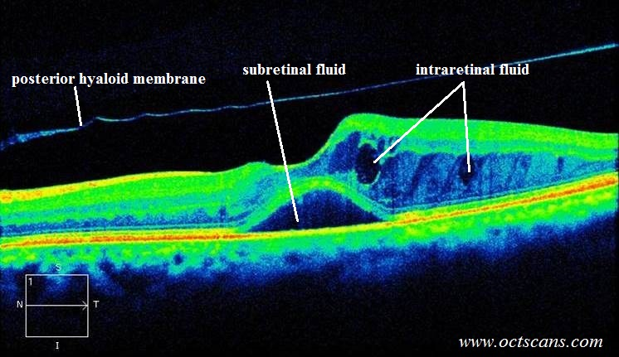
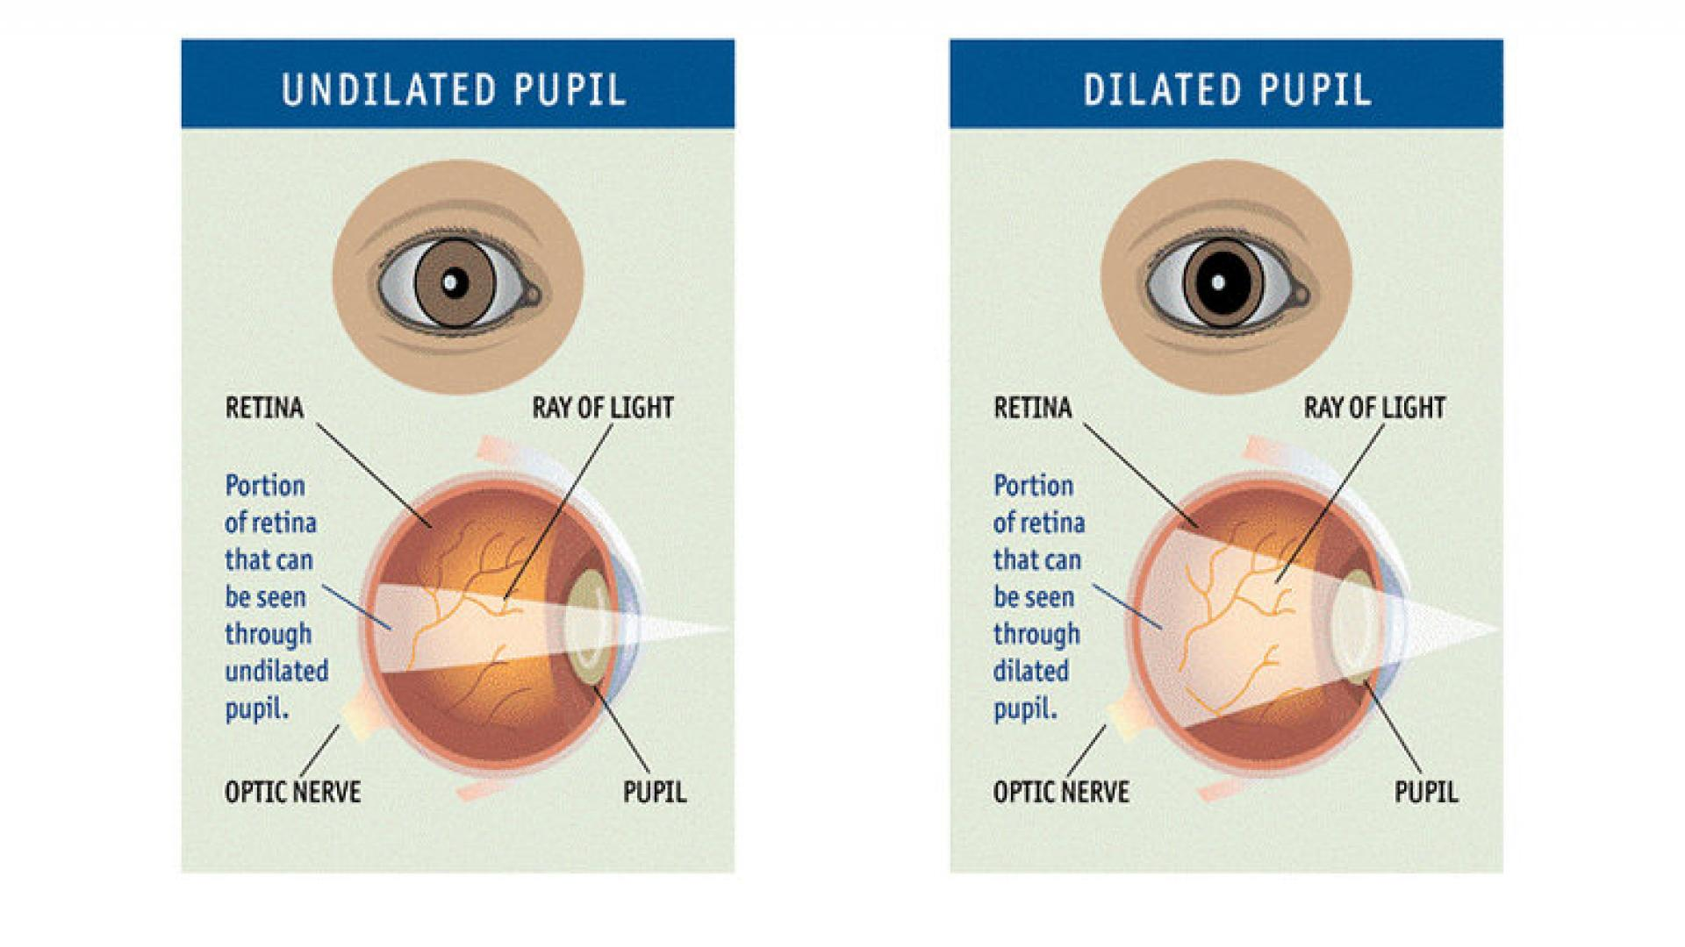
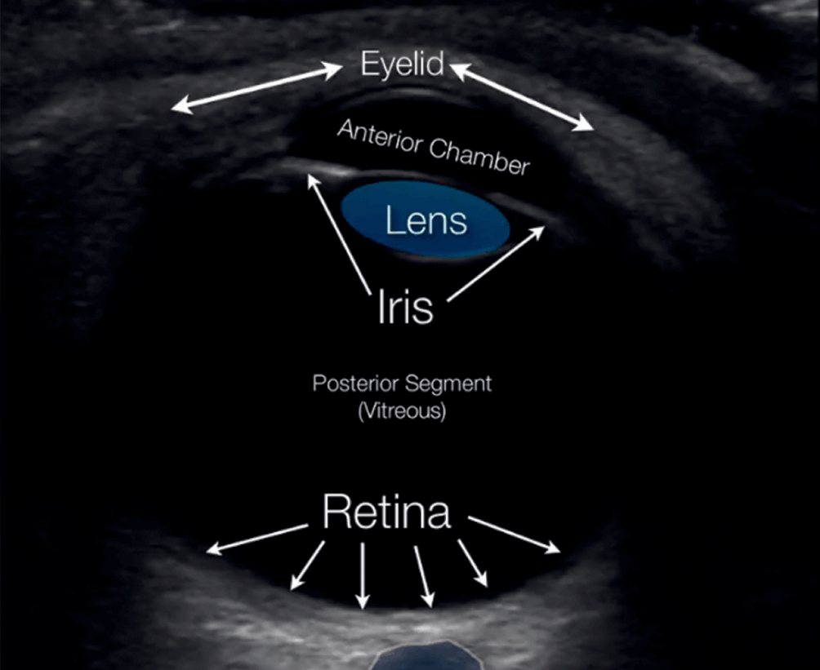
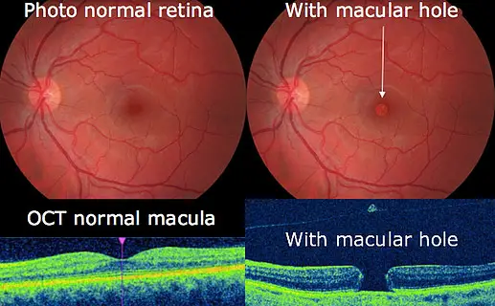

Slide 8

